Slide 1

Accelerating Electrification of CA’s
Multifamily Buildings
CEC IEPR Decarbonization Workshop
July 12, 2021

Slide 2


StopWaste Residential Decarb Work
CEC Local Government Challenge Grant¹
  Multifamily Electrification Readiness Report
  EnergyPro Lite (Low-Cost Assessment Tool)
  Multifamily Benchmarking Report²
  Rental Housing Potential Study³
Whitepaper: “Local Government Levers for Energy Policy in the Existing Single-Family Residential Sector” ⁴
Bay Area Multifamily Building Enhancement Program (BAMBE)
1. https://www.stopwaste.org/accelerating-multifamily-building-upgrades
2. https://www.stopwaste.org/sites/default/files/Benchmarking%20Report_Final_3.27.20.pdf
3. https://www.stopwaste.org/sites/default/files/Rental%20Housing%20Potential%20Study_FINAL.pdf
4. https://www.bayrencodes.org/wp-content/uploads/2020/12/EE-and-Electrification-White-Paper_FINAL_12.28.2020.pdf
Notes:
-Timeline of grant late 2017 through the end of 2020
--MFERR and EnergyPro Lite, addressed in detail later in my presentation
--MF Benchmarking report, published in March 2020, based on benchmarking TA provided by AEA to over 70 MF properties of various vintages, sizes, and meter configurations. Identified challenges to complete and accurate benchmarking data and provided recommendations for improvements and areas of further research
--RHPS surveyed and interviewed local jurisdiction rental housing inspection staff to better understand their programs and to assess how EE assessment could be layered on. We also looked at out of state programs in Boulder, NYC, and Austin, where EE programs have been integrated in to their rental housing inspection programs
--The white paper was released in Dec 2020 and explored energy-related policies leveraged by cities, new concepts being pursued, and the impact such policies could have on the residential single family sector here in the East Bay

Slide 3
BAMBE/BayREN MF Program
Program Path | Completed Projects | Total Units | Rebate Amount
Traditional (Whole-building EE) | 562 | 40,832 | $29,572,846 ($52,620 project, $724/unit)
Clean Heating Pathway (CHP, includes BAAQMD adder funds) | 5 (thru end of 2020,19 currently in TA) | 351 (2,116 in TA) | $303,350 ($60,670/project, $864/unit, incl. $40.1k in BAAQMD funds)
Notes:
-Relate this to SB350 50% by 2030 goal – 20% reduction with a ~5% penetration rate since 2013
-Re permitting, Engaging the planning and buildings department as early as possible is critical to determining hidden costs and installation considerations that are not intuitive, but required in order for the project to be permitted. For example, some building departments required shielding for outdoor compressors or had detailed requirements for compressor locations, including setbacks, and some planning departments required architectural drawings for any new heat pump termination vents on exterior facades or required more costly alternative equipment and installs to eliminate any facade vent terminations. These requirements often resulted in project delays, increased costs,
Include highlights and recommendations to scale up from TBD Sales Force report from Chris and AEA’s 12/20 CHP report for Air District
https://cbbf458e-67d0-4a11-9597-023b97b18cc4.filesusr.com/ugd/fbb014_5f394d44c3114359b36abf6afa9c460b.pdf

Slide 4
Recommendations to Scale Electrification Programs
Attractive incentives (kickers/adders for electrification)
Robust technical assistance (TA)
Increase education – owners, contractors, building departments
Standardize and streamline permitting
Bring back PV incentives for market-rate MF properties
Emphasize health and safety/comfort advantages

Slide 5
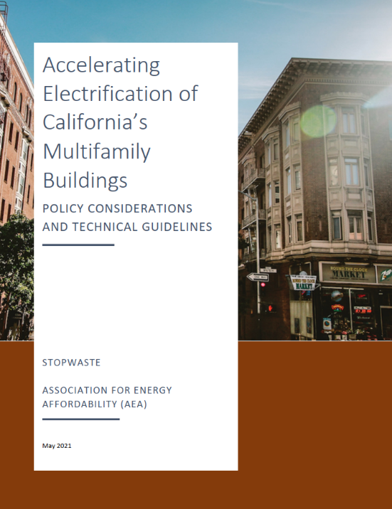
MF Electrification Report
Recommendations for Program Administrators and Gov’t Agencies
  Incentivize electrical infrastructure upgrades
  Offset capacity increases with EE gains
  Take into account non-energy benefits
  Continue to address improvement of in-unit spaces
  Coordinate incentive offerings across multitude of funding sources
Notes:
Shout out to AEA – Jack Atchison, Aubrey Dority and Nick Dirr as well as my colleague Heather Larson
-Part 1 more relevant to local gov/regional orgs/programs – in development and design of ordinances or programs specific to existing MF, Part 2 for implementers – TA staff, consultants, contractors (GCs, Electrical), building departments looking for a deep dive on electrification or as glossary to looks at a specific part
-Point out that this is whole building electrification and EE but can be used for specific elements like HVAC and DHW. While well-planned electrification paired with deep energy efficiency may reduce utility bill costs, utility bill reduction cannot be assumed. Detailed
upfront analysis, as detailed in this report, should be completed to mitigate the risk of increased utility costs to both owners and residents.
Other resources are out there, TRC MF electrification paper –(the policy and financing landscape for existing building electrification and multifamily EV charging infrastructure retrofits.), but this on stands along in its usefulness on the front of functional technical guidance

Slide 6
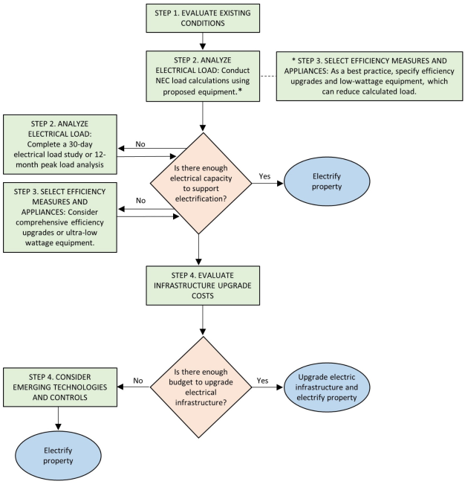
MF Electrification Report
Recommendations for Program Implementers
  Functional technical guidelines, for implementers
  80/20 rule
  4-step process – Decision Tree
Notes:
Read out the steps and note that I don’t expect people to be able to read them on their screen

Slide 7
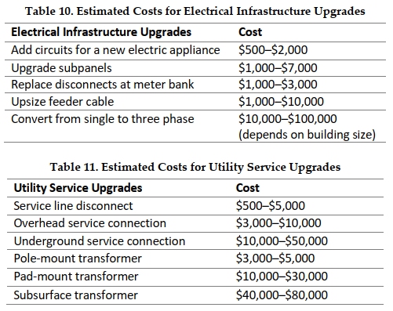
Evaluate Upgrade Cost and Consider Emerging Alternatives (Step 4)
Notes:
Note how this can be used on a project or program basis. Electrification programs should track these costs so the ranges can be narrowed over time.
This may even be more useful for policy makers than implementers. Total cost range would be helpful
Add notes about why there’s a wide range and how it can be used for programs or projects
Briefly mention interplay with red flags section and also small vs large project

Slide 8
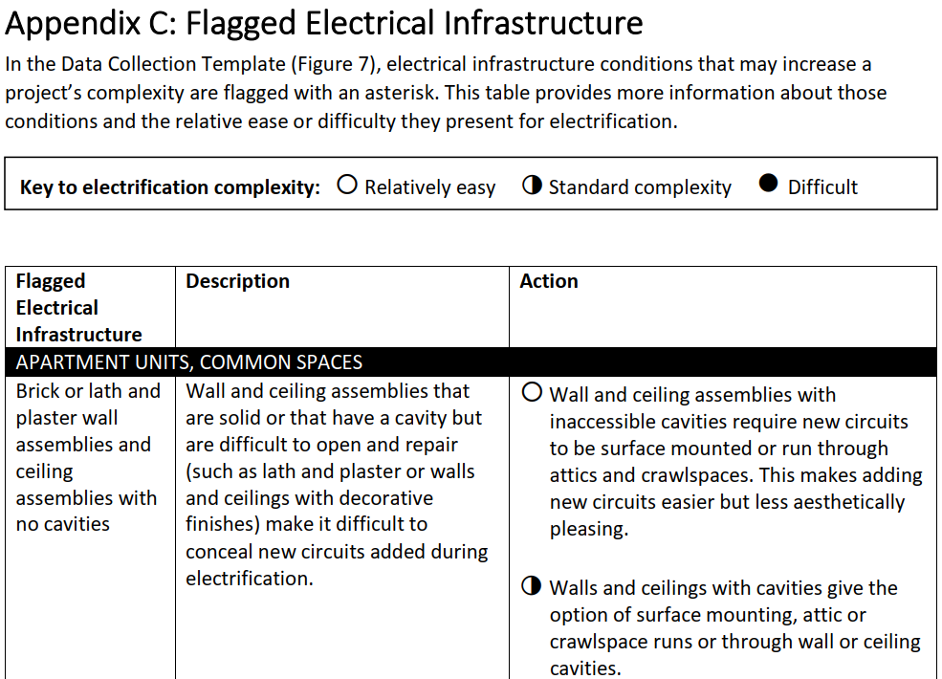
Flagged Electrical Infrastructure
Notes:
Existing building conditions that directly impact electrification
This is in Appendix C - Icons showing the difficulty of each solution
Explanation of each condition and why it matters
Actions to address

Slide 9





Emerging Tech Alternatives
Smart Panels
Smart Splitters
EV dynamic load management
Dialogue with local code enforcement
  Appendix A Product Guides incl. emerging tech
Notes:
Mention how all of these techs are ways of controlling load, not capacity. Briefly describe function of smart panels and splitters. NEC doesn’t take into account smart panels and splitters, does take in to account EV dynamic load management (likely because of specific EV folks advocating for it, also the draw for Evs so much higher)

Slide 10
Equity and Workforce Development
Electrification ≠ utility bill reduction, need more research
Energy burden in CA¹
  2% energy burden across all Californians
  60-80% AMI = 3%
  30-60% AMI = 4%
  0-30% = 9% (over 4x the State average)
Incentivize contractors to participate in equitable workforce development
  e.g. MCE/AEA Workforce, Education, & Training Program (WET)²
Tap Governor’s $1.1b Jobs Package³
1. https://www.energy.gov/eere/slsc/maps/lead-tool - Department of Energy Low-Income Energy Affordability Data (LEAD) Tool
2. https://www.mcecleanenergy.org/contractors/#WET
3. http://www.ebudget.ca.gov/2021-22/pdf/Revised/BudgetSummary/LaborandWorkforceDevelopment.pdf - From revised May 2021 Budget Proposal
Notes:
-Electrification does not mean lower energy bills, it can if well-planned up front, but is not a given
-Policymakers should address the possibility of negative effects on low-income renters if owners are able to pass through electrification upgrade costs to renters in the form of higher rents
-Electrification projects should include significant in-unit electrification AND EE work
-DOE definition of Energy Burden is the percentage of gross household income spent on energy cost. It’s easy to see how decision for lower income folks can come down to putting food on the table or keeping the lights on

Slide 11
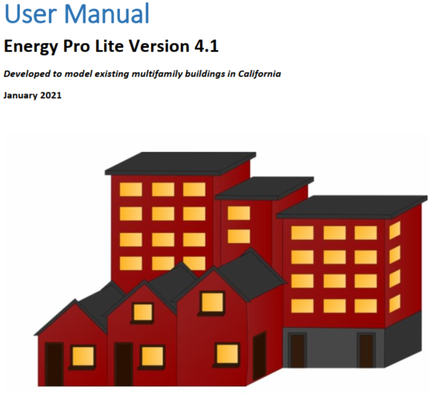
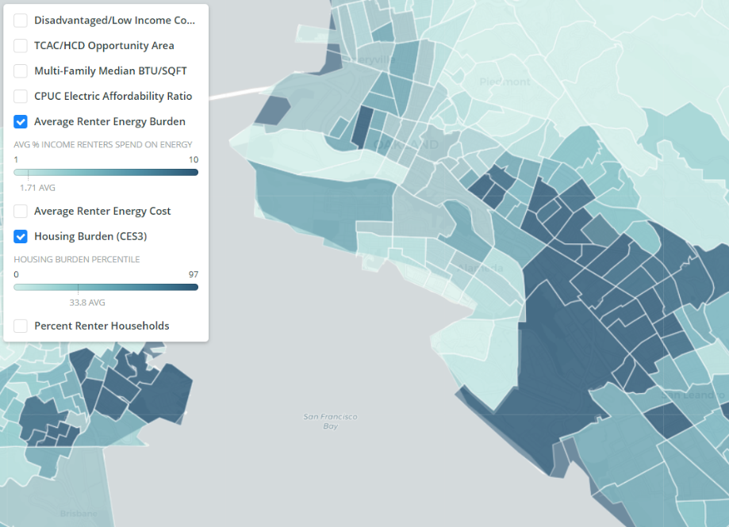
Data and Analytical Tools
NOAH Identification Pilots
Notes:
EnergyPro Lite (EPL) Model electrification of existing multifamily buildings, free to cities and programs
Quantitative and qualitative – NOAH identification pilots
Benchmarking content from report, recent NOAH ID work with Chris, highlight EPL and ability to model electrification and how that helps programs implement (BAMBE, LIWP, SoCalREN, City of Berkeley). Pull content from

Slide 12

Q&A
This Photo by Unknown Author is licensed under CC BY-SA-NC
Notes:
Can toggle over to report if time

Slide 13
Thank you!
Multifamily Electrification Report available here¹
“Accelerating Multifamily Building Upgrades” CEC grant deliverables here²
Ben Cooper bcooper@stopwaste.org 510-891-6511
https://www.stopwaste.org/accelerating-electrification-of-california%E2%80%99s-multifamily-buildings
https://www.stopwaste.org/accelerating-multifamily-building-upgrades
Notes:
Copy and past URL in to the chat
CALL TO ACTION
Share with your colleagues thinking electrification ordinances or programs/pilots serving or affecting existing MF – the EE considerations, nuances of the multifaceted MF sector, non-energy benefits and considerations, program layering. Share with your larger networks – building department staff, contractors, architects, who could benefit from a functional technical deep dive or a handy resource where they can pick out specific technical topics and be led to helpful resources.
If you interested in a more detailed run through, please shoot me an email. I’m working on formal dissemination opportunities with AEA

