Slide 1
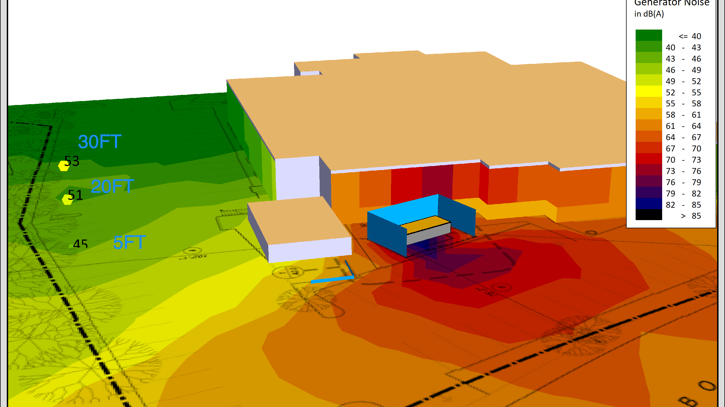
Microgrids:
Challenges and Performance
California Energy Commission
Integrated Energy Policy Report Update
Assessing the Role of Microgrids in California
Prepared by CONTECH-CA, John Griffiths PE LEED AP
July 7,, 2020

Slide 2
Proposed Essential Power Systems
Types of systems – as defined in CEC 705
  Hybrid system utilizing alternate power sources such as solar/storage or fuel cell to supplement traditional back up power
  Supplant tradition emergency power systems with renewable systems

Slide 3
Proposed Essential Power Systems
Advantages
  Utilize renewable resources
  Asset is constantly being utilized
  Grant funding available for suitable systems
  Not subject to fuel delivery problems during major outage
  No noise or exhaust to be addressed

Slide 4
Proposed Essential Power Systems…
Challenges
Institutional inertia
Perceived safety risk associated with alternate solutions
Capital expense
Excessive complexity
System components and supply chain
Cyber Security
Providing consistent power for extended period of time
Design guides not readily available
Codes do not allow optimal system configuration
Owner, contractors, and vendors not familiar with alternate systems
Equipment standards evolving
Project team is risk-averse and do not want to use new systems

Slide 5
KAISER RICHMOND MICROGRID

Slide 6
TOTAL USAGE kWh

Slide 7
Discussion
John Griffiths PE LEED AP
415 652 4833
WWW.CONTECH-CA.COM

