Slide 1
Harmonizing with DOE and Canada & Early Replacement for Home Appliances
California Energy Commission
IEPR Staff Workshop on Plug Load Efficiency

Slide 2
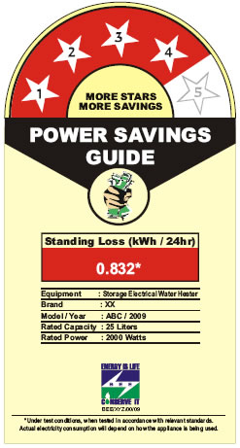
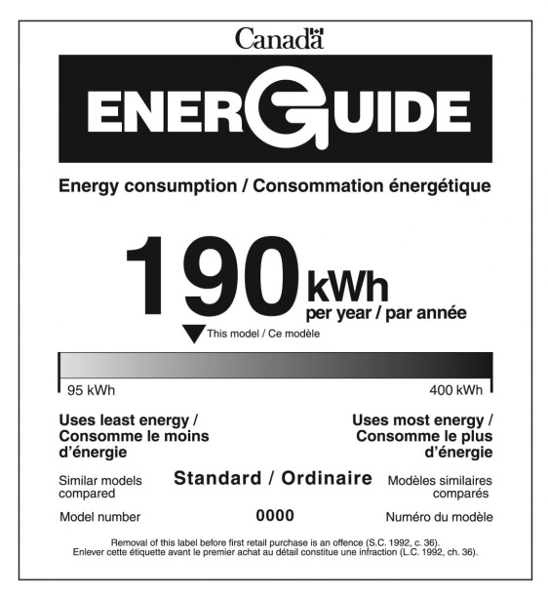
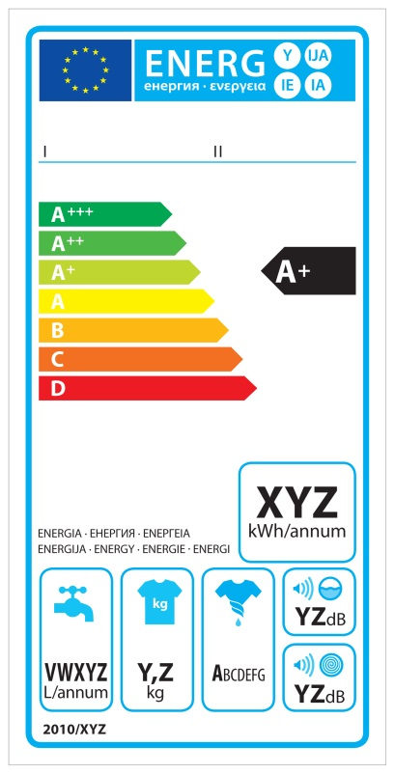
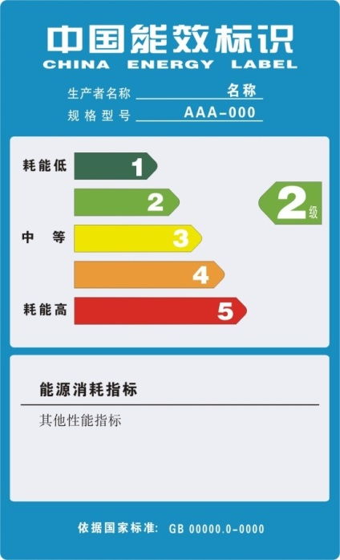
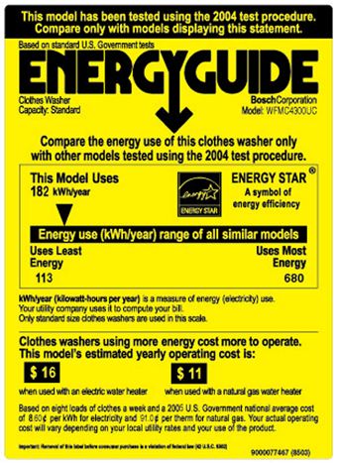
Global Appliance Energy Standards - Disharmonized
Much Work Lies Ahead for Harmonization

Slide 3














Appliance Energy Standards in US-Canada
Additional Work Lies Ahead for US-Canada
States
Federal
Federal
Provinces

Slide 4
Examples of Disharmony
Portable Air Conditioner
ENERGYGUIDE/ENERGuide
Appliance Databases

Slide 5
Portable Air Conditioner
Test Procedures
  ANSI/AHAM PAC-1-2014 “Portable Air Conditioners”
  ANSI/ASHRAE 128-2011 “Method of Rating Unitary Spot Air Conditioners” (test procedure specifically states that it not be used for units under 65,000 BTUs)
  DOE is developing a test procedure that will rely on ANSI/AHAM PAC-1-2014
Definition
  DOE defines single-duct, dual-duct and spot coolers
  CEC defines only “spot air conditioner” but has interpreted its regulations to cover portable air conditioners more broadly

Slide 6
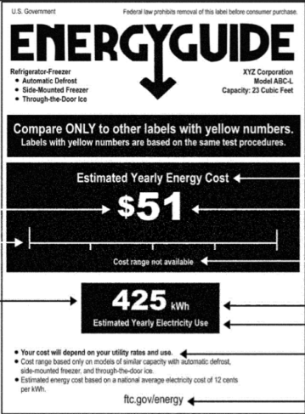
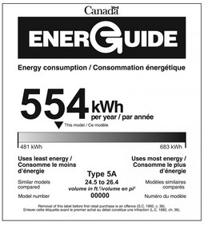
ENERGYGUIDE/ENERGuide
US using new test procedures and the label states energy cost
NRCan using conversion factor to approximate certain new test procedures and the label states annual energy use

Slide 7
Appliance Databases
DOE CCMS database
FTC also has a reporting requirement and database, which can now be satisfied by certification with DOE through CCMS
ENERGY STAR Qualified Products Listing
NRCan EnerGuide database
CEC appliance database
AHAM Verifide database of products in a voluntary industry verification program

Slide 8
Appliance Databases Inconsistent
Definition of “active” units is different from FTC, to DOE, to EPA ENERGY STAR
DOE and FTC do not require the same models to be included in their reports
  FTC requires a listing of “each basic model in current production”
  DOE requires a listing of all basic models that are “being sold or offered for sale by the manufacturer or private labeler”
  DOE’s requirement is much broader—potentially requires reporting of basic models that have been out of production for years

Slide 9
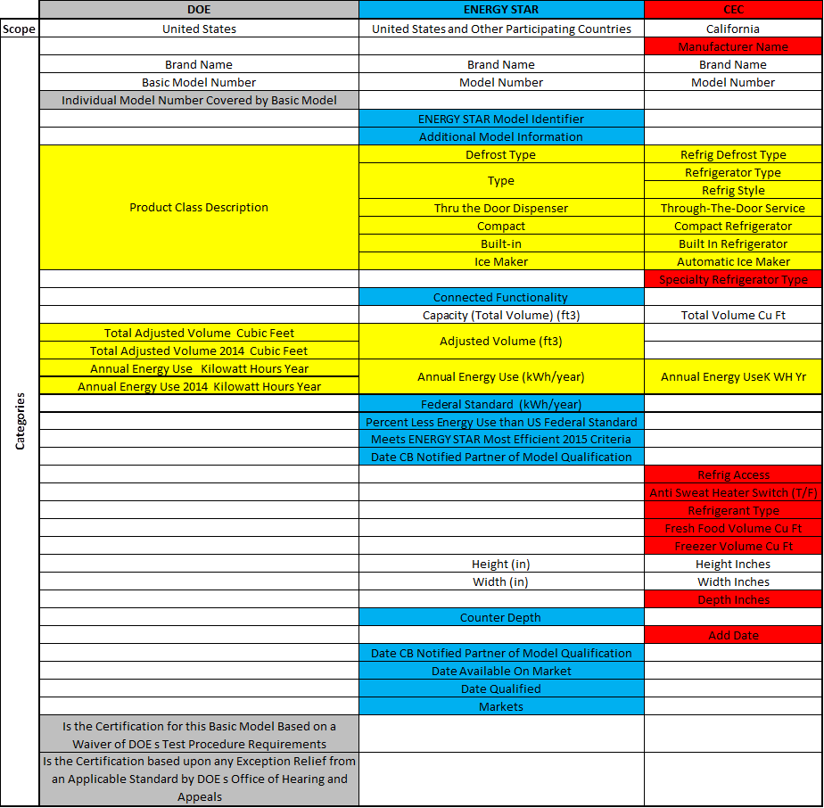
Appliance Databases Inconsistent
Database Categories are Inconsistent
Some overlap with categories in databases, but descriptions are different
Unique Categories
  DOE has 3
  ENERGY STAR has 12
  CEC has 9

Slide 10
Appliance Databases Harmonization
Ideally 1 database for the US and Canada
  That means—DOE and FTC need to harmonize the models to be included (FTC definition should prevail) and CEC and DOE databases should be harmonized
Reduce consumer confusion
Increase data consistency

Slide 11
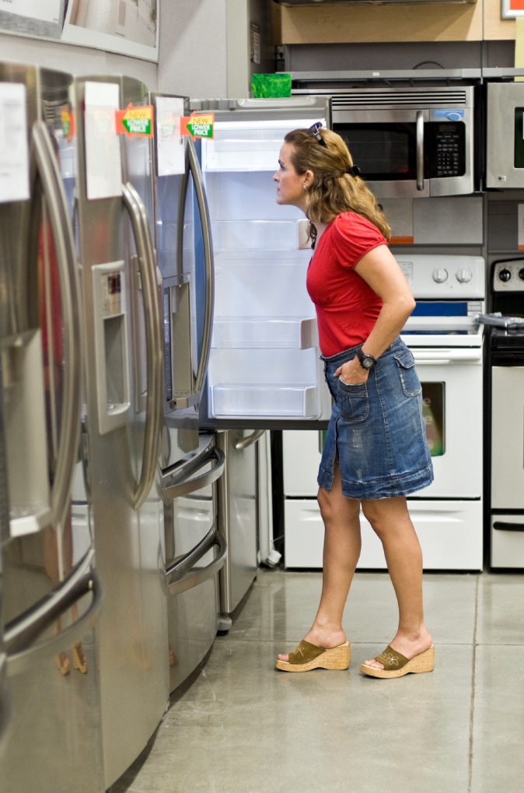
Early Replacement of Older Appliances
A New Paradigm for Efficiency Programs

Slide 12
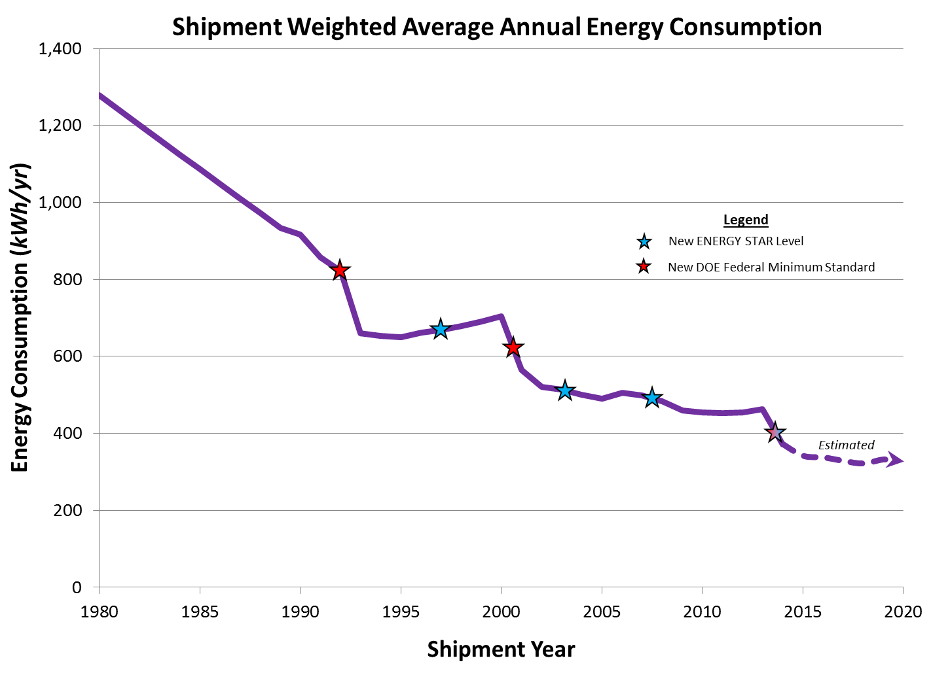

Cost-Benefit Analysis More Challenging
Not as Many Kwh Savings Comparing
New ENERGY STAR to New non-ENERGY STAR
2008: 20% of 500=100 kWh
60% Drop
2014: 10% of 400=40 kWh

Slide 13


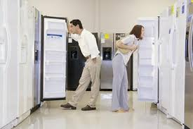
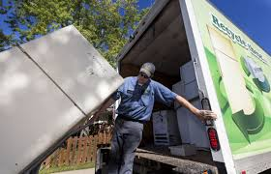
What is an Early Replacement Program?
Early Replacement
Purchase Rebate
Disposal Rebate

Slide 14
Changing the Paradigm: Early Replacement
Linked Rebates
Current model
  Existing programs seek to remove older appliances from the grid or incentivize purchase of new products, but not both
  Only 0.2-0.4% of US households have access to programs combining purchase and disposal rebates (none in California)
  Energy savings are often measured as merely the difference between new ENERGY STAR models and a DOE standard models
New paradigm
  Linking purchase and disposal rebates (i.e., requiring proof that old unit is removed from grid) will capture the much greater efficiency increment between old and new units

Slide 15
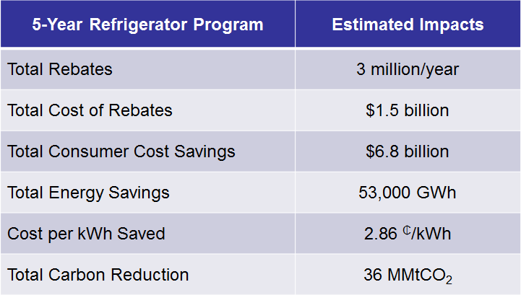
Projected Results at the National Level

Slide 16
Projected Results at the California Level
5-Year Refrigerator Program | Estimated Impacts
Total Rebates | 320,000/year
Total Cost of Rebates | $162 million
Total Consumer Cost Savings | $956 million
Total Energy Savings | 5,644 GWh
Cost per kWh Saved | 2.86 ₵/kWh
Total Carbon Reduction | 2.94 MMtCO₂

Slide 17

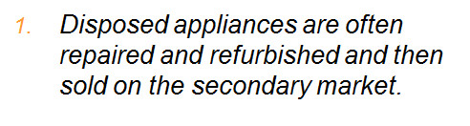

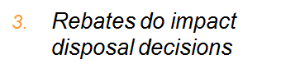
AHAM Consumer Research

Slide 18
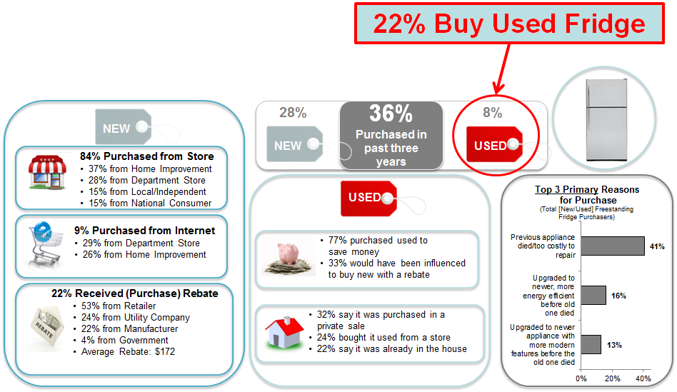
Data on Freestanding Fridge Purchases

Slide 19
Thank You
Kevin Messner
President
(530) 309-5629
Kmessner@PoliticaLogic.net

