Slide 1

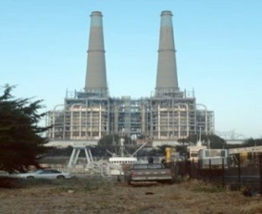


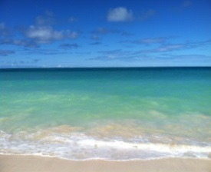
Once Through Cooling
Diablo Canyon
State Water Resources Control Board
Jonathan Bishop
Chief Deputy Director
California Energy Commission Workshop
April 27, 2015
Alternative Energy Stocks
cosebellitas
Animal World
The Ocean Foundation

Slide 2

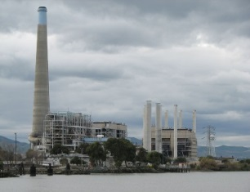
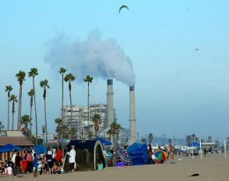

Background
On May 4, 2010, the State Water Board adopted the Statewide “Water Quality Control Policy on the Use of Coastal and Estuarine Waters for Power Plant Cooling”
  Also known as the Once-Through Cooling Policy (OTC- Policy)
The Policy was established to:
  Implement federal Clean Water Act § 316(b)
The Policy is implemented through National Pollutant Discharge Elimination System permits
Center for American Progress
Flickriver
gigaom
Alternative Energy Stocks

Slide 3
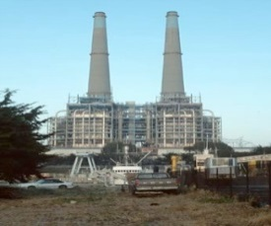
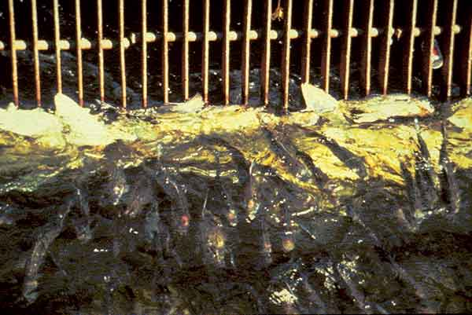
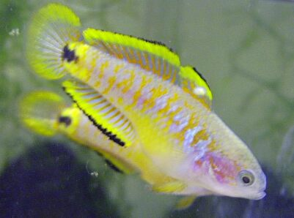
Current Policy
Intent of the Policy:
  Protect the beneficial uses of the State’s coastal and estuarine waters
  Ensure the State’s electrical power needs are met
Applied to 19 power plants facilities, including two nuclear power plants
  Several facilities have retired or repowered, some in advance of their compliance date
cosebellitas
Food and Agriculture Organization of the U.N
hynpoikanikan.blogspot
The Ocean Foundation

Slide 4


Implementation Provisions
Section 2.A. Describes the compliance alternatives :
  Track 1 – 93 percent reduction in intake flow rate; feasible with a closed-cycle wet cooling system
  Track 2 – Impingement mortality and entrainment reduction must meet a comparable level to that which would be achieved under Track 1
Advanced Aquarist
gigaom
Animal World
Ethical Ocean

Slide 5
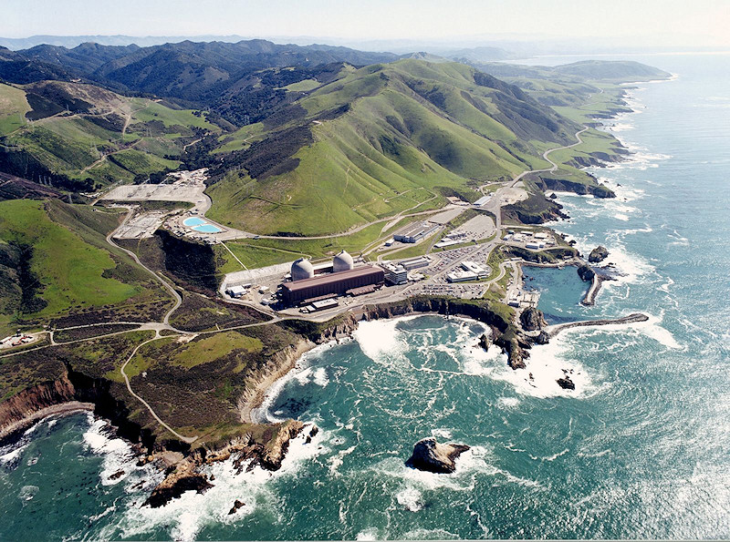
Implementation Provisions for Nuclear-Fueled Power Plants
Section 3.D requires owners/operators of nuclear facilities to conduct special studies to investigate alternatives for compliance
  Nuclear Review Committee established
  Ability to achieve 93 percent intake reduction
  Independent third party assessment – Bechtel Power Corporation
http://www.jimzim.net/Photos/DiabloCanyonAerialPhotoByPG&E.jpg

Slide 6
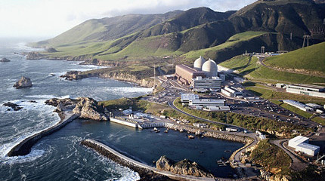
Special Studies Report submittal to the Water Board
Special studies to assess alternative technologies for compliance
  Bechtel Power Corporation Report assessed Diablo Canyon Power Plant technology alternatives
  The report was presented to the Board on Nov 18, 2014
http://www.pgecurrents.com/wp-content/uploads/2012/03/300x200_dcpp2.jpg

Slide 7
Bechtel Power Corporation
Assessed the potential technologies in two phases:
  Phase I . Feasibility evaluation of eight technologies without regard for cost, schedule, or permitting.
    Three were feasible
  Phase II. Evaluation of the three technologies in the aspects of cost, permitting , and schedule
cosebellitas
Food and Agriculture Organization of the U.N
hynpoikanikan.blogspot
The Ocean Foundation

Slide 8
Bechtel Report Findings
  Feasible technologies
    Onshore mechanical intake fine mesh screening systems
    Offshore modular wedge wire systems
    Closed-cycle cooling systems (five-cycle variations)
  Cost and Schedule
    Cost from $0.46 to $14 billion
    From 8 to 14 years
  South Lot Addenda Technology
    Saltwater Cooling Towers
    Cost from $6.2 to $8 billion
    Schedule 14 years
cosebellitas
Food and Agriculture Organization of the U.N
hynpoikanikan.blogspot
The Ocean Foundation

Slide 9
Next Steps
Water Board is evaluating the results of the special studies conducted by Bechtel Power Corporation
Policy section 3.D(7): evaluate need to amend the Policy based upon
  Cost of compliance
  Ability to achieve compliance with Track 1
  Environmental impacts
Policy section 3.D(8): Board may establish alternate requirements for compliance based upon finding that:
  compliance costs wholly out of proportion to costs previously identified; OR
  Compliance is wholly unreasonable based on specified factors
cosebellitas
Food and Agriculture Organization of the U.N
hynpoikanikan.blogspot
The Ocean Foundation

Slide 10
Alternative requirements
If alternate requirements are less stringent than Track 1, the difference in impacts to marine life shall be fully mitigated
The mitigation shall be associated with the State’s Marine Protected Areas in the geographic region of the facility
Currently, Diablo Canyon Power Plant compliance due date is Dec 31, 2024
Center for American Progress
Flickriver
gigaom
Alternative Energy Stocks

