Slide 1
Scoping Workshop
Funding to Advance Integrated Planning of Gas System Decommissioning
Energy Research and Development Division, California Energy Commission
Presenter: Martine Schmidt-Poolman, PhD
October 13, 2025

Slide 2
Housekeeping
Participants will be muted during the presentation
Please type your question in the Q&A window
This workshop will be recorded
Workshop documents and written responses:
  Workshop page for workshop notice, presentation, and recording (forthcoming) https://www.energy.ca.gov/event/workshop/2025-10/scoping-workshop-funding-advance-integrated-planning-gas-system
  Docket 23-ERDD-02 for the docketed responses: https://efiling.energy.ca.gov/Lists/DocketLog.aspx?docketnumber=23-ERDD-02%20

Slide 3
Why Are We Seeking Input?
Forthcoming Grant Funding Opportunity:
  Up to $2.5M available
  Research to develop frameworks, strategies, and tools needed to collaboratively chart a strategic energy transition
Public input to inform solicitation development

Slide 4
Workshop Agenda
Background on Gas R&D funding program
Initial ideas regarding scope and focus of anticipated solicitation
Seeking input on specific discussion questions regarding proposed research

Slide 5
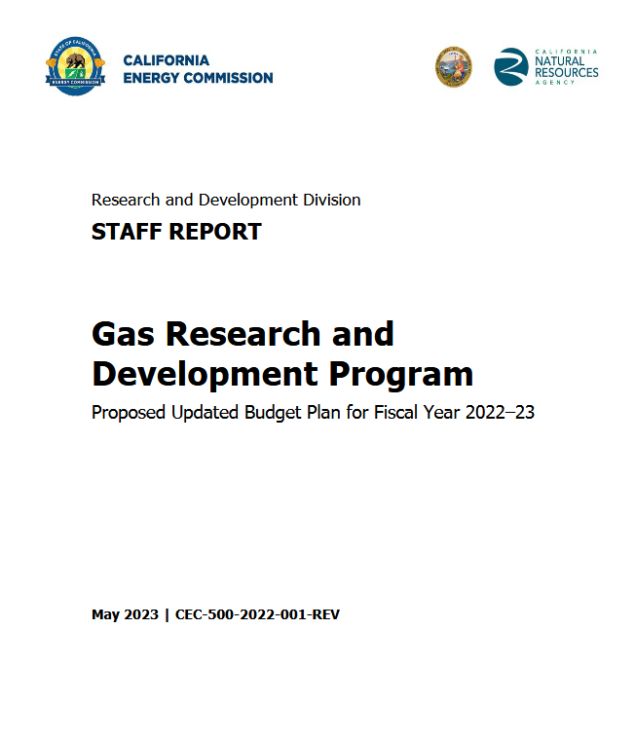
Gas Research and Development Program
Proposed research supports​ the Gas R&D Program:
Scaled-Up Gas Decommissioning Pilots and Integrated Planning Tools (FY 2022/23, FY 2023/24**)​
For further information on​ gas research plans and annual reports​:
https://www.energy.ca.gov/data-reports/reports/energy-research-and-development-investment-plans-and-annual-reports
** CPUC Resolution G-3603 approves $2 million for the “Scaled-up Gas Decommissioning Pilots and Integrated Planning Tools” Initiative, although the full plan is still under review.

Slide 6
Purpose of Forthcoming Solicitation
Advance collaborative planning capacity for a strategic energy transition by improving understanding of infrastructure, operations, and multiple actors’ needs, abilities, and concerns.
Develop:
  Enhanced planning tool for robust site identification
  Framing of the network of actor dependencies
  Lexicon: consistent terminology to foster collective learning and collaboration

Slide 7
Topic 1: Enhance integrated planning tools to support gas planning efforts
Anticipated Funding: $ 2,000,000
Research will:
  Improve and expand an existing gas decommissioning assessment tool supported by Gas R&D
  Support long-term planning, including developing long-term gas scenarios
  Support community outreach
Notes:
Starting with research topic 1: Enhancement of integrated planning tools to support gas planning efforts,
For which we anticipate $2 million in funding
Research from this group will build on recent and ongoing Gas R&D-funded decommissioning research, which has laid a valuable foundation for assessing the technical and economic feasibility of decommissioning segments of the gas distribution system.
Since that research launched in early 2020, state gas planning activities have
advanced analytical work to respond to energy system transition risks and challenges in the short and medium term.
Various guidelines for cost-effective decarbonization and leveraging of infrastructure data are ongoing. It is clear that existing gas decommissioning tools and frameworks need to be updated, refined, and expanded to support more recent legislative mandates and long-term planning, including long-term gas scenarios, mapping requirements, and community outreach. We are specifically calling out refinements to be made the Gas Distribution System Screening Tool (which we often refer to as the Data Driven Tool).
Notes: [The DNV and UCLA research team developed the resulting Gas Distribution System Screening Tool to support the state in its ability to explore characteristics of promising sites for decommissioning gas assets and it is a first step in a larger research portfolio intended to support collaborative planning for California’s gas system in a low-carbon future.
Gold-Parker et al, 2024; Klima et al, forthcoming.
Data-Driven Tool: research agreement PIR-22-002 funded by FY 2020-2021 Gas R&D Budget Plan]

Slide 8

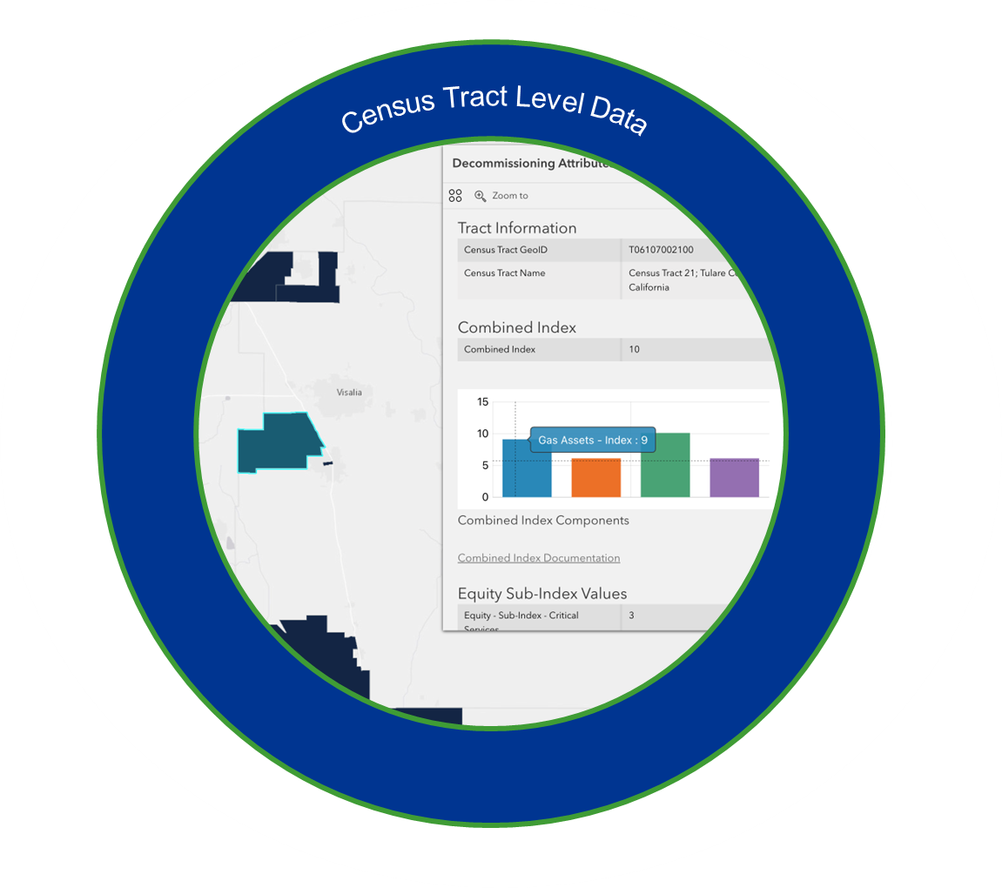
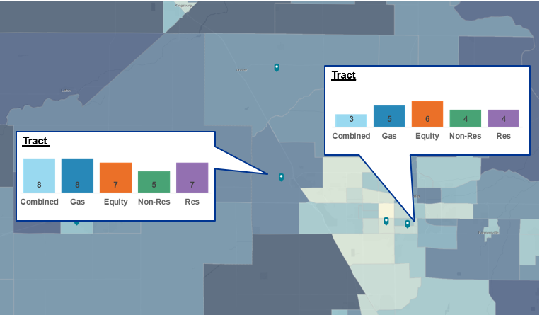

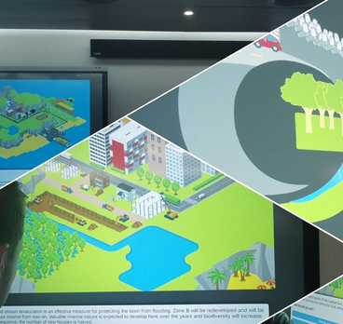

Research Focus – Topic 1
Assess existing decommissioning tools & programs
Update data and maintain existing Data-Driven Tool
Enhance tool’s metrics and flexibility to query
Improve outreach portfolio based on empirics
Enhanced tool that expands capacity to collaboratively plan
Image sources: iStock, PIR-22-002 Oct 8, 2025 webinar, RoyalHaskoningDHV

Slide 9
Topic 2: Develop actor playbook to support strategic decommissioning planning
Anticipated Funding: $500,000
Research will:
  Identify key actors
  Articulate roles that actors may play
  Develop playbook that:
  Identifies and prioritizes potential pathways for collaboration
  Includes typology to facilitate consistent naming and grouping of actors

Slide 10
Resulting Guide
Playbook: a dynamic, action-oriented guide
  Provides next steps in implementation
  Outlines strategies, methods and processes to catalyze action
  Helps navigate evolving changes in decommissioning processes

Slide 11
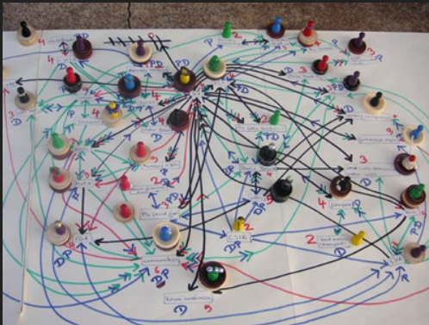

Research Focus – Topic 2
In-depth consultation and analysis to:
  Map roles, responsibilities, influences and relationships at different phases of decommissioning
  Develop frameworks that show influence, benefits and resources
  Organize information into a playbook
Image sources: https://netmap.wordpress.com, iStock,

Slide 12
Discussion Questions – Topic 1
Research Topic 1: Enhance Integrated Planning Tools to Support Gas Planning Efforts
What other tools, research and strategic efforts (in decommissioning space or otherwise) could inform this research?
What existing efforts can proposed research coordinate with and be informed?
What limitations in current knowledge about identification of decommissioning sites should be addressed by this research?
To support decommissioning efforts, how should the study approach be structured to:
  Identify valuable data sources and metrics to include into the tool?
  Assess the specifications for outreach materials to be sourced from the tool?
  Provide other meaningful enhancements to the tool?
Is the proposed funding of $2 million sufficient to support the research scope to analyze, update and develop an enhanced Data-Driven Tool?
Any other questions from attendees?

Slide 13
Discussion Questions- Topic 2
Research Topic 2: Develop Actor Playbook to Support Strategic Decommissioning Planning
What other analyses, efforts and guides to strategic change (in decommissioning space or otherwise) could inform this research?
What are the biggest current gaps in knowledge or disconnects across actors concerning implementation of decommissioning that this research should address?
Which distinct phases are there in the gas decommissioning process that research should focus playbook development on?
How should the study approach be structured to:
  Meaningfully analyze stakeholders, actors and involved parties in the gas transition?
  Provide actionable insights for decommissioning planning?
Is the proposed funding of $500,000 sufficient to support the research scope to develop the playbook?
Any other questions from attendees?

Slide 14
Questions and Answers
Please type your question in the Question and Answers window or raise your hand and you will be called on to unmute yourself
Please introduce yourself (your name and affiliation)

Slide 15
Thank you!
Please submit your written comments by
5:00 p.m. October 27, 2025
Submit electronically through the Energy Commission’s “Gas Research and Development” docket, 23-ERDD-02 here: https://efiling.energy.ca.gov/EComment/EComment.aspx?docketnumber=23-ERDD-02
Or by email to the Docket Unit at: docket@energy.ca.gov
  Please include docket number 23-ERDD-02 and “Advancing Integrated Planning” in the subject line
Or by paper copy to the Docket Unit: California Energy Commission || Docket Unit, MS-4 || Re: Docket No. 23-ERDD-02 || 715 P Street || Sacramento, CA 95814
Visit https://www.energy.ca.gov/event/workshop/2025-10/scoping-workshop-funding-advance-integrated-planning-gas-system to view the workshop notice, presentation, and recording (forthcoming)
Visit https://efiling.energy.ca.gov/Lists/DocketLog.aspx?docketnumber=23-ERDD-02%20 for the docketed responses to our questions

