Slide 1
Applications of Open Data to Support Climate Resilience in California’s Electricity Sector
Request for Comments on Forthcoming Solicitation
Sustainability and Health Research
Energy Research & Development Division
Presenter: Aryana Sherzai
October 30, 2024

Slide 2
Housekeeping
All participants muted on Zoom (until Q&A)
Zoom recording
Comments and questions
  Please use “Q&A” feature for substantive comments and questions (not chat).
  Please reserve the “Chat” feature for technical issues, etc.

Slide 3
Why Are We Seeking Your Input?
Forthcoming Grant Funding Opportunity: up to $4.6M to fund development of open-source, best available climate and wildfire tools that support resilience planning and outreach by California IOUs and other energy sector stakeholders, building on prior EPIC efforts.
To ensure high-impact research, we are seeking input to inform solicitation development.

Slide 4
Workshop Agenda
Background on EPIC funding program
Initial ideas regarding scope and focus of anticipated solicitation
Seek input from stakeholders on specific discussion questions regarding proposed research.
Input from today’s workshop plus public comments (oral and/or written comments) will help shape the Grant Funding Opportunity.

Slide 5
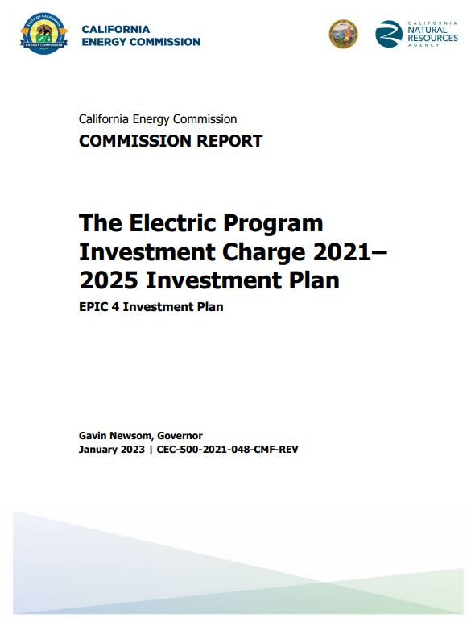
EPIC Research and Development Program
Proposed research supports the CEC’s EPIC 4 Investment Plan:
Topic 44. Integrating Climate Resilience in Electricity System Planning (pp. 212-218)
To access report: https://www.energy.ca.gov/publications/2021/electric-program-investment-charge-proposed-2021-2025-investment-plan-epic-4
5

Slide 6




Purpose of Forthcoming Solicitation
Deliver open-source climate and wildfire tools
Leverage best-available datasets funded by EPIC
Curate science and data for ease of use
Assist stakeholders with building resilience
Notes:
With this solicitation, we would like to see the development of open-source climate and wildfire tools that can be used by stakeholders like IOUs to support planning for climate extremes including wildfires. As a result, these tools will help build resilience of our electricity infrastructure and communities. These tools will leverage recent EPIC-funded datasets on climate and wildfire, and will be curated to be easily accessible, understandable, and usable.

Slide 7
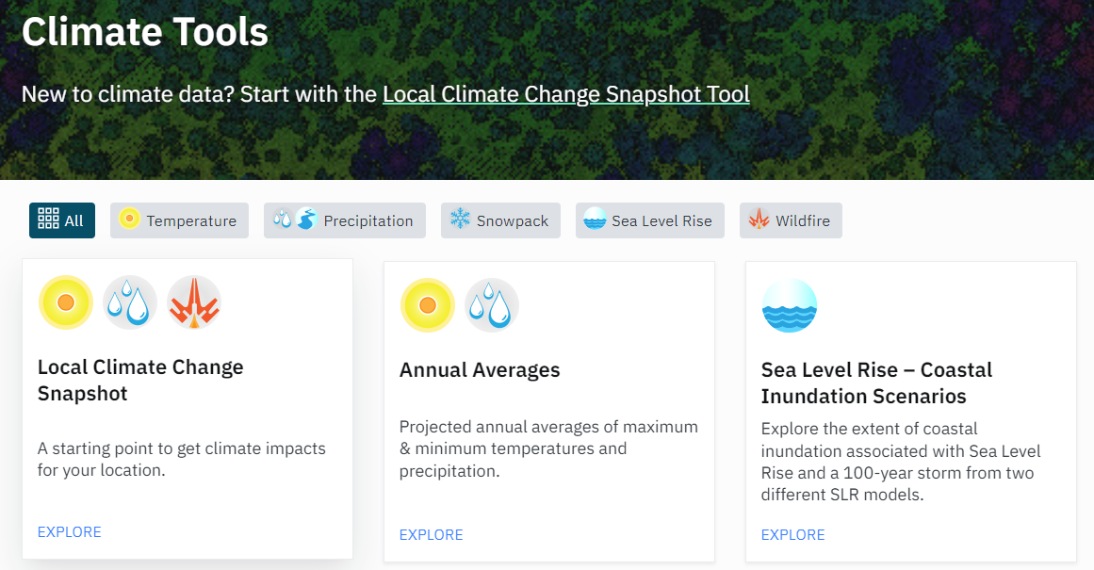

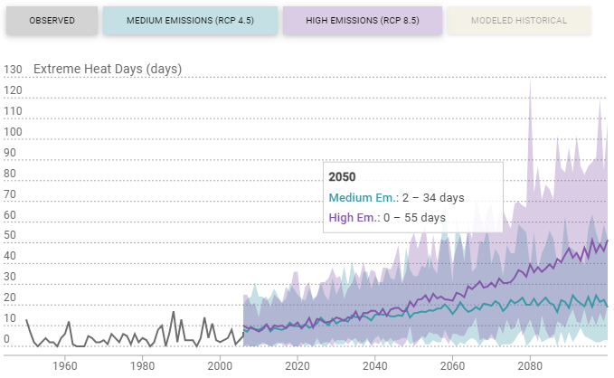

Group 1: Development of Tools and Visualizations for the Updated Cal-Adapt Data Explorer
(Anticipated Funding: $2.8 million)
New tools & visualizations will:
Build on recent updates to Cal-Adapt
Leverage much richer climate & weather data
Ensure continued, easy access to best available climate science

Slide 8
Status of CMIP5 Cal-Adapt Tools
Tool | Data Source | Status
Local Climate Change Snapshot | CMIP5/4th CCA | To be retired
Extreme Heat Days & Warm Nights | CMIP5/4th CCA | To be retired
Annual Averages | CMIP5/4th CCA | To be retired
Maps of Projected Change | CMIP5/4th CCA | To be retired
Wildfire | CMIP5/4th CCA | To be retired
Cooling Degree Days and Heating Degree Days | CMIP5/4th CCA | To be retired
Sea Level Rise & Coastal Inundation Scenarios | CMIP5/4th CCA | To be retired
Extreme Precipitation Events | CMIP5/4th CCA | To be retired
Extreme Weather | CMIP5/4th CCA | To be retired
Sea Level Rise - CalFloD-3D | CMIP5/4th CCA | To be retired
Snowpack | CMIP5/4th CCA | To be retired
Hourly Projections of Sea Level | CMIP5/4th CCA | To be retired
Current climate tools:
  use prior generation CMIP5/Fourth Climate Change Assessment data
  are facing retirement
Group 1 Opportunity:
Redevelop select tools that portray CMIP6/Fifth Assessment data + innovate new tools

Slide 9
Ongoing Cal-Adapt Updates
EPC-21-038* is:
Enabling access and alignment with Fifth Assessment data
Building 2 new tools:
  renewable energy resources viewer
  climate/wildfire viewer
EPC-21-038 is not:
Preserving continued access to the most popular existing tools or designing other new tools
*EPC-21-038, Climate-Informed Energy Sector Adaptation Planning Web Application via Cal-Adapt, $750K, Eagle Rock Analytics

Slide 10
Project Expectations:
Future Cal-Adapt Development
Scope
Shape
Share
Scope out essential tools by engaging with stakeholders who rely on Cal-Adapt and analyzing feedback
Develop tools that leverage Fifth Assessment data and respond to stakeholder needs
Enable open access of tools on cal-adapt.org and ensure they are accessible and valuable to the broad range of stakeholders

Slide 11
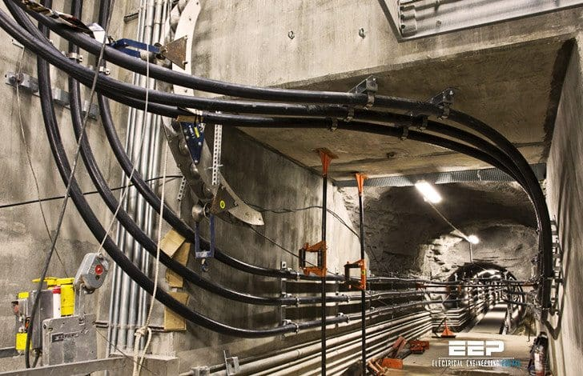
Group 2: Wildfire Planning Tool Leveraging Long-Term Scenarios Developed for California’s Fifth Climate Change Assessment
(Anticipated Funding: $800,000)
Wildfire Planning Tool will:
Be free, open access, and user-friendly
Portray changing fire risks, leveraging EPIC-funded long-term wildfire scenarios dataset
Support wildfire adaptation and mitigation planning
Figure: Underground power lines. Credit: Electrical Engineering Portal

Slide 12
Long-Term Wildfire Scenarios*
EPC-18-026** has:
Produced numerous climate, vegetation, and land-use scenarios exploring wildfire risk to electricity sector through 2100
Produced datasets with metrics on:
  Fire size
  Fire severity
  Smoke emissions
  Fire presence
  # of fires over CA domain
EPC-18-026 has not:
Produced a tool to explore these datasets, allowing users to query and analyze historic and projected wildfire risk
Optimized datasets for cloud computing and storage
*EPC-18-026 documentation and datasets will be available Spring 2025 at the earliest
**EPC-18-026, Comprehensive Open Source Development of Next Generation Wildfire Models for Grid Resiliency, $5M, Spatial Informatics Group

Slide 13
Project Expectations:
Long-Term Wildfire Planning Tool
Scope
Shape
Share
Scope out long-term planning gaps that can be filled leveraging EPIC-funded future wildfire scenario datasets
Develop tool that makes data interpretable, and helps address identified planning gaps
Enable open access to tool to ensure it can support energy-sector wildfire mitigation and adaptation planning and other needs
Example Functions:
portray fire-related metrics, highlight exposure of infrastructure, and identify areas facing high wildfire hazards under climate change

Slide 14
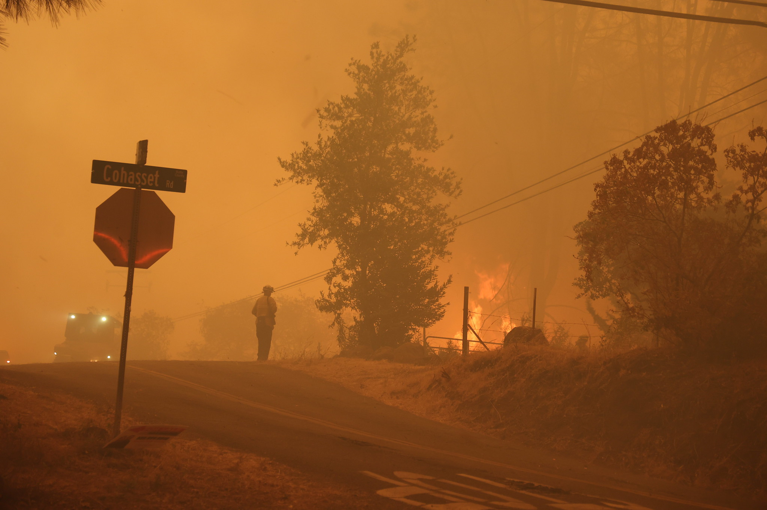
Group 3: Integration of Climate-Informed Science into Open Near-Term Wildfire Modeling Platform
(Anticipated Funding: $1 million)
Near-Term Wildfire Modeling Platform will:
Be free, open access, and user-friendly
Integrate EPIC research results into near-term model on open platform
Inform IOUs’ situational awareness with updated fire behavior models reflecting new fuel and weather regimes
Figure: Park Fire, California, 2024. Credit: CAL FIRE

Slide 15
Wildfire Behavior Modeling Advancements
EPC-18-026 has:
Advanced research on climate-driven relationships of wildfire behavior with extreme weather events and changing fuel conditions
Developed an open platform to portray near-term forecasts of:
  active fire spread
  fire weather danger
  potential for new destructive fires
EPC-18-026 has not:
Incorporated research findings into near-term forecasting platform
Replaced the Rothermel fire spread equations with new dynamic coupled weather-wildfire behavior models in the open platform

Slide 16
Project Expectations:
Near-Term Wildfire Modeling Platform
Scope
Shape
Share
Integrate new science into a modeling platform that can produce near-term, climate-informed wildfire forecasts
Enable open access to ensure the platform can support situational awareness of wildfire regimes affected by climate change
Scope out near-term awareness gaps that can be filled leveraging EPIC-funded advances in climate-driven wildfire behavior science

Slide 17
Comments and Questions
Three ways to provide feedback or ask questions:
Use the raise hand function in Zoom:
  Zoom Phone controls:
    *6 - Toggle mute/unmute.
    *9 - Raise hand.
  Please introduce yourself by stating your name and affiliation.
Type comments and questions in the question function on Zoom:
  Please provide name and affiliation.
  Please indicate which discussion questions you are commenting on (E.g., 1, 2, etc.).
Submit written comments & questions:
  Send written comments & questions to docket@energy.ca.gov by no later than November 15, 2024, 5 p.m. PST.
    Include docket number 23-ERDD-01 and “Staff Workshop on Applications of Open Data to Support Climate Resilience of California’s Electricity Sector” in the subject line

Slide 18
Discussion Questions: Group 1
Development of Tools and Visualizations for the Updated Cal-Adapt Data Explorer
(Anticipated Funding: $2.8 million)
Which of the existing Cal-Adapt tools would you consider the most important to preserve access to?
What are opportunities for innovation in how we present Fifth Assessment (CMIP6) data?
What are the possibilities and opportunities for developing tools that enable integration of private data while maintaining confidentiality/sovereignty?
Could the scope of the project as currently outlined be accomplished with the proposed budget?

Slide 19
Discussion Questions: Group 2
Wildfire Planning Tool Leveraging Long-Term Scenarios Developed for California’s Fifth Climate Change Assessment
(Anticipated Funding: $800,000)
Should the Wildfire Planning Tool be part of the Cal-Adapt enterprise? If so, to what extent? If not, what considerations should inform how it's made publicly available?
Given the available data from EPC-18-026, what kinds of decisions can this tool support?
What other ongoing or planned research efforts, if any, should this work coordinate with or leverage to help inform the goals and increase the impact of this effort?
Could the scope of the project as currently outlined be accomplished with the proposed budget?

Slide 20
Discussion Questions: Group 3
Integration of Climate-Informed Science into Open Near-Term Wildfire Modeling Platform
(Anticipated Funding: $1 million)
How might this be positioned to be most useful to utilities? How could integration of this platform into utility operation be best facilitated?
How might this be positioned to be most useful to the broad suite of stakeholders? How could this platform best facilitate situational awareness?
What other ongoing or planned research efforts, if any, should this work coordinate with or leverage to help inform the goals and increase the impact of this effort?
Could the scope of the project as currently outlined be accomplished with the proposed budget?

Slide 21
Thank You!
Please submit your written comments by
5:00 p.m. November 15, 2024
Submit electronically through the Energy Commission’s “Research Idea Exchange” docket here: https://efiling.energy.ca.gov/EComment/EComment.aspx (Enter docket # 23-ERDD-01)
Or by email to the Docket Unit at: docket@energy.ca.gov
  Please include docket number 23-ERDD-01 and “Staff Workshop Applications of Open Data to Support Climate Resilience in California’s Electricity Sector” in the subject line
Or by paper copy to the Docket Unit: California Energy Commission || Docket Unit, MS-4 || Re: Docket No. 19-ERDD-01 || 715 P Street || Sacramento, CA 95814
Visit: https://www.energy.ca.gov/event/workshop/2024-10/staff-workshop-regarding-applications-open-data-support-climate-resilience to view the workshop notice, presentation, and recording (forthcoming).

