Slide 1
Advanced Battery Bankability Center Stakeholder Workshop
October 27, 2022

Slide 2
Workshop Agenda
Commissioner Opening Remarks
CEC Staff Presentation
Presentation on Li-Bridge and Battery NY
Panel Discussion: Perspectives from Battery Technology Companies
Public Comments and Questions
Closing and Next Steps

Slide 3
Housekeeping
• Workshop is being recorded on Zoom
• Virtual Participation via Zoom or telephone during the Public Comment period
• Presentation and other related documents are available online:
  Workshop on Advanced Battery Bankability and Manufacturing Readiness Center Funding Concept Event Page
  https://www.energy.ca.gov/event/workshop/2022-10/advanced-battery-bankability-and-manufacturing-readiness-center-funding
• Research Idea Exchange Docket No. 19-ERDD-01
  Website to submit comments
  https://efiling.energy.ca.gov/Lists/DocketLog.aspx?docketnumber=19-ERDD-01

Slide 4
Commitment to Diversity
CEC adopted a resolution strengthening its commitment to diversity in our funding programs. CEC continues to encourage disadvantaged and underrepresented businesses and communities to engage in and benefit from our many programs.
To meet this commitment, CEC staff conducts outreach efforts and activities to:
  Engage with disadvantaged and underrepresented groups throughout the state.
  • Notify potential new applicants about the CEC’s funding opportunities.
  • Assist applicants in understanding how to apply for funding from the CEC’s programs.
  • Survey participants to measure progress in diversity outreach efforts.

Slide 5
We Want to Hear From You!
Participation Survey
Survey responses will be summarized anonymously to track attendance of underrepresented groups in our workshops for public reporting purposes.
Online participants, please use this link: https://forms.office.com/g/XzrhG71YBK
Thanks!

Slide 6
Welcome and Opening Remarks
Commissioner Opening Comments

Slide 7
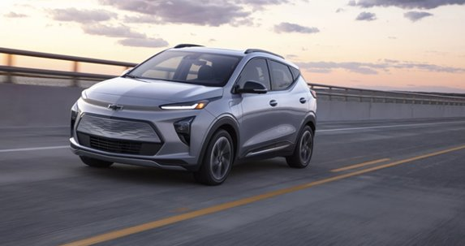
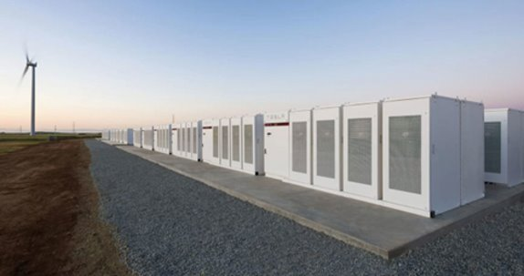
Battery Storage is Key to California's Energy Policy Goals
Executive Order N-79-20: 100 Percent Zero-Emission Vehicles by 2035 – 8 million EVs by 2030 (currently 1.2 million+)
Advanced Clean Cars II rule –100% of new cars and light trucks sold will be zero-emission vehicles
SB 100: 100 Percent Clean Electricity by 2045 –
48,800 MW battery storage capacity (currently > 4,000 MW)

Slide 8

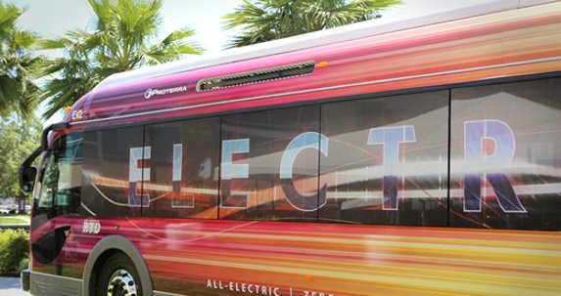
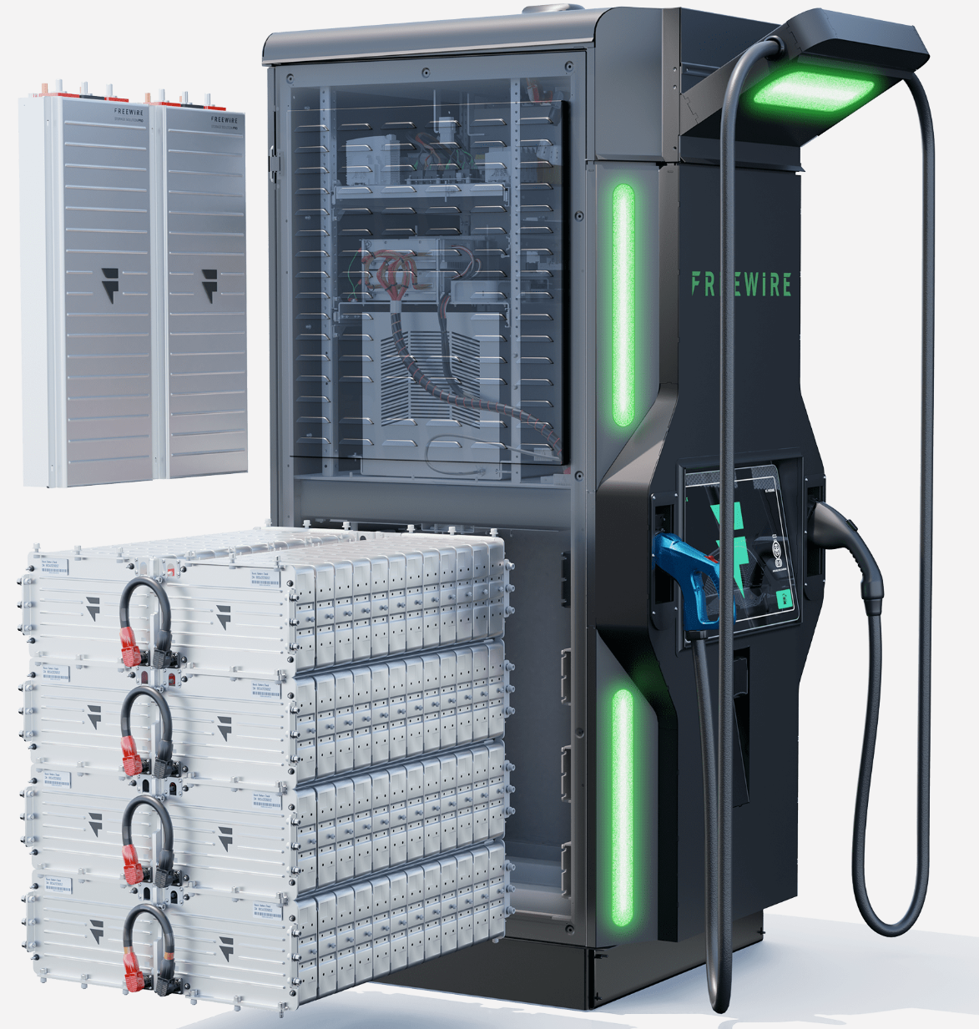
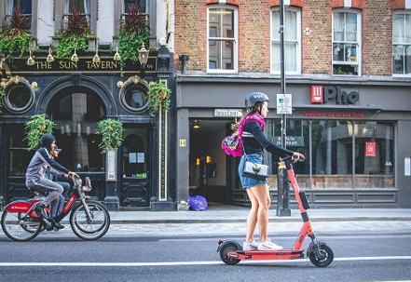
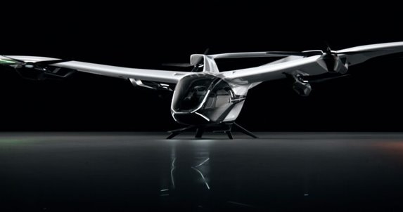
An Expanding Role for Batteries in our Energy and Climate Goals
Medium and Heavy-Duty Transportation
Drone Applications
Ultra-fast EV Charging
Micro Mobility
Aviation

Slide 9








New Technologies are Addressing Challenges to Current Lithium-ion Batteries
Cost and performance: improve key metrics such as energy density, charge time, cycle life and $/kWh.
Supply chain security: reduce cobalt, nickel and reliance on imported lithium.
Safety: reduce thermal runaway and other safety concerns.
End-of-Life Management: increase the economic feasibility to repurpose and recycle lithium-ion batteries.

Slide 10
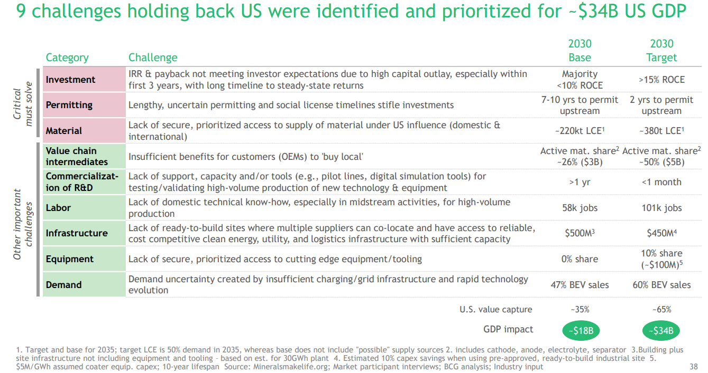
Barriers Remain for New Battery Technologies and Companies
Source: Li-Bridge: Bridge the Lithium Battery Supply Chain Gap. Boston Consulting Group. https://cdn.ymaws.com/ny-best.org/resource/resmgr/reports/2022-08-15_li-bridge_compend.pdf

Slide 11

Advanced Battery Bankability Accelerator (ABBA) Concept
CEC plans to issue a competitive solicitation in Q1, 2023
Will select one applicant to implement and operate ABBA.
Estimated CEC funding amount: $30-50 million
  $10-15 million immediately available.
  Significant cost share will be required
Partnerships are strongly encouraged.

Slide 12
ABBA Concept
Purpose: To accelerate the scale-up and industry acceptance of next-generation battery technologies.
Recruit battery customers/stakeholders to participate and communicate their specific technical and cost requirements
De-risk new technologies through independent benchmarking, analysis, and testing
Provide workforce training development and training opportunities for battery manufacturing
Establish a testbed environment with standard test protocols for battery technology companies
Establish pilot production environment(s) to demonstrate manufacturability

Slide 13
Battery NY – Li-Bridge presentations
Per Stromhaug
John Cerveny
Battery NY – Li-Bridge

Slide 14
Panel Discussion: Perspectives from Battery Technology Companies
Speakers:
Michelle Browne, Business Development Manager – Sparkz
Jonathan Tan, CEO Coreshell Technologies
Michael Burz, CEO – Enzinc
Virginia Klausmeier, CEO – Sylvatex Inc.

Slide 15
Stakeholder Questions
What should be the top-priorities for the bankability center (and why)?
What other activities could the Center undertake that would accelerate adoption and scale-up of new battery storage technologies?
How do we ensure access for start-up companies to the Center’s service and facilities?
  Should the solicitation require multiple locations? i.e. minimum one Northern and one Southern California location?
  What requirements should be put in place to ensure start-up companies can access the facilities and services?
What should be the minimum cost share requirement (i.e. 50% of CEC funds requested)?

Slide 16
Questions and Answers
Two ways to ask questions:
Use the raise hand feature in Zoom:
  Zoom phone controls:
    *6 – Toggle mute/unmute
    *9 – Raise hand
  Introduce yourself by stating your name and affiliation
  Keep questions under 3 minutes to allow time for others
2. Type questions in the Q&A Box in Zoom:
Please provide name and affiliation.

Slide 17
Q&A Comments
Please submit written comments to Research Idea Exchange Docket No. 19-ERDD-01
  https://efiling.energy.ca.gov/Lists/DocketLog.aspx?docketnumber=19-ERDD-01
Written comments are due by November 4, 2022

