Slide 1
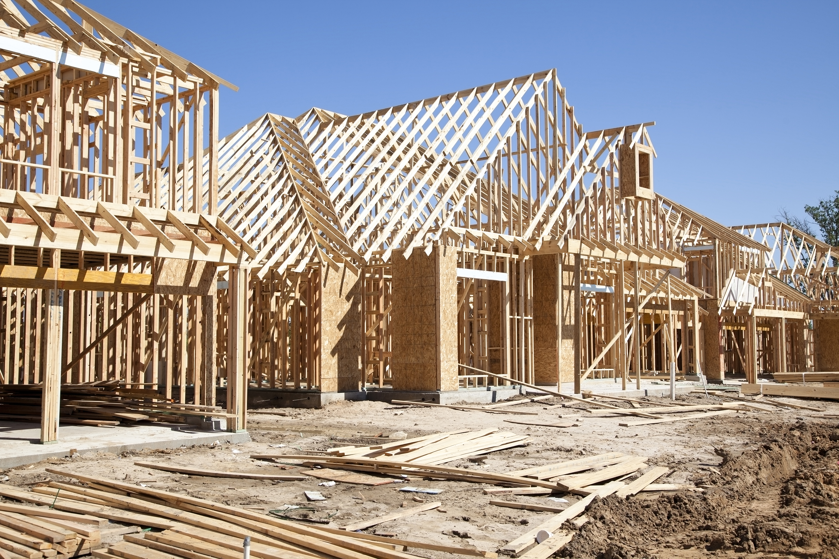
Staff Workshop (AB 137)
California Electric Homes Program (CalEHP)
(named in statutes as the Building Initiative for Low-Emissions Development Phase 2)
March 17, 2022 | 10:00 a.m.

Slide 2
Virtual Housekeeping
Webinar conducted remotely via Zoom and is being recorded
Program Webpage:
  https://www.energy.ca.gov/programs-and-topics/programs/california-electric-homes-program-calehp
Virtual Participation through Zoom
  Raise Hand or Q&A feature
  Telephone participants dial *9 to raise your hand
Written Comments to Docket # 21-DECARB-01:
  https://efiling.energy.ca.gov/Ecomment/Ecomment.aspx?docketnumber=21-DECARB-01
  Deadline: Thursday, March 31, 2022, by 5:00 P.M.
2

Slide 3

Welcome!
Commissioner J. Andrew McAllister, Ph.D.
3

Slide 4
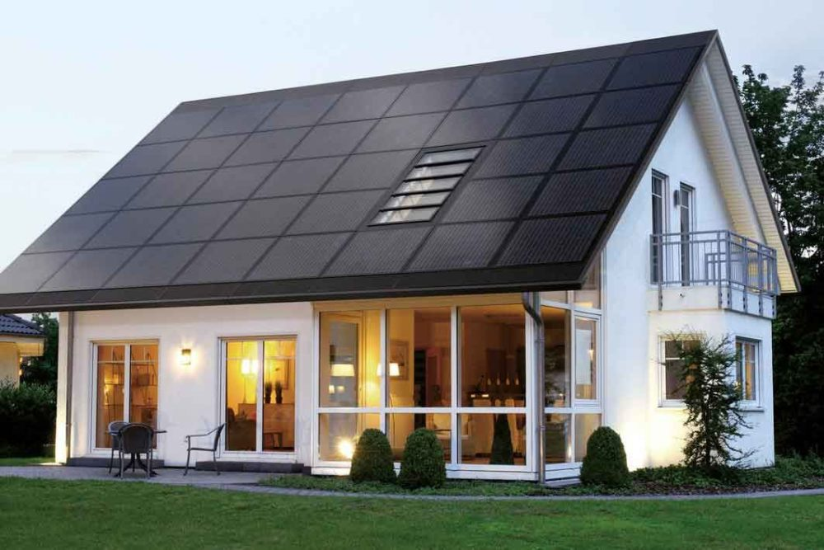
CA Electric Homes Program:
Workshop Goals
Outline California Energy Commission’s (CEC) approach on Program's third-Party Administration
Solicit Input on:
  Guiding Principles for Program Design
  Solicitation Requirements and Specific Design Elements
  Potential Market Transformation Initiatives
    Technical Assistance
    Building Recognition Concept
4

Slide 5

Workshop Agenda
Welcome
Program Background
Draft Proposed Guiding Principles
Third-Party Administrator Requirements &
Potential Program Design Requirements
All-Electric Building Recognition Concept
Public Comment
Next Steps
Adjourn
5

Slide 6
Background
California Electric Homes Program (CalEHP)

Slide 7
Program Background: What is CalEHP?
Market transformation program to increase the building of all-electric homes, as well as the installation of residential energy storage
Statewide
Targets buildings that exceed local and state building energy code
Will be implemented through a competitively selected third-party administrator
Legislation:
Assembly Bill 137 (Ting, Chapter 77, Section 17, Statutes 2021)
Building Initiative for Low-Emissions Development Phase 2
Public Resources Code Section 25403.2

Slide 8
Program Budget
Program Activity | Budget
Incentives | $58,125,000
Administration | $16,875,000
3rd Party Administrator | Up To $7,500,000 (no more than 10% of program fund)
Other: in-house administration; potential for technical assistance, builder recognition conceept, additional incentive funding | $9,375,000
TOTAL | $75,000,000

Slide 9
Proposed Program Development Timeline
Milestone | Date*
Adopt Guiding Principles at a CEC Business Meeting | May 2022
Grant Funding Opportunity (GFO)/Solicitation posted | June 2022
GFO pre-application workshop | June/July 2022
GFO application Deadline | July 2022
Select 3rd Party Administrator and Post Notice Of Proposed Award (NOPA) | August 2022
Finalize Contract Details with 3rd Party Administrator | October 2022*
*Anticipated dates, subject to change.

Slide 10
Program’s Design Structure
Program Requirements established in the Contract Solicitation by the CEC
CEC Guiding Principles
Statute
Proposed Design of Selected Third-Party Implementer

Slide 11
Draft Proposed Guiding Principles

Slide 12

Guiding Principles for the Development of CalEHP
The guiding principles will be adopted by the CEC and provide the framework for the proposed program design, designed by the selected third-party administrator
Market Transformation Building Greenhouse Gas (GHG) Reduction Energy Equity and Disadvantaged Communities Grid Resiliency Program Eligibility
Speed, Program Simplicity, and Quality Outreach & Public Engagement Fiscal Responsibility Incentive Layering Program Reporting

Slide 13

Guiding Principles
Market Transformation
The program goal is to accelerate significant market adoption of new all-electric residential buildings and installation of residential energy storage systems
Building GHG Reduction
The program will help California reach its 2030 GHG reduction goals through building new all-electric homes
Energy Equity and Disadvantaged Communities
Commitment to improving the environment and economically advancing at-risk communities and righting the wrongs of the disproportionate environmental effects of pollution in Californian communities
Grid Resiliency
Energy-storage only incentives should target geographical areas of heat islands and high or very high fire hazard severity zones, and residential community buildings and senior homes to further strengthen the state’s resiliency

Slide 14
Guiding Principles, continued
Program eligibility
Incentives are available for new market-rate all-electric residential buildings and/or energy storage developments across the state
Buildings must exceed state and local building code requirements
  Projects that qualify for BUILD (low-income program) are not eligible for CalEHP
Speed, Program Simplicity, and Quality
  The CEC’s ambitious environmental goals require near-term implementation and long-term results
Outreach and Public Engagement
  The program design and stakeholder feedback should incorporate best practices for stakeholder engagement and ensure adequate information sharing and collaboration

Slide 15
Guiding Principles, continued
Fiscal responsibility
Potential third-party administrators should consider cost efficiencies, ensuring appropriate use of the funds, and leveraging efforts to streamline program administration
Incentive Layering
It is reasonable to allow for incentive layering to accelerate market adoption
Incentives can be leveraged but cannot exceed the cost to the builder
Program reporting
The third-party administrator will readily make available, to both the public and the CEC, program development and implementation data

Slide 16

Feedback on Guiding Principles
Questions for the CEC?
Questions for stakeholders:
  Are there additional policy priorities or requirements that the CEC should consider?
Limited to 3 minutes per comment
Zoom Participants
Use the “raise hand” feature to make verbal comments or Q&A feature
Telephone Participants:
Dial *9 to raise your hand
Dial *6 to mute/unmute your phone line
16

Slide 17
Third-Party Administrator Requirements
Potential Program Design Requirements

Slide 18
Requirements for Third-Party Administrator
At least five years of experience successfully implementing energy or efficiency incentive and rebates programs in California, with IOUs, POUs, or other governmental agencies
  Including the ability to hold and disburse incentive funds
Expertise in outreach and stakeholder engagement
Technical expertise in near-zero emission technologies and all-electric building and development in California
Required to be registered and be in good standing with the California Secretary of State, https://www.sos.ca.gov, to enter into an agreement with the CEC
Administrator cannot be a recipient of these incentive funds
18

Slide 19

Role of the Third-Party Administrator
Develop program consistent with
  Statute
  Guiding principles
  Grant Funding Opportunity (GFO) requirements
Develop mechanism for stakeholder engagement and public input, including technical advisory group
Implement incentive program
Provide technical assistance to eligible applicants
Collect and report program data
19

Slide 20

Feedback on Third-Party Administrator Role
Questions for CEC?
Questions for stakeholders:
Does the role structure presented pose any unanticipated challenges for a third party?
Limited to 3 minutes per comment
Zoom Participants
Use the “raise hand” feature to make verbal comments or Q&A feature
Telephone Participants:
Dial *9 to raise your hand
Dial *6 to mute/unmute your phone line
20

Slide 21
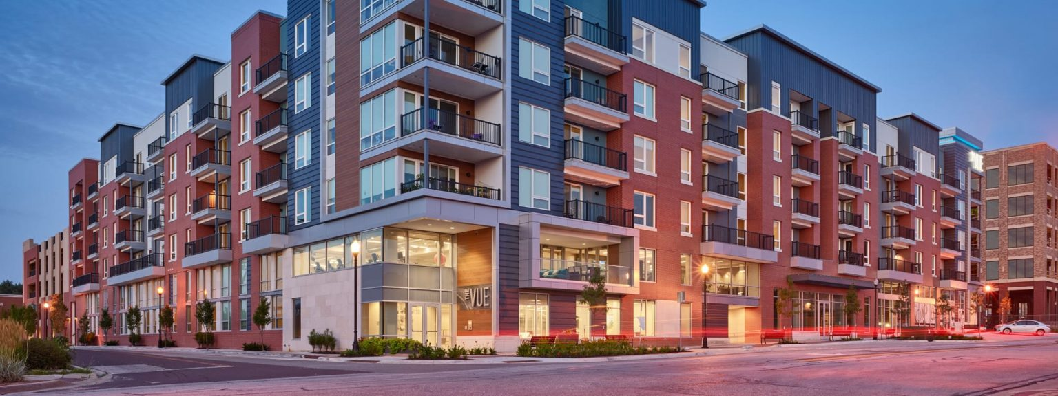
Potential Program Design Requirements
Targeting energy storage-only projects:
  Allocate 5% of total incentive funding
  Limit to new all-electric housing in local jurisdictions with reach codes?
Establish per-applicant/developer cap
Specific funding amount or structure, for example:
  Flat rate vs. sliding scale with increased efficiency
  Equipment specific kickers
  Specific geographical areas, DACs
  What are appropriate amounts and structures for the incentive?
21

Slide 22

Potential Program Design Requirements, continued
Develop and conduct outreach and advertisement plans
Perform data collection and reporting
Design technical assistance program for builders
What type of technical assistance does the market need to accelerate adoption?
How much of the funding should be allocated to technical assistance?
  What elements of the program design should the CEC establish in the contractor solicitation?
    What is best left for a third-party implementer?
22

Slide 23
Public Comments/Discussion Period
Limited to 3 minutes per comment
Zoom Participants
Use the “raise hand” feature to make verbal comments
or Q&A feature
Telephone Participants:
Dial *9 to raise your hand
Dial *6 to mute/unmute your phone line
23

Slide 24
All-Electric Building Recognition Concept

Slide 25
All-Electric Market Assistance
Direct Financial Incentives
Lower cost or increase profitability for decarbonized buildings
Technical Assistance
Help builders and designers with technical aspects of building decarbonization
Building Recognition Program
Help increase sales and value of decarbonized buildings through endorsement.

Slide 26
Building and Builder Recognition Concept
Scope
Narrow Scope
CalEHP Projects
Broad Scope
BUILD Projects
New Residential All-Electric Construction (not incented)
Out of Scope
All-Electric Commercial Buildings
All-Electric Existing Buildings

Slide 27
Key Components
Specification that defines the design criteria for a recognized building.
A method for demonstrating that a building meets the criteria
Compelling branding with rules for replication and placement on materials or buildings.
Communication and marketing materials conveying health, environmental, and economic advantages of participating buildings.

Slide 28




Examples of Similar Efforts

Slide 29

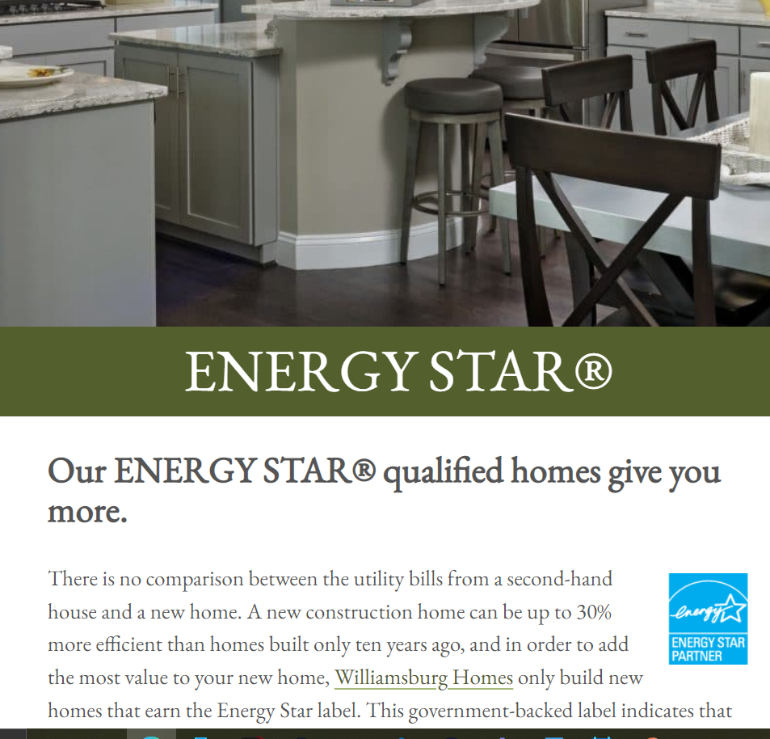
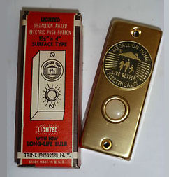

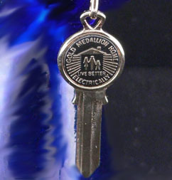
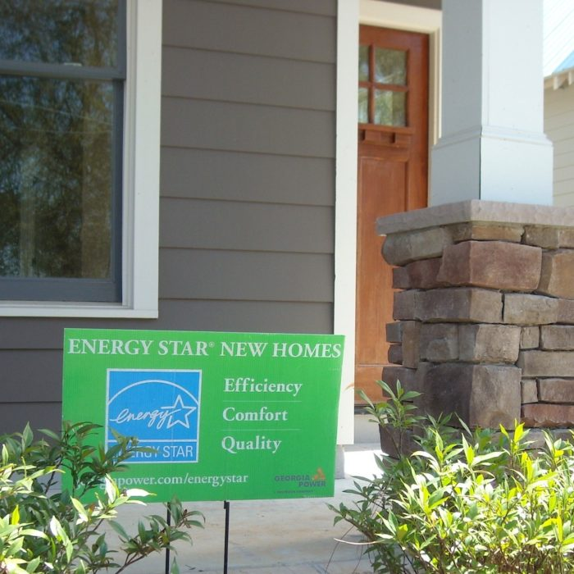
Potential Assets
Brochures
Web Materials
Physical Assets

Slide 30
Conceptual Steps for Development
Focus groups and market research to identify key values
Design marketing and education materials
Application process developed

Slide 31
Feedback on Award Concept
Questions for CEC?
Questions for Stakeholders:
How can the Energy Commission best support the sales of new all-electric residential buildings that align with California’s climate goals?
What research into marketing all-electric and low emission buildings already exists?
Which types of marketing assets are most useful (i.e., brochures, physical plaques, websites, etc.)?
Zoom Participants
Use the “raise hand” feature to make verbal comments or Q&A feature
Telephone Participants:
Dial *9 to raise your hand
Dial *6 to mute/unmute your phone line
31

Slide 32

Public Comments/Discussion Period
Limited to 3 minutes per comment
Zoom Participants
Use the “raise hand” feature to make verbal comments
or Q&A feature
Telephone Participants:
Dial *9 to raise your hand
Dial *6 to mute/unmute your phone line
32

Slide 33
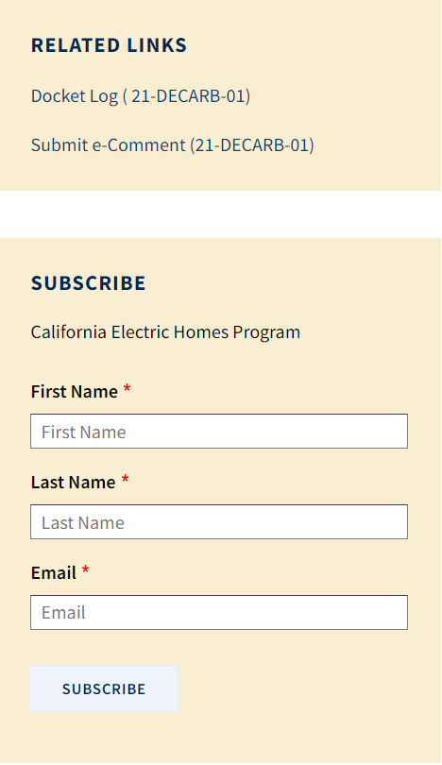
Contact Information
Email:
CalEHP@energy.ca.gov
Docket for Public Comment:
https://efiling.energy.ca.gov/Ecomment/Ecomment.aspx?docketnumber=21-DECARB-01
Webpage:
https://www.energy.ca.gov/programs-and-topics/programs/california-electric-homes-program-calehp
Don’t forget to…
Subscribe to the list server to receive CalEHP Program updates.
33

Slide 34
Solicitation/GFO - Proposed Timeline
Next Steps!
Activity | Date
Workshop comment period ends | March 31, 2022, 5 p.m.
Solicitation release | June 2022*
Pre-application workshop | June 2022*
* Anticipated dates. Subject to change.
To sign up for the CalEHP listserv, visit:
https://ww2.energy.ca.gov/listservers/index_cms.html

Slide 35
Submit Comments to Docket 21-DECARB-01
Electronic Commenting System
Visit the comment page for this docket at:
https://efiling.energy.ca.gov/Ecomment/Ecomment.aspx?docketnumber=21-DECARB-01
Comment by E-mail
E-mail: docket@energy.ca.gov
Subject Line: “21-DECARB-01 March Workshop”
  All comments due by Thursday, March 31, 2022, by 5:00pm
35

Slide 36
Thank you for participating.

