Slide 1
Forecast of Medium and Heavy Duty Vehicle Fleet
Transportation Energy Demand Forecasts
Rosenfeld Hearing Room
November 24, 2015
Bob McBride
Demand Analysis Office
Energy Assessments Division
Bob.McBride@energy.ca.gov / 916-654-5009

Slide 2
To Cover Today
Adoption based on Argonne Truck 5 Model
Market penetration insights
Fleets from 2013 to 2026

Slide 3
Medium & Heavy Trucks & Buses in 2013
 | Class 3: 10,000 to 14000 pounds | Class 3-8 Motor homes | Class 4-6: 14,001 to 26,000 lb. | Class 7: 26,001 to 32,000 pounds | Class 8: Over 32,000 pounds
Diesel | 116,635 | 32,498 | 190,937 | 65,209 | 199,462
Hybrid Diesel | 0 | 0 | 0 | 0 | 95
Electric | 52 | 2 | 982 | 3 | 79
Flex Ethanol | 8,326 | 441 | 353 | 0 | 0
Gasoline | 80,579 | 133,087 | 76,823 | 3,994 | 9,871
Natural Gas | 180 | 8 | 2,351 | 751 | 11,492
Propane | 185 | 7 | 760 | 133 | 539

Slide 4
Four Demand Cases
Demand Cases |  | Input Scenario Assumptions
 |  | Econ Demo | Fuel Prices |  | MDV and HDV |  | Policy Goal Achieved
 |  |  | Liquid Fuels | NG, Electric | DSL/NG Vehicle Price | NG Adoption Rate
Common Demand Cases | High Energy Demand | H | L | L | L/L | H | Phase 1 Truck Fuel Economy
 | Low Energy Demand | L | H | H | H/H | L | Phase 2 Truck Fuel Economy
 | Mid Energy Demand | M | M | M | M/M | M | Phase 1 Truck Fuel Economy
High Alternative Fuel Demand |  | H | H | L | H/L | H | Phase 2 Truck Fuel Economy
Phase 1 and 2 refer to EPA/NHTSA Truck Fuel Efficiency and GHG Standards. Phase 2 is in rulemaking.

Slide 5
Forecast of Alternative Fuel Buses

Slide 6
Medium/Heavy Truck Stock, 2013
 | diesel | electric | flex ethanol | gasoline | natural gas | propane
Class 3 | 111,992 | 47 | 7,055 | 72,027 | 66 | 98
Class 3 to 8 Motorhomes | 32,494 | 2 | 441 | 133,068 | 8 | 7
Class 4 to 6 | 164,573 | 414 | 69 | 57,162 | 544 | 242
Class 7 | 56,484 | 0 | 0 | 3,314 | 149 | 111
Class 8 | 42,334 | 2 | 0 | 7,248 | 658 | 11
Class 8 California Tractor Trailer Day Cab | 135,859 | 5 | 0 | 1,276 | 1,474 | 2
Class 8 Refuse & Recycle | 8,946 | 5 | 0 | 516 | 2,938 | 4
Class 8 Interstate Tractor Trailer Sleeper Cab | 75,163 | 0 | 0 | 0 | 0 | 0

Slide 7
Observations from Argonne Truck 5 Model Results
High annual miles and larger vehicles favor natural gas
  Long haul trucks, especially interstate
Frequent stops favor certain technologies
  Battery electric trucks
  Diesel-electric Hybrid
  Start-stop technology for conventional fuels
Low annual miles and low fuel prices favor conventional fuels, even gasoline over diesel
E85 medium duty truck emerges after 2020 for medium duty

Slide 8
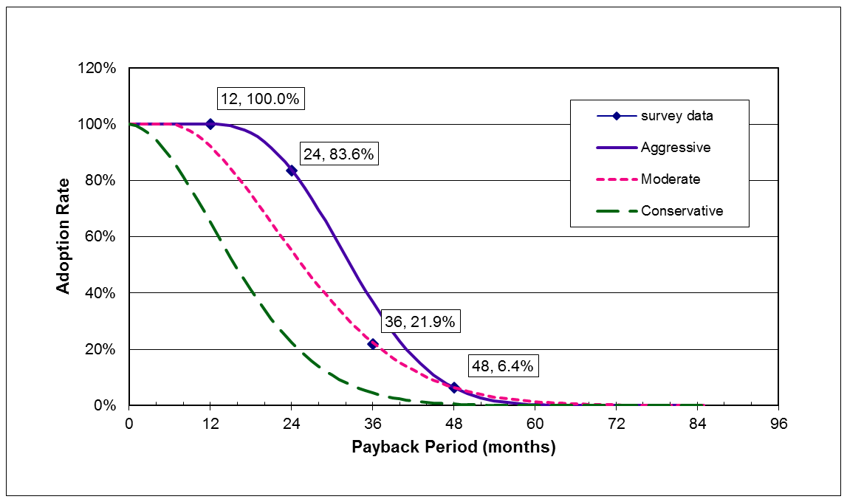
Argonne Truck Model Alternative to Baseline Technology Adoption Rate
For this DAO forecast the “Aggressive” curve was used in all Truck Model runs.
Source: National Petroleum Council, 2012. Baseline is gasoline for class 3-6, diesel otherwise.

Slide 9
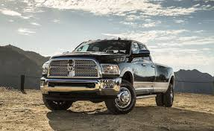
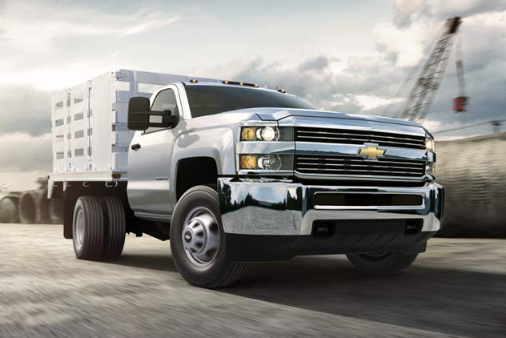
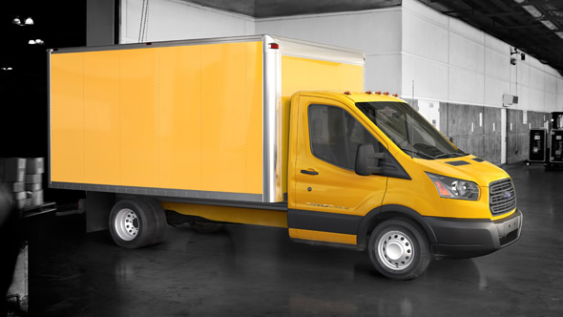
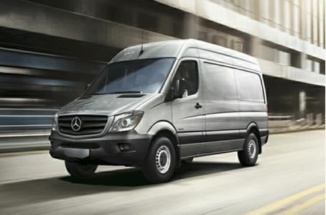
Class 3: 10,000 to 14,000 pounds loaded

Slide 10
Fuel Economy Class 3 (MPGGE)
Source: Sierra Research and Energy Commission staff analysis., 2015

Slide 11
E85 and Gasoline Truck Percentage of Class 3 Fleet

Slide 12
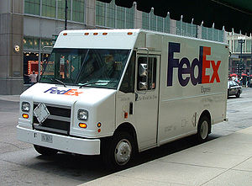
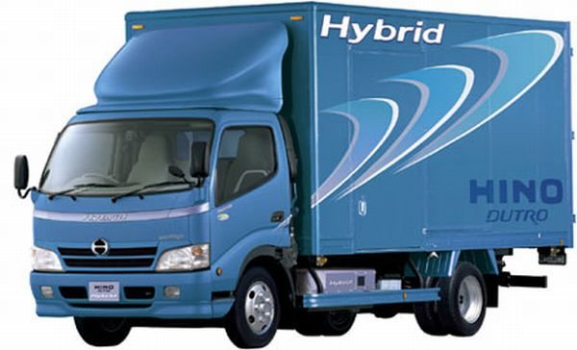
Class 4 to 6

Slide 13
Fuel Economy Class 4 to 6 (MPGGE)
Source: Sierra Research and Energy Commission staff analysis., 2015

Slide 14
Fuel Economy Class 4 to 6 Gasoline & Electric
Source: Sierra Research and Energy Commission staff analysis., 2015

Slide 15
Diesel-electric Hybrid Percentage of Class 4 to 6 Fleet

Slide 16
Forecast of Class 3 to 6 Trucks (1 of 3)
High refers to the High Demand Case, Mid to the Mid Demand, and Low to the Low Demand Case.

Slide 17
Forecast of Class 3 to 6 Trucks (2 of 3)
High refers to the High Demand Case, Mid to the Mid Demand, and Low to the Low Demand Case.

Slide 18
Forecast of Class 3 to 6 Trucks (3 of 3)
High refers to the High Demand Case, Mid to the Mid Demand, and Low to the Low Demand Case.

Slide 19
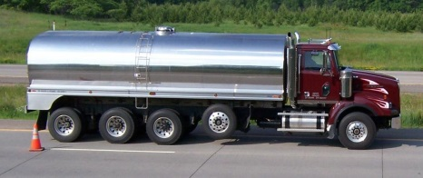
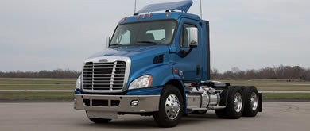
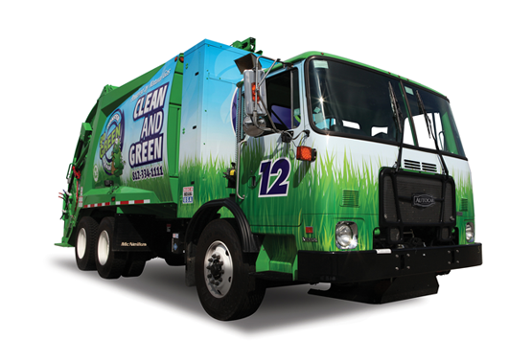
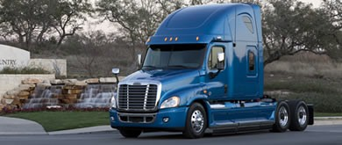
Trucks Over 26,000 pounds

Slide 20
Fuel Economy, Class 8 Interstate Tractor Trailer (MPDGE)
Source: Sierra Research and Energy Commission staff analysis., 2015.

Slide 21
Market Adoption given Incremental Price of LNG Interstate Tractor-trailers
High AFV refers to the High AFV Demand Case, High refers to the High Demand Case, Mid to the Mid Demand, and Low to the Low Demand Case. In classes 7 and 8, incremental price is the vehicle prices of NG minus diesel trucks.

Slide 22
Market Adoption of LNG Interstate Tractor trailers given Fuel Price
High AFV refers to the High AFV Demand Case, High refers to the High Demand Case, Mid to the Mid Demand, and Low to the Low Demand Case.

Slide 23
Fuel Economy, Class 8 Refuse/Recycling Truck (MPDGE)
HIGH refers to the High Demand Case, REF to the Mid Demand Case, and Low to the Low Demand Case.

Slide 24
Natural Gas Refuse Truck Adoption as Percentage
High AFV refers to the High AFV Demand Case, High refers to the High Demand Case, Mid to the Mid Demand, and Low to the Low Demand Case.

Slide 25
Natural Gas Class 7 & 8 Trucks

Slide 26
Diesel Class 7 & 8 Trucks
High AFV refers to the High AFV Demand Case, High refers to the High Demand Case, Mid to the Mid Demand, and Low to the Low Demand Case.

Slide 27
Questions? Comments?
Bob McBride
Demand Analysis Office
Energy Assessments Division
Bob.McBride@energy.ca.gov / 916-654-5009
Notes:
Phone number…

