Slide 1
Transportation Energy Demand Forecast
IEPR Workshop on the Revised Transportation Energy Demand Forecasts
Rosenfeld Hearing Room
November 24, 2015
Aniss Bahreinian
Demand Analysis Office
Energy Assessments Division

Slide 2
National Gasoline Prices vs. California New LDV Sales-Weighted Average Fuel Economy

Slide 3
On-Road Gasoline Demand

Slide 4
On-Road Diesel Demand Forecast

Slide 5
E85 Demand Forecast

Slide 6
Transportation Electricity Demand Forecast

Slide 7
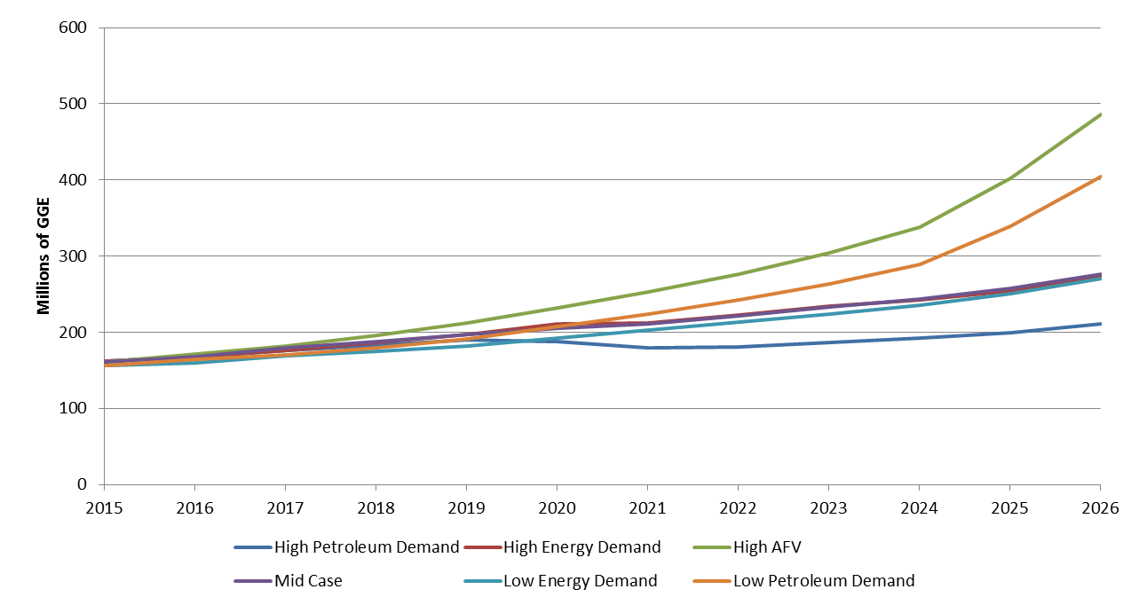
Transportation Natural Gas Demand Forecast

Slide 8
Transportation Hydrogen Demand Forecast

Slide 9
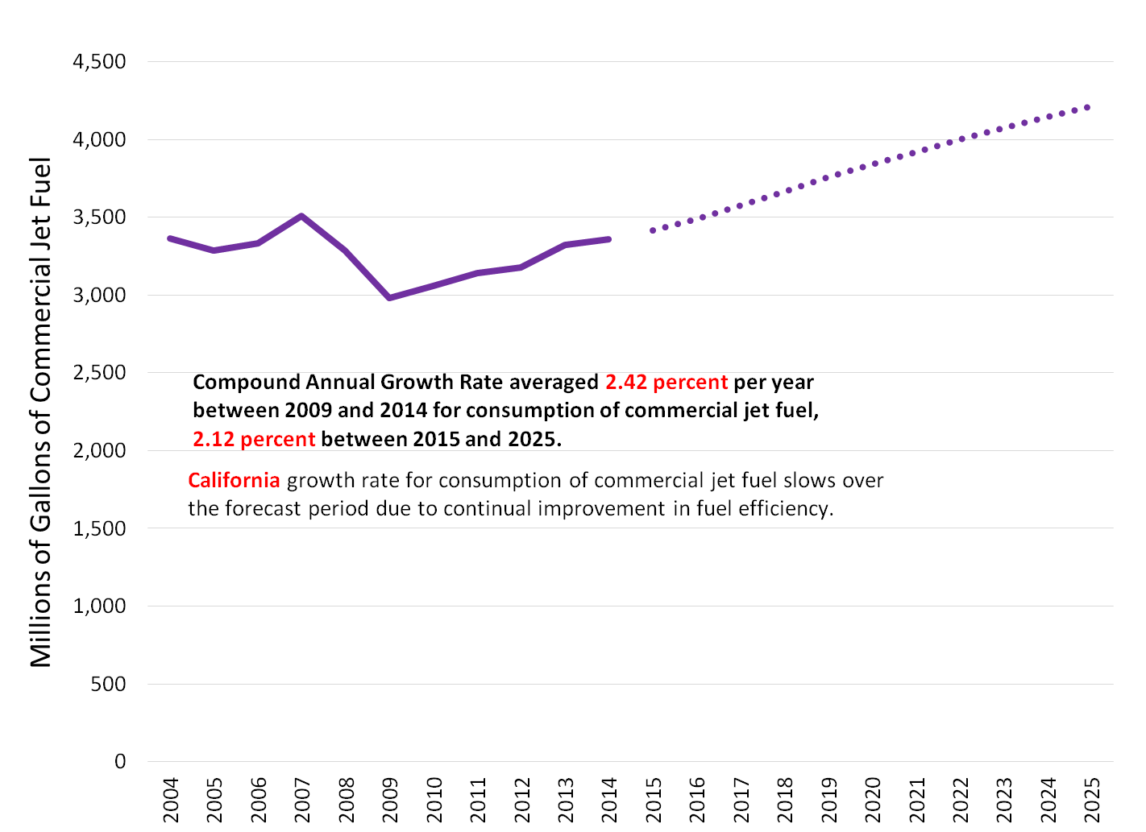
Commercial Jet Fuel Demand Forecast

Slide 10
Off-Road Diesel Demand Forecast

Slide 11
High Speed Rail Electricity Demand Forecast
Source: California High Speed Rail Authority

Slide 12
Questions? Comments?
Aniss Bahreinian
Demand Analysis Office
Energy Assessments Division
aniss.bahreinian@energy.ca.gov / 916-653-0381

