Slide 1

Pacific Gas & Electric Company
Gas Research, Development & Demonstration
2024/2025 Investment Plan
April 18, 2025

Slide 2
PG&E Gas RD&D Overview
Purpose: Seek your feedback on 2024 & 2025 Plans, our filing date is June 1
Since 2013 and with guidance from the California Public Utilities Commission, PG&E’s Gas RD&D team has supported hundreds of projects with technical resources, personnel, and funding.
These projects seek to develop technologies and processes to:
Enhance the safety, affordability, and reliability of the gas system
Reduce emissions
Understand how to adapt the gas system for the migration to cleaner fuels,
such as hydrogen
Increase the benefits of clean energy programs in disadvantaged communities
2025 Outreach Campaign Participants
California Energy Commission
Lawrence Livermore National Laboratory
Pipeline Research Council International
SoCalGas RD&D
University of California, Berkeley
University of California, Irvine
University of California, Los Angeles
University of California, Riverside
Our 2025 Plan Drivers
Each year, Gas RD&D staff prepare a research plan for approval by the CPUC.
The plan is influenced by CPUC policies and proceedings, such as its ESJ Action Plan, as well as various state and federal policies, including AB 32, SB 1383, and AB 617.
A key part of plan development is gathering stakeholder input.
      Annual Workshop
      Meetings with IOUs and other R&D groups
      Annual outreach campaign
      DACAG

Slide 3
PG&E Gas RD&D Overview Cont.
THEME/INITIATIVE | 2024 BUDGET | 2025 BUDGET
Gas System Integrity Theme | $4,794,740 | $5,091,348
Geohazard Risk Management​
Compliance with New Regulations​
Storage Wells​
Revised Emission Calculation Methodologies​
Efficient Methane Leak Repair​
Advanced Methane Leak Detection​
Decarbonization Theme | $2,191,660 | $2,291,965
Impact of Hydrogen​
Energy Efficiency
Networked Geothermal
Integrating Cleaner Fuels​
Total | $6,986,400 | $7,383,313
Today's goal is to get feedback for the 2024/2025 plans and help us identify future considerations for our program. Two initial thoughts from the team:
How can we support and engage with individuals and community organizations?
What community priorities should we consider when choosing initiatives and where and how to deploy technologies?
Notes:
Today's goal is to get feedback for the 2024/2025 plans and help us identify future considerations for our program. Two initial thoughts from the team:
How can we support and engage with individuals and community organizations?
What community priorities should we consider when choosing initiatives and where and how to deploy technologies?

Slide 4
Theme 1: Gas System Integrity

Slide 5
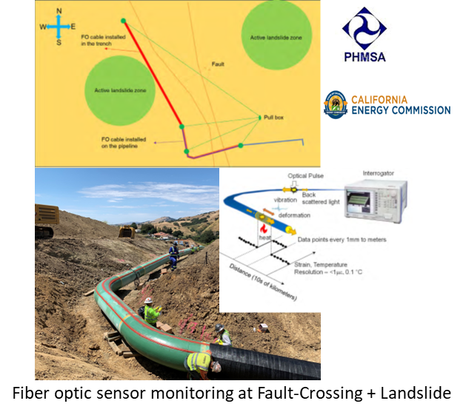
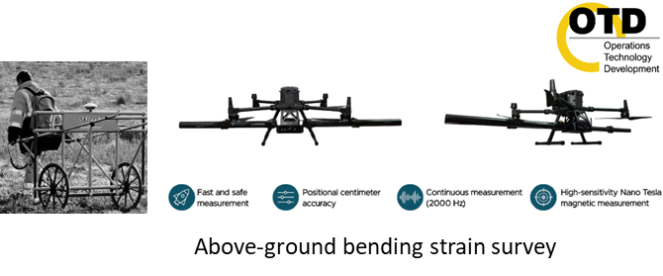
2024/2025 Initiative 1: Geohazard Risk Management
DACAG Priority Areas: Long-term Natural Gas, Community Engagement
Challenge
Industry cannot accurately understand, predict, and model changing risk levels of emerging geohazards, such as earthquakes, landslides, soil subsidence, flooding, and wildfires.
Assessments use costly inline inspection tools or even more costly digging to expose pipe.
Solution
Provide more capable inline inspection tools to increase visibility into the integrity of assets subject to increasing geohazard risks.
Develop more accurate modeling tools to use the better data.
Relevant DACAG Priorities
Prioritizes safety in communities located near aging infrastructure
Prevents service outages, evacuations, or infrastructure failure, which have greater impact on households with fewer resources
Enables more equitable investment
Supports more clear, transparent communication

Slide 6
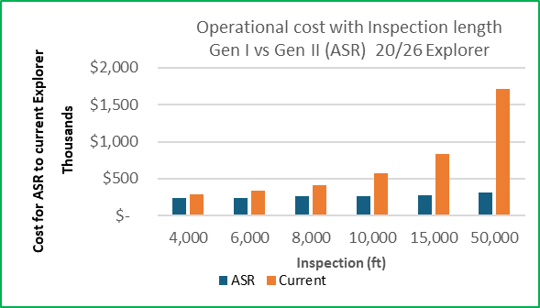
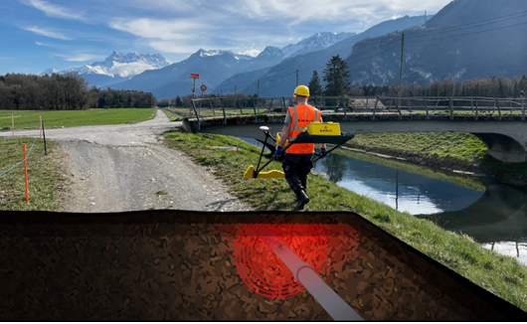
2024/2025 Initiative 2: Compliance with New Regulations
DACAG Priority Areas: Affordability, Long-term Natural Gas, Community Engagement
Challenge
Per the Federal Pipeline and Hazardous Materials Safety Administration (PHMSA) New Mega Rule requirements, PG&E needs to expand the scope of many existing inspection and monitoring processes and deploy entirely new processes across many of our assets. This drives O&M costs upward, decreasing energy affordability.
Solution
Maintain or improve gas system safety and reliability to meet compliance requirements.
Proactively reduce costs and improve affordability.
Relevant DACAG Priorities
Gen II Explorer Robot Inspection System for unpiggable pipeline live inspection
More capably and efficiently comply to the new regulations and enhance the resulted safety, reliability and affordability benefits at ESJ Communities.
Reduces environmental burden, which ESJ Communities are more likely to experience
Encourages community transparency and engagement
EMPIT's non-intrusive inspection/monitoring
of pipeline integrity

Slide 7
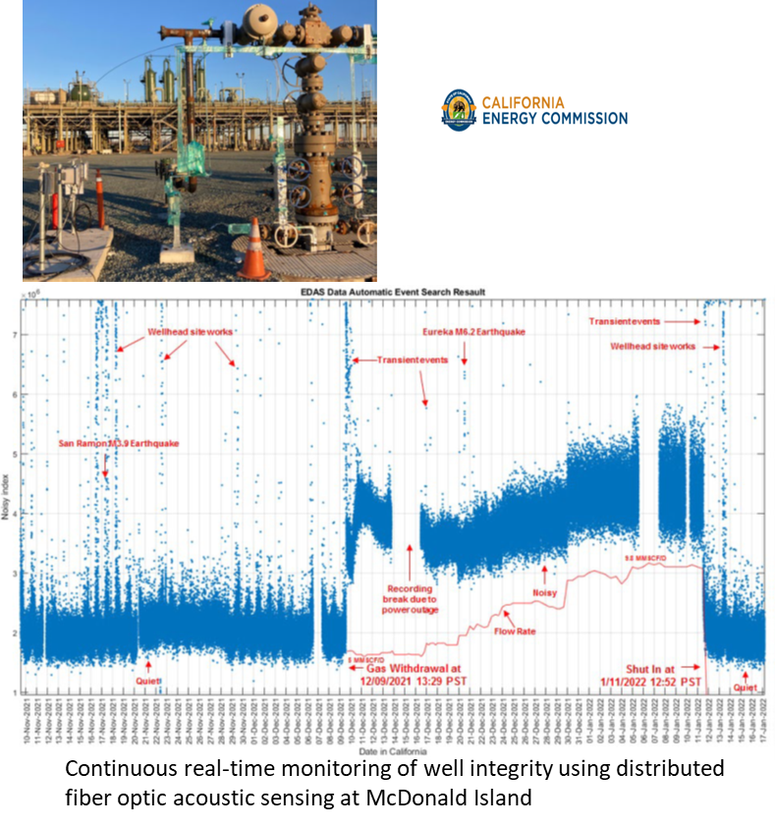
2024/2025 Initiative 3: Storage Wells
DACAG Priority Areas: Affordability, Long-term Natural Gas
Challenge
Per Geologic Energy Management Division (CalGEM) and Pipeline and Hazardous Materials Safety Administration (PHMSA) Regulations on underground storage well integrity inspection and testing, current practices rely on periodic high-resolution, in-line technologies that are intrusive and may cause damage or introduce additional risk from frequent rig intervention activities.
This can result in very costly inspections—up to $3 million per well for in-line methods.
Solution
Develop technoeconomic fiber optic sensor monitoring solutions focusing on AI/ML field data analytics and transmission.
Optimize O&M costs via continuous monitoring of well integrity.
Relevant DACAG Priorities
Prevent catastrophic failures in vulnerable areas such as ESJ Communities that are often located near legacy infrastructure
Reduce energy costs through operational efficiency

Slide 8
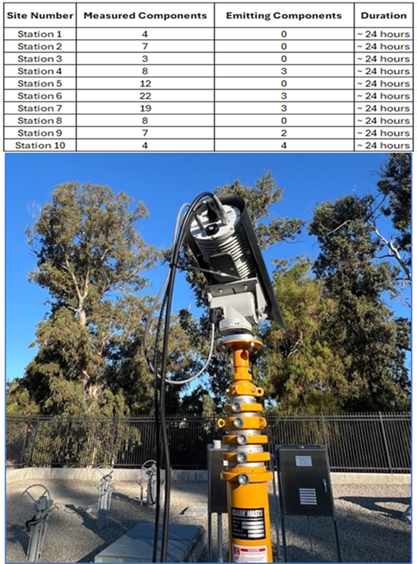
2024/2025 Initiative 4: Revised Emission Calculation Methodologies
DACAG Priority Areas: Gas System Decarbonization
Challenge
PG&E has made great progress in reducing emissions, but there are still limitations on reaching both internal and regulatory emission reduction goals.
Figures for Transmission Metering and Regulating station emissions are not based on actual recorded emissions but instead on station-level population-based emission factors.
While efficient, this approach doesn't provide accurate emissions estimates and does not allow PG&E to demonstrate emissions reduction efforts.
Solution
Gather essential data to facilitate adjustments in the emissions reporting framework.
Relevant DACAG Priorities
Better represent emissions in low-density or underserved communities
Enables better modeling of health impacts and cumulative pollution exposure

Slide 9
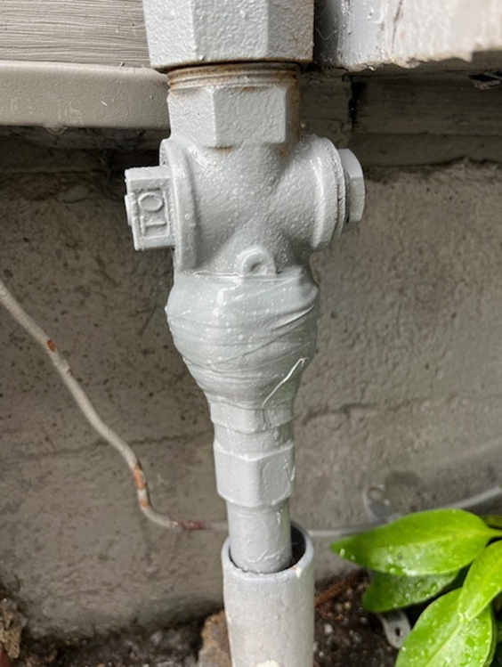
2024/2025 Initiative 5: Efficient Methane Leak Repair
DACAG Priority Areas: Affordability, Gas System Decarbonization
Challenge
The current meter set leak repair process is time-consuming and increases ergonomic exposure for workers completing the repairs.
Solution
Develop novel technologies that minimize repair times, reduce the need for follow-up service visits, and maintain a high-quality seal that can handle pressure at 60 psi.
Relevant DACAG Priorities
Improve air quality in residential areas, including low-income and frontline communities.
Reduce gas service interruptions, which disproportionately impact those in ESJ communities.
Faster repairs demonstrate accountability and responsiveness.
Safer, more sustainable jobs support long-term employment and reduce injury-related costs.

Slide 10
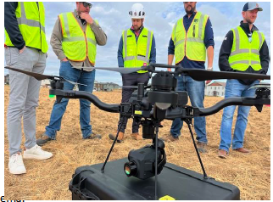
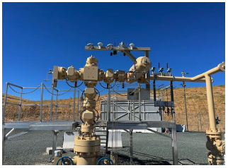
2024/2025 Initiative 6: Advanced Methane Leak Detection
DACAG Priority Areas: Affordability, Gas System Decarbonization, Long-term Natural Gas
Challenge
The industry evolves quickly and there are constantly new technologies on the market that can quicken leak detection and improve efficiency.
Solution
Continuously investigate new leak detection technologies as they enter the market, including mobile leak detection, aerial leak detection (drones, helicopters, fixed-wing aircraft, and satellite systems), as well as continuous monitoring options for facilities such as underground storage and station assets.
Relevant DACAG Priorities
Early leak detection allows for faster repairs, reducing the environmental impact and ensuring cleaner air for those communities most exposed to pollution.
Reduce overall operating costs, which often lead to lower rates for all customers, but especially benefit lower-income households that spend a larger share of their income on utilities.

Slide 11
Theme 2: Decarbonization

Slide 12
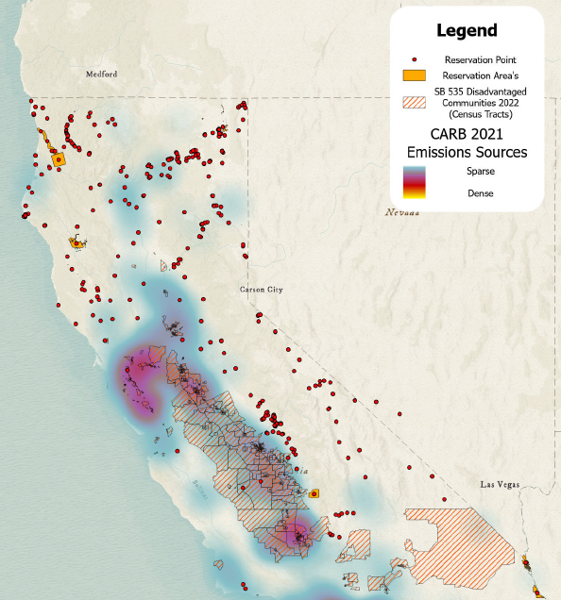
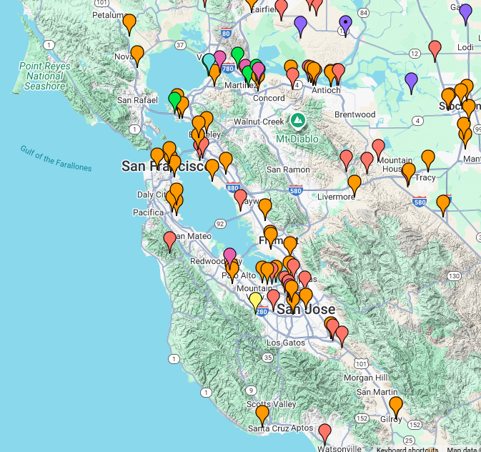
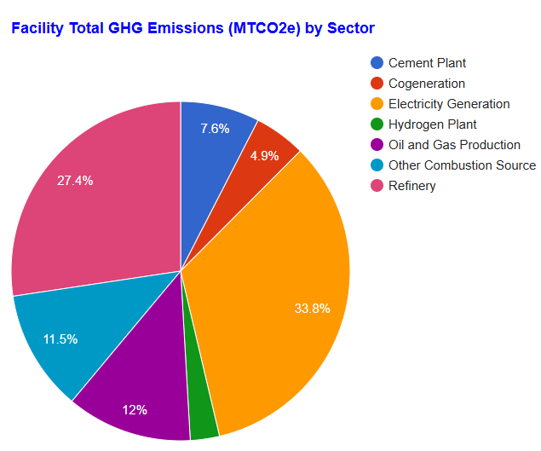
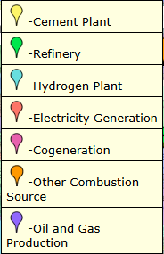
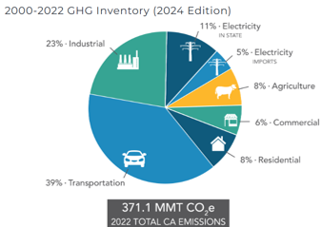
Decarbonization Background
DACAG Priority Areas: Affordability, Gas System Decarbonization, Long-term Planning
Sources:
SB_535_Disadvantaged_Communities_2022 (FeatureServer)
NAHC Digital Atlas
CARB’s pollution map
Source:
https://ww2.arb.ca.gov/ghg-inventory-data
Notes:
Initiative 3: Energy Efficiency
What barriers to energy efficiency programs do residents in your communities face most often?
What kinds of co-benefits (e.g., indoor air quality, comfort, bill savings) matter most to your communities?
How can we design RD&D pilots so that they directly inform future ESJ-focused efficiency programs?

Slide 13
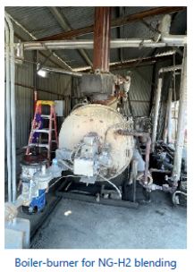
2024/2025 Initiative 1: Impact of Hydrogen
DACAG Priority Areas: Gas System Decarbonization, Long-term Natural Gas
Challenge
Hydrogen has different physical and chemical properties compared to natural gas, which can affect the integrity and safety of the infrastructure
Solution
To understand the impact of hydrogen utilization on the gas system, customer end uses, and appliances, it is essential to study and adapt existing infrastructure accordingly. Supporting the interaction between traditional energy resources and emerging fuels can achieve affordability by repurposing natural gas pipelines and avoiding additional electrical infrastructure costs
Relevant DACAG Priorities
This approach will reduce GHG emissions, benefiting ESJ communities, while providing training and education opportunities in hydrogen blending pipeline operations.
Additionally, enabling hard-to-electrify customers to access affordable energy solutions promotes the exploration of hydrogen and renewable energy sources.
Source: UTD 2.24.H Hydrogen-blending at Asphalt Plants – Field Tests

Slide 14
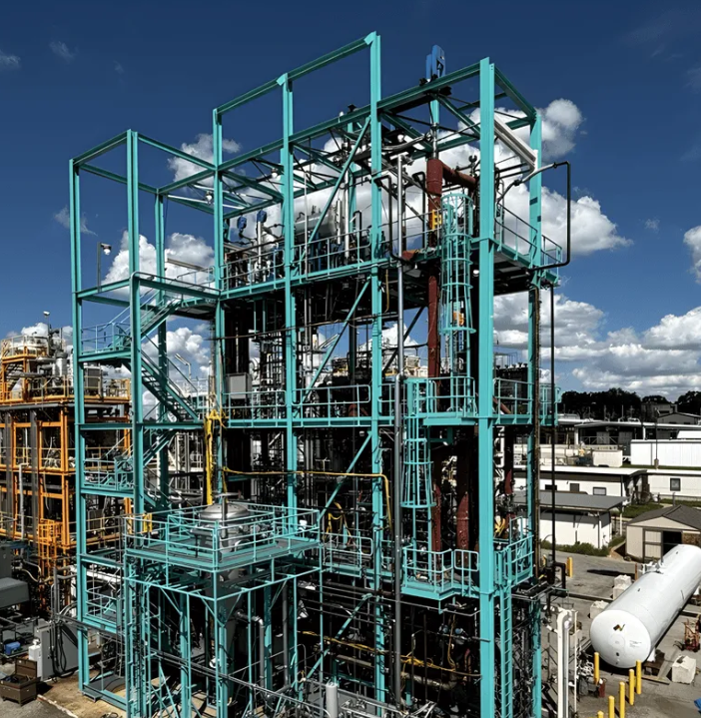
2024/2025 Initiative 2: Integrating Cleaner Fuels
DACAG Priority Areas: Gas System Decarbonization, Long-term Natural Gas
Challenge
Blending clean fuels with natural gas can affect overall gas quality and require modifications to measurement systems.
Solution
Integrating clean fuels like traditional and non-traditional RNG, renewable hydrogen, and synthetic methane involves supporting R&D and pilot projects to explore cost-effective interconnection, addressing feedstock limitations, ensuring compatibility with existing infrastructure and processes, and developing novel fuel production methods.
Relevant DACAG Priorities
Accelerate the transition to clean energy by supporting R&D and pilot projects that explore cost-effective interconnection and ensure compatibility with existing infrastructure
Create safer, more sustainable jobs in the green energy sector, supporting long-term employment
Reduce greenhouse gas emissions, benefiting disadvantaged communities and contributing to overall environmental justice goals
Source: Formerly C-zero, Graphitic Energy | Moving American energy forward

Slide 15
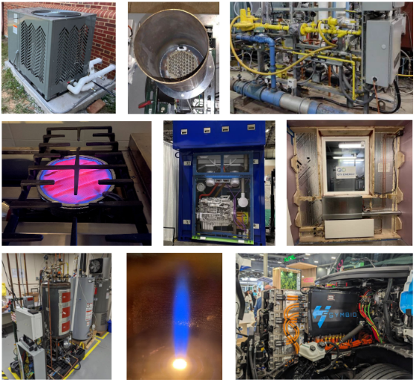
2024/2025 Initiative 3: Energy Efficiency
DACAG Priority Areas: Affordability, Gas System Decarbonization, Long-term Natural Gas
Challenge
California faces challenges in energy efficiency due to aging infrastructure, high energy demand, wildfire risks, regulatory hurdles, equity and accessibility issues, and the need for technological integration.
Solution
Implementing advanced energy systems with smart controls, energy storage, customer engagement, and financial incentives can significantly enhance energy efficiency for hard-to-electrify customers without the need for extensive electrical upgrades. These systems provide reliable and cost-effective heating with lower electrical demand, making them ideal for facilities with limited electrical capacity.
Relevant DACAG Priorities
Improve air quality in residential areas, including low-income and frontline communities, by reducing energy consumption and emissions from traditional energy sources
Reduce energy bills for low-income households through the adoption of energy-efficient technologies, improving affordability and financial stability
Source: UTD Research Project Summaries 2023-2024

Slide 16
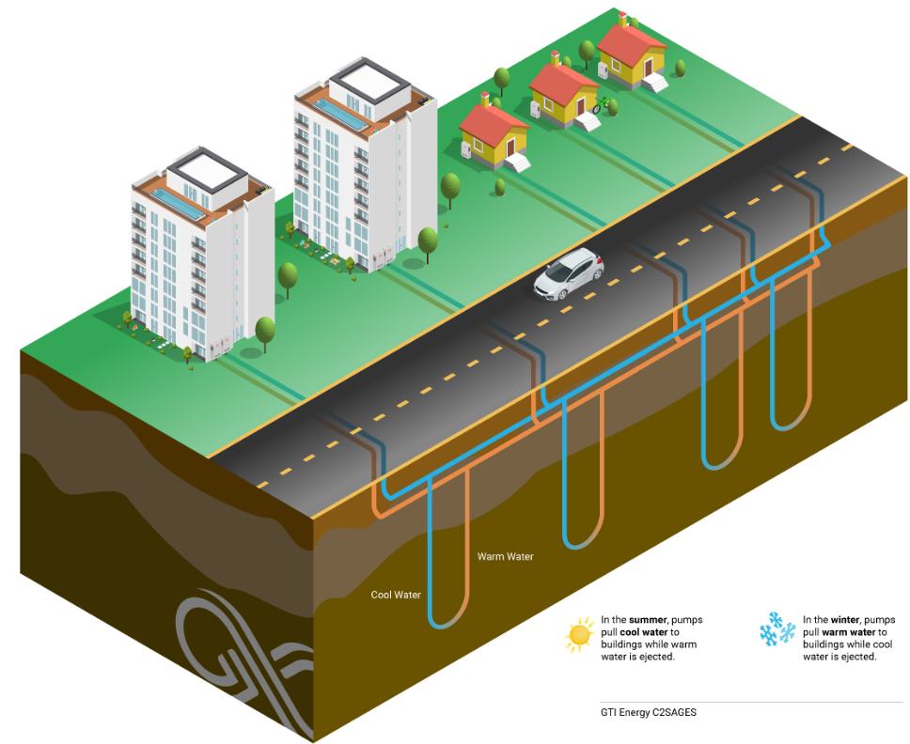
2024/2025 Initiative 4: Networked Geothermal
DACAG Priority Areas: Affordability, Gas System Decarbonization, Long-term Natural Gas
Challenge
Utilities face increasing pressure to transition to low-carbon solutions in response to building electrification mandates. As more buildings switch to electric heat pumps, gas utilities risk losing customers and facing stranded assets in gas infrastructure.
Solution
Leveraging stable underground temperatures for heating and cooling, networked geothermal systems offer a sustainable solution. Supporting R&D and pilot projects can explore cost-effective interconnection and deployment, addressing limitations in geothermal technologies and processes.
Relevant DACAG Priorities
Enhance energy reliability by implementing networked geothermal systems, which can reduce gas service interruptions that disproportionately impact ESJ communities
Reduce energy bills for low-income households through the adoption of geothermal technologies, improving affordability and financial stability
Source: C2SAGES • GTI Energy

Slide 17
Q&A

Slide 18
Thank you
Gas Research Development & Demonstration
Please email your feedback on 2024 & 2025 Plans to Innovation@pge.com by April 29 to meet our June 1 filing date.
For more information about our program, visit us at www.pge.com/innovation

