Slide 1
Overview of the SoCalGas 2024 & 2025 RD&D Research Plan
Presentation to the Disadvantaged Communities Advisory Group (DACAG)
April 18th, 2025

Slide 2


SoCalGas Research Development & Demonstration (RD&D) Overview
Purpose for Today’s Presentation: To seek feedback on SoCalGas 2024 and 2025 RD&D Research Plan (targeting submission to CPUC in June).
Potential Discussion Questions:
Do you have any specific suggestions on how we can enhance our community engagement efforts?
How might your communities be interested in receiving information about research and demonstration projects?
Any there any research gaps, problem statements of interest to ESJ communities that we should consider in our research plan?
What specific research areas would you recommend SoCalGas RD&D prioritize? Which ratepayer benefits would you like to see SoCalGas RD&D prioritize?
Can you think of any areas for RD&D to explore that may enhance customer experience?
Goal of SoCalGas RD&D: Fund research to develop, demonstrate and adopt new technologies that are aligned with state energy policy and benefit our ratepayers by:
  Improving energy affordability.
  Increasing safety and reliability.
  Improving local air quality.
  Reducing GHG emissions.
SoCalGas RD&D Budget: Funded by gas ratepayers, approved in SoCalGas 2024 General Rate Case (GRC).
  $17.9 million budget for 2024.
  $18.4 million budget for 2025.

Slide 3
Key Milestones for RD&D Research Plan Development
Q4 2024
Conducted technical stakeholder interviews for feedback*.
Received approval of budget from the California Public Utilities Commission (CPUC) via SoCalGas GRC (December 2024).
Q1 2025
Developed RD&D program structure.
Q2 2025
Gather feedback from DACAG (April 18).
Hold public workshop, including ESJ Advisory Board Panel (April 28).
Identified technology gaps and problem statements.
Gathered feedback from CPUC (March 27).
Submit Research Plan (June).
Conducted outreach to assemble an Environmental and Social Justice (ESJ) Advisory Panel.
*Interviews Conducted for
2024 & 2025 RD&D Research Plan
California Energy Commission
California Metals Corporation
GTI Energy (formerly Gas Technology Institute (GTI)
Lawrence Berkeley National Laboratory
Lawrence Livermore National Laboratory
National Renewable Energy Laboratory
NYSEARCH (Northeast Gas Association Research Committee)
Pacific Gas and Electric Company
Pipeline Research Council International
South Coast Air Quality Management District
Southwest Gas
U.S. Department of Energy

Slide 4
Budget for 2024 & 2025 RD&D Research Plan
GAS SYSTEM INTEGRITY THEME | 2024 BUDGET: $4,608,000 | 2025 BUDGET: $4,904,000
Environmental & Safety
Operations Technology
System Design & Materials
System Inspection & Monitoring
DECARBONIZATION THEME | 2024 BUDGET: $10,654,000 | 2025 BUDGET: $11,647,000
Low-Carbon Fuels Technologies
Gas & Energy Storage
Energy Reliability & Resilience
Building & Facility Systems
Low-Carbon Fuels Integration
4

Slide 5
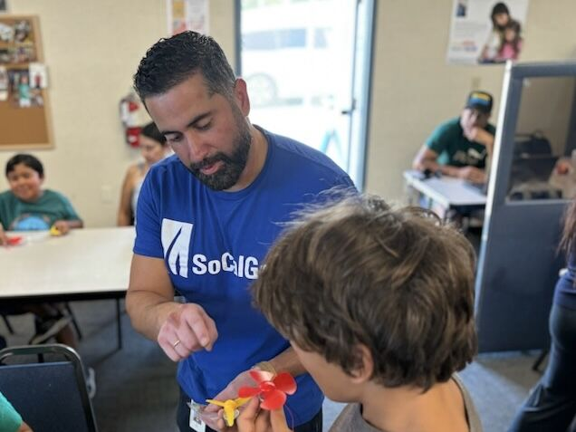


SoCalGas Community Engagement in 2024
SoCalGas Spent $1.08B with 608 Diverse Firms in 2024
SoCalGas RD&D Supported 41 Projects in ESJ Communities
SoCalGas RD&D, University of California at Irvine, and National Renewable Energy Laboratory team up for “Science Camp” at Oak View Library in Huntington Beach.
Boyle Heights High School’s First All-Girls Team Competes on International Stage at the Horizon Hydrogen Grand Prix World Finals.

Slide 6
Gas system integrity Theme
Initiatives:
System Design & Materials
System Inspection & Monitoring
Environmental & Safety
Operations Technology

Slide 7
System Design and Materials Initiative
Challenge: Modernizing an infrastructure developed over decades requires adaptability. We must adjust the design and materials to meet evolving ratepayer needs, accommodate new fuel sources, comply with changing regulations, and incorporate modern technology to enhance efficiency and reduce costs for ratepayers. This is important because:
Optimizing system design and material compatibility is critical in maintaining a safe infrastructure while reducing costs for ratepayers.
Validating material and equipment compatibility is essential to avoid system and equipment outages for maintenance and repairs.
Proposed Solutions:
Improve safety and air quality by exploring new sources of Renewable Natural Gas (RNG) and testing odorant compatibility to safely support renewable energy goals.
Improve affordability and reliability by:
  developing a Cathodic Protection (CP) System Design Tool to optimize CP Area remediation.
  increasing the accuracy of modeling for Underground Storage Well Casing Burst pressures to optimize remediation costs.
Improve affordability by gathering data on costs, customer interest, and other parameters to inform non-pipeline alternative frameworks.
Improve safety by evaluating two-way communication with customer meters to increase gas shut off response time for emergencies.
Alignment with DACAG Priorities:
(1) Affordability & Disconnections.
(2) Building, Industrial, Gas System Decarbonization, and Clean Renewable Hydrogen.
(5) Long-term Planning (SB 100, SB 350, IEPR, Offshore Wind, Lithium Valley Vision, Long-Term Natural Gas, Smart Grids and Broadband).

Slide 8
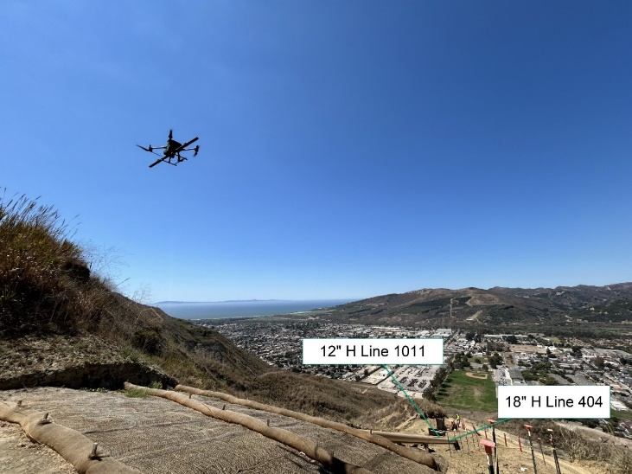
System Inspection and Monitoring Initiative
Challenge: Maintaining a vast infrastructure across diverse terrains and climates demands agile technologies. These technologies must efficiently assess the pipeline condition and provide real-time feedback to improve emergency response times and boost efficiency. This is important because:
Enhanced visibility of gas infrastructure through remote monitoring and high-resolution tools enables proactive threat management, preventing loss of containment and injuries.
Proactive threat detection and management reduces costs for ratepayers through planned maintenance and remediation.
Proposed Solution:
Improve safety and reliability by
  enhancing detection of cracks, hard spots, shielded coating, and long seam types with Inline Inspection Tools
  developing real time scouring monitoring to enhance response time during extreme weather events.
Improve affordability and operational efficiency by reducing costs for Optical Pipeline Monitoring allowing expansion of monitoring capabilities.
Improve safety and operational efficiency by conducting strain analysis in geohazard susceptible areas utilizing a drone-based platform.
Improve affordability and reliability by developing a range extender to reduce number of launching points for robotic Inline Inspection.
Alignment with DACAG Priorities:
(1) Affordability & Disconnections.
(4) Electricity Reliability, Resiliency, and Load Flexibility (Including Distribution and Transmission Grid Planning and Distributed Energy Resources).

Slide 9
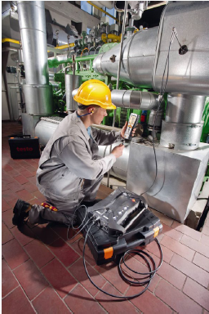
Environmental and Safety Initiative
Challenge: Minimize the environmental impact of the pipeline network while maintaining safe, reliable service at an affordable price. Technologies in this initiative focus on protecting the gas infrastructure and improving the efficiency of operations. This is important because:
Damage Prevention and technologies that safeguard the gas infrastructure prevent loss of containment, greenhouse gas (GHG) emissions and costly repairs.
Technologies that optimize gas operations equipment improve efficiency, reducing operating costs and improving air quality.
Proposed Solutions:
Improve safety, air quality and affordability by:
  exploring the use of ruggedized plastic pipe and/or barriers to prevent loss of containment from 3rd party damage.
  developing water jet cross bores that do not damage pipelines during sewer lateral inspections.
Improve safety and reliability by assessing technologies to pipeline strikes in real time utilizing Cathodic Protection systems
Improve affordability and air quality using predictive modeling for gas turbines to increase operating efficiencies of equipment.
Alignment with DACAG Priorities:
(1) Affordability & Disconnections.
(2) Building, Industrial, Gas System Decarbonization, and Clean Renewable Hydrogen.

Slide 10
Operations Technology Initiative
Challenge: Optimize Gas Operations activities by supporting the development of technologies and advancing techniques that improve the safety of the gas infrastructure, while boosting operational efficiency and reducing costs for ratepayers. This is important because:
Technologies that improve infrastructure locating reduce the risk of 3rd party damage and emergency pipeline shutdowns/repairs.
Technologies that improve construction practices and protect infrastructure extend the service life of gas assets and lower long-term costs for ratepayers.
Proposed Solutions:
Improve affordability and safety by enhancing the usability of acoustic, electromagnetic and ground-probing radar infrastructure imaging in diverse terrains/soil types.
Improve reliability and safety by:
  enhancing locating abilities of plastic pipe using radiofrequency identification (RFID) embedded tape/tag.
  enhancing conformance to manufacturer standards with in-situ data logging of plastic fusions
Improve safety by modernizing communication protocols (cyber security) for critical infrastructure pursuant to Resolution G-3601.
Improve affordability by validating the use of “no heat” wire attachment for installing Locating and Cathodic Protection wires.
Alignment with DACAG Priorities:
(1) Affordability & Disconnections.

Slide 11
Decarbonization theme
Initiatives:
Low-Carbon Fuel Technologies
Gas and Energy Storage
Energy Reliability & Resilience
Building & Facility Systems
Low-Carbon Fuel Integration

Slide 12
Low-Carbon Fuel Technologies Initiative
Challenge: Support the development and demonstration of technologies centered on the production of low-carbon fuels and increase the supply of affordable and reliable, low-carbon gas for ratepayers. This is important because:
Development of affordable low-carbon fuels can reduce the financial impact of the energy transition on all ratepayers.
Industrial processes to produce or refine fuels use heat from combustion of fossil sources, impacting local air quality. Replacing these technologies with advanced heating systems can reduce emissions at industrial centers.
Proposed Solutions:
Improve affordability and air quality by:
  evaluating potential areas for cost reduction in the RNG value chain, including interconnections.
  demonstrating the feasibility of a direct solar conversion of biogas into hydrogen and solid carbon.
Improve air quality by:
  developing and demonstrating RNG production technologies using organic or municipal waste, or woody biomass, integrated with engineered carbon management or removal strategies.
  demonstrating biogas upgrading via biomethanation.
Improve affordability, reliability and air quality by developing and demonstrating electrolyzer technology that can operate dynamically without loss in efficiency or durability.
Alignment with DACAG Priorities:
(1) Affordability & Disconnections.
(2) Building, Industrial, Gas System Decarbonization, and Clean Renewable Hydrogen.
(5) Long-term Planning (SB 100, SB 350, IEPR, Offshore Wind, Lithium Valley Vision, Long-Term Natural Gas, Smart Grids and Broadband).

Slide 13
Gas and Energy Storage Initiative
Challenge: Advance innovation in large volume energy and gas storage technologies. Cost-effective, long-duration energy storage supports electric grid reliability, resilience, and performance. This can enable a steady supply of low-carbon gas, supporting energy infrastructure. This is important because:
Optimizing gas supply through large-scale storage can help reduce impacts of price volatility and improve energy affordability.
New technologies driven by renewable energy resources cannot maintain consistent production rates, due to intermittency of power production. Gas and energy storage can improve operational efficiency by accommodating potentially extreme dynamics in operations.
Proposed Solutions:
Improve safety, affordability and air quality by:
  conducting research studies on geological storage of hydrogen, such as the feasibility study with the California Energy Commission and Pacific Gas & Electric.
  supporting development of cryogenic storage technologies that will reduce product losses and reduce costs.
Alignment with DACAG Priorities:
(1) Affordability & Disconnections.
(2) Building, Industrial, Gas System Decarbonization, and Clean Renewable Hydrogen.
(5) Long-term Planning (SB 100, SB 350, IEPR, Offshore Wind, Lithium Valley Vision, Long-Term Natural Gas, Smart Grids and Broadband).

Slide 14
Energy Reliability & Resilience Initiative
Challenge: Develop and integrate cost-effective, low-emissions energy resources designed to keep ratepayers and critical infrastructure powered during extreme weather, natural disasters, and grid outages. This is important because:
Diverse energy resources support electric grid reliability.
Decentralized resources powered by low-carbon fuels offer a way to provide equitable, lower cost energy, ensuring affordability for all communities while supporting the transition to clean energy.
Proposed Solutions:
Improve affordability and reliability by:
  supporting development of technologies for onsite low emission power generation and combined heat and power (CHP) optimization.
  supporting development of advanced energy management system controls and integration.
  integrating of generation technologies with on-site energy storage solutions.
  demonstrating mobile hydrogen fuel cell generation systems.
  demonstrating coupled electrolyzer and fuel cell for long-duration energy storage.
Alignment with DACAG Priorities:
(1) Affordability & Disconnections.
(4) Electricity Reliability, Resiliency, and Load Flexibility (Including Distribution and Transmission Grid Planning and Distributed Energy Resources).

Slide 15
Building & Facility Systems Initiative
Challenge: Advance new technologies that cost-effectively reduce emissions from California’s building and facilities. This is important because:
Investing in innovations such as advanced energy management systems, waste heat recovery, and smart building controls can reduce energy use, leading to lower energy expenses, reducing bill impact for SoCalGas customers.
Efficiency measures within buildings and facilities will lead to reduced energy consumption and operational expenses.
Proposed Solutions:
Improve affordability and operational efficiency by:
  reducing direct emissions from boilers, water heaters, heating, ventilation and air conditioning (HVAC) systems, and industrial process equipment.
  supporting development of technologies for load flexibility and thermal energy storage.
  supporting development of building envelope technologies.
  demonstrating an advanced commercial window retrofits technology.
  demonstrating and testing a gas-fired high efficiency liquid desiccant air conditioning and humidity control system.
Alignment with DACAG Priorities:
(1) Affordability & Disconnections.
(2) Building, Industrial, Gas System Decarbonization, and Clean Renewable Hydrogen.
(5) Long-term Planning (SB 100, SB 350, IEPR, Offshore Wind, Lithium Valley Vision, Long-Term Natural Gas, Smart Grids and Broadband).

Slide 16
Low-Carbon Fuel Integration Initiative
Challenge: Advance end-use equipment capable of integrating low-carbon fuels, including RNG and clean renewable hydrogen. Low-carbon fuels can be a complementary to electrification and may be particularly useful for “hard-to-electrify” applications. This is important because:
Integrating low-carbon fuels with end-use equipment that uses existing infrastructure could minimize ratepayer cost associated with decarbonization.
Advancing the research and development of low-carbon fuel alternatives has the potential to significantly reduce GHG emissions for ratepayers and reduce emissions of carbon monoxide and particulate matter (PM) from end-use equipment.
Proposed Solutions:
Improve affordability and air quality by:
    assessing impacts of low-carbon fuel integration on product quality in the metal refining industry.
    assessing equipment retrofits to accommodate unique chemical and physical properties.
    optimizing systems to use combination of fuels while minimizing emissions.
    demonstrating electrolysis cells for green steel production.
    demonstrating and testing commercial and industrial heating equipment with clean renewable hydrogen.
Alignment with DACAG Priorities:
(1) Affordability & Disconnections.
(2) Building, Industrial, Gas System Decarbonization, and Clean Renewable Hydrogen.
(5) Long-term Planning (SB 100, SB 350, IEPR, Offshore Wind, Lithium Valley Vision, Long-Term Natural Gas, Smart Grids and Broadband).

Slide 17


Feedback Process
We captured all verbal feedback on this call, and welcome additional written feedback can be sent via email by April 30 to: RDDInfo@socalgas.com​
Your feedback will be reviewed, documented in the final draft of our research plan, and incorporated where possible.
Stay in Touch
SoCalGas RD&D Webpage ​
https://www.socalgas.com/sustainability/research-development-demonstration
SoCalGas RD&D LinkedIn
https://www.linkedin.com/showcase/socalgas-research-development-&-demonstration-rd&d-
17

Slide 18
Thank you

