Slide 1
Societal Cost Test Overview
Disadvantaged Communities Advisory Group (DACAG)
Chris Westling, Energy Division
November 15, 2024

Slide 2
Procedural Background
  CPUC Standard Practice Manual defines four cost-effectiveness tests from different perspectives (TRC, RIM, PCT, PAC) - all of which are entirely focused on only grid benefits and grid costs
  Energy Division staff introduced a Societal Cost Test (SCT) through a 2017 staff proposal. The SCT would most closely approximate the TRC but would expand the parameters from the grid/ratepayers to global society at-large.
  D.19-05-019 authorized a proposed Societal Cost Test to be tested in the Integrated Resource Planning proceeding, Rulemaking (R.) 16-02-007. D.19-05-019 also directed Energy Division staff to, in 2021, evaluate results of the SCT testing and recommend the best use of the SCT in future decision-making.
  The research results were published in a January 2022 report: Societal Cost Test Impact Evaluation: CPUC Staff Report on the Impact of a Societal Cost Test on Resource Procurement
  Additionally research and results of on particulate air pollution from various sources including gas generation was published in a 2021 report: Quantifying the Air Quality Impacts of Decarbonization and Distributed Energy Programs in California
Notes:
TRC, RIM, PCT, PAC

Slide 3
Societal Cost Test Inputs
SCT Inputs | Final Decision
Discount Rate | Appy a 3% Social Discount Rate.
Social Cost of Carbon | Report both the Base Social Cost of Carbon (50th percentile) and High Social Cost of Carbon (95th percentile) in all SCT results.
Methane Leakage | Adopt the updated methane leakage of 2.3%
"Society" Definition | Treat federal incentives as a transfer
Air Quality Adder | Adopt the updated Air Quality Adder of $14/MWh
Notes:
Discount Rate
2022 Report tests a “social discount rate” of 3% (OMB), as opposed to RESOLVE's 5% (est. of WACC)
Support for 5% WACC (IOU's)
Support for 3% Social Discount Rate (350, CEDMEC, NRC)
Support for lower 2% EPA research rate (SBUA)
Social Cost of Carbon
2022 Report "Base SCC": 3% discount rate applied to 50th percentile IWG modeling ($53 in 2020 up to $81 in 2045)
2022 Report "High SCC": 3% discount rate applied to 95th percentile IWG modeling ($155 in 2020 up to $249 in 2045)
Support for High SCC (350, CEDMEC, CBD/PCF, Clean Coalition, SEIA, SBUA).
Support reporting both and/or the central estimate (PG&E, PAO, SCE).
Methane Leakage
-Current ACC methane leakage adder uses in-state leakage (0.6% of consumption)
-Research indicates that the total is closer to the national average (2.3% of consumption), as 95% of CA gas is imported
-Support for in-state or lower value (Sempra)
"Society" Definition
-Consideration of federal incentives as a "benefit" or a "transfer".
-Support for "society" being California and federal incentives as a benefit (not transfer) (350, CEDMEC, CBD + PCF in part, Clean Coalition, CUE, NRDC, PG&E in-part, PAO, Recurve, Sempra, SBUA, SEIA, UCAN)
-Support for "society" being broader, as non-California societal costs are included by using federal SCC, discount rates (PG&E)
Air Quality Adder
-IDER specified a $6/MWh "Interim AQ Adder" (based on EPA Co-Benefits Risk Assessment Tool) while granting flexibility for additional research to be pursued
-CPUC contracted with UC Irvine to conducted new, state-of-the-art air quality monitoring, which modeled a much higher number of $14/MWh statewide.
-Support for the updated AQA (Clean Coalition, NRDC, PG&E, SBUA, SEIA)
-Support for reporting both, given geographic differences not captured (IOU's)
-Support while highlighting need for more localized application (CBD/PCF, SBUA). Note that this would be functionally impossible to apply.

Slide 4
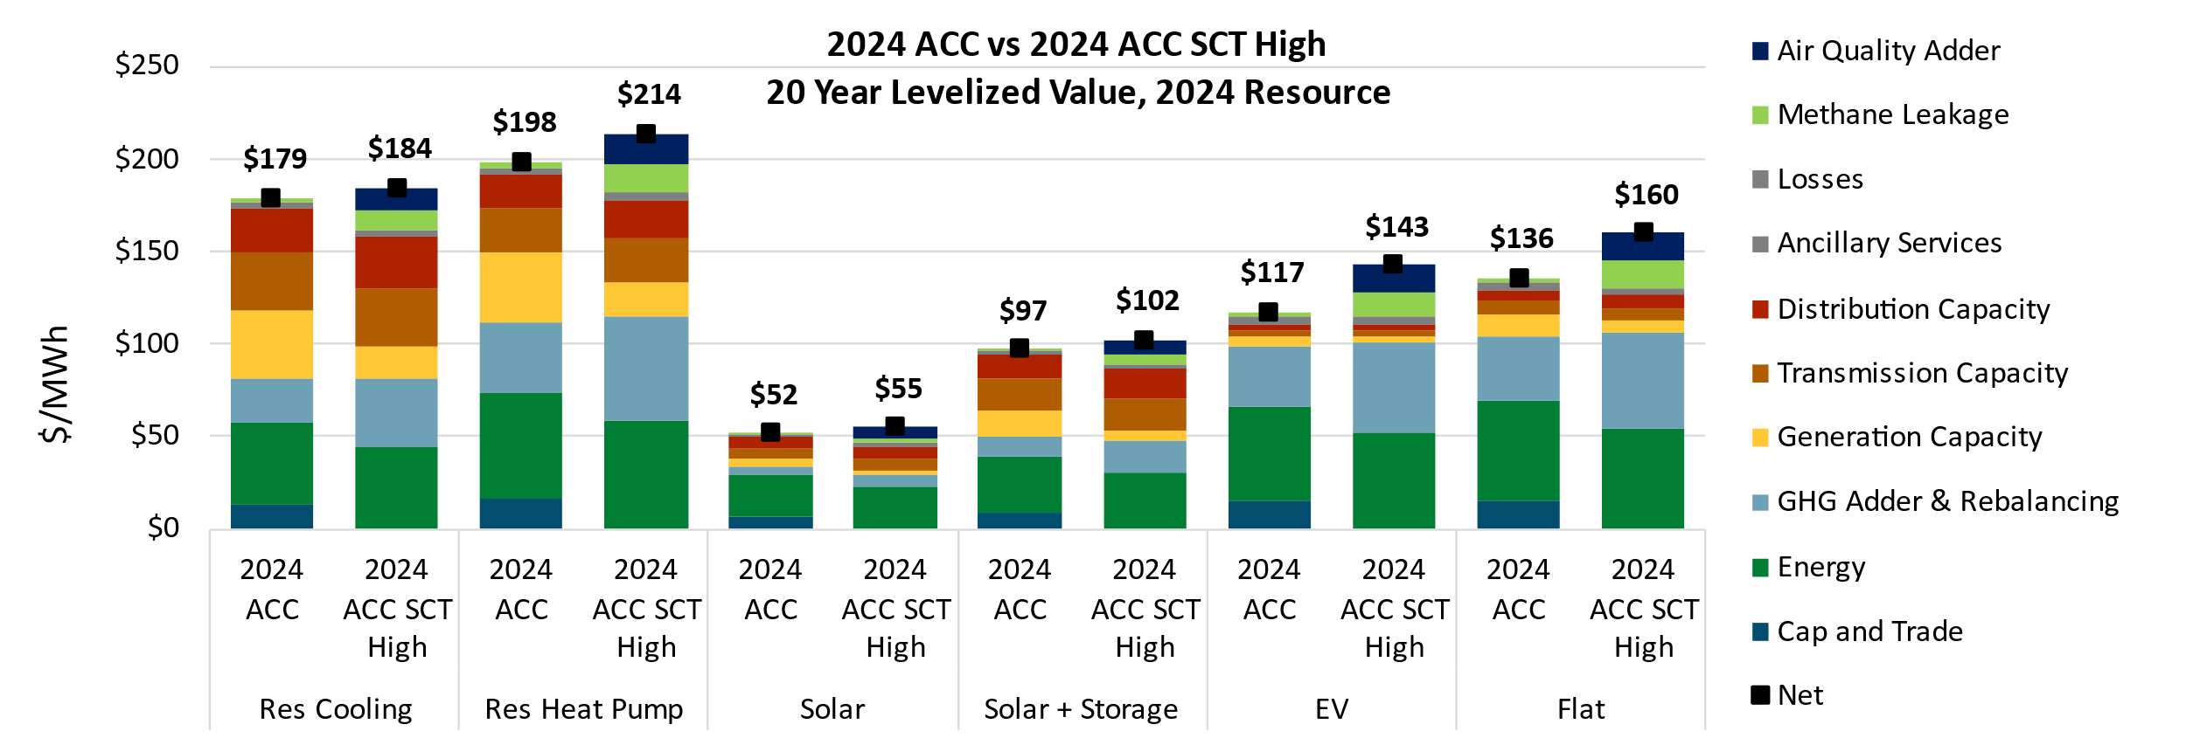
Societal Total Avoided Costs by End Use
2024 ACC TRC vs. 2024 ACC SCT High
Higher Greenhouse Gas, Methane Leakage, and Air Quality values increase avoided costs and costs
Greenhouse Gas avoided costs increase while generation capacity avoided costs decrease
Key End Uses
Avoided Costs
Costs
Avoided Costs
Avoided Costs
Costs
Costs/Avoided Costs
Notes:
Overall, the SCT has a higher avoided cost and that's mainly because of the higher methane leakage rates and the addition of air quality adder.

Slide 5
Final Decision
On July 15, 2024, D.24-07-015 was issued and adopted the Societal Cost Test (SCT) as an additional test for the Commission to consider when evaluating the cost-effectiveness of DERs.
  SCT was implemented in the 2024 ACC Resolution issued on November 7, 2024 and becomes effective April 1, 2025
The SCT considers the principal benefits and costs experienced by society (e.g., the impact of particulate air pollution on human health) in its evaluation of cost-effectiveness for behind-the-meter resources.
  The SCT is an information-only test. The Total Resource Cost (TRC) Test remains the primary cost-effectiveness test for evaluating DER cost-effectiveness.

Slide 6

CPUC

