Slide 1
Location-Specific Gas System Decommissioning Scoping Workshop (Staff Workshop) k
Request for Input on Forthcoming Solicitation
Sustainability and Health Unit
Energy Research & Development Division
Presenter: Dr. Mithra Moezzi
March 27, 2024

Slide 2
Housekeeping
All participants muted on Zoom (until Q&A)
Zoom recording
  Forthcoming at: https://www.energy.ca.gov/event/workshop/2024-03/location-specific-gas-system-decommissioning-scoping-workshop
Comments and questions
  Please use “Q&A” feature for substantive comments and questions (not chat).
  Please reserve the “Chat” feature for technical issues, etc.

Slide 3
Why Are We Seeking Your Input?
In Q2/Q3 2024, we expect to release a Grant Funding Opportunity (GFO) funding up to $2.2M of research* to investigate location-specific aspects of gas decommissioning, supporting long-term gas planning & state goals
CEC staff seek input from researchers, industry, organizations, and the public on research needs and opportunities serving these initiatives
That input will inform the scope and structure of the anticipated solicitation
*Funded under two initiatives, “Location-Specific Analysis of Decommissioning to Support Long-Term Gas Planning”, pp. 34-35 in Natural Gas Research and Development Program, Proposed Budget Plan For Fiscal Year 2021-2022 and “Scaled-Up Gas Decommissioning Pilots and Integrated Planning Tools” pp. 12-16 in Gas Research and Development Program: Proposed Updated Budget Plan for Fiscal Year 2022-23

Slide 4
Workshop Agenda
Introduction to CEC’s Gas R&D Funding
Background on solicitation perspective
Specific questions to the audience
Open discussion
Input from today’s workshop plus public comments (whether oral or written) will help shape the Grant Funding Opportunity.

Slide 5
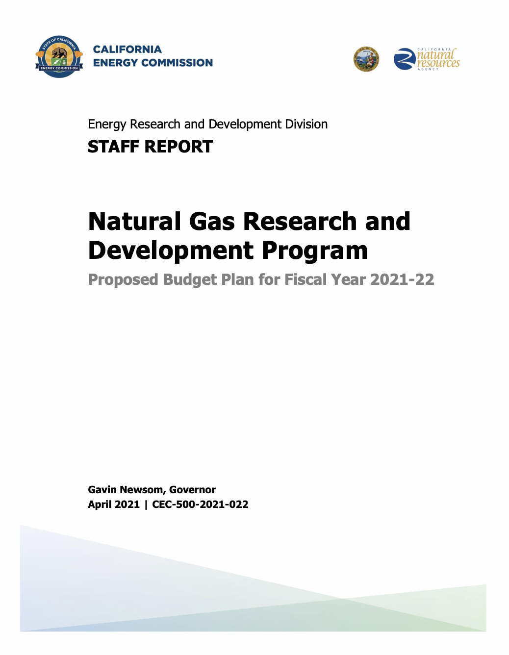
CEC’s Gas Research Planning
CEC’s Gas Research Program supports public interest R&D.
Anticipated solicitation would be funded under two initiatives:
Location-Specific Analysis of Decommissioning to Support Long-Term Gas Planning (FY 21-22)
Scaled-Up Gas Decommissioning Pilots and Integrated Planning Tools (FY 22-23)
For further information see:
  Workshop page: https://www.energy.ca.gov/event/workshop/2024-03/location-specific-gas-system-decommissioning-scoping-workshop
  Gas research plans and annual reports: https://www.energy.ca.gov/data-reports/reports/energy-research-and-development-investment-plans-and-annual-reports

Slide 6

Initiative Background and Perspective

Slide 7
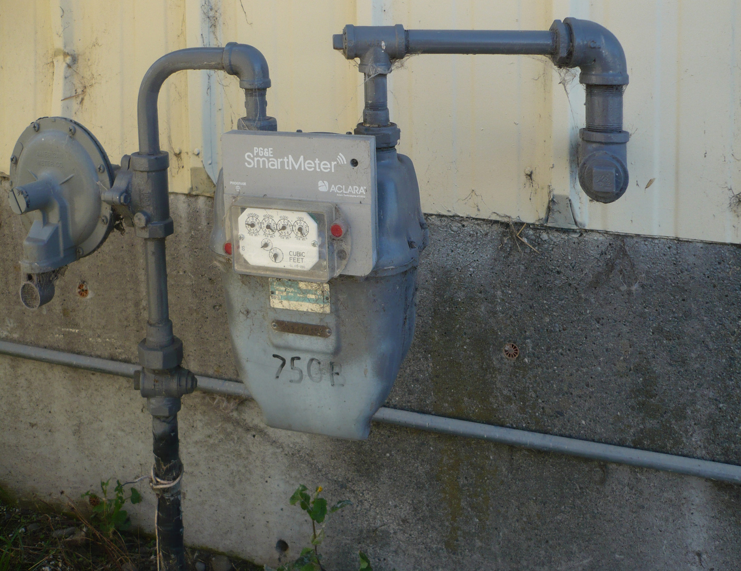
Problem Background
The state envisions greatly decreased fossil gas use achieved by decommissioning & end use decarbonization
Challenges to doing this include:
  Motivating change in tens of millions of end uses
  Coordinating end use change with infrastructural change
  Fostering equity in the transition
Gas Smart Meter
Image: Ellin Beltz, https://commons.wikimedia.org/wiki/File:PG%26E_Meter_in_Fortuna_CA.jpg#/media/File:PG&E_Meter_in_Fortuna_CA.jpg (CC BY-SA 3.0)

Slide 8
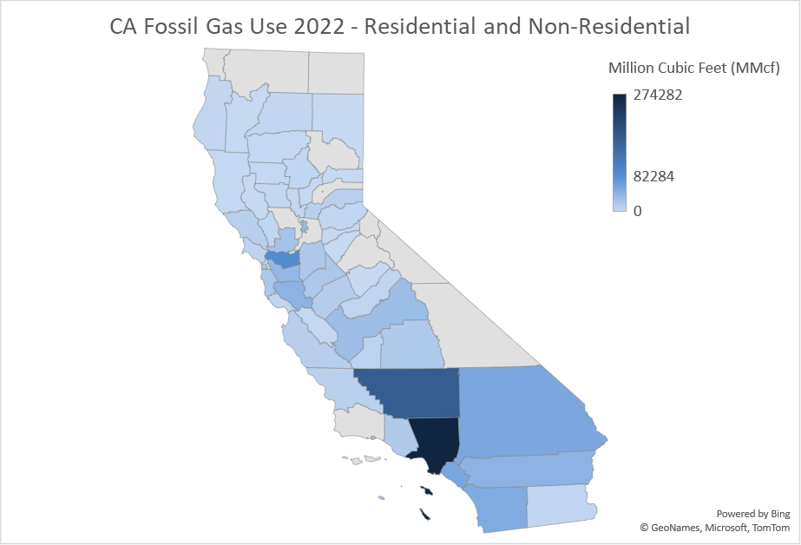
Piped Fossil Gas Use by County 2022*
Total by County
Los Angeles | 24%
Kern | 15%
Contra Costa | 8%
Total | 47%
Non-Residential by County
Los Angeles | 24%
Kern | 23%
Contra Costa | 10%
Total | 57%
Residential by County
Los Angeles | 25%
Orange | 8%
Riverside | 6%
Total | 39%
*2022 consumption, excluding power sector. Data are from California Energy Consumption Database.

Slide 9
California Gas Consumption by Sector
2023 California Natural Gas Consumption by End Use (eia.gov)

Slide 10
Energy Transitions Perspectives
Focus on
End Points
Focus on
Energy Systems

Slide 11
Selected Transition Knots
Rented properties are harder to decarbonize due to split incentives and related issues | As customers move off piped gas, fixed costs would typically fall to remaining customers | Tricky to coordinate end use changes with physical decommissioning
Some households, businesses may not be interested in decarbonizing gas end uses | Supply chains for some electrical equipment, parts, and expertise are uneven | Gas can provide energy resilience during power outages
Conversions can be expensive, disruptive, time-consuming, entail risk | Electricity rates for some customers are expected to rise considerably in the near term | Certain sectors, end uses, and locations are harder to convert due to technical, economic, or cultural reasons
Electricity supply and system reinforcements needed for energy reliability, including winter peaks | Key data on gas use details or gas use conversions are not available to researchers and planners | Performance and customer acceptance aren’t yet well-studied, but they impact pace and patterns going forward

Slide 12
Objectives of Forthcoming GFO
Award an expected 2-4 grants to:
Conduct empirically-based analysis to inform a long-term strategy for a gas system transition retaining a distributional lens
Understand location- and context-specific considerations for motivating end use conversions and assessing transition impacts
Develop tailored solutions for addressing various barriers and mitigating undesired impacts
Provide info that helps coordinate expected changes in gas end use with infrastructure and resource planning, equity considerations, programs, research…

Slide 13
Question to Participants

Slide 14
Comments and Questions
Three ways to provide feedback or ask questions:
Use the raise hand function in Zoom:
  Zoom Phone controls:
    *6 - Toggle mute/unmute.
    *9 - Raise hand.
  Please introduce yourself by stating your name and affiliation.
Type comments and questions in the question function on Zoom:
  Please provide name and affiliation.
  Please indicate which discussion questions you are commenting on (E.g., 1, 2, etc.).
Submit written comments & questions:
  Send written comments & questions to docket@energy.ca.gov by no later than April 12, 2024
    Include docket number 23-ERDD-02 and “Location-Specific Gas System Decommissioning Workshop” in the subject line

Slide 15
Questions on Research Topics I
What research on coordinating gas end use changes with safety and hydraulic issues are needed?
What research concerning gas transitions in rural or tribal areas is needed? What key considerations should be included? What other locational or sectional categories need attention?
What research on supply/value chains, including decision-making contexts of building owners & homeowners, tenants, contractors, and suppliers would be most useful to support California’s energy transitions? Feasible?
Would research providing independent assessment of receptivity to, and barriers for, conversion of gas end uses for different customer niches be useful? If so, what niches are most important (e.g., mobile homes, high or low consumers, low solar potential, particular regions?)
What further research is needed on converting from fossil gas in commercial buildings and facilities? What cases might be especially useful to examine?

Slide 16
Questions on Research Topics II
What additional research needed on utilizing alternative gases for decarbonization gas use is needed?
Would research on how gas end use patterns are changing by customer, location, end use be feasible? Useful?
What additional information synthesis or consolidation would be useful to support research, planning, technology development, and other investments related to long-term decommissioning targets?
What other decommissioning and decarbonizing topics, solutions, or approaches should we be aware of?

Slide 17
Request for Insights & Leads on Experience, Data
Please assist us by providing information, insights, or data resource leads concerning the following:
Public and building owner level of awareness and interest?
Existing studies on decision-making by consumers, building owners, vendors as related to piped fossil gas vs. alternatives
Information on distribution of gas conversions to electricity or lower-carbon alternatives? Who is electrifying what why?
Available quantitative data beyond what we know of on gas use or equipment any sector? Ongoing or recent studies using gas interval meter data or otherwise refining gas demand by customer, end use, geography, weather, etc. conditions.
Unpublished & unpublishable information, understanding, knowledge …

Slide 18

Open Discussion
What other decommissioning and decarbonizing topics, solutions, approaches, or resources should we be thinking about funding research on, as related to this GFO,
or creating a gas energy transition more generally?

Slide 19
Thank You!
Please submit your written comments by
April 12, 2024
Submit electronically through the Energy Commission’s “Gas Research and Development” docket here: https://efiling.energy.ca.gov/Ecomment/Ecomment.aspx?docketnumber=23-ERDD-02
Or by email to the Docket Unit at: docket@energy.ca.gov
  Please include docket number 23-ERDD-02 and
  “Location-Specific Gas System Decommissioning Workshop” in the subject line
Visit: https://www.energy.ca.gov/event/workshop/2024-03/location-specific-gas-system-decommissioning-scoping-workshop to view the workshop notice, and (forthcoming) presentation and recording

