Slide 1
Analysis of Benefits Associated With Projects and Technologies Supported by the Clean Transportation Program:
2023 Final Summary
Roberto Vercellino and Dan Mazzone
December 2023

Slide 2
Contents
1
Summary of Projects Data
2
Expected Benefits
3
Market Transformation Benefits
4
Combined Benefits
5
Conclusion & Next Steps
S.M.
Market Transformation Benefits in Detail

Slide 3
Scope of This Analysis
CTP Benefits
Expected Benefits
Market Transformation Benefits
Perceived Vehicle Price
Fuel Production
Refueling Infrastructure
Vehicle Deployment
Vehicle Cost Reductions
Advanced Technologies
Types of Benefits
Expected benefits accrue because of the direct displacement of petroleum-based fuels or vehicle technologies.
Market transformation benefits accrue because of CTP funding shifting the underlying market dynamics and accelerating the adoption of alternative fuel vehicles.
Benefit Outcomes
Displaced petroleum consumption
GHG emissions reductions
Criteria pollutant reductions
Jobs supported
Equity and social benefits.
Other Assumptions
Benefits accruing from 2013–2035.
Expected and market transformation are considered additive in this analysis.

Slide 4
Summary of Projects Data

Slide 5
Projects Funded Under the CTP Included in This Analysis
Project Type | # of Projects Analyzed | CTP Funding Analyzed ($ millions)
Biomethane Production | 12 | 35.90
Gasoline Substitutes Production | 5 | 10.80
Diesel Substitutes Production | 10 | 41.50
Electric Vehicle (EV) Charging – Light Duty (LD)* | 621 | 288.60
EV Charging – Medium and Heavy Duty (MD/HD) | 89 | 72.20
Hydrogen Refueling Stations – LD | 89 | 135.90
Hydrogen Refueling Stations – MD/HD | 4 | 25.40
E85 Fueling Stations | 19 | 1.40
Natural Gas Fueling Stations | 41 | 14.80
Manufacturing (Infrastructure) | 8 | 26.40
Natural Gas Commercial Trucks | 13 | 51.30
Light-Duty Battery-Electric Vehicles (BEVs) and Plug-In Hybrid Electric Vehicles (PHEVs) | 4 | 2.80
Clean Vehicle Rebate Project (CVRP) and Hybrid and Zero Emission Truck and Bus Voucher Incentive Project (HVIP) Support | 2 | 22.50
MD/HD Truck Demonstration | 33 | 79.80
Manufacturing (Vehicles) | 26 | 226.70
Other | 0 | 0.00
Total | 976 | 1036.00
Projects are grouped into three classes:
Fuel production
Fueling infrastructure
Vehicles
* Project data for the California Electric Vehicle Infrastructure Project (CALeVIP) were estimated using available information on the program’s website. See Slide 38 for more details.

Slide 6
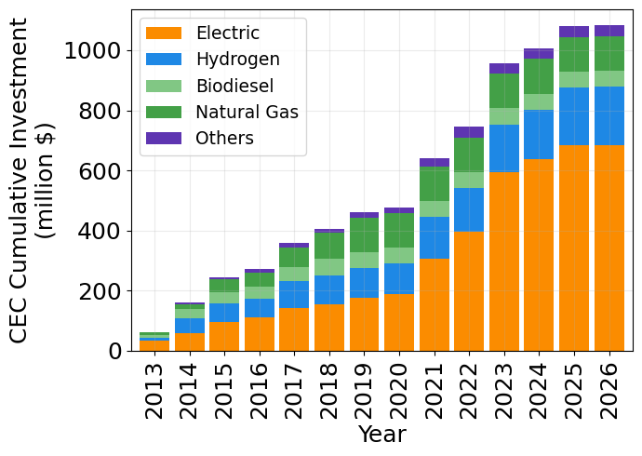
CTP Funding Over Time Based on Fuel Class
3%
11%
CTP funding analyzed shows incrementally higher focus on projects fueled by electricity and hydrogen.
Between 2020 and the current day, funding to electricity-based projects has increased from 41% to 63%, whereas it has gone from 11% to 5% for biofuels.
5%
18%
63%

Slide 7
Expected Benefits

Slide 8
Expected Benefits Summary Tables
Annual expected benefits shown by project subclass and evaluation year
 | Petroleum Fuel Reductions (million gallons/year) | Petroleum Fuel Reductions (in million gallons) | Petroleum Fuel Reductions (in million gallons) | Petroleum Fuel Reductions (in million gallons) | GHG Reductions (thousand metric tons CO₂e/year)
Project Type | 2020 | 2025 | 2030 | 2035 | 2020 | 2025 | 2030 | 2035
Fuel Production - Biomethane | 0.11 | 5.44 | 5.84 | 5.84 | 1.44 | 155.34 | 163.5 | 163.5
Fuel Production - Diesel Substitutes | 11.18 | 18.08 | 18.08 | 18.08 | 92.06 | 142.43 | 127.04 | 127.04
Fuel Production - Gasoline Substitutes | 7.21 | 7.47 | 7.47 | 7.47 | 14.11 | 9.24 | 3.86 | 3.86
Fueling Infrastructure - E85 Ethanol | 2.4 | 2.5 | 0 | 0 | 7.46 | 5.97 | 0 | 0
Fueling Infrastructure - Electric Chargers - LD | 2.18 | 24.96 | 68.72 | 25.69 | 17.19 | 194.4 | 537.06 | 213.28
Fueling Infrastructure - Electric Chargers - MD/HD | 0.05 | 0.98 | 3.47 | 3.06 | 0.44 | 9.09 | 31.75 | 29.68
Fueling Infrastructure - Hydrogen - LD | 1.51 | 6.42 | 13.17 | 7.3 | 8.35 | 30.85 | 53.75 | 29.79
Fueling Infrastructure - Hydrogen - MD/HD | 0 | 0.19 | 1.43 | 1.53 | 0 | 0.74 | 4.27 | 4.59
Fueling Infrastructure - Natural and Renewable Gas | 10.16 | 10.76 | 0.15 | 0 | 24.16 | 16.14 | 0.02 | 0
Vehicles - CVRP and HVIP Support | 1.36 | 1.48 | 0 | 0 | 10.72 | 11.51 | 0 | 0
Vehicles - MD/HD Truck Demonstration | 0.43 | 1.12 | 0.58 | 0 | 3.12 | 6.57 | 2.47 | 0
Vehicles - Light-Duty BEVs and PHEVs | 0 | 0.04 | 0.04 | 0 | 0.01 | 0.3 | 0.28 | 0
Vehicles - Natural Gas Commercial Trucks | 0.58 | 2.76 | 2.86 | 0 | 1.07 | 2.93 | 0.62 | 0
Total | 37.18 | 82.21 | 121.8 | 68.97 | 180.13 | 585.52 | 924.62 | 571.75

Slide 9
Expected Benefits Summary Tables (continued)
Annual expected benefits shown by project subclass and evaluation year
 | NO_{x} Reductions (tons/year) |  |  |  | PM_{2.5} Reductions (tons/Year)
Project Type | 2020 | 2025 | 2030 | 2035 | 2020 | 2025 | 2030 | 2035
Fueling Infrastructure - Electric Chargers - LD | 6.74 | 50.85 | 117.83 | 40.22 | 0.18 | 1.97 | 5.18 | 1.79
Fueling Infrastructure - Electric Chargers - MD/HD | 0.28 | 10.43 | 25.51 | 19.75 | 0 | 0.09 | 0.3 | 0.26
Fueling Infrastructure - Hydrogen - LD | 1.53 | 4.2 | 7.36 | 3.67 | 0 | 0 | 0 | 0
Fueling Infrastructure - Hydrogen - MD/HD | 0 | 0.4 | 2.78 | 2.8 | 0 | 0.01 | 0.05 | 0.05
Fueling Infrastructure - Natural and Renewable Gas | 0 | 0 | 0 | 0 | 0 | 0 | 0 | 0
Vehicles - CVRP and HVIP Support | 4.2 | 3.01 | 0 | 0 | 0.11 | 0.12 | 0 | 0
Vehicles - MD/HD Truck Demonstration | 3.04 | 5.4 | 1.85 | 0 | 0.01 | 0.03 | 0.01 | 0
Vehicles – Light-Duty BEVs and PHEVs | 0 | 0.08 | 0.06 | 0 | 0 | 0 | 0 | 0
Vehicles - Natural Gas Commercial Trucks | 0.01 | 0.8 | 0.56 | 0 | 0 | 0 | 0 | 0
Total | 15.81 | 75.16 | 155.95 | 66.44 | 0.3 | 2.22 | 5.54 | 2.1

Slide 10
Expected Benefits to Disadvantaged and Low-Income Communities

Slide 11
Expected Benefits to Disadvantaged and Low-Income Communities (DACs & LICs)
Annual expected benefits in 2030
 | Inside DACs | Outside DACs | Inside LICs | Outside LICs | Statewide
Petroleum Reductions (million gallons/year) | 29.92 | 16.95 | 31.46 | 15.42 | 74.92
GHG Reductions (thousand tons/year) | 251.05 | 91.46 | 247.99 | 94.52 | 582.1
NOx Reduction (metric tons/year) | 20.73 | 20.47 | 29 | 12.2 | 114.74
PM 2.5 Reduction (metric tons/year) | 0.26 | 0.38 | 0.38 | 0.25 | 4.9
DAC and LIC are assigned based on denomination provided by CEC.
Where denomination is missing, geographical match is attempted.
Where geographical information is not provided, benefits are assumed to be statewide.
Cumulative expected benefits in 2030
 | Inside DACs | Outside DACs | Inside LICs | Outside LICs | Statewide
Petroleum Reductions (million gallons) | 379.64 | 164.36 | 394.54 | 149.47 | 424.59
GHG Reductions (thousand tons) | 2467.32 | 877.24 | 2414.83 | 929.73 | 3296.72
NOx Reduction (metric tons) | 118.45 | 164.99 | 179.28 | 104.16 | 672.59
PM 2.5 Reduction (metric tons) | 1.8 | 3.42 | 2.95 | 2.26 | 24.97

Slide 12
Expected Benefits to DACs and LICs (continued)
Annual expected benefits in 2030
 | Inside DACs or LICs | Outside DACs and LICs | Statewide
Petroleum Reductions (million gallons/year) | 37.97 | 8.91 | 74.92
GHG Reductions (thousand tons/year) | 298.65 | 43.86 | 582.1
NOx Reduction (metric tons/year) | 32.32 | 8.88 | 114.74
PM 2.5 Reduction (metric tons/year) | 0.5 | 0.14 | 4.9
The same benefits from the previous slide are presented here in a combined fashion:
  Inside DACs or LICs, or both.
  Outside both DACs and LICs.
  Statewide means again insufficient data was available to localize the projects’ benefits.
Cumulative expected benefits in 2030
 | Inside DACs or LICs | Outside DACs and LICs | Statewide
Petroleum Reductions (million gallons) | 458.5 | 85.51 | 424.59
GHG Reductions (thousand tons) | 2,933.62 | 410.94 | 3,296.72
NOx Reduction (metric tons) | 199.52 | 83.92 | 672.59
PM 2.5 Reduction (metric tons) | 3.57 | 1.64 | 24.97

Slide 13
Market Transformation Benefits

Slide 14
Summary of Market Transformation Benefits
Annual market transformation benefits in 2030
Market Transformation Influence | Petroleum Displacement (million gallons/year) |  | GHG Reduction (thousand metric ton/year) |  | NOx Reduction (metric ton/year) |  | PM2.5 Reduction (metric ton/year)
Scenario | Low | High | Low | High | Low | High | Low | High
EV Perceived Price Reduction due to EVSE Availability | 1.9 | 8.07 | 48.4 | 230.61 | 4.11 | 19.34 | 0.16 | 0.85
FCEV Perceived Price Reduction due to HRS Availability | 4.18 | 12.68 | 85.89 | 260.45 | 7.1 | 21.49 | 0.29 | 0.88
EV Cost Reduction due to Investment in Manufacturing | 1.58 | 1.59 | 30.98 | 31.13 | 2.61 | 2.62 | 0.07 | 0.07
Total | 7.67 | 22.34 | 165.26 | 522.19 | 13.82 | 43.45 | 0.52 | 1.8
Cumulative market transformation benefits in 2030
Market Transformation Influence | Petroleum Displacement (million gallons) |  | GHG Reduction (thousand metric ton) |  | NOx Reduction (metric ton) |  | PM2.5 Reduction (metric ton)
Scenario | Low | High | Low | High | Low | High | Low | High
EV Perceived Price Reduction due to EVSE Availability | 12.1 | 48.54 | 291.32 | 1316.83 | 22.54 | 100.66 | 0.96 | 4.79
FCEV Perceived Price Reduction due to HRS Availability | 22.82 | 68.29 | 454.1 | 1360.32 | 35.52 | 106.27 | 1.79 | 5.34
EV Cost Reduction due to Investment in Manufacturing | 9.66 | 9.7 | 180.68 | 181.39 | 14.49 | 14.55 | 0.45 | 0.45
Total | 44.58 | 126.54 | 926.11 | 2858.54 | 72.55 | 221.47 | 3.21 | 10.59

Slide 15
Combined Benefits

Slide 16
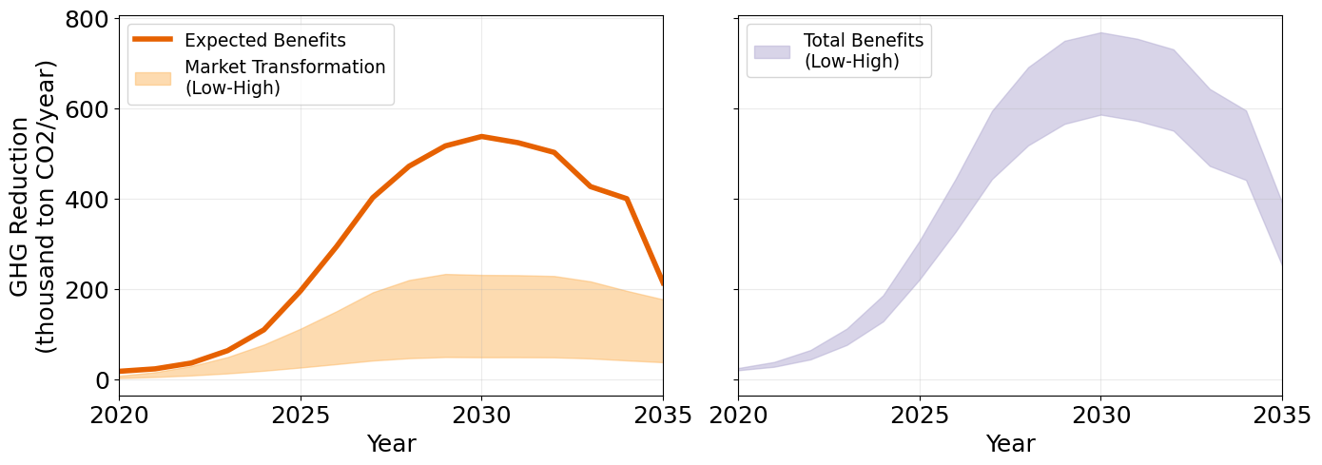
Benefits due to CTP Improving EVSE Availability
GHG reduction benefits due to CEC investments in LD EV Infrastructure
 | GHG Reductions (thousand metric tons CO₂e/year)
Benefit Type | 2020 | 2021 | 2022 | 2023 | 2024 | 2025 | 2026 | 2027 | 2028 | 2029 | 2030 | 2031 | 2032 | 2033 | 2034 | 2035
Expected Benefits | 17.19 | 22.67 | 35.57 | 63.00 | 109.13 | 194.40 | 293.24 | 401.60 | 471.22 | 516.19 | 537.06 | 523.38 | 501.81 | 426.13 | 399.34 | 213.28
Market Transformation (Low) | 2.37 | 4.66 | 8.06 | 12.63 | 18.55 | 25.60 | 33.16 | 41.09 | 46.25 | 48.80 | 48.40 | 48.43 | 48.16 | 45.76 | 41.39 | 37.34
Market Transformation (High) | 7.13 | 15.27 | 28.77 | 48.72 | 76.38 | 111.17 | 150.14 | 192.07 | 219.27 | 232.72 | 230.61 | 230.06 | 228.18 | 216.22 | 195.33 | 176.47

Slide 17
Correlation between Investments and GHG Reduction Benefits
Cumulative GHG Reductions by 2035 and CEC Investments Included in the Analysis
 | Cumulative GHG Reductions (thousand metric ton CO2) | Cumulative CEC Funding (million $ analyzed) | GHG Reductions per Dollar Invested (kg CO2e/$ analyzed) | Dollar Invested per GHG Reduction ($ analyzed/metric ton CO2)
Expected Benefits + Market Transformation (Low Case) | 12,060.44 | 1,082.00 | 11,146.44 | 89.71
Expected Benefits + Market Transformation (High Case) | 15,930.69 | 1,082.00 | 14,723.38 | 67.92
Cumulative GHG Reductions by 2035 and All CEC Investments
 | Cumulative GHG Reductions (thousand metric ton CO2) | Cumulative CEC Funding (million $) | GHG Reductions per Dollar Invested (kg CO2e/$) | Dollar Invested per GHG Reduction ($/metric ton CO2)
Expected Benefits + Market Transformation (Low Case) | 12,060.44 | XX | YY | ZZ
Expected Benefits + Market Transformation (High Case) | 15,930.69 | XX | YY | ZZ

Slide 18
Conclusions & Next Steps

Slide 19
Conclusions
NREL estimated the expected and market transformation benefits of a portfolio of transportation-related projects funded through CEC’s Clean Transportation Program over the past decade.
The benefits from the projects were estimated in terms of displaced petroleum, GHG emissions reductions, and reductions in criteria air pollutant emissions.
The methods for conducting the analysis largely emulate those employed to generate the 2021 CTP benefits report, with some updates to the assumptions, data, and methodology [1].
1. California Energy Commission. 2021. Analysis of Benefits Associated With Projects and Technologies Supported by the Clean Transportation Program. Sacramento, CA: CEC. CEC-600-2021-039. https://doi.org/10.2172/1886868.

Slide 20
Next Steps
Task | Complete By | Completed
Complete expected benefits and market transformation analysis | 11/22/23 | ✓
Complete economic impact analysis | 12/15/23
Submit final report for reviews | 12/15/23
Report is publicly available | 01/08/24

Slide 21
Thank You
NREL/PR-5400-87699
This work was authored by the National Renewable Energy Laboratory, operated by Alliance for Sustainable Energy, LLC, for the U.S. Department of Energy (DOE) under Contract No. DE-AC36-08GO28308. Support for the work was also provided by the California Energy Commission under Agreement FIA-22-23255-0. The authors would also like to thank Margaret Mann and Eric Wood for the guidance provided through this work. The views expressed in the article do not necessarily represent the views of the DOE or the U.S. Government. The U.S. Government retains and the publisher, by accepting the article for publication, acknowledges that the U.S. Government retains a nonexclusive, paid-up, irrevocable, worldwide license to publish or reproduce the published form of this work, or allow others to do so, for U.S. Government purposes.

Slide 22
Market Transformation Benefits in Details

Slide 23
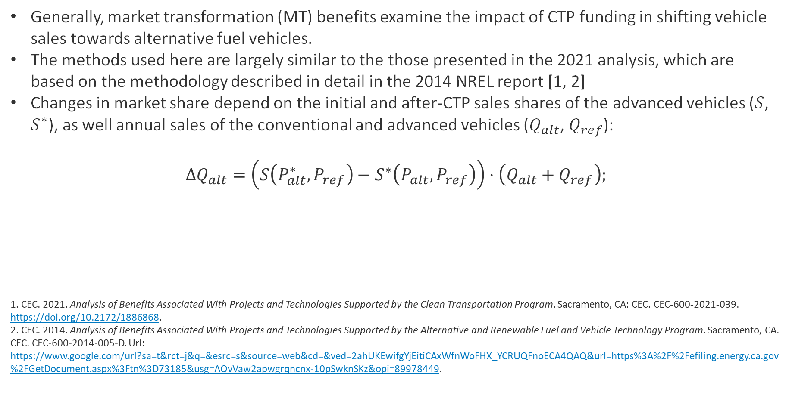
Market Transformation Methodology Overview
Generally, market transformation (MT) benefits examine the impact of CTP funding in shifting vehicle sales towards alternative fuel vehicles.
The methods used here are largely similar to the those presented in the 2021 analysis, which are based on the methodology described in detail in the 2014 NREL report [1, 2]
Changes in market share depend on the initial and after-CTP sales shares of the advanced vehicles ($S$, $S^{∗}$), as well annual sales of the conventional and advanced vehicles ($Q_{alt}$, $Q_{ref}$):
$$ΔQ_{alt}=\left(S\left(P_{alt}^{∗}, P_{ref}\right)−S^{∗}\left(P_{alt}, P_{ref}\right)\right)⋅\left(Q_{alt}+Q_{ref}\right);$$
1. CEC. 2021. Analysis of Benefits Associated With Projects and Technologies Supported by the Clean Transportation Program. Sacramento, CA: CEC. CEC-600-2021-039. https://doi.org/10.2172/1886868.
2. CEC. 2014. Analysis of Benefits Associated With Projects and Technologies Supported by the Alternative and Renewable Fuel and Vehicle Technology Program. Sacramento, CA. CEC. CEC‐600‐2014‐005‐D. Url: https://www.google.com/url?sa=t&rct=j&q=&esrc=s&source=web&cd=&ved=2ahUKEwifgYjEitiCAxWfnWoFHX_YCRUQFnoECA4QAQ&url=https%3A%2F%2Fefiling.energy.ca.gov%2FGetDocument.aspx%3Ftn%3D73185&usg=AOvVaw2apwgrqncnx-10pSwknSKz&opi=89978449.

Slide 24
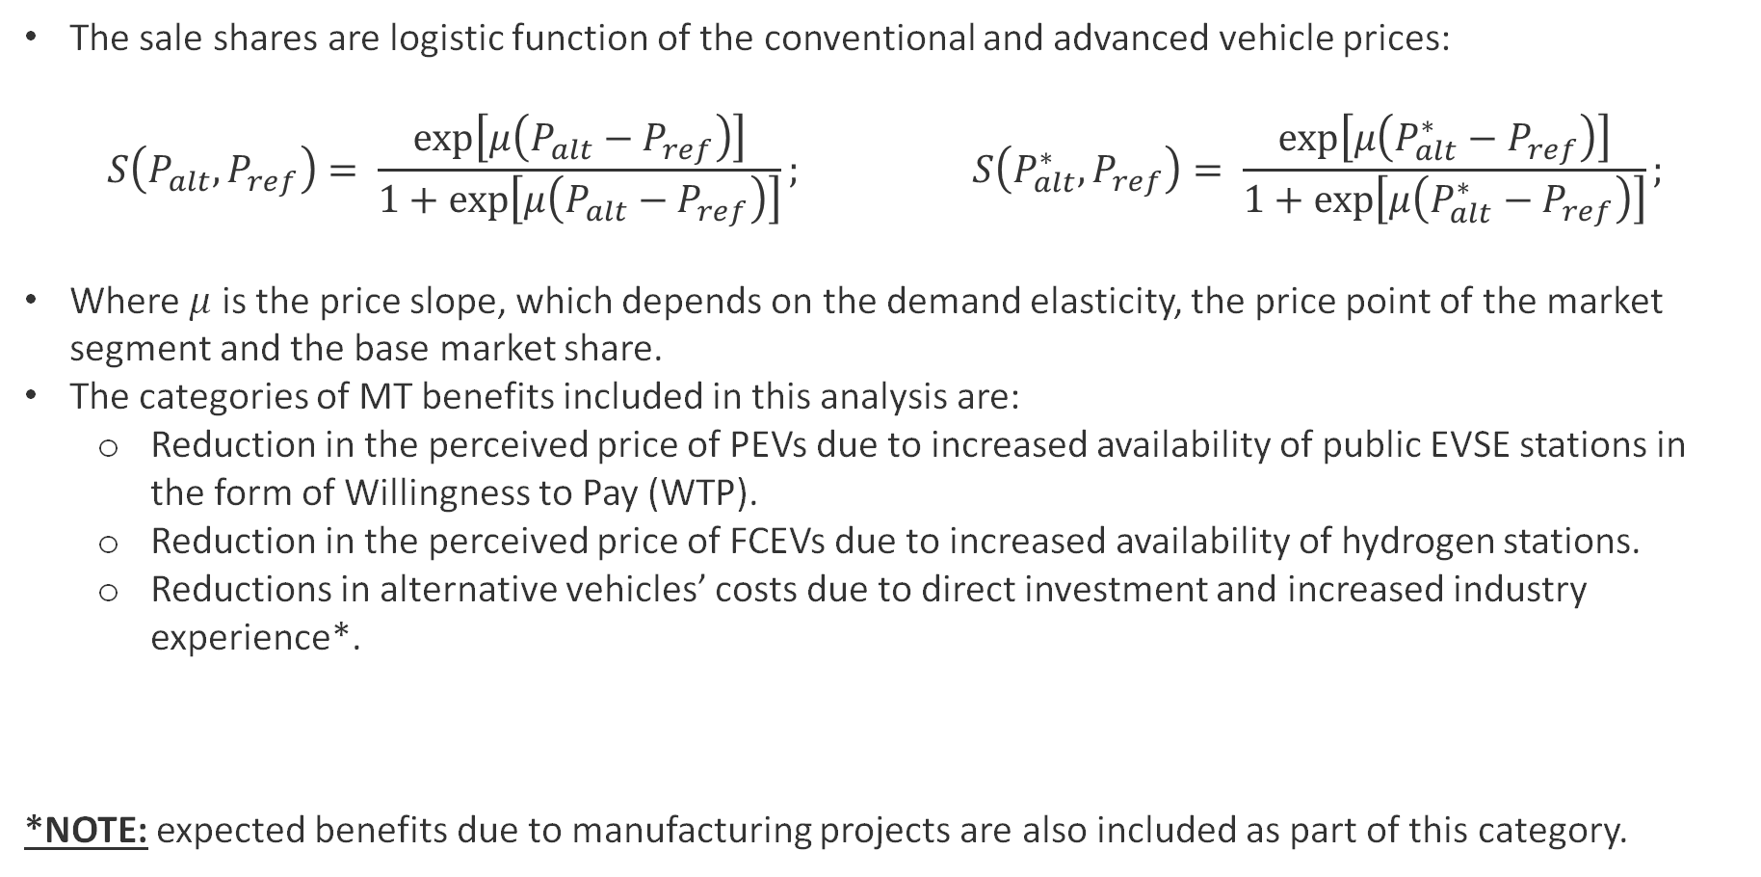
Market Transformation Methodology Overview (continued)
The sale shares are logistic function of the conventional and advanced vehicle prices:
$$S\left(P_{alt}, P_{ref}\right)= \frac{\exp\left[μ\left(P_{alt}−P_{ref}\right)\right]}{1+\exp\left[μ\left(P_{alt}−P_{ref}\right)\right]}; S\left(P_{alt}^{∗}, P_{ref}\right)= \frac{\exp\left[μ\left(P_{alt}^{∗}−P_{ref}\right)\right]}{1+\exp\left[μ\left(P_{alt}^{∗}−P_{ref}\right)\right]};$$
Where $μ$ is the price slope, which depends on the demand elasticity, the price point of the market segment and the base market share.
The categories of MT benefits included in this analysis are:
  Reduction in the perceived price of PEVs due to increased availability of public EVSE stations in the form of Willingness to Pay (WTP).
  Reduction in the perceived price of FCEVs due to increased availability of hydrogen stations.
  Reductions in alternative vehicles’ costs due to direct investment and increased industry experience*.
*NOTE: expected benefits due to manufacturing projects are also included as part of this category.

Slide 25
EV Charging Infrastructure

Slide 26
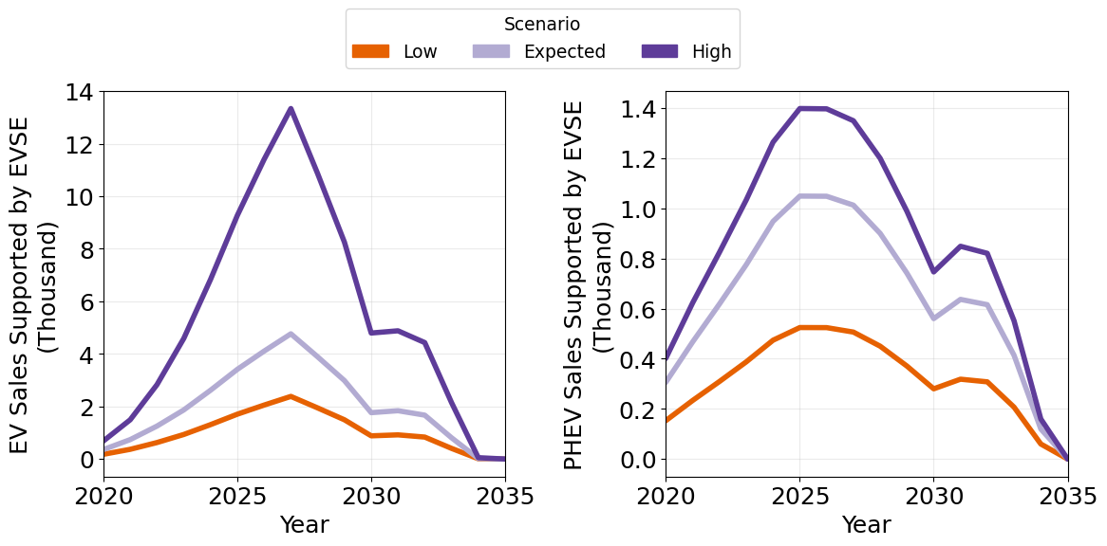
EVs Perceived Price Reductions due to EVSE Deployment
Reductions in the perceived price of EV are calculated based on willingness to pay (WTP) . WTP is calculated based on availability of charging stations compared to coverage at full electrification, the vehicles’ range and other factors.
From the date of the station’s completion, WTP is scaled linearly over 10 years to represent increase in perception.
WTP generated through CTP-funded electric chargers is used as EVs perceived price reduction.
Difference between high/expected/low scenarios are factors applied to WTP:
  High: 100%
  Expected: 50%
  Low: 25%

Slide 27
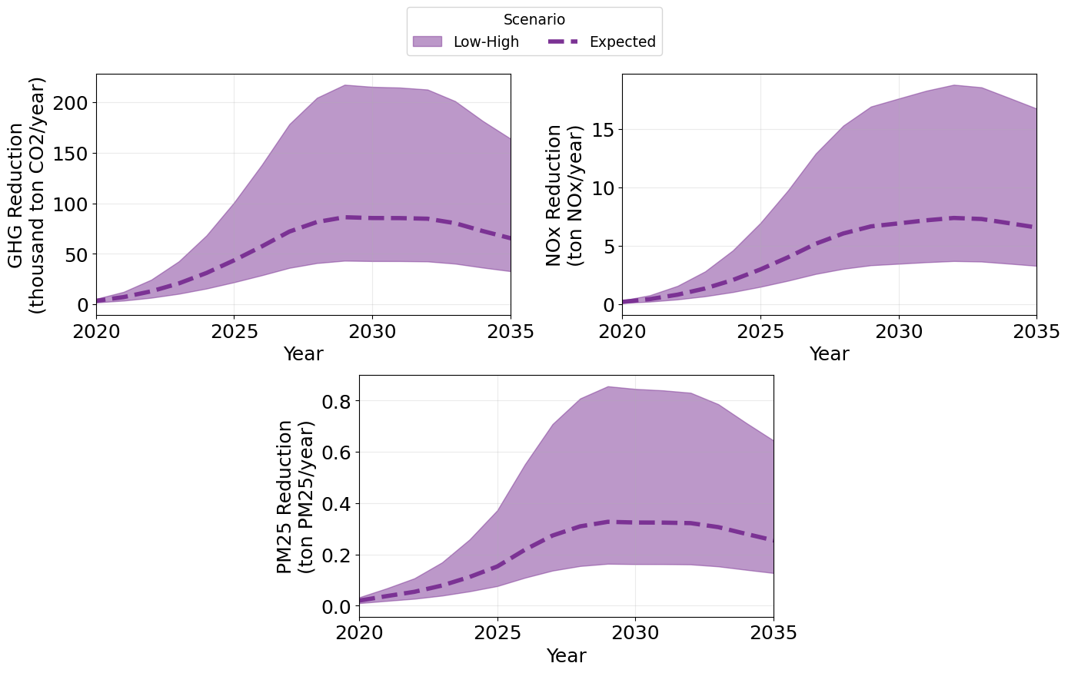
Benefits from Increase in EV Market Share
Large variation in all benefits categories examined is due to different estimates of vehicles sales supported by the projects.
Different categories see benefits peaking at different times due to expected vehicles characteristics, i.e. GHG reductions and PM25 peak around 2027, while NOx in 2030.

Slide 28
H2 Refueling Infrastructure

Slide 29
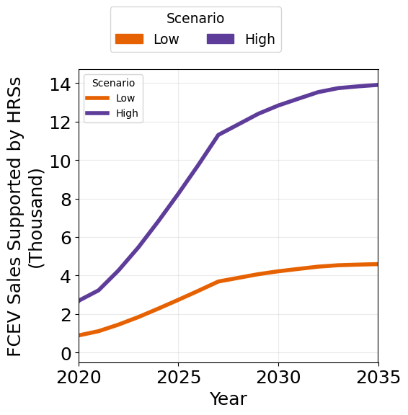
FCEVs Perceived Price Reductions due to HRSs Deployment
Perceived price reductions are calculated as marginal improvements on penalties associated with the increase availability of HRSs thanks to CEC funded stations
The baseline penalty comes from extensive consumer choice survey in several urban areas, scaled to CA areas based on population [source]:
  For urban areas, baseline penalties and benefits are represented as natural log curves in function of HRS availability.
  Intercity cost penalties are calculated assuming a linear relationship between HRS availability along interstates and the associated penalty reduction: an initial penalty of $2,000 was used and reduced by $333 for each station installed along the interstate.
Changes in market share due to increased HRS availability are estimated for two early adopter market segments (2.5 percent and 10 percent of LDV sales) and two vehicle price points ($65,000 and $50,000).

Slide 30
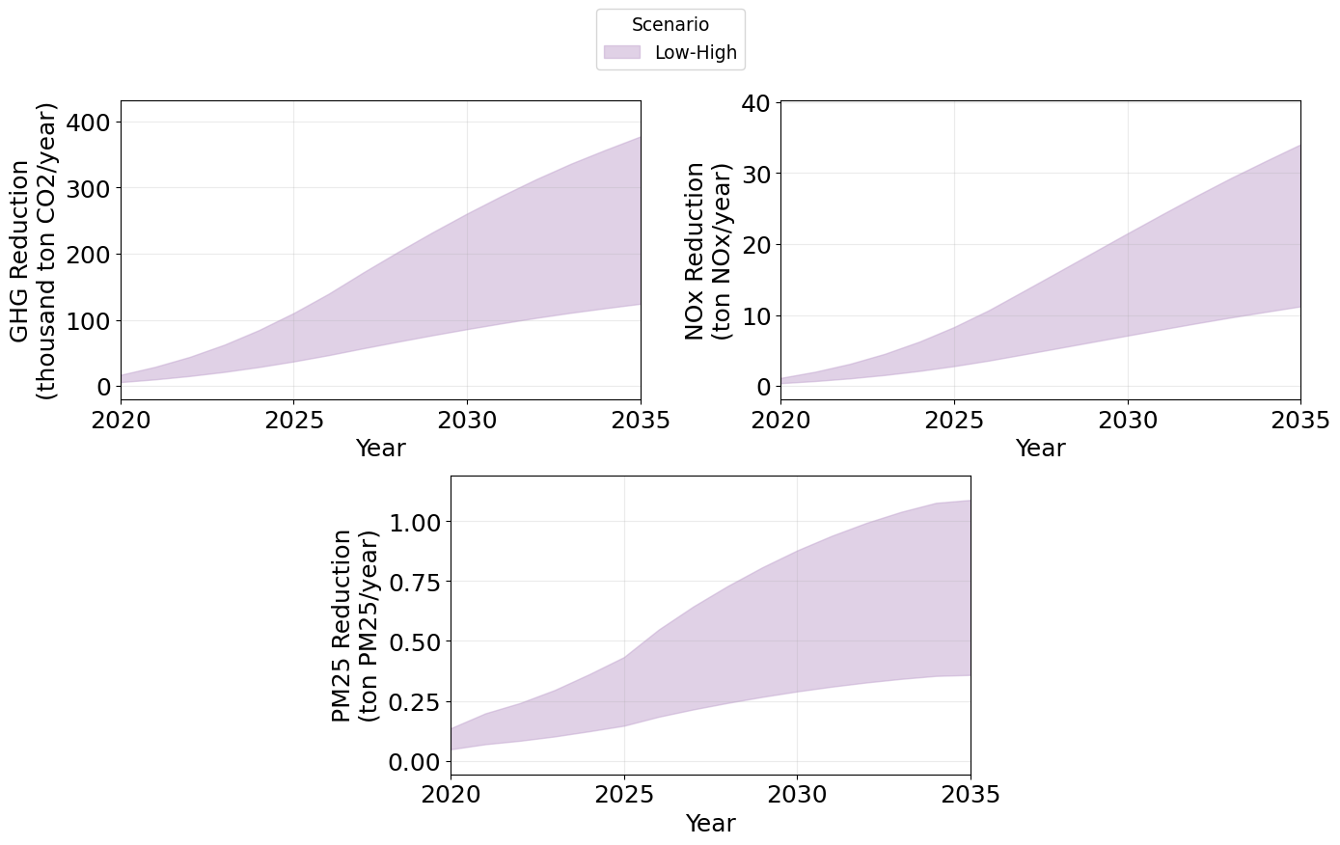
Benefits from Increase in FCEV Market Share
Again, variations in all benefits categories examined are due to different estimates of vehicles sales supported by the projects.
In all categories, the benefits increase through 2035, due to sustained vehicles sales.

Slide 31
EV Components and Vehicle Manufacturing

Slide 32
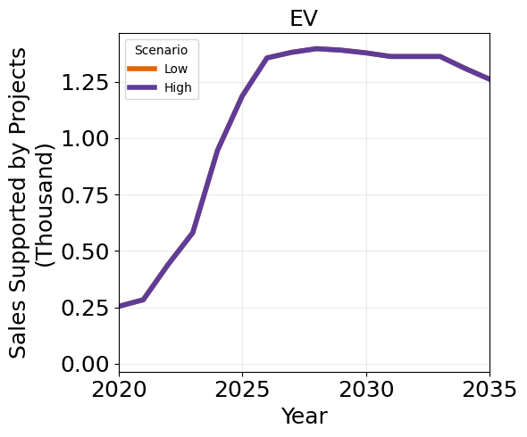
Reduction in EVs Production Costs due to Funding in Manufacturing
Vehicles manufacturing costs reductions are estimated by applying an average industry experience curve and varying the progress ratio to determine high and low estimates.
Only a fraction of profit margins are passed on to consumers as a surplus.
The change in price is based upon several factors:
  The specified investment.
  Learning factor.
  Initial cumulative production output.
  Initial vehicle price.
The change in vehicle price is applied to determine the change in market share for both manufacturing and component investments.
Differences between low/high scenarios are in the learning rates applied (0.988 and 0.912, respectively), although they do not impact the vehicles sales.

Slide 33
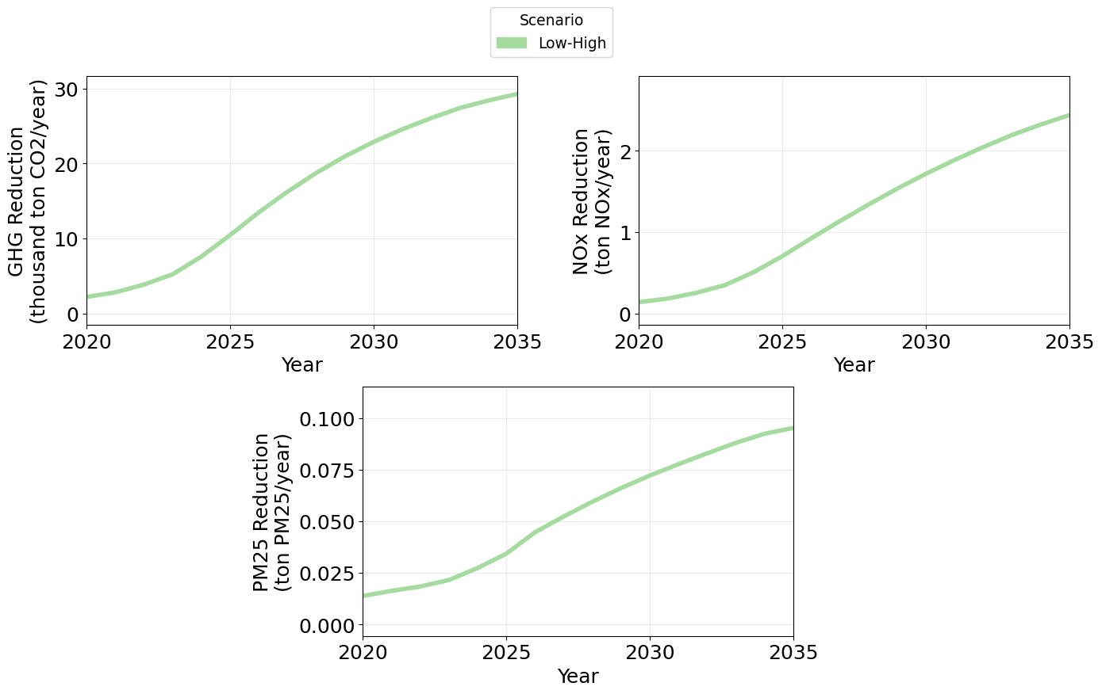
Benefits from Increase in EV Market Share
Nearly identical vehicles supported sales from low/high scenarios generate identical benefits.
Aligned with expected vehicles’ sales, the rate at which benefits grow decreases with time.

Slide 34
Summary of Market Transformation Benefits

Slide 35
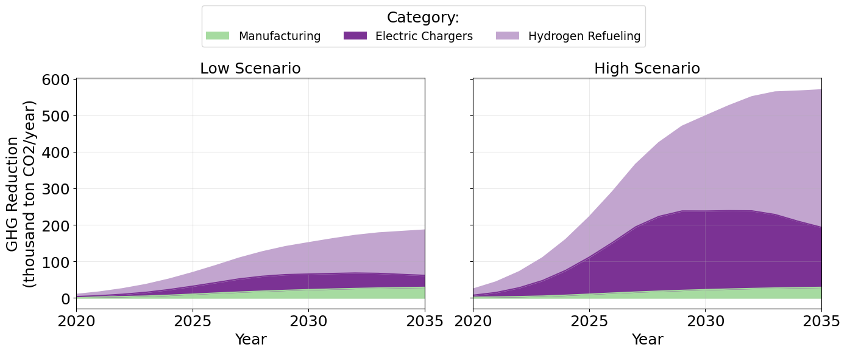
GHG Reductions from Market Transformation
Benefits from manufacturing projects are consistent between scenarios.
In both scenarios, benefits due to EVSE availability peak around 2030, whereas benefits due to HRSs see a sustained growth through 2035.

Slide 36
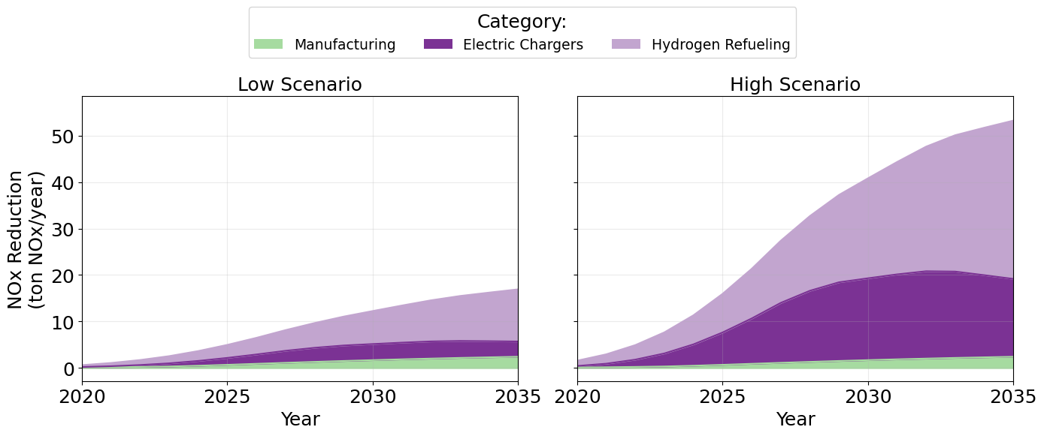
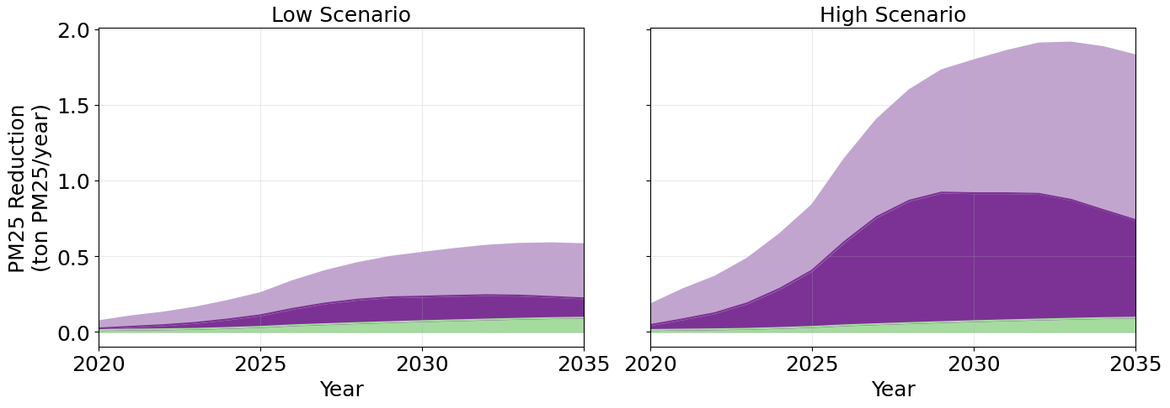
Improvements in Criteria Pollutants from Market Transformation

