Slide 1
Research to Inform Environmental Sustainability of a Clean Energy Transition (Enviro-SET)
Request for Comments on Forthcoming Solicitation
Energy-Related Environmental Research
Energy Research & Development Division
Presenters: Julia Harnad and David Stoms
December 13, 2023

Slide 2
Workshop information
All participants muted on Zoom (until Q&A)
Zoom recording
Comments and questions
  Please use “Q&A” feature for substantive comments and questions (not chat).
  Please reserve the “Chat” feature for technical issues, etc.
Event Page: https://www.energy.ca.gov/event/workshop/2023-12/staff-workshop-funding-advance-environmental-sustainability-clean-energy

Slide 3
Why We Are Seeking Your Input?
Forthcoming Grant Funding Opportunity: up to $3M to fund research that would provide best available science to achieve environmental sustainability of the state’s clean energy transition in five areas:
  Automated mapping of solar energy development footprints and modeling land suitability for dual-use purposes
  Assessing and minimizing environmental and biological resource impacts of clean energy deployments
  Testing bird-friendly windows for decarbonized buildings
  Identifying biologically appropriate exterior lighting
  Planning R&D to advance California’s clean energy circular economy
To ensure high-impact research, we are seeking input to inform solicitation development.

Slide 4
Workshop Agenda
Background on EPIC funding program
Initial ideas regarding scope and focus of anticipated solicitation
Seek input from stakeholders on specific discussion questions regarding proposed research.
Input from today’s workshop plus public comments (oral and/or written comments) will help shape the Grant Funding Opportunity.

Slide 5
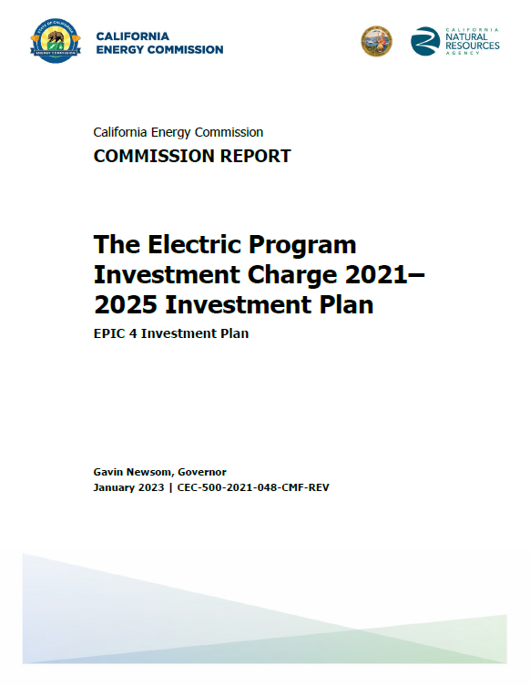
EPIC Research and Development Program
Proposed research supports the CEC’s EPIC 4 Investment Plan:
Initiative 45. Advancing Environmental Sustainability of Energy Deployments (pp. 221-225)
To access report: https://www.energy.ca.gov/publications/2021/electric-program-investment-charge-proposed-2021-2025-investment-plan-epic-4
5

Slide 6
Tentative Grant Funding Amounts
Group | Tentative Topics | Suggested Funding
1 | Automated mapping of solar energy development footprints and modeling land suitability for dual-use purposes | Up to $ 1,000,000 For 1 project
2 | Assessing and minimizing environmental and biological resource impacts of clean energy deployments | Up to $ 1,000,000 For 2 projects
3 | Testing bird-friendly windows for decarbonized buildings | Up to $ 500,000 For 1 project
4 | Identifying biologically appropriate exterior lighting | $ 500,000 For 1 project
5 | Planning R&D to advance the clean energy circular economy | $ 500,000 For 1 project

Slide 7
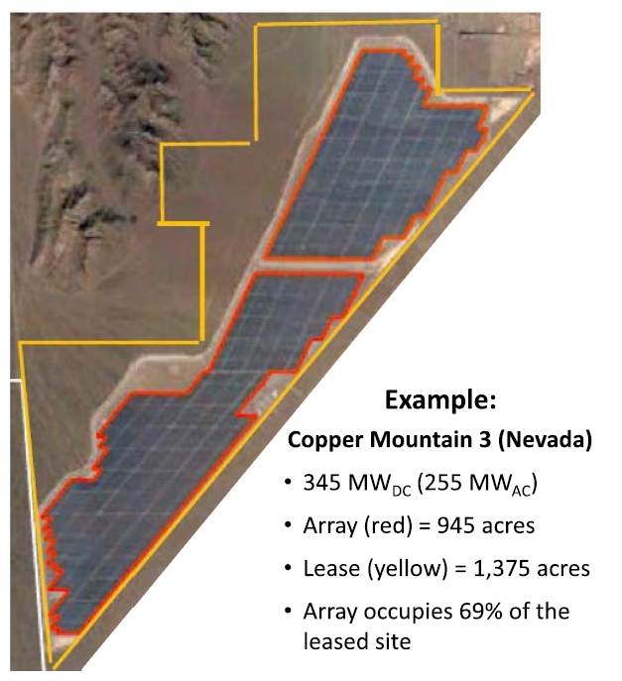
Research Background Group 1:
Automated mapping of solar energy development footprints and modeling land suitability for dual-use purposes
Solar footprints, array
vs total site area
SB 100 planning needs up-to-date maps of solar footprints to track PV expansion. Current mapping is:
  Labor intensive to produce and maintain.
  Challenging to represent total site area compared to the array.
  Not comprehensive for distributed scale systems.
  Unable to detect vegetation in facilities.
Global Renewables Watch uses artificial intelligence to map all utility-scale solar installations.
Source: Bolinger and Bolinger, 2022.

Slide 8
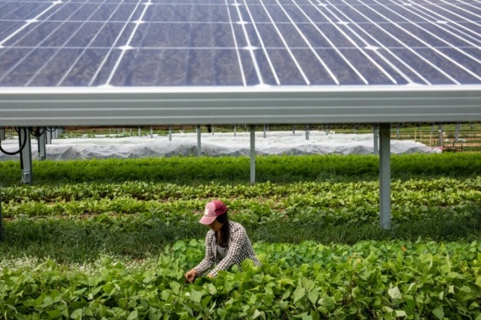
Research Background Group 1:
Automated mapping of solar energy development footprints and modeling land suitability for dual-use purposes (continued)
Dual use strategies, where the panels are co-located with other land uses like agrivoltaics could reduce impacts.
Identifying which lands in California are suitable for this dual use would help planning for landowners, solar developers and SB100 planners
SB 688 would have required CEC to award grants to support agrivoltaic systems and to map land suitability for agrivoltaics.
Source: https://www.energy.gov/eere/solar/articles/potential-agrivoltaics-us-solar-industry-farmers-and-communities

Slide 9
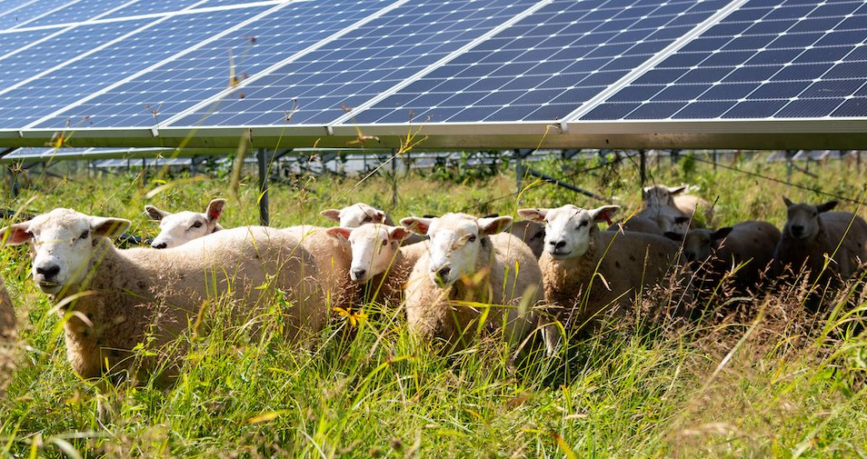
Group 1: Automated mapping of solar energy development footprints and modeling land suitability for dual-use purposes
  Develop automated method for mapping of solar footprints
    utility and distributed scales
    direct array and total project area
    vegetation management types in footprints
      complete removal of plant cover (blading)
      crops or pasture
      pollinator-friendly habitat
  Identify lands most suited for dual use purposes such as agrivoltaics
Source: https://pv-magazine-usa.com/2021/05/12/new-york-funds-a-study-to-learn-how-grazing-can-benefit-solar-installations/

Slide 10
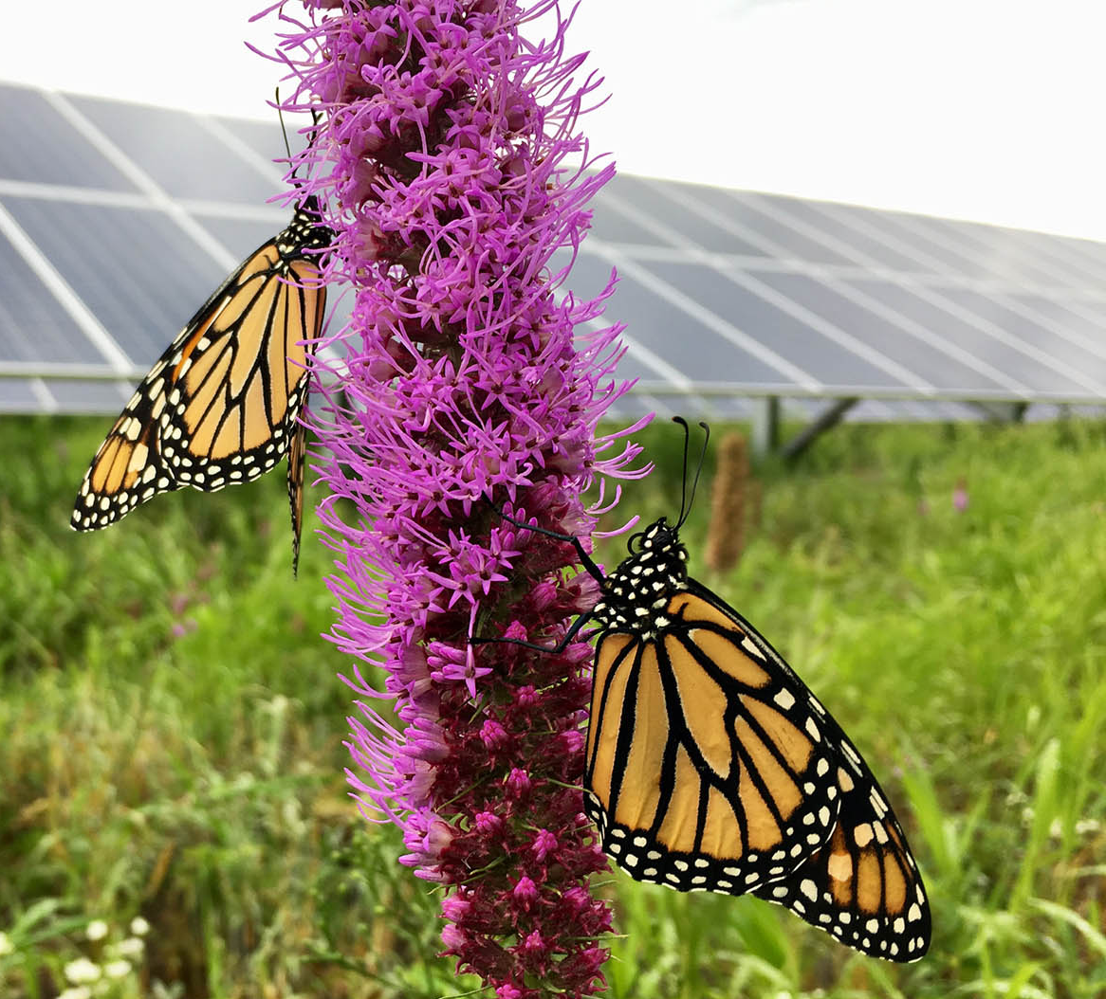
Research Background Group 2:
Assessing and minimizing environmental and biological resource impacts of clean energy deployments
Regulators, energy planners, permitting agencies, energy developers and other stakeholders need to be informed about potential risks to wildlife and plant communities and how those can be mitigated.
Possible delays and denial of new clean energy projects can be avoided through robust, best-available science.
Source: https://www.ernstseed.com/solar-energy-farms/

Slide 11
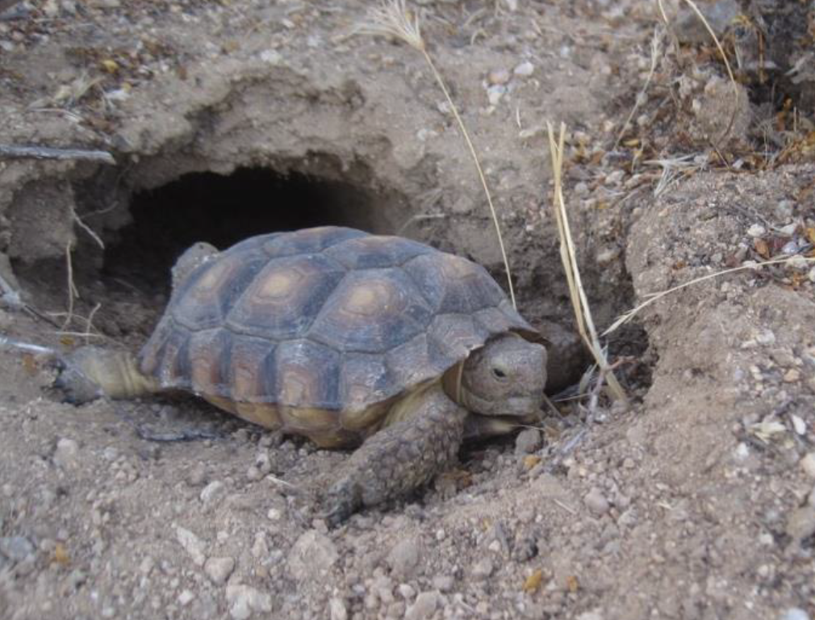
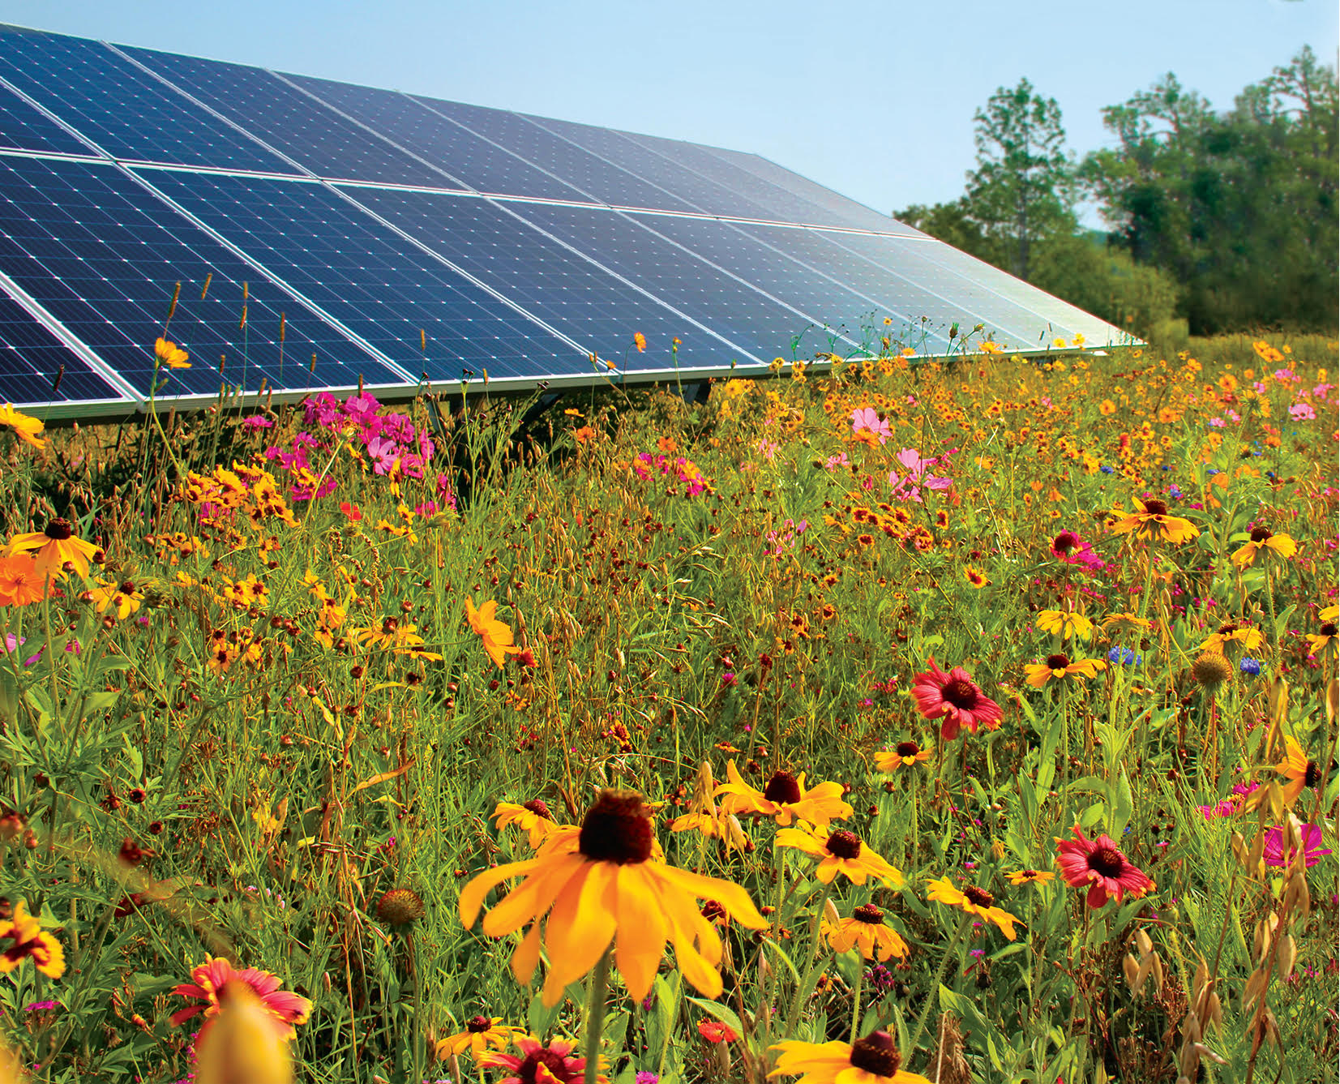
Group 2: Assessing and minimizing environmental and biological resource impacts of clean energy deployments
Tools for mitigation and monitoring:
head starting Desert Tortoise
Examples of possible projects include but not limited to:
Biological and ecological vulnerability assessments (field work, modeling, or monitoring)
Biological Impact minimization or compensation (curtailments or deterrents, offsets)
Costs and benefits of dual use solar energy production (e.g., agrivoltaics)
Innovative environmental monitoring technologies (e.g., environmental DNA)
Lithium extraction’s environmental effects or mitigation strategies
Source: CEC EPC -16-038
Pollinator-friendly solar project
Source: Encore Renewable Energy

Slide 12

Research Background Group 3:
Testing bird-friendly windows for decarbonized buildings
Hundreds of millions of birds are killed annually in North America from collisions with windows due to their reflectivity or transparency
California Building Standard’s Commission recently adopted new voluntary regulations on bird-friendly building designs in the California Green Building Standards Code (part 11, Title 24 section A5.107)
Source: https://www.dreamstime.com/stock-photos-tree-reflection-image8250583
U.S. Green Building Council’s LEED program adopted a pilot credit (55) for reducing bird collisions with windows
Achieving decarbonization objectives is an active area of technology research within EPIC such as photovoltaic films and smart windows

Slide 13
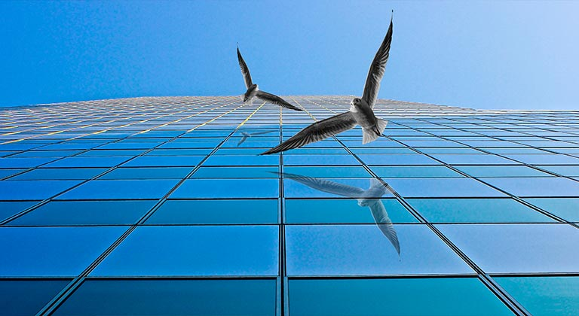
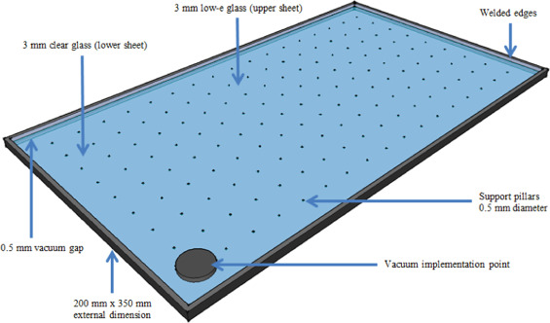
Group 3: Testing bird-friendly windows for decarbonized buildings
Suggested research areas would:
Test window treatments intended to reduce bird fatalities from collisions.
Assess tradeoffs between potential reduction in wildlife fatal collisions and energy services at market share:
  Energy generation or savings (kWh)
  Efficiency (through associated metrics such as U-factor, Solar Heat Gain Coefficient, and visual transmittance)
Source: Giroux glass
Vacuum-Insulated Glass Windows
Source: AudioScienceReview

Slide 14
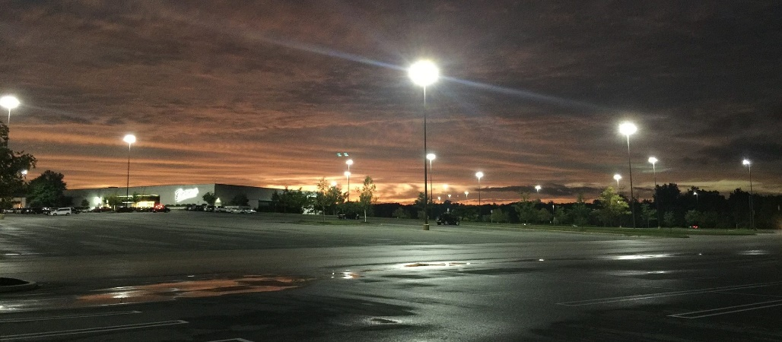
Research Background Group 4:
Identifying biologically appropriate exterior lighting
Title 24 required light emitting diode (LED) exterior lighting as a cost-effective way to increase energy efficiency.
There is concern that LED lighting is kept on beyond when necessary.
Scientific evidence shows that “ecological light pollution” may have significant impact on night pollinating insects, bats, migratory birds, and other species.
AB 38 (Lee) was introduced in last legislative session to curb the harmful impacts of artificial light at night.
Source: https://fmcservicesllc.com/2020/06/22/parking-lot-lights-for-summertime/

Slide 15
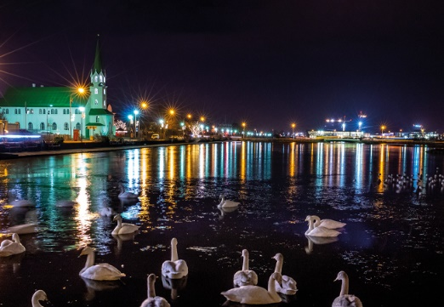
Group 4: Identifying biologically appropriate exterior lighting
Minimizing the impacts of light pollution on wildlife
Research could include:
Field and laboratory experimentation to identify the risks to California species.
Examine trade-offs between artificial lighting properties (e.g., emitted spectrum, intensity, shielding, and duration of lighting) appropriate for wildlife and for lighting requirements.
Source: CIBSE Journal
Recommend “biologically appropriate lighting” for key California species as a first step toward adapting Title 24 standards on exterior lighting.

Slide 16
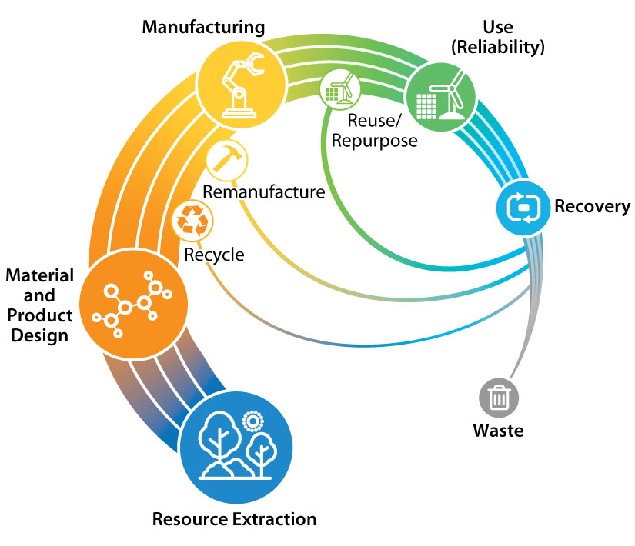
Research Background Group 5: Planning R&D to advance California’s clean energy circular economy
SB100 clean energy goals require an increase in clean energy technology equipment with an associated growing volume of retired equipment.
Large quantities of mined and processed virgin materials could lead to limited resource availability and supply chain concerns.
EPIC fosters a systems approach to research with designing innovative and environmentally responsible energy technologies.
CEC has a history of promoting circularity through building a circular battery economy.
Circular economy for energy materials
Source: https://www.nrel.gov/about/circular-economy.html
Lithium Valley Commission’s final Report of the Blue Ribbon Commission on Lithium Extraction in California recommends developing a circular economy with environmentally sound practices.

Slide 17
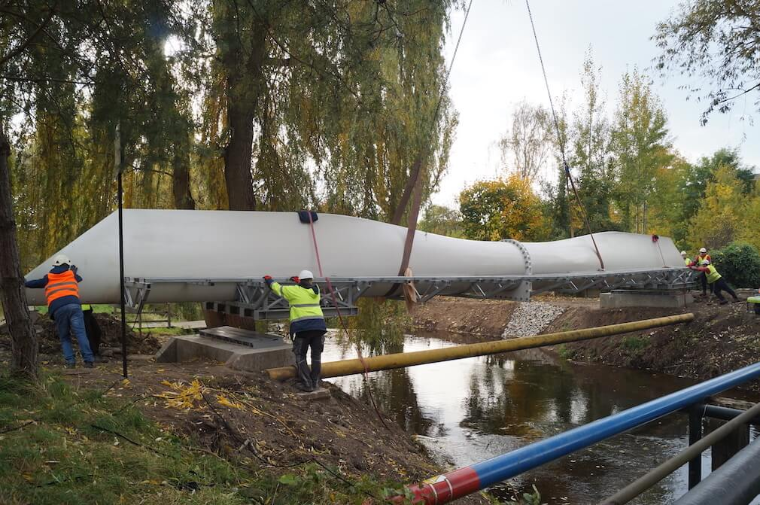
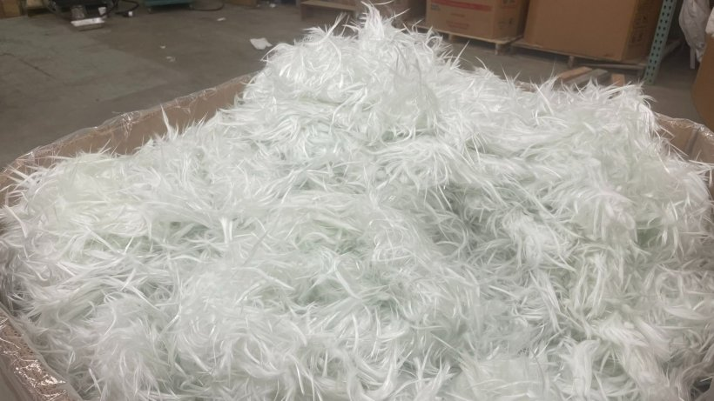
Group 5: Planning R&D to advance California’s Clean Energy Circular Economy
Repurposed Wind Turbine blade
foot bridge design
Contributing to solutions on topics like:
  Renewable energy materials and product design for extended life.
  Existing renewable energy components’ disassembly design towards recycling and reuse.
  Developing new technologies to process complex composite materials stemming from current retired renewable energy components towards high demand fields.
  Developing renewable energy remanufacturing guidelines.
Source:https://windexchange.energy.gov/end-of-service-guide
Carbon Rivers’ recycled glass fiber
from wind turbines
Source: DOE

Slide 18
Comments and Questions
Three ways to provide feedback or ask questions:
In the Zoom live application: Please use the raise hand function, unmute yourself and introduce yourself by stating your name and affiliation.
  Zoom Phone controls: *9 to Raise hand; *6 to Toggle mute/unmute. Please introduce yourself by stating your name and affiliation.
Type comments and questions in the question function on Zoom:
  Please provide name and affiliation.
  Please indicate which discussion questions you are commenting on (E.g., 1a, 1b, 2, etc.).
Submit written comments & questions:
  Send written comments & questions to docket@energy.ca.gov by no later than Friday December 29, 2021, 5 p.m. PST.
    Include docket number 23-ERDD-01 and “Advancing the Environmental Sustainability of the Clean Energy Transition” in the subject line

Slide 19
Group 1 Discussion Questions: Automated mapping of solar energy development footprints and modeling land suitability for dual-use purposes
  Should AI mapping of solar footprints and suitability for dual use solar be combined in one research project?
  Should the project be limited to developing the automated mapping methods or should it also generate a map of solar footprints? If a map, should it be statewide or WECC-wide?

Slide 20
Group 2 Discussion Questions: Assessing and minimizing environmental and biological resource impacts of clean energy deployments
  What additional types of research topics would be valuable to fill key knowledge gaps?
  Should this topic be focused on a particular group of species/ecosystems or electricity generation technologies?

Slide 21
Group 3 Discussion Questions: Testing bird-friendly windows for decarbonized buildings
  Should the project focus on either electricity generation technologies or energy efficiency technologies or both?
  Should the project focus on testing existing energy windows or new technologies to be developed to meet both bird and energy objectives or both?

Slide 22
Group 4 Discussion Questions: Identifying biologically appropriate exterior lighting
  Should the project focus on particular species or groups of species? If so, which ones?
  Should the project be limited to studying LED lighting or include any outdoor lighting technologies in use?

Slide 23
Group 5 Discussion Questions: Planning R&D to advance California’s clean energy circular economy
    Which clean energy circular economy topic proposed has the highest priority and why? (design for extended life; design for recycling and reuse; new technologies to manage retired materials’; remanufacturing guidelines)
    Are there any other topics we should consider including?

Slide 24
Discussion Questions for all groups:
What suggestions would you make to improve the scope and/or focus of these efforts, given the total of $3 million budget available?
How can the efforts outlined above best complement and build on other research and analysis efforts?
How can the efforts outlined above best deliver high-impact, policy-relevant results?
What are key gaps in knowledge and methods to inform a reliable, resilient transition to a zero-carbon electricity system, as directed by the goals of SB 100?

Slide 25
Thank You!
Please submit your written comments by
5 p.m. December 29, 2023
Submit electronically through the Energy Commission’s “Research Idea Exchange” docket here: https://efiling.energy.ca.gov/Lists/DocketLog.aspx?docketnumber=23-ERDD-01
Or by email to the Docket Unit at: docket@energy.ca.gov
  Please include docket number 23-ERDD-01 and “Advancing the Environmental Sustainability of the Clean Energy Transition” in the subject line
Or by paper copy to the Docket Unit: California Energy Commission || Docket Unit, MS-4 || Re: Docket No. 23-ERDD-01 || 715 P Street || Sacramento, CA 95814

