Slide 1
CEC Computer Technical feasibility, Cost effectiveness, and Schedule impact
Robert White, Dell
April 26, 2016

Slide 2
TEC improvement potential & shipment impact
Technical feasibility
Cost effectiveness (BOM plus other costs)
Schedule impact

Slide 3
Desktops - Technical Feasibility
Product development cycles do not allow enough time to redesign product to meet a January 1, 2018 effective date.
A 24 month grace period between publication of the final rule aligns with a January 1, 2019 effective date
The proposed single category of 50 kWh TEC limit is too stringent and is 19 kWh lower than Category 0 (entry level) in ENERGY STAR 6.1 framework that provides 6 categories for DT’s
ITI has collected power data for 170 currently shipping platforms, the 50 kWh limit only allows ~10% pass rate, most of those platforms utilize notebook parts and provide limited expandability

Slide 4
Margin to CEC Limit – Desktop – All systems
CEC D2 Limit – Measured TEC = TEC Margin Value
  Positive Margin Passes CEC Limit, Negative Fails
Majority of systems have a margin of -25 to -100
  Most systems are 50% to 200% over the limit
PASSING SYSTEMS
FAILING SYSTEMS

Slide 5
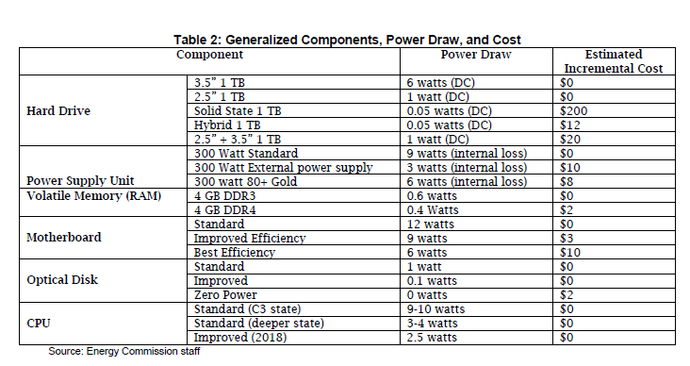
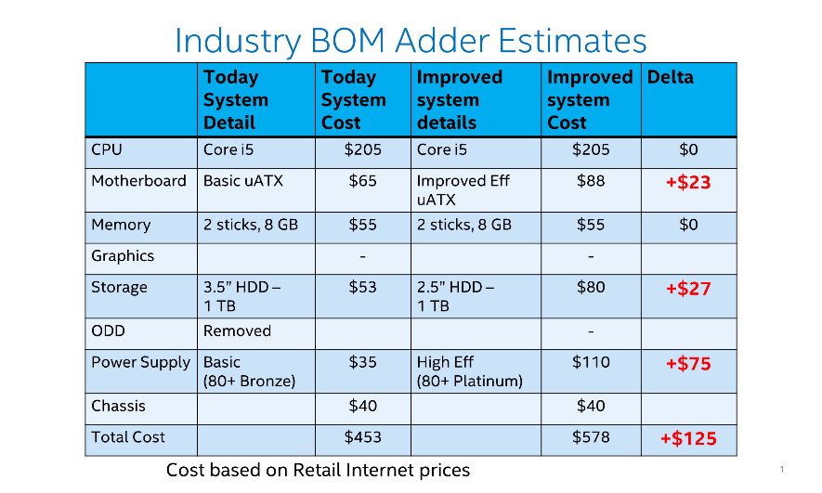
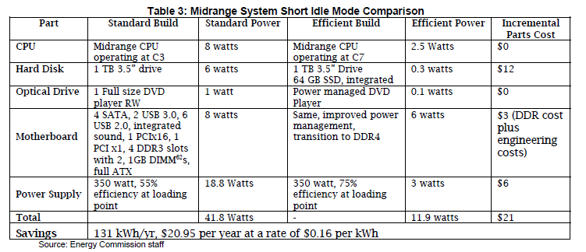
CEC Cost Effectiveness
Industry Estimates
-
$11
$255
$16
???
-
$150
$60 Platinum
-
$1
-
$5
$24
-
$10 Mobile
??
-
-
-
Industry Estimates
$0
$16
$10
$24
$60
$110
CEC BOM cost estimates -Key Issues:
Issue 1: We are far apart on pricing. CEC & Industry must agree on projected cost impacts
Issue 2: Industry requires multiple vendors for each component, manufacturing variability requires designs to be more efficient than specified limits which increases costs
300W vs. 350W PSU???
Cost effectiveness remains the biggest gap (CEC vs. Industry Estimates)

Slide 6
Preamble
Highlighting 4 slides industry previously presented related to cost and schedule
Want to understand why industry input wasn’t considered?

Slide 7
System & Chipset Costs
As previously stated in TN# 205339 Related to Costs and schedule impacts
Lack of categories or appropriate adders will leave mobile parts as only option to meet limit – Between $40.00 and $120.00 per unit to change
Based on i5 / i3 processor and chipset prices currently on Intel.com website
Minimum price Average Price and Maximum price of available listed processor and chipsets are compared

Slide 8
Hard Drives Capabilities
As previously stated in TN# 206314 related to Hard Drive Idle Power Summary
Although we have discussed Idle and Standby drive states, it is not possible to achieve platform standby state power levels with the drive in “Idle” state (as defined in drive spec sheets)
  HDD idle states in spec sheets have platter spun down. This is not possible for main disk in idle test methods without developing new/changed operating systems.
Main Takeaway
2.5” drives will be able to meet a 1W idle power goal
3.5” drives will not be able to meet a 1W idle power goal
  Motor technology is very mature such that further power reductions are unlikely
  Larger disk mass, higher motor bearing friction and windage contribute to higher motor power at idle when compared to 2.5” drives
  None of the power reduction enablers discussed previously will allow us to reach the 1 W power goal

Slide 9
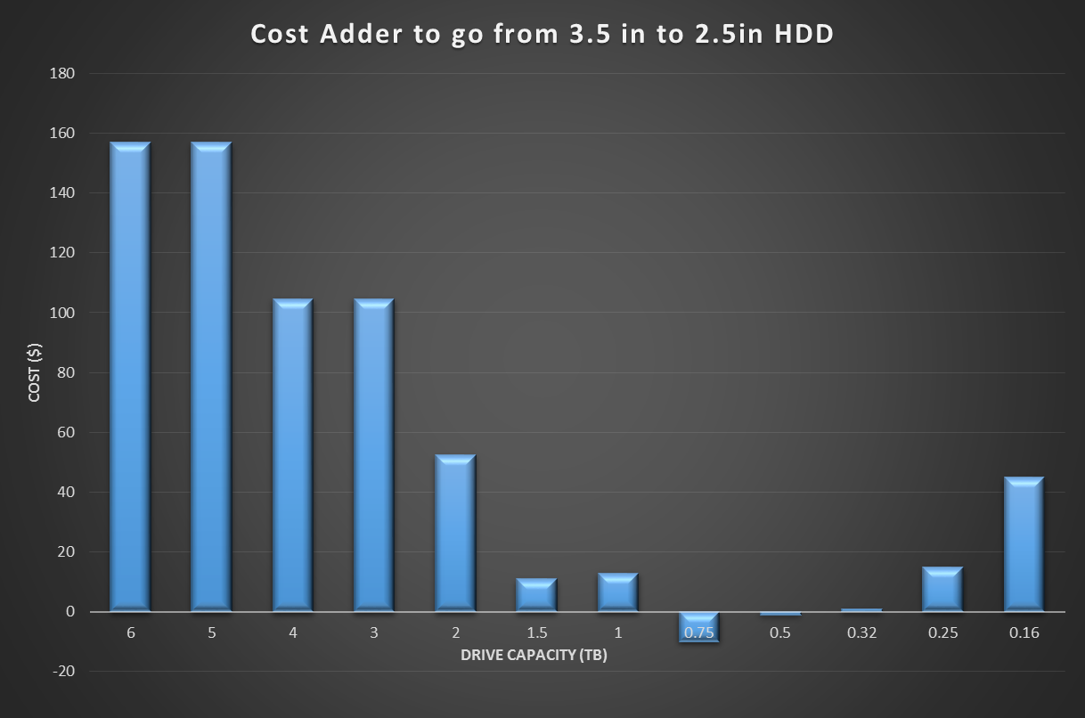
$ of changing to 2.5in HDD in a Desktop
As previously stated in TN# 205339 related to 2.5” vs 3.5” Hard Drive Costs
Cost neutral only applies to limited range of capacities
2.5in systems do have lower performance in some applications
3.5in Eﬃcient drives still have size and performance tradeoﬀs
Customers needing large Capacity will experience between $50.00 and 150.00 per unit cost increase or have to add drives after initial purchase

Slide 10
Power Supply Design Schedules
  Insufficient number of existing PSU's to support all platforms being shipped into California. Demand of these PSU’s would exceed supply.
As previously stated in TN# 206278 Related to Power Supply Redesign Schedules
Short Term 12-­‐24 mo.
  Use existing PSU’s on the market selecting good low load eﬀ., (will not provide enough margin)
  Transition to single output PSU (Common now but not pervasive)
Medium Term 24-­‐36 mo.
  Low load optimization of existing PSU’s using existing system architecture
    Low load Eﬀ. optimization – may sacriﬁce high load Eﬀ.
    Implementation costs still being evaluated
• Long Term 36mo. Plus
  Low load optimization of PSU’s requiring silicon changes
    Variable frequency / pulse skipping …
    Evaluate Light load indication system to PSU
      PSU redesign plus 6-9 mo. min to evaluate opportunities for light load indication
    Implementation costs still being evaluated
Variability of light load eﬃciency in production may be signiﬁcant
  PSU losses become dominated by parameters insigniﬁcant in normal operation
  Aggressive limits may drive signiﬁcant yield loss driving up costs

Slide 11
Improving low-load efficiency
Increasing efficiency below 20% load is a long-term project
In the December 16, 2015 EPRI and Ecova report named Test Results for Low Power Testing of Computer Power Supplies - stated “lower leakage currents and switching losses as well as new techniques for addressing emissions through better filter designs or switching algorithms would be required”
Because the loading point varies based upon the maximum output wattage (200W vs. 500W), specifying efficiency at a fixed loading point is not sufficient
Industry needs time to work with our suppliers and EPRI/Ecova to investigate a global standard that comprehends the technical difficulties and recognizes/awards best practices

Slide 12
Schedule Impacts
Manufacturers cannot update design criteria until a final (locked) regulation is published
1 year between publication and effective date does not provide adequate time to redesign shipping models nor introduce design changes to models that are undergoing global Safety, EMI, and Environmental certifications and have not been placed on the global market
Major motherboard and chipset design changes typically require a minimum of 24 months to verify, implement and certify for the global marketplace
Industry requests models that are already on the market on/after the effective date be grandfathered from the 50 kWh Desktop TEC limits
New models introduced to the market after the effective date would comply to all CEC criteria

Slide 13
Additional Schedule Impacts
Manufacturers adhere to technology roadmaps that incorporate new technology enhancements
To further reduce idle mode power, additional modifications to those designs must include
  New Power Supply’s
  New CPU’s/Chipsets/Motherboards
  2.5” or SSD hard drives
  Discrete Graphics cards with reduced idle power
  Expandability cards (NIC, Sound, TV tuner, etc.)
  Operating Systems enhancements to allow computers to remain in lower-power idle state (schedule/delay background tasks)
  Anti-virus, Spyware, Malware, and other Security enhancements
  Global EMI, Safety, Environmental, and other certifications
A minimum 24-36 months is necessary

Slide 14
END

