Slide 1
Analysis of Benefits Associated With Projects and Technologies Supported by the Clean Transportation Program:
2023 Executive Summary
Roberto Vercellino and Dan Mazzone
October 2023

Slide 2
Introduction
In 2007, California Assembly Bills (AB) 118 and 109 created the Clean Transportation Program (CTP), which authorized the California Energy Commission (CEC) to fund projects concerning alternative fuels and advanced transportation technologies to help attain the state’s climate change policies. In 2013, AB 8 extended the expiration of the CTP to January 2024.
AB 109 also requires CEC to prepare a report summarizing the benefits resulting from the program.
Since then, CEC has collaborated with National Renewable Energy Laboratory (NREL) to prepare and publish biannual reports summarizing CTP’s benefits related to petroleum displacement, greenhouse gas (GHG) reductions, air pollution, and more.
This report updates the input data, calculation methodologies, and resulting outputs from the CEC’s 2021 report [1].
The results to be incorporated in the CEC’s final Integrated Energy Policy Report (IEPR) might change.
1. California Energy Commission. 2021. Analysis of Benefits Associated With Projects and Technologies Supported by the Clean Transportation Program. Sacramento, CA: CEC. CEC-600-2021-039. https://doi.org/10.2172/1886868.

Slide 3
Goals of CTP-Funded Projects
As stated in the 2021 benefits analysis report and in AB 8 [1,2], the goals of CTP-funded projects are to:
Develop and improve alternative and renewable low‐carbon fuels.
Enhance alternative and renewable fuels for existing and developing engine technologies.
Produce alternative and renewable low-carbon fuels in California.
Decrease, on a full-fuel-cycle basis, the overall impact and carbon footprint of alternative and renewable fuels and increase sustainability.
Expand fuel infrastructure, fueling stations, and equipment.
Improve light-, medium-, and heavy-duty vehicle technologies.
Retrofit medium- and heavy-duty on-road and non-road vehicle fleets.
Expand infrastructure connected with existing fleets, public transit, and transportation corridors.
Establish workforce training programs, conduct public education and promotion, and create technology centers.
1. California Energy Commission. 2021. Analysis of Benefits Associated With Projects and Technologies Supported by the Clean Transportation Program. Sacramento, CA: CEC. CEC-600-2021-039. https://doi.org/10.2172/1886868.
2. California Assembly Bill 8. Statutes of 2013, Perea, Chapter 401. http://www.leginfo.ca.gov/pub/13-14/bill/asm/ab_0001-0050/ab_8_bill_20130928_chaptered.pdf

Slide 4
Scope of This Analysis
CTP Benefits
Expected Benefits
Market Transformation Benefits
Perceived Vehicle Price
Fuel Production
Refueling Infrastructure
Vehicle Deployment
Vehicle Cost Reductions
Advanced Technologies
Types of Benefits
Expected benefits accrue because of the direct displacement of petroleum-based fuels or vehicle technologies.
Market transformation benefits accrue because of CTP funding shifting the underlying market dynamics and accelerating the adoption of alternative fuel vehicles.
Benefit Outcomes
Displaced petroleum consumption
GHG emissions reductions
Criteria pollutant reductions
Jobs supported
Equity and social benefits.
Modeling Horizon
Benefits accruing from 2013–2035.
Benefits considered in this report

Slide 5
Summary of Evaluated Projects

Slide 6
Projects Funded Under the CTP Included in This Analysis
Project Type | # of Projects Analyzed | CTP Funding Analyzed ($ millions)
Biomethane Production | 12 | $35.9
Gasoline Substitutes Production | 5 | $10.7
Diesel Substitutes Production | 10 | $41.5
Electric Vehicle (EV) Charging – Light Duty (LD)* | 621 | $288.6
EV Charging – Medium and Heavy Duty (MD/HD) | 89 | $72.2
Hydrogen Refueling Stations – LD | 71 | $128.2
Hydrogen Refueling Stations – MD/HD | 4 | $25.5
E85 Fueling Stations | 19 | $1.3
Natural Gas Fueling Stations | 42 | $14.9
Manufacturing (Infrastructure) | 8 | $26.4
Natural Gas Commercial Trucks | 13 | $51.3
Light-Duty Battery-Electric Vehicles (BEVs) and Plug-In Hybrid Electric Vehicles (PHEVs) | 4 | $2.8
Clean Vehicle Rebate Project (CVRP) and Hybrid and Zero Emission Truck and Bus Voucher Incentive Project (HVIP) Support | 2 | $22.5
MD/HD Truck Demonstration | 33 | $79.8
Manufacturing (Vehicles) | 30 | $235.2
Other | 0 | $0
Total | 963 | $1,036.8
Projects are grouped into three classes:
Fuel production
Fueling infrastructure
Vehicles
* Project data for the California Electric Vehicle Infrastructure Project (CALeVIP) were estimated using available information on the program’s website. See Slide 38 for more details.

Slide 7
Methodology Updates From Previous Analysis
Several updates to the 2021 analysis are introduced [1]:
The scope of the analysis is limited to projects funded in the last 10 years (since 2013).
Additional project categories are added to the analysis, namely MD/HD EV charging and hydrogen (H₂) refueling infrastructure projects.
The life cycle emissions parameters (i.e., carbon intensity [CI]), are updated to reflect the latest Low Carbon Fuel Standard (LCFS) data [2].
The CIs of replaced fuels (i.e., gasoline and diesel fuels) in each year are assumed to be the LCFS benchmarks for those fuels, rather than the CI of the fuel itself [3].
The assumed infrastructure life spans are shortened to reflect generally observed trends:
Project Class | Project Subclass | Current Life Span (Years) | Previous Life Span (Years)
Fuel production | - | 20 | 40
Fueling infrastructure | - | 10 | 20
Vehicles | - | 10 | 16
- | Manufacturing | 10 | 50
1. California Energy Commission. 2021. Analysis of Benefits Associated With Projects and Technologies Supported by the Clean Transportation Program. Sacramento, CA: CEC. CEC-600-2021-039. https://doi.org/10.2172/1886868.
2. CARB. 2023. “LCFS Pathway Certified Carbon Intensities.” https://ww2.arb.ca.gov/resources/documents/lcfs-pathway-certified-carbon-intensities.
3. CARB. 2020. Low Carbon Fuel Standard. https://ww2.arb.ca.gov/sites/default/files/2020-07/2020_lcfs_fro_oal-approved_unofficial_06302020.pdf.

Slide 8
Petroleum Displacement Estimates

Slide 9
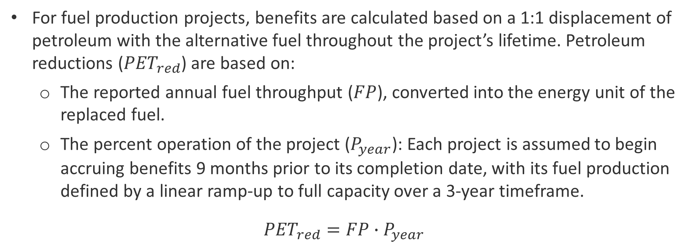
Fuel Production Projects
For fuel production projects, benefits are calculated based on a 1:1 displacement of petroleum with the alternative fuel throughout the project’s lifetime. Petroleum reductions (${PET}_{red}$) are based on:
  The reported annual fuel throughput ($FP$), converted into the energy unit of the replaced fuel.
  The percent operation of the project ($P_{year}$): Each project is assumed to begin accruing benefits 9 months prior to its completion date, with its fuel production defined by a linear ramp-up to full capacity over a 3-year timeframe.
${PET}_{red}={FP}_{ }∙P_{year}$

Slide 10
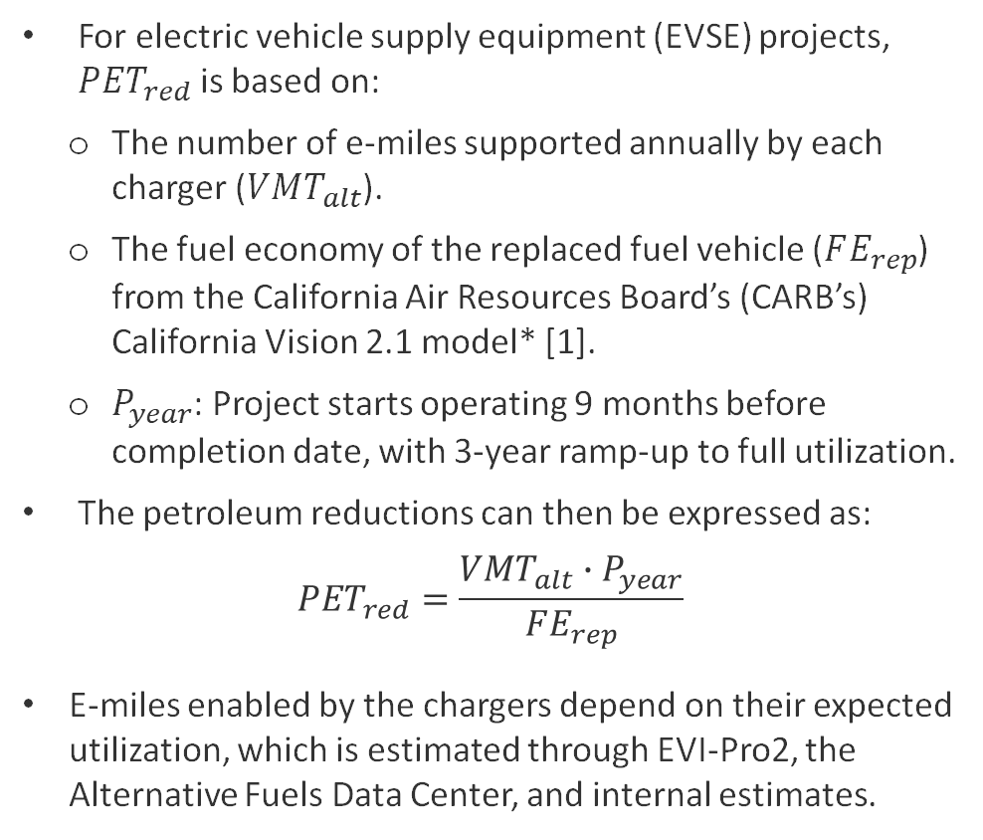
Light-Duty EV Charging Infrastructure
For electric vehicle supply equipment (EVSE) projects, ${PET}_{red}$ is based on:
  The number of e-miles supported annually by each charger ($VMT_{alt}$).
  The fuel economy of the replaced fuel vehicle ($FE_{rep}$) from the California Air Resources Board’s (CARB’s) California Vision 2.1 model* [1].
  $P_{year}$: Project starts operating 9 months before completion date, with 3-year ramp-up to full utilization.
The petroleum reductions can then be expressed as:
$${PET}_{red}=\frac{VMT_{alt}∙P_{year}}{FE_{rep}}$$
E-miles enabled by the chargers depend on their expected utilization, which is estimated through EVI-Pro2, the Alternative Fuels Data Center, and internal estimates.
Charger Utilization Percentage by Year and Type
Year | L2 Public | L2 Multifamily Home | L2 Workplace | DC 50 kW | DC 150 kW ª
2020 | 4.53% | 4.53% | 7.13% | 6.12% | 6.12%
2021 | 4.64% | 6.38% | 8.12% | 6.89% | 6.89%
2022 | 4.94% | 8.46% | 9.58% | 7.76% | 7.76%
2023 | 5.07% | 10.23% | 10.44% | 8.63% | 8.63%
2024 | 5.23% | 12.01% | 11.86% | 9.50% | 9.50%
2025 | 5.76% | 14.66% | 12.44% | 10.37% | 10.37%
2026 | 5.76% | 14.66% | 12.98% | 11.24% | 11.24%
2027 | 5.65% | 14.40% | 14.04% | 12.11% | 12.11%
2028 | 5.60% | 14.27% | 14.62% | 12.98% | 12.98%
2029 | 5.59% | 14.25% | 15.07% | 13.85% | 13.85%
2030 | 5.76% | 14.66% | 15.40% | 14.72% | 14.72%
ª DC 150-kW project utilization estimates are assumed to be identical to DC 50 kW. See Slide 41 for the correlation between assumed utilization and e-miles.
* Vehicle-specific parameters are assigned based on vehicle type assignments listed in Slides 39–40.
CARB. 2023. “Vision Scenario Planning.” Accessed Oct. 4, 2023. https://ww2.arb.ca.gov/resources/documents/vision-scenario-planning.

Slide 11
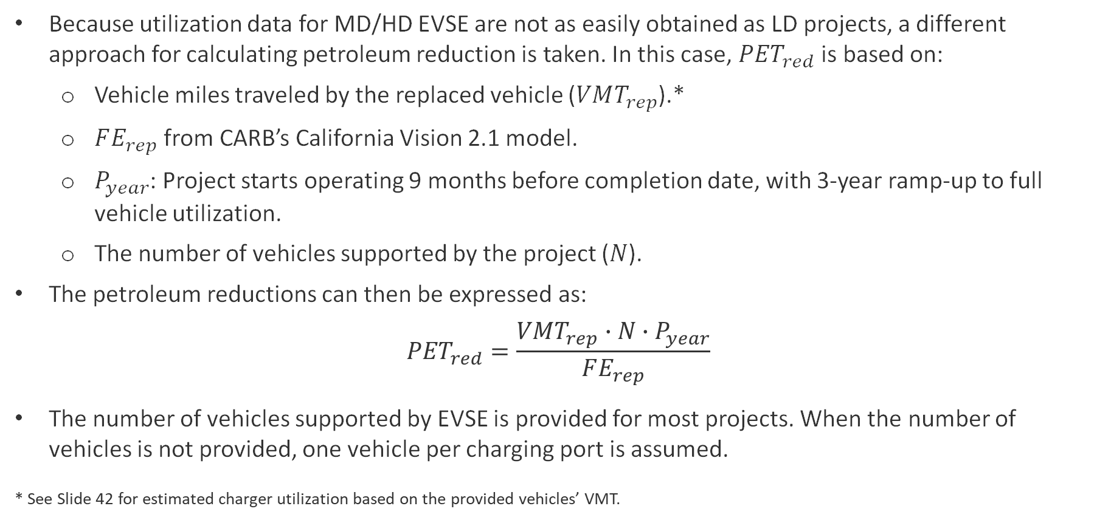
Medium- and Heavy-Duty EV Charging Infrastructure
Because utilization data for MD/HD EVSE are not as easily obtained as LD projects, a different approach for calculating petroleum reduction is taken. In this case, ${PET}_{red}$ is based on:
  Vehicle miles traveled by the replaced vehicle ($VMT_{rep}$).*
  $FE_{rep}$ from CARB’s California Vision 2.1 model.
  $P_{year}$: Project starts operating 9 months before completion date, with 3-year ramp-up to full vehicle utilization.
  The number of vehicles supported by the project ($N$).
The petroleum reductions can then be expressed as:
$${PET}_{red}=\frac{VMT_{rep}∙N∙P_{year}}{FE_{rep}}$$
The number of vehicles supported by EVSE is provided for most projects. When the number of vehicles is not provided, one vehicle per charging port is assumed.
* See Slide 42 for estimated charger utilization based on the provided vehicles’ VMT.

Slide 12
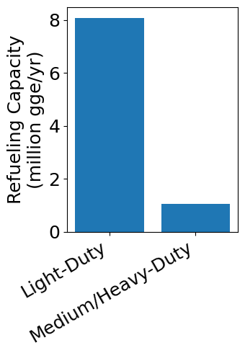
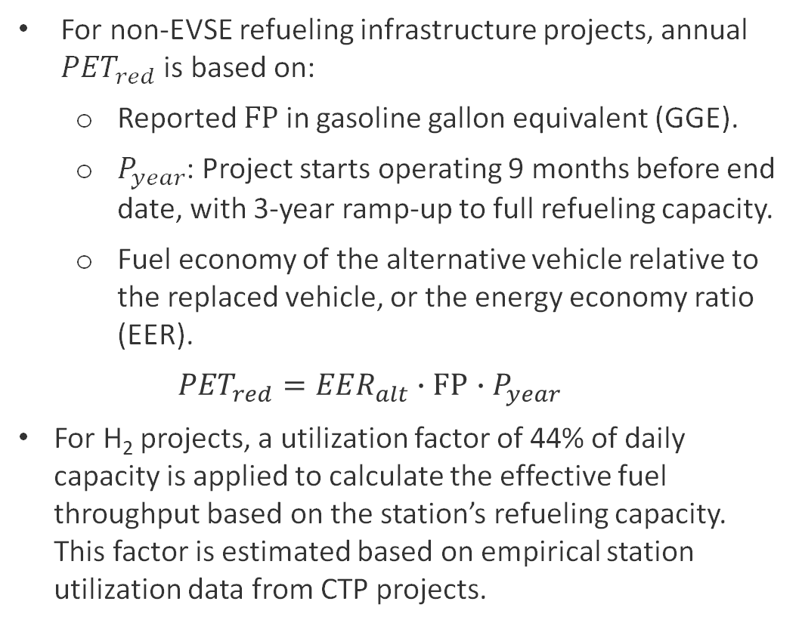
Non-Electric Fueling Infrastructure
Fuel Conversion to GGE [1]
For non-EVSE refueling infrastructure projects, annual ${PET}_{red}$ is based on:
  Reported $FP$ in gasoline gallon equivalent (GGE).
  $P_{year}$: Project starts operating 9 months before end date, with 3-year ramp-up to full refueling capacity.
  Fuel economy of the alternative vehicle relative to the replaced vehicle, or the energy economy ratio (EER).
  $${PET}_{red}={EER_{alt}∙FP}_{ }∙P_{year}$$
For H₂ projects, a utilization factor of 44% of daily capacity is applied to calculate the effective fuel throughput based on the station’s refueling capacity. This factor is estimated based on empirical station utilization data from CTP projects.
Fuel Type | Conversion Units | Conversion Factor
Diesel | GGE/gallon | 1.155
E85 | GGE/gallon | 0.734
Electricity | GGE/kWh | 0.031
Gasoline | GGE/GGE | 1
Hydrogen | GGE/kg | 1.019
H₂ Refueling Infrastructure Projects Summary
U.S. Department of Energy. 2023. “Fuel Conversion Factors to Gasoline Gallon Equivalents.” https://epact.energy.gov/fuel-conversion-factors.

Slide 13
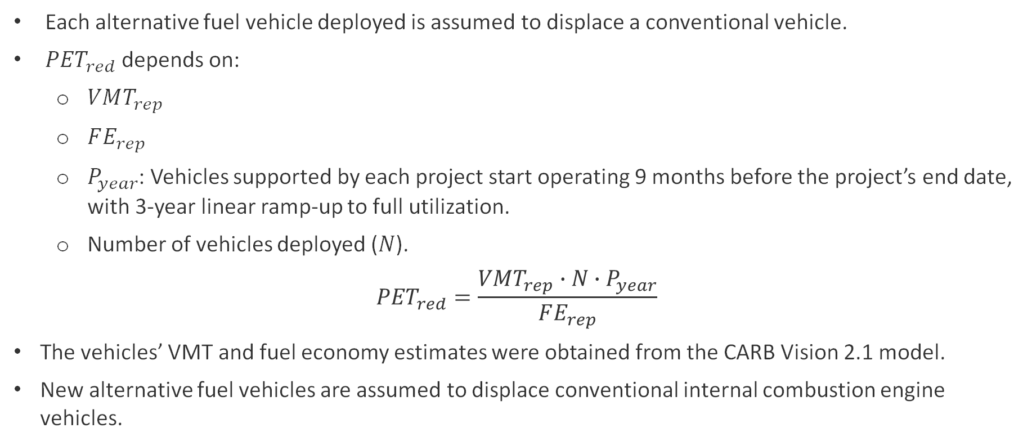
Vehicle Deployment Projects
Each alternative fuel vehicle deployed is assumed to displace a conventional vehicle.
${PET}_{red}$ depends on:
  $VMT_{rep}$
  $FE_{rep}$
  $P_{year}$: Vehicles supported by each project start operating 9 months before the project’s end date, with 3-year linear ramp-up to full utilization.
  Number of vehicles deployed ($N$).
$${PET}_{red}=\frac{VMT_{rep}∙N∙P_{year}}{FE_{rep}}$$
The vehicles’ VMT and fuel economy estimates were obtained from the CARB Vision 2.1 model.
New alternative fuel vehicles are assumed to displace conventional internal combustion engine vehicles.

Slide 14
GHG Reduction Estimates

Slide 15
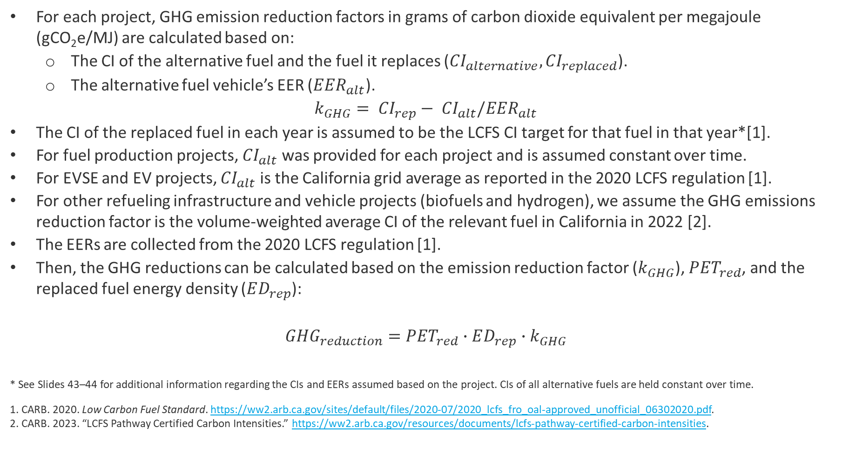
GHG Reduction Calculations
For each project, GHG emission reduction factors in grams of carbon dioxide equivalent per megajoule (gCO₂e/MJ) are calculated based on:
  The CI of the alternative fuel and the fuel it replaces (${{CI}_{alternative}, CI}_{replaced}$).
  The alternative fuel vehicle’s EER ($EER_{alt}$).
$$k_{GHG}= {CI}_{rep}− {CI}_{alt}/EER_{alt}$$
The CI of the replaced fuel in each year is assumed to be the LCFS CI target for that fuel in that year*[1].
For fuel production projects, ${CI}_{alt}$ was provided for each project and is assumed constant over time.
For EVSE and EV projects, ${CI}_{alt}$ is the California grid average as reported in the 2020 LCFS regulation [1].
For other refueling infrastructure and vehicle projects (biofuels and hydrogen), we assume the GHG emissions reduction factor is the volume-weighted average CI of the relevant fuel in California in 2022 [2].
The EERs are collected from the 2020 LCFS regulation [1].
Then, the GHG reductions can be calculated based on the emission reduction factor ($k_{GHG}$), ${PET}_{red}$, and the replaced fuel energy density ($ED_{rep}$):
$${GHG_{reduction}={PET}_{red}∙ED_{rep}∙k}_{GHG}$$
* See Slides 43–44 for additional information regarding the CIs and EERs assumed based on the project. CIs of all alternative fuels are held constant over time.
1. CARB. 2020. Low Carbon Fuel Standard. https://ww2.arb.ca.gov/sites/default/files/2020-07/2020_lcfs_fro_oal-approved_unofficial_06302020.pdf.
2. CARB. 2023. “LCFS Pathway Certified Carbon Intensities.” https://ww2.arb.ca.gov/resources/documents/lcfs-pathway-certified-carbon-intensities.

Slide 16
Air Pollution Improvements

Slide 17
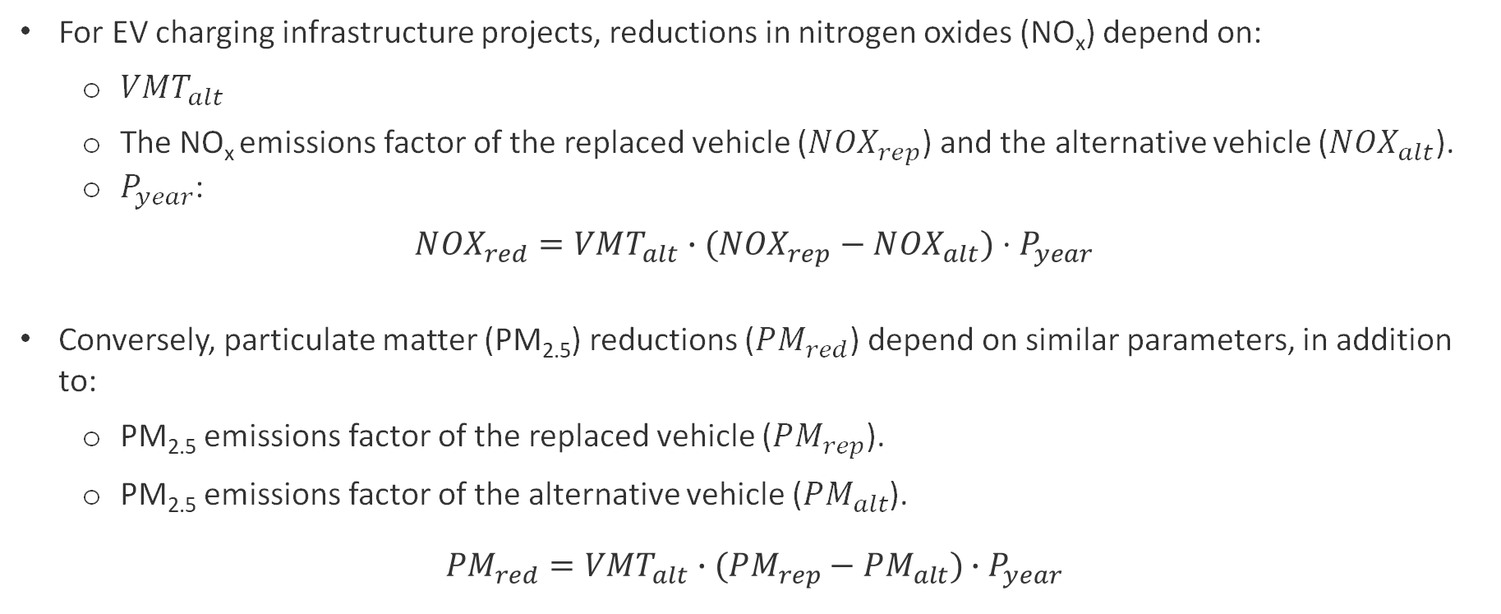
Air Pollution Improvements for EVSE Projects
For EV charging infrastructure projects, reductions in nitrogen oxides (NO_{x}) depend on:
  $VMT_{alt}$
  The NO_{x} emissions factor of the replaced vehicle ($N{OX}_{rep}$) and the alternative vehicle ($N{OX}_{alt}$).
  $P_{year}$:
$$N{OX}_{red}=VMT_{alt}∙(N{OX}_{rep}−N{OX}_{alt})⋅P_{year}$$
Conversely, particulate matter (PM_{2.5}) reductions ($PM_{red}$) depend on similar parameters, in addition to:
  PM_{2.5} emissions factor of the replaced vehicle ($PM_{rep}$).
  PM_{2.5} emissions factor of the alternative vehicle ($PM_{alt}$).
$$PM_{red}=VMT_{alt}∙(PM_{rep}−PM_{alt})∙P_{year}$$

Slide 18
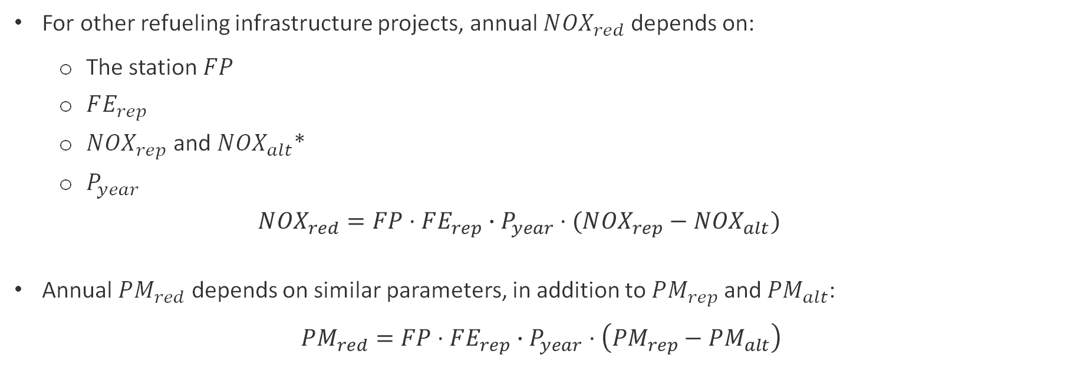
Air Pollution Improvements for Other Refueling Projects
For other refueling infrastructure projects, annual $N{OX}_{red}$ depends on:
  The station $FP$
  $FE_{rep}$
  $N{OX}_{rep}$ and $N{OX}_{alt}$*
  $P_{year}$
  $$N{OX}_{red}=FP⋅FE_{rep}∙P_{year}⋅(N{OX}_{rep}−N{OX}_{alt})$$
Annual $PM_{red}$ depends on similar parameters, in addition to$PM_{rep}$ and $PM_{alt}$:
$$PM_{red}=FP⋅FE_{rep}∙P_{year}⋅\left(PM_{rep}−PM_{alt}\right)$$
* Vehicle-specific parameters are assigned based on vehicle type assignments listed in Slide 39.

Slide 19
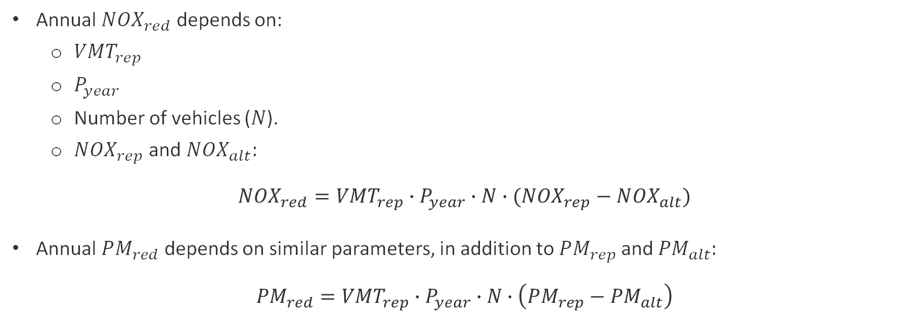
Air Pollution Improvements for Vehicle Projects
Annual $NOX_{red}$ depends on:
  $VMT_{rep}$
  $P_{year}$
  Number of vehicles ($N$).
  $N{OX}_{rep}$ and $N{OX}_{alt}:$
$$N{OX}_{red}=VMT_{rep}∙P_{year}∙N∙(N{OX}_{rep}−N{OX}_{alt})$$
Annual $PM_{red}$ depends on similar parameters, in addition to$PM_{rep}$ and $PM_{alt}:$
$$PM_{red}=VMT_{rep}∙P_{year}∙N∙\left(PM_{rep}−PM_{alt}\right)$$
* Vehicle-specific parameters are assigned based on vehicle type assignments listed in Slide 39.

Slide 20
Expected Benefits Summary

Slide 21
Expected Benefits Summary Tables
Annual expected benefits are shown by project subclass and evaluation year:
 | Petroleum Fuel Reductions (million gallons/year) | Petroleum Fuel Reductions (in million gallons) | Petroleum Fuel Reductions (in million gallons) | Petroleum Fuel Reductions (in million gallons) | GHG Reductions (thousand metric tons CO₂e/year)
Project Type | 2020 | 2025 | 2030 | 2035 | 2020 | 2025 | 2030 | 2035
Fuel Production - Biomethane | 0.11 | 5.44 | 5.84 | 5.84 | 1.44 | 155.34 | 163.50 | 163.50
Fuel Production - Diesel Substitutes | 11.18 | 18.08 | 18.08 | 18.08 | 92.06 | 142.43 | 127.04 | 127.04
Fuel Production - Gasoline Substitutes | 7.21 | 7.47 | 7.47 | 7.47 | 14.11 | 9.24 | 3.86 | 3.86
Fueling Infrastructure - E85 Ethanol | 2.40 | 2.50 | 0.00 | 0.00 | 7.46 | 5.97 | 0.00 | 0.00
Fueling Infrastructure - Electric Chargers - LD | 1.79 | 21.87 | 61.87 | 22.56 | 14.11 | 156.53 | 398.35 | 145.22
Fueling Infrastructure - Electric Chargers - MD/HD | 0.05 | 1.22 | 5.36 | 4.70 | 0.44 | 10.31 | 39.70 | 34.39
Fueling Infrastructure - Hydrogen - LD | 2.56 | 13.19 | 17.71 | 2.72 | 14.15 | 63.33 | 72.30 | 11.10
Fueling Infrastructure - Hydrogen - MD/HD | 0.00 | 0.19 | 1.43 | 1.53 | 0.00 | 0.74 | 4.27 | 4.59
Fueling Infrastructure - Natural and Renewable Gas | 10.20 | 10.81 | 0.15 | 0.00 | 24.23 | 16.19 | 0.02 | 0.00
Vehicles - CVRP and HVIP Support | 1.45 | 1.08 | 0.00 | 0.00 | 11.42 | 7.72 | 0.00 | 0.00
Vehicles - MD/HD Truck Demonstration | 0.47 | 1.08 | 0.42 | 0.00 | 3.42 | 5.99 | 1.60 | 0.00
Vehicles - Light-Duty BEVs and PHEVs | 0.00 | 0.03 | 0.02 | 0.00 | 0.01 | 0.21 | 0.14 | 0.00
Vehicles - Natural Gas Commercial Trucks | 0.58 | 2.46 | 1.99 | 0.00 | 1.07 | 2.72 | 0.55 | 0.00
Total | 37.99 | 85.41 | 120.35 | 62.90 | 183.92 | 576.72 | 811.33 | 489.69

Slide 22
Expected Benefits Summary Tables (continued)
Annual expected benefits are shown by project subclass and evaluation year:
 | NO_{x} Reductions (tons/year) |  |  |  | PM_{2.5} Reductions (tons/Year)
Project Type | 2020 | 2025 | 2030 | 2035 | 2020 | 2025 | 2030 | 2035
Fueling Infrastructure - Electric Chargers - LD | 1.23 | 12.98 | 36.88 | 13.51 | 0.12 | 1.61 | 1.73 | 0.63
Fueling Infrastructure - Electric Chargers - MD/HD | 0.28 | 8.65 | 39.44 | 35.01 | 0.00 | 0.41 | 3.82 | 3.43
Fueling Infrastructure - Hydrogen - LD | 0.70 | 3.35 | 4.17 | 0.60 | 0.07 | 0.41 | 0.20 | 0.03
Fueling Infrastructure - Hydrogen - MD/HD | 0.00 | 0.40 | 2.78 | 2.80 | 0.00 | 0.01 | 0.05 | 0.05
Fueling Infrastructure - Natural and Renewable Gas | 0.00 | 0.00 | 0.00 | 0.00 | 0.00 | 0.00 | 0.00 | 0.00
Vehicles - CVRP and HVIP Support | 1.79 | 1.77 | 0.00 | 0.00 | 0.08 | 0.06 | 0.00 | 0.00
Vehicles - MD/HD Truck Demonstration | 3.41 | 7.63 | 2.29 | 0.00 | 0.11 | 0.20 | 0.02 | 0.00
Vehicles – Light-Duty BEVs and PHEVs | 0.00 | 0.03 | 0.03 | 0.00 | 0.00 | 0.00 | 0.00 | 0.00
Vehicles - Natural Gas Commercial Trucks | 0.00 | 0.00 | 0.00 | 0.00 | 0.00 | 0.00 | 0.00 | 0.00
Total | 7.42 | 34.81 | 85.58 | 51.92 | 0.39 | 2.71 | 5.82 | 4.14

Slide 23
Expected Benefits to Disadvantaged and Low-Income Communities

Slide 24
Cumulative Expected Benefits in 2035 in
Disadvantaged and Low-Income Communities
Benefits to Disadvantaged Communities (DACs)
 | Petroleum Reductions (million gallons) | GHG Reductions (thousand tons) | NO_{x} Reductions (tons) | PM_{2.5} Reductions (tons)
Inside DAC | 536.80 | 3,718.45 | 252.34 | 19.72
Outside DAC | 488.14 | 3,051.23 | 337.71 | 25.58
Statewide | 440.90 | 2,920.85 | 263.26 | 15.26
Projects without DAC/LIC designations were assumed to be outside of DAC/LIC areas.
Projects whose funded activities are not attributable to a specific address are defined as “statewide” projects and are not considered in the DAC/LIC analysis.
54.9% of GHG emissions reductions are concentrated in DACs and 51.7% are concentrated in LICs.
Benefits to Low-Income Communities (LICs)
 | Petroleum Reductions (million gallons) | GHG Reductions (thousand tons) | NO_{x} Reductions (tons) | PM_{2.5} Reductions (tons)
Inside LIC | 535.56 | 3,501.99 | 247.44 | 13.39
Outside LIC | 489.39 | 3,267.69 | 342.60 | 31.92
Statewide | 440.90 | 2,920.85 | 263.26 | 15.26

Slide 25
Benefits by Project Subclass in Detail

Slide 26
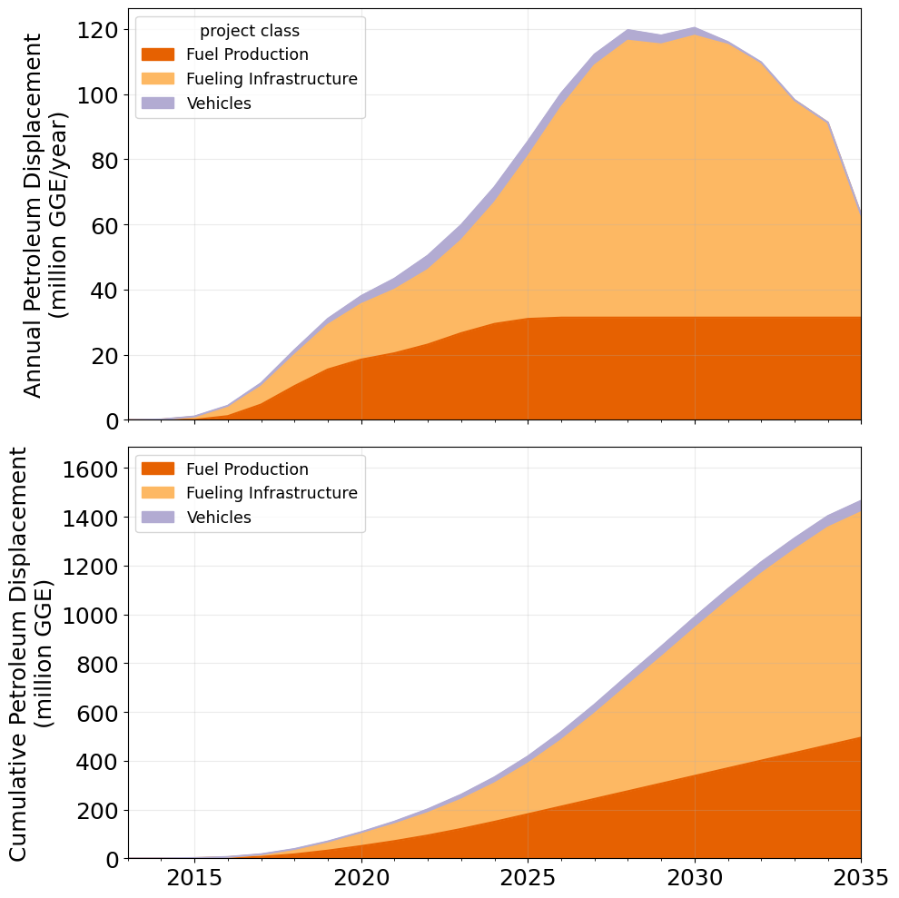
Petroleum Reductions
Among CEC-funded projects, fueling infrastructure is the largest contributor to petroleum displacement.
Among CEC-funded fueling infrastructure projects, the main contributions are from deployment of EV chargers (37.1% of cumulative petroleum reductions) and H₂ refueling stations (13%).
Alternative fuel production projects generate the second most cumulative petroleum reductions (38.5%), dominated by biomass-based diesel (22.1%) and biomethane (7.10%).

Slide 27
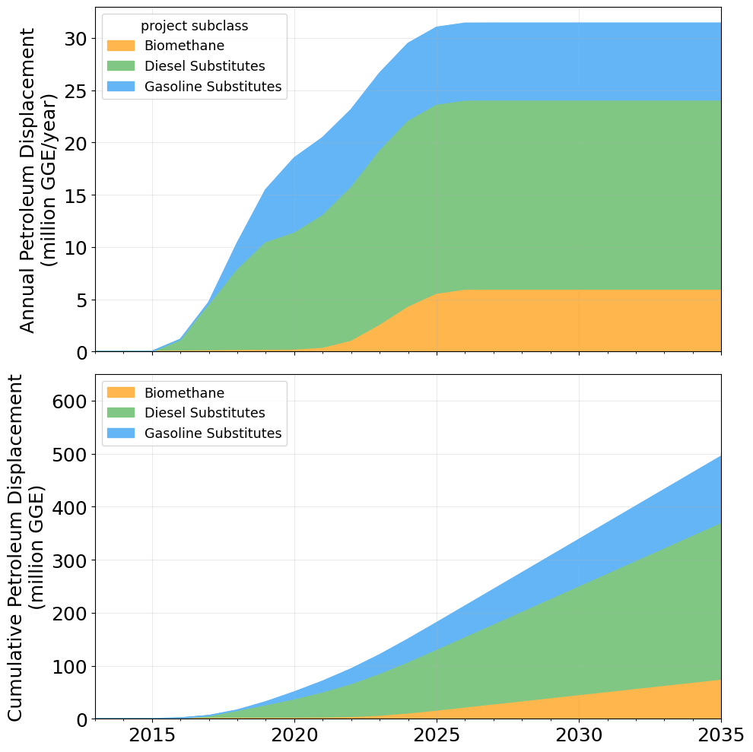
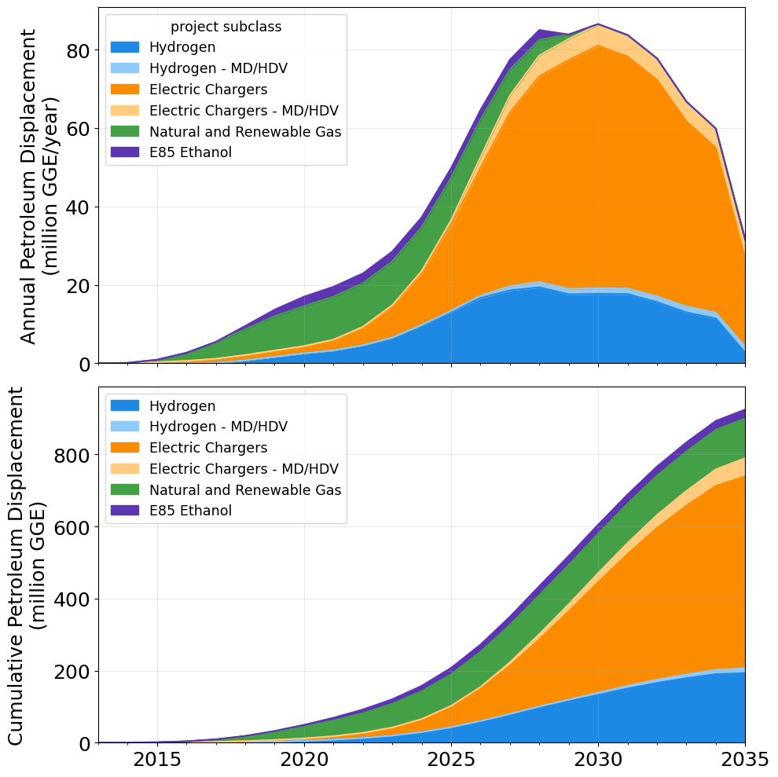
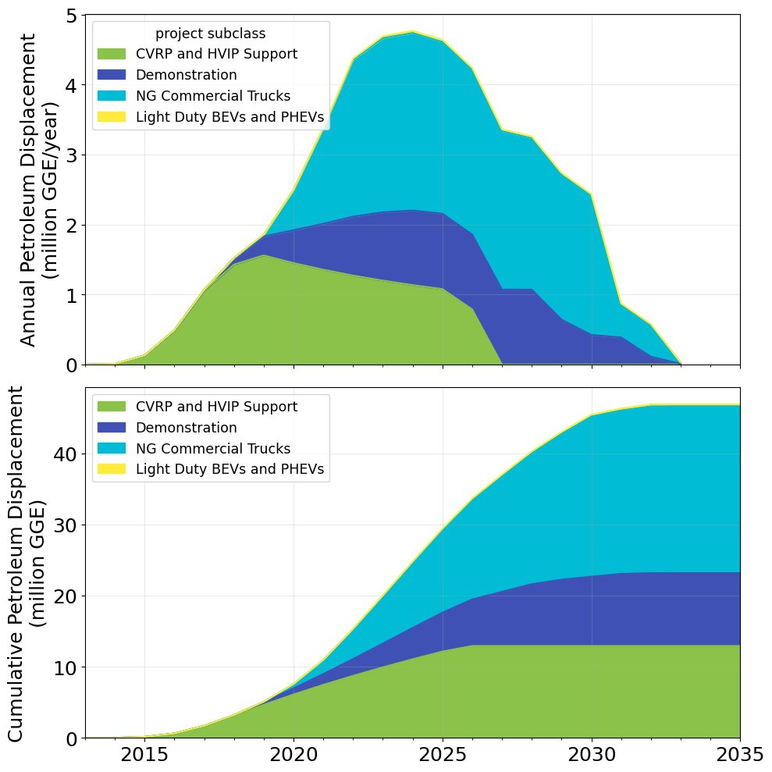
Petroleum Reductions
Fuel Production
Fueling Infrastructure
Vehicles

Slide 28
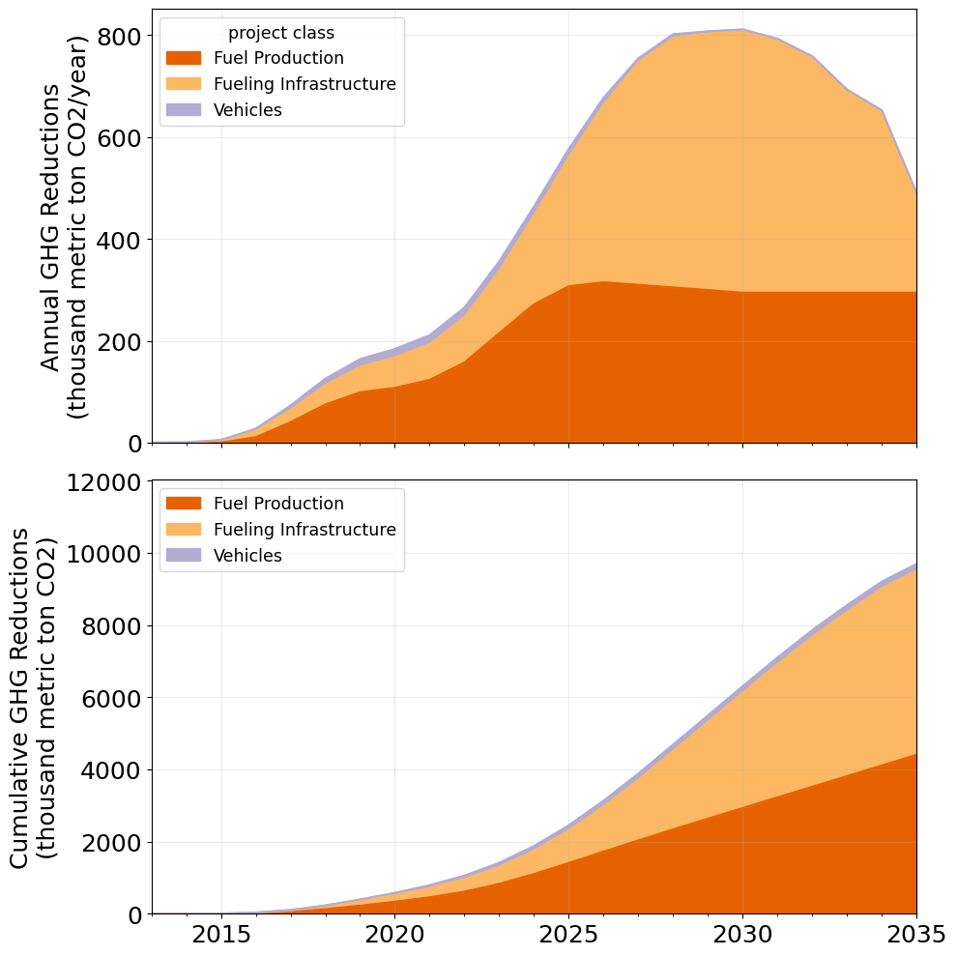
GHG Emissions Reductions
GHG reductions are a function of petroleum displacement and GHG emissions factors (CI).
Petroleum reductions from H₂ refueling infrastructure have limited impacts on GHG reductions relative to EVSE due to H₂’s relatively higher CI.
GHG reductions are largely due to fuel production projects (accounting for 52.8% of cumulative benefits) and refueling infrastructure projects (45.5%).
The outsized impact on GHG emissions reductions (relative to petroleum displacement) of biomass-based diesel and biomethane are due to their lower CIs relative to ethanol.

Slide 29
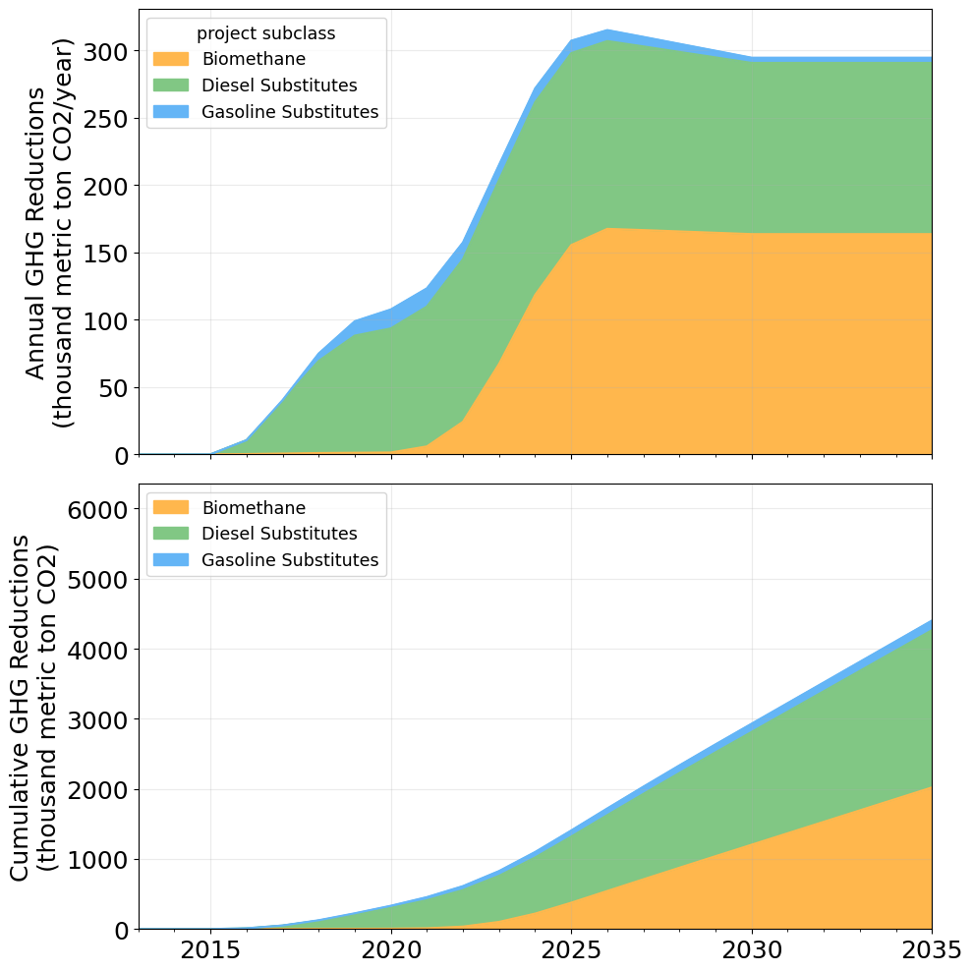
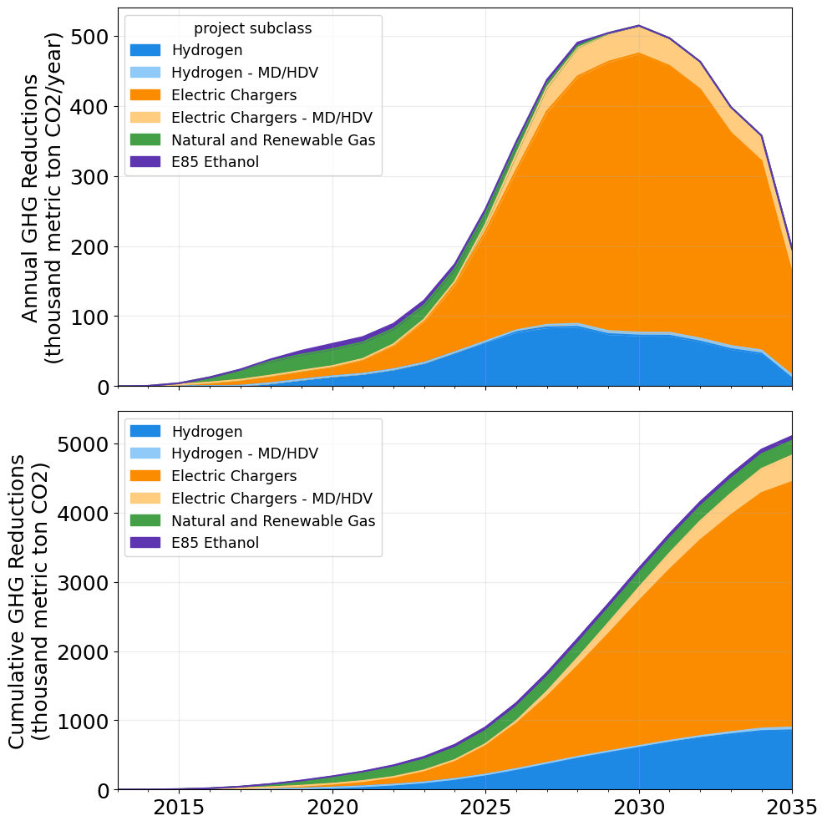
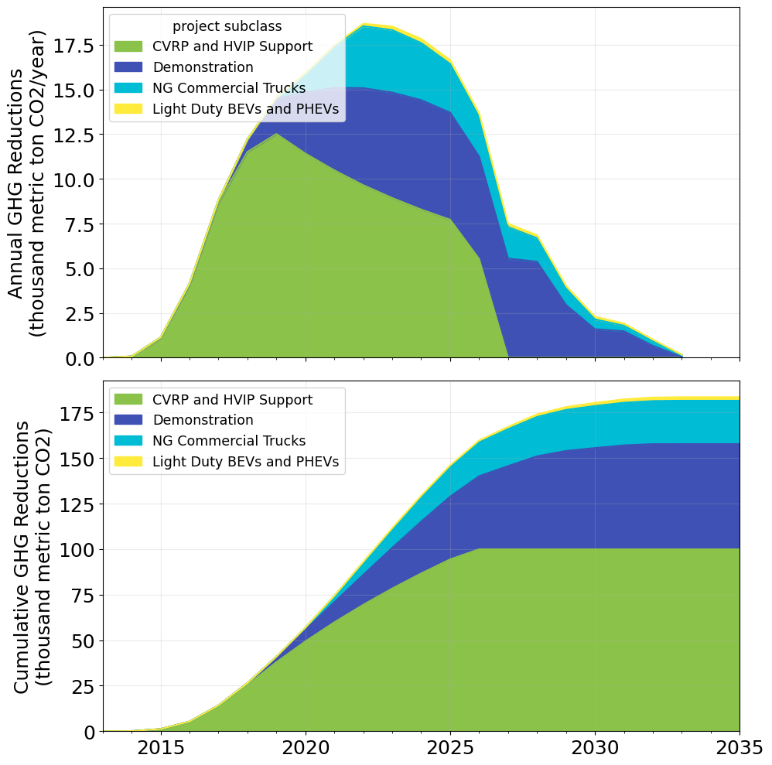
GHG Emissions Reductions
Fuel Production
Fueling Infrastructure
Vehicles

Slide 30
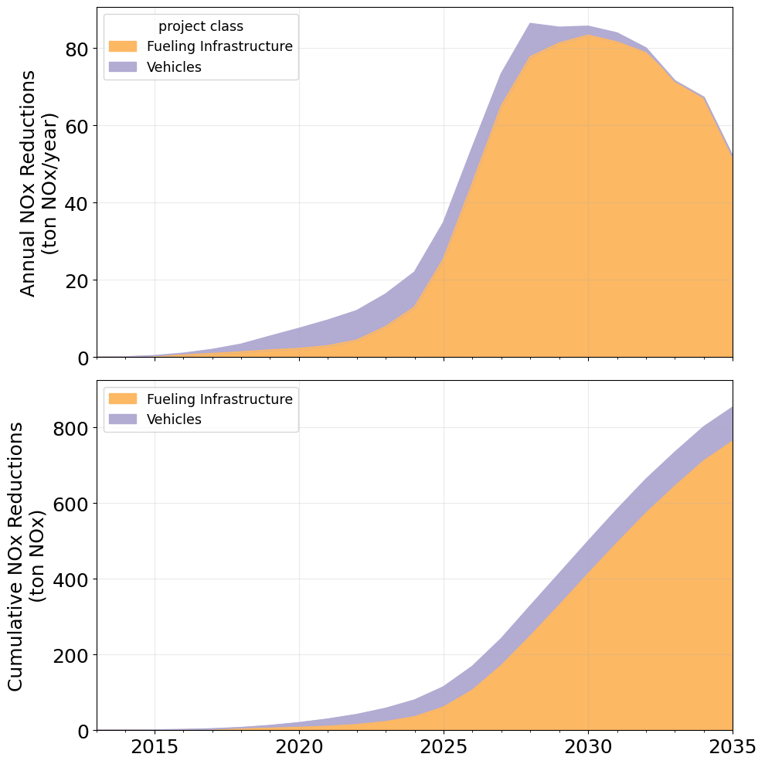
NO_{x} Emissions Reductions
As in the 2021 analysis, fuel production projects here are not assumed to result in direct air quality improvements.
Vehicle projects have a significant early impact on NO_{x}, while an augmented focus on fueling infrastructure projects results in their benefits significantly increasing after 2025.
Ultimately, fueling infrastructure projects account for most of the NO_{x} reductions, particularly due to LD and MD/HD EV charging infrastructure (accounting respectively for 36.9% and 44.4% of cumulative benefits).

Slide 31
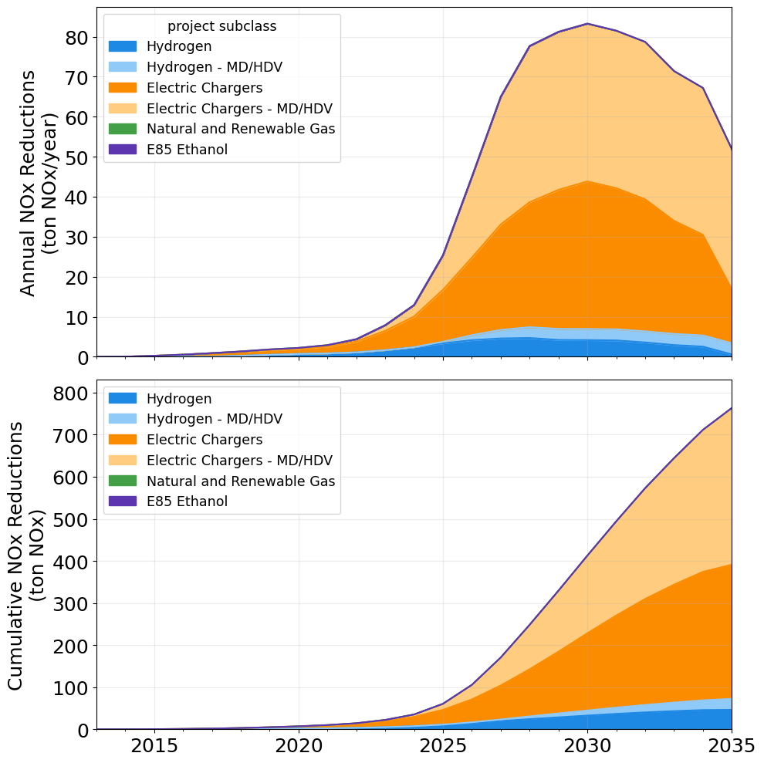
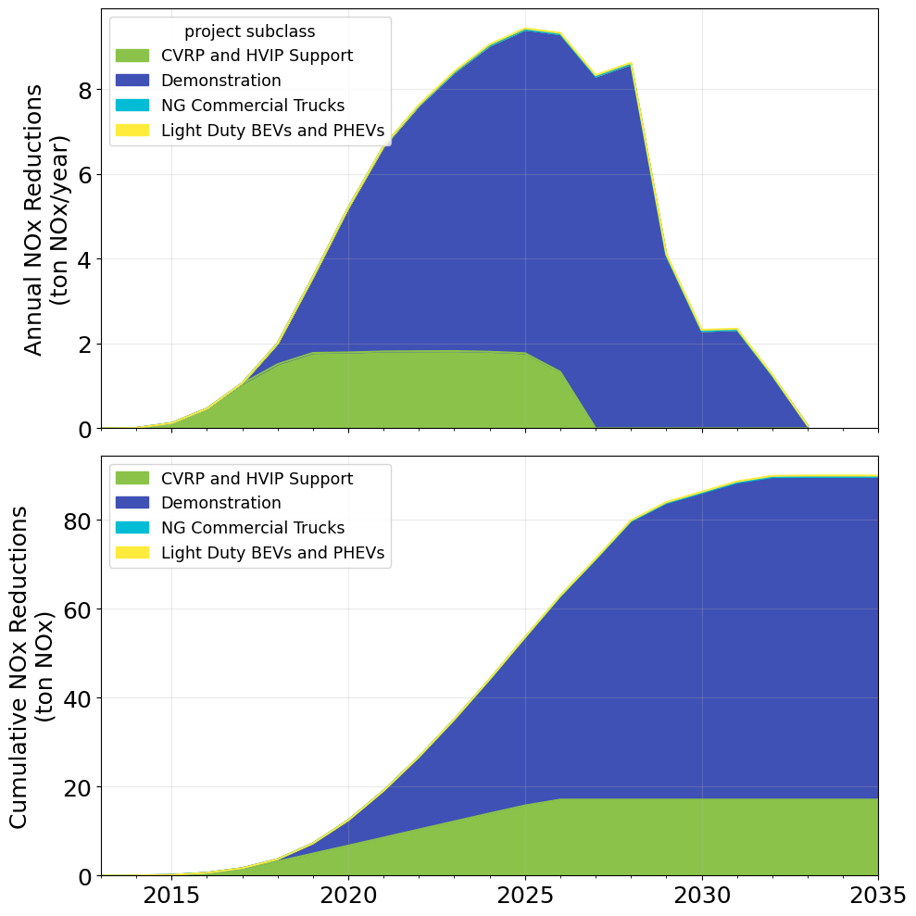
NO_{x} Emissions Reductions
Fueling Infrastructure
Vehicles

Slide 32
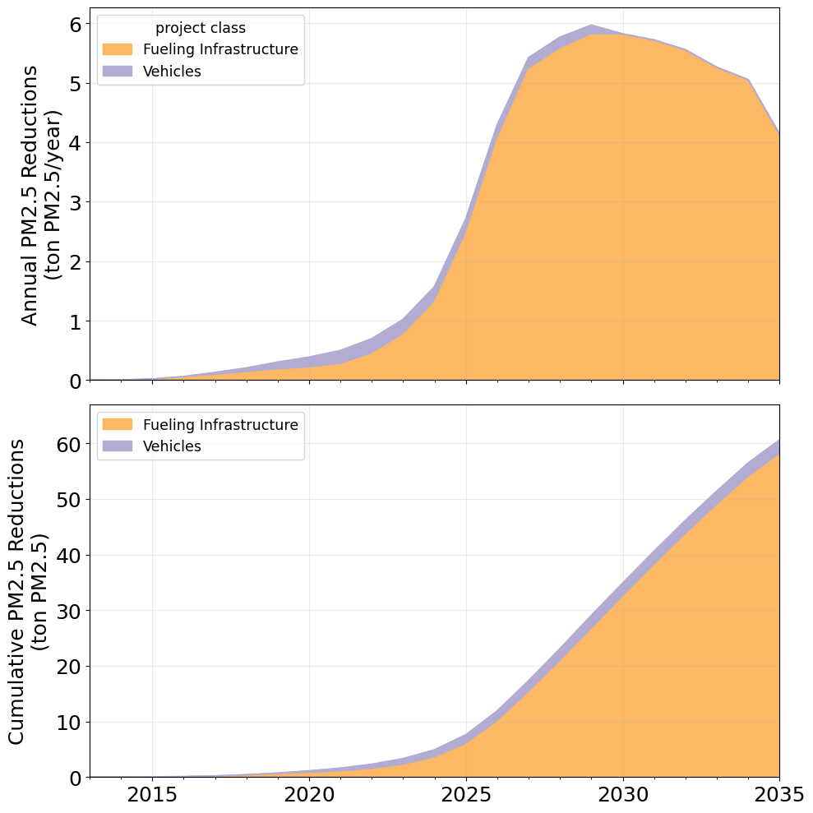
PM_{2.5} Emissions Reductions
As in the 2021 analysis, fuel production projects here are not assumed to result in direct air quality improvements.
The vast majority of PM_{2.5} reductions are attributed to fueling infrastructure projects. Annual benefits increase rapidly through 2030 before tapering off.
Within fueling infrastructure projects, the largest PM_{2.5} reductions are generated by LD and MD/HD EVSE projects, accounting for 30.4% and 59.5% of cumulative benefits, respectively.

Slide 33
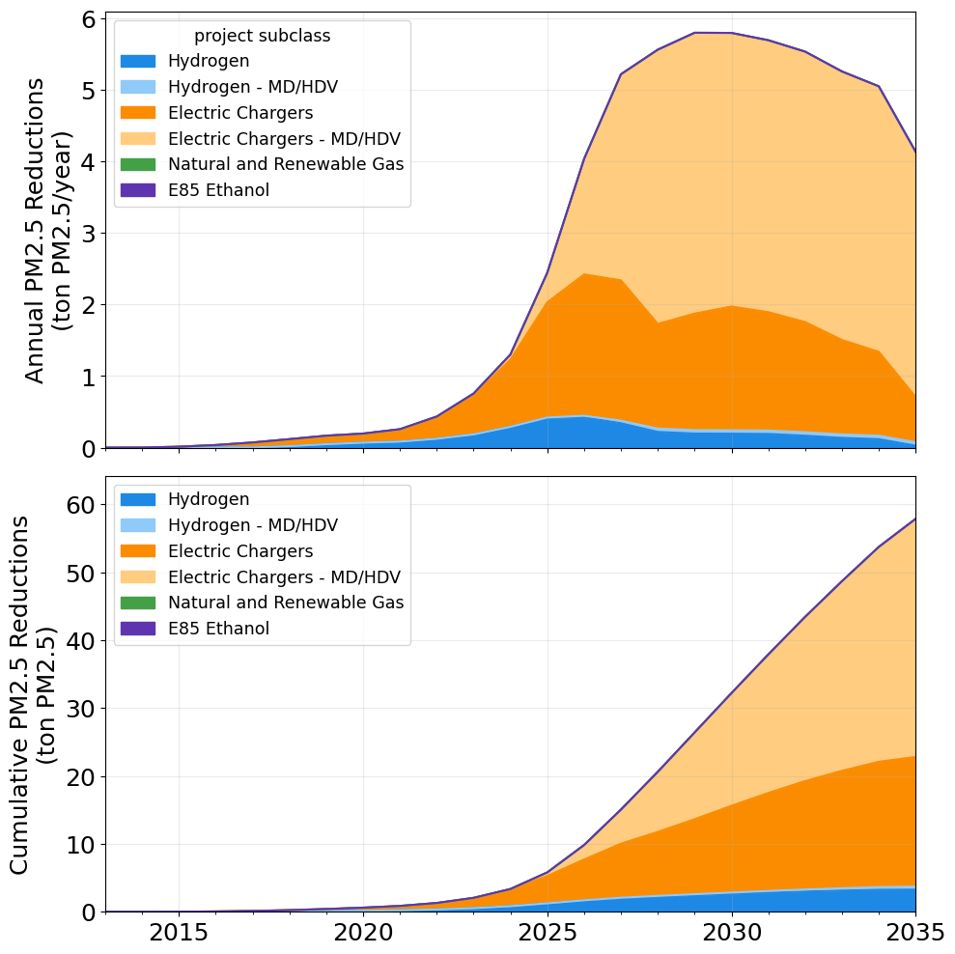
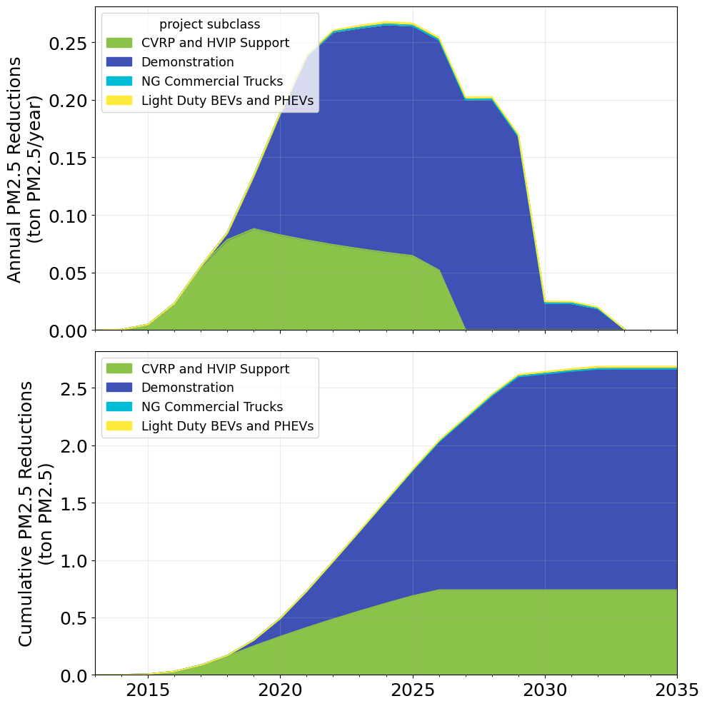
PM_{2.5} Emissions Reductions
Fueling Infrastructure
Vehicles

Slide 34
Conclusions & Next Steps

Slide 35
Conclusions
NREL estimated the expected benefits of a portfolio of transportation-related projects funded through CEC’s Clean Transportation Program over the past decade.
The expected benefits from the projects were estimated in terms of displaced petroleum, GHG emissions reductions, and reductions in criteria air pollutant emissions.
The methods for conducting the analysis largely emulate those employed to generate the 2021 CTP benefits report, with some updates to the assumptions, data, and methodology [1].
CEC awards for fuel production and vehicle deployment projects have declined over time and therefore have annual benefits. However, biodiesel and biomethane production projects account for 51.6% of cumulative GHG emissions reductions, partly due to their longer assumed life spans.
Refueling infrastructure projects generate the greatest share of GHG emissions reductions beginning in 2025, primarily from light-duty EV infrastructure projects, which account for 31.6% of all cumulative benefits.
MD/HD infrastructure projects are the greatest contributor to air pollution reductions (44.4% in NO_{x} and 59.5% in PM_{2.5}) due to the displacement of diesel fuel.
1. California Energy Commission. 2021. Analysis of Benefits Associated With Projects and Technologies Supported by the Clean Transportation Program. Sacramento, CA: CEC. CEC-600-2021-039. https://doi.org/10.2172/1886868.

Slide 36
Future Work
Several improvements can be made toward better accuracy of the results from this analysis, including (but not limited to):
Incorporating more detailed CALeVIP internal project data.
Updating EV chargers' utilization assumptions with estimates based on observed behavior.
Improving H₂ refueling station utilization data with more up-to-date and accurate estimates.
Evaluating market transformation benefits supported by projects funded through the CTP, including jobs created and other socioeconomic benefits.
Updating vehicles’ estimated characteristics such as fuel economy, miles traveled, and criteria air pollutant emissions factors.

Slide 37
Thank You
NREL/PR-5400-87699
This work was authored by the National Renewable Energy Laboratory, operated by Alliance for Sustainable Energy, LLC, for the U.S. Department of Energy (DOE) under Contract No. DE-AC36-08GO28308. Support for the work was also provided by the California Energy Commission under Agreement FIA-22-23255-0. The authors would also like to thank Margaret Mann and Eric Wood for the guidance provided through this work. The views expressed in the article do not necessarily represent the views of the DOE or the U.S. Government. The U.S. Government retains and the publisher, by accepting the article for publication, acknowledges that the U.S. Government retains a nonexclusive, paid-up, irrevocable, worldwide license to publish or reproduce the published form of this work, or allow others to do so, for U.S. Government purposes.

Slide 38
CALeVIP Electric Vehicle Infrastructure Assumptions
Project features were extracted from the CALeVIP dashboard [1].
For 2019–2022, only completed projects are included.
2023: projects completed in 2023 + 1/3 projects in progress.
2024 and 2025: 1/3 projects in progress for each year.
The “in progress” projects that are allocated is the difference between the cumulative “in progress” projects and completed projects in 2023 (to avoid double-counting).
Source | Cumulative Funding (million $) | Cumulative Number of Ports
CALeVIP online data dashboard [1] | $191.51 | 11,146
1. California Energy Commission. 2023. “CALeVIP Rebate Statistics Dashboard.” Accessed Sept. 15, 2023. https://calevip.org/rebate-statistics.

Slide 39
Vehicle Type Assumptions for Fuel Production and Refueling Infrastructure
Fuel production and refueling infrastructure projects for biomass-based diesel, ethanol, and natural gas are assigned the following vehicle types.* The vehicle types are matched to EMFAC Vehicle IDs to determine the fuel economy of the conventional vehicle being replaced.
Alternative Fuel | Vehicle Type | EMFAC Vehicle ID | Replaced Fuel
Biodiesel/Fischer-Tropsch Diesel/Renewable Diesel | Heavy-Duty Diesel CA International Registration Plan Truck | T7 CAIRP | Diesel
Ethanol | Light-Duty Automobile | LDA | Gas
Natural gas | Other buses | OBUS | Diesel
* EVSE and H₂ refueling infrastructure project descriptions specify the type of vehicle served by the infrastructure.

Slide 40
Vehicle Parameter Assumptions
Assumed vehicle efficiencies and pollutant emission factors as a function of replaced fuel, vehicle type, and year [1].
 |  |  | Fuel Economy (miles/GGE) | Petroleum Fuel Reductions (in million gallons) | Petroleum Fuel Reductions (in million gallons) | Petroleum Fuel Reductions (in million gallons) | NO_{X} Emissions Factor (gNO_{x}/mile) |  |  |  | PM_{2.5} Emissions Factor (gPM_{2.5}/mile)
Replaced Fuel | Vehicle Type | EMFAC Vehicle ID | 2020 | 2025 | 2030 | 2035 | 2020 | 2025 | 2030 | 2035 | 2020 | 2025 | 2030 | 2035
Gasoline | Light-Duty Car | LDA | 33.15 | 39.88 | 39.8 | 39.85 | 0.021 | 0.015 | 0.015 | 0.015 | 0.020 | 0.020 | 0.019 | 0.019
Gasoline | Light-Duty Truck | LDT1 | 28.67 | 37.79 | 37.73 | 37.77 | 0.021 | 0.015 | 0.015 | 0.015 | 0.020 | 0.020 | 0.019 | 0.019
Diesel | Light-Duty Car | LDA | 38.78 | 46.69 | 46.7 | 46.82 | 0.024 | 0.005 | 0.005 | 0.005 | 0.020 | 0.018 | 0.018 | 0.018
Diesel | Light Heavy Duty | LHD1 | 21.19 | 21.2 | 21.24 | 21.26 | 0.073 | 0.047 | 0.047 | 0.047 | 0.039 | 0.038 | 0.038 | 0.038
Diesel | Urban Bus | UBUS | 4.16 | 4.16 | 4.16 | 4.16 | 1.815 | 1.815 | 1.815 | 1.814 | 0.374 | 0.374 | 0.374 | 0.374
Diesel | School Bus | SBUS | 6.73 | 6.73 | 6.73 | 6.71 | 1.027 | 1.029 | 1.031 | 1.038 | 0.324 | 0.324 | 0.324 | 0.324
Diesel | Other Buses | OBUS | 8.04 | 8.03 | 8.02 | 8.01 | 0.433 | 0.434 | 0.439 | 0.442 | 0.061 | 0.061 | 0.061 | 0.061
Diesel | Heavy-Duty (>26k lbs) | T6 Instate Heavy | 9.21 | 9.24 | 9.27 | 9.33 | 0.860 | 0.849 | 0.810 | 0.781 | 0.061 | 0.061 | 0.061 | 0.061
Diesel | Heavy-Duty (<26k lbs) | T6 Instate Small | 8.98 | 9.01 | 9.03 | 9.07 | 0.806 | 0.818 | 0.805 | 0.796 | 0.061 | 0.061 | 0.061 | 0.061
Diesel | Heavy-Duty Out-of-State | T6 OOS Heavy | 9.26 | 9.3 | 9.34 | 9.39 | 0.947 | 0.936 | 0.925 | 0.921 | 0.061 | 0.061 | 0.061 | 0.061
Diesel | Heavy-Duty CA Registered Truck | T7 CAIRP | 6.96 | 7.02 | 7.06 | 7.08 | 0.884 | 0.831 | 0.800 | 0.790 | 0.038 | 0.038 | 0.038 | 0.038
Diesel | Drayage Truck (Other) | T7 Other Port | 6.8 | 6.81 | 6.82 | 6.81 | 0.985 | 0.953 | 0.950 | 0.966 | 0.038 | 0.038 | 0.038 | 0.038
Diesel | Drayage Truck (South Coast) | T7 POLA | 6.59 | 6.63 | 6.67 | 6.68 | 1.433 | 1.359 | 1.284 | 1.266 | 0.038 | 0.038 | 0.038 | 0.038
Diesel | Solid Waste Collection Truck | T7 SWCV | 2.45 | 2.45 | 2.45 | 2.45 | 1.891 | 1.891 | 1.891 | 1.891 | 0.043 | 0.043 | 0.043 | 0.043
Diesel | Heavy-Duty Single-Unit Truck | T7 Single | 6.97 | 6.98 | 6.98 | 6.99 | 0.831 | 0.849 | 0.866 | 0.875 | 0.038 | 0.038 | 0.038 | 0.038
Diesel | T7 Single Construction | T7 Single Construction | 6.94 | 6.93 | 6.91 | 6.9 | 0.885 | 0.931 | 0.975 | 1.004 | 0.038 | 0.038 | 0.038 | 0.038
Diesel | Heavy-Duty Tractor | T7 Tractor | 7.12 | 7.13 | 7.15 | 7.17 | 0.848 | 0.849 | 0.828 | 0.812 | 0.038 | 0.038 | 0.038 | 0.038
1. CARB. 2023. “Vision Scenario Planning.” Accessed Oct. 4, 2023. https://ww2.arb.ca.gov/resources/documents/vision-scenario-planning.

Slide 41
Light-Duty EVSE Project E-Miles and Charger Utilization
Charger Utilization (% of daily capacity)
E-Miles Supported (miles/year)
Year | L2 Public | L2 Multifamily Home | L2 Workplace | DC 50 kW | DC 150 kW*
2020 | 4.53% | 4.53% | 7.13% | 6.12% | 6.12%
2021 | 4.64% | 6.38% | 8.12% | 6.89% | 6.89%
2022 | 4.94% | 8.46% | 9.58% | 7.76% | 7.76%
2023 | 5.07% | 10.23% | 10.44% | 8.63% | 8.63%
2024 | 5.23% | 12.01% | 11.86% | 9.50% | 9.50%
2025 | 5.76% | 14.66% | 12.44% | 10.37% | 10.37%
2026 | 5.76% | 14.66% | 12.98% | 11.24% | 11.24%
2027 | 5.65% | 14.40% | 14.04% | 12.11% | 12.11%
2028 | 5.60% | 14.27% | 14.62% | 12.98% | 12.98%
2029 | 5.59% | 14.25% | 15.07% | 13.85% | 13.85%
2030 | 5.76% | 14.66% | 15.40% | 14.72% | 14.72%
Year | L2 Public | L2 Multifamily Home | L2 Workplace | DC 50 kW | DC 150 kW*
2020 | 11,421 | 11,421 | 17,977 | 107,224 | 321,671
2021 | 11,711 | 16,105 | 20,496 | 120,724 | 362,172
2022 | 12,473 | 21,338 | 24,175 | 135,961 | 407,884
2023 | 12,784 | 25,803 | 26,333 | 151,198 | 453,595
2024 | 13,186 | 30,305 | 29,914 | 166,436 | 499,307
2025 | 14,524 | 36,981 | 31,379 | 181,673 | 545,019
2026 | 14,527 | 36,983 | 32,754 | 196,910 | 590,730
2027 | 14,257 | 36,331 | 35,413 | 212,147 | 636,442
2028 | 14,117 | 35,990 | 36,881 | 227,384 | 682,153
2029 | 14,099 | 35,947 | 38,028 | 242,622 | 727,865
2030 | 14,525 | 36,981 | 38,864 | 257,859 | 773,577
Based on the assumed charger utilization, vehicle efficiency (0.25 kWh/mi), and the provided chargers’ power and number of ports, the number of e-miles supported by each charger can be calculated.
* DC 150kW charger utilization is assumed to be the same as DC 50kW charger utilization

Slide 42
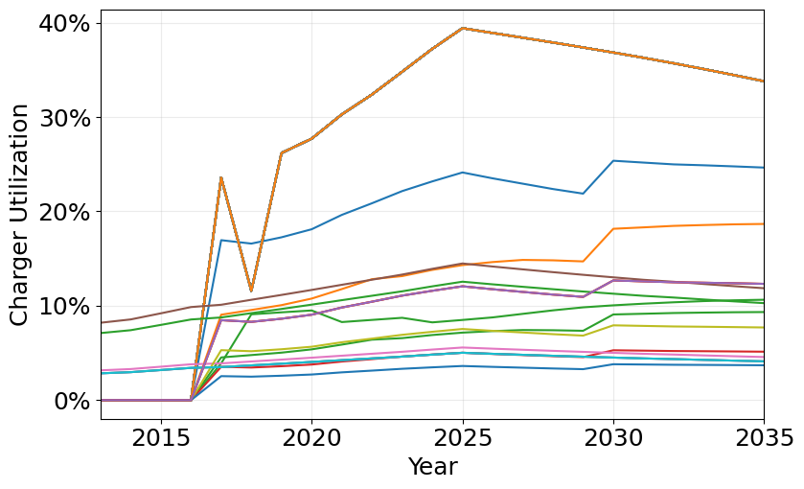
Utilization – MD/HD EVSE
The following figure shows charger utilization for MD/HD EVSE projects as estimated based on the VMT, number of vehicles, number of charging ports, and available charging power. Each line in the plot represents one of the 75 MD/HD EVSE projects included in the analysis.

Slide 43
California LCFS Parameters [1]
Year | Gasoline Standard (gCO₂e/MJ)* | Diesel Standard (gCO₂e/MJ)*
2011 | 95.61 | 94.47
2012 | 95.37 | 94.24
2013 | 97.96 | 97.05
2014 | 97.96 | 97.05
2015 | 97.96 | 97.05
2016 | 96.5 | 99.97
2017 | 95.02 | 98.44
2018 | 93.55 | 96.91
2019 | 93.23 | 94.17
2020 | 91.98 | 92.92
2021 | 90.74 | 91.66
2022 | 89.5 | 90.41
2023 | 88.25 | 89.15
2024 | 87.01 | 87.89
2025 | 85.77 | 86.64
2026 | 84.52 | 85.38
2027 | 83.28 | 84.13
2028 | 82.04 | 82.87
2029 | 80.8 | 81.62
2030 | 79.55 | 80.36
2031 | 79.55 | 80.36
2032 | 79.55 | 80.36
2033 | 79.55 | 80.36
2034 | 79.55 | 80.36
2035 | 79.55 | 80.36
Fuel | Unit | Energy Density
Gasoline Blendstock (CARBOB) | (MJ/gal) | 119.53
Reformulated Gasoline (CaRFG) | (MJ/gal) | 115.83
Diesel | (MJ/gal) | 134.47
Pure methane | (MJ/ft³) | 102
Liquefied natural gas | (MJ/gal) | 78.83
Compressed natural gas | (MJ/therm) | 105.5
Electricity | (MJ/kWh) | 3.6
Hydrogen | (MJ/kg) | 120
Ethanol | (MJ/kg) | 80.53
Denatured ethanol | (MJ/gal) | 81.51
Biodiesel | (MJ/gal) | 126.13
Renewable diesel | (MJ/gal) | 129.65
Alternative jet fuel | (MJ/gal) | 126.37
Propane | (MJ/gal) | 89.63
EV Class | EER | Replaced Fuel
LD | 3.4 | Gasoline
HD Truck | 5.0 | Diesel
Bus | 3.1 | Diesel
Locomotive | 3.3 | Diesel
Cargo | 2.7 | Diesel
Fuel Cell Vehicle Class | EER | Replaced Fuel
LD | 2.7 | Gasoline
HD | 1.9 | Diesel
* We assume that the gasoline and diesel standard remain at 2030 levels from 2031 to 2035.
CARB. 2020. Low Carbon Fuel Standard. https://ww2.arb.ca.gov/sites/default/files/2020-07/2020_lcfs_fro_oal-approved_unofficial_06302020.pdf

Slide 44
Carbon Intensity Assumptions
For refueling infrastructure projects, vehicle projects, and fuel production projects (where a CI was not provided), we assume a CI based on the observed feedstock mix in California in 2022:
Fuel | Feedstock | Source | CI (gCO₂e/MJ)
Electricity | Grid average | CARB LCFS Current Certified Pathways (GREET 3.0) | 81.42
Hydrogen | 54% fossil natural gas, 44% renewable, 2% electrolysis | CARB LCFS Quarterly Summary | 110.77
Compressed natural gas | Fossil compressed natural gas | CARB LCFS Lookup Table | 79.21
Ethanol | 83% corn, 12% biomass, 5% other | CARB LCFS Quarterly Summary | 58.84
Fischer-Tropsch diesel | Municipal solid waste | CARB LCFS Current Certified Pathways (GREET 3.0) | 14.78
Biodiesel | 31% distiller’s corn oil, 32% used cooking oil, 25% tallow, 12% soy/canola oil | CARB LCFS Quarterly Summary | 28.5
Ethanol* | Sweet sorghum* | CARB LCFS Quarterly Summary | 50.15
Compressed natural gas* | Food scraps* | CARB LCFS Quarterly Summary | −28.2
* Used for projects whose feedstock is specified.

