Slide 1
CEC – Monitor Update to
Final Draft of Regulation
Part 1: Fundamentals
Humberto Fossati
April 26, 2016

Slide 2
CEC Impact
On-mode Compliance is too low today…
Compliance, evaluating a sampling current display models is 19%
Compliance for Standard resolution displays (Less than 5MP) is 20%
Compliance for Enhanced performance displays (Greater than 5MP) is 29%
Seeing some improvements as current monitors are being re-designed
for ES7.0 compliance
Displays Tested
Diagonal Size in inches (in) | On Mode in Watts (Pon_mox) | Number of displays tested | Compliant displays | Percent Compliant | Comment
17≤d<23" | (4.2*r) + (0.02*A) +2.2 | 44 | 6 | 14% | Low-End models will not benefit from technology improvements as fast as High-end monitors
23≤d<25" | (4.2*r) + (0.04*A) -2.4 | 35 | 7 | 20%
25≤d≤30" | (4.2*r) + (0.07*A) -10.2 | 17 | 5 | 29% | Large displays with high-resolution panels
Total |  | 96 | 18 | 19% Avg

Slide 3
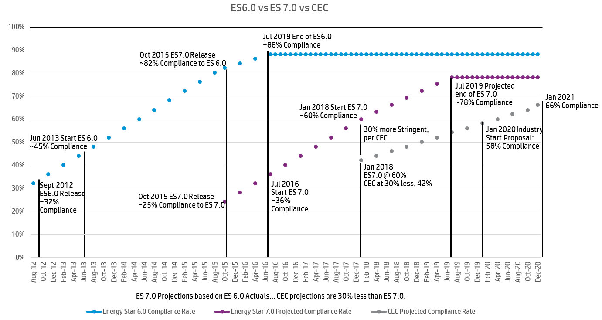
Compliance: ES6.0 vs ES7.0 vs CEC (Best Case Projections)

Slide 4
Clarifications for data shown in these slides
Data is an Industry Average estimate
Where not available, some Data has been obtained by HP, being a good representation of the marketplace
Material Cost data is an average, and is “Cost to the OEM”…
“Price increase to the End User” is much higher, and dependent on the
mark-ups each Industry OEM has along its supply chain and
“go to market” models

Slide 5
Impact on current product
Of current ES6.0 compliant product (82% of total):
  About 60% can be ES7.0 compliant by Jan/1/2018
  At current CEC proposed limits (30% more stringent),
  only 42% of displays may be compliant to the CEC limits
  Remaining 58% can not comply, regardless of cost
The current 18% (100%-82%) non ES6.0 product would also not meet CEC
  OEM Cost adder from $2 to $10, based on what the current model includes
By Jan 1, 2019, expect to raise compliance to CEC limit by 19%, from 42% to 50%
By Jan 1, 2020, expect to raise compliance to CEC limit by 16%, from 50% to 58%
Of the level that can be theoretically compliant:
  Business needs may dictate that up to 20% of these do not get re-designed:
  Either because we can not afford the cost increase (low end models)
  Or the product will EOL in the next 2-4 quarters

Slide 6
Take Aways from current projections
Can California afford the large projected reduction of Monitor models in the marketplace?
Assuming we can manage the same rate of Power Reduction Improvements as we were able to do for ES 6.0, we still project to just have 58% of OEMs SKUs compliant by Jan 1 2020, and 66% by Jan 2021
If CEC would remove the “30% more stringent” goal, and match ES7.0 equivalent Power limits, we could be at ~78% compliance by Jan 2020, but Industry feels this is still too low for a “mandatory” Regulation
Hence, our Proposal for further relaxation as follows:
  Remove smaller monitors (less than 20”) from the Scope of the Regulation
  Revert to the original limits for Sleep and OFF modes
  Remove the more restrictive limits for monitors > 5MP
  Do not hinder innovation on the High-End monitor designs

Slide 7
Industry Proposal for adjustment of Power Limits
CEC Baseline: By Jan 1, 2018 (for <5MPix):
Diagonal Screen Size CEC On-Mode Power Limits
d < 17” Out of Scope
17" ≤ d < 23.0" (4.2*r) + (0.02*A) +2.2
23.0" ≤ d < 25.0" (4.2*r) + (0.04*A) -2.4
25.0" ≤ d ≤ 30.0" (4.2*r) + (0.07*A) -10.2
d > 30.0” Out of Scope
Industry Proposal:
d < 20” Out of Scope
No use of alternate limits for displays with larger than 5MPix resolution
A delayed “Effective date”
For sizes 23” to 30” formulas should be relaxed to increase percent compliance

Slide 8
Display / Panel Efficiency Options
Diagonal Size in inches (in) | On Mode in Watts (Pon_mox)
17≤d<23" | (4.2*r) + (0.02*A) +2.2
23≤d<25" | (4.2*r) + (0.04*A) -2.4
25≤d≤30" | (4.2*r) + (0.07*A) -10.2
High Efficiency LEDs:
For a given point in time, we have a variety of LED efficiencies…
  We can consider a range of 60 to 120 Lumen/W.
There is the standard “white LED” solution for the bulk of BLU designs.
  They typically meet a 72% of NTSC for color gamut,
  Are in the 70~90 Lumen/W efficiency rating, and
  Are used as a string on one edge of the panel.
  Number of LEDs used will affect uniformity, brightness levels, and thermals.
Then, there are the specialized LED solutions for high color gamut panels (sRGB and/or AdobeRGB), which in general are less efficient and are much higher in cost.
There is a concern with assurance of supply for the more efficient LEDs as those currently have less than 10% of the overall market-share;
  A slow increase in demand will assure steady supply.
Cost Estimates for LEDs (Prices seen by End User are much higher):
For panels smaller than 24”, we average a cost up of $3.50~$5.00 for each 10% efficiency improvement.
For panels larger than 24”, the average cost up is $5.50~$10.00 for each 10% improvement in efficiency.
For the same size solution, we can also see a 10% energy efficiency year-over-year at roughly the same cost target.
  That is, the LED today that outputs 60Lm/W can output 65Lm/W in about a year, for the same price…
Notes:
Lot 6 form no longer needed, use lot 3 instead .

Slide 9
Display / Panel Efficiency Options
Diagonal Size in inches (in) | On Mode in Watts (Pon_mox)
17≤d<23" | (4.2*r) + (0.02*A) +2.2
23≤d<25" | (4.2*r) + (0.04*A) -2.4
25≤d≤30" | (4.2*r) + (0.07*A) -10.2
Enhancement Films:
      Monitors 19.x” and under are considered “budget” or “Opening Price point” monitors.
            The top three requirements for this segment are “cost”, “cost”, “cost”
            The Industry can not afford to add any type of enhancement films
      Monitors above 19.6”, are considered “Value” centric monitors:
            Most of the solutions are have less than “Full HD” resolution (1920*1080)
            For those that have a Full HD (1920*1080) resolution, they are considered “Mainstream”
            Few monitors HD (1368*768) and below use any kind of enhancement films
            Some Full HD monitors can afford these films, especially as we move from TN, to VA or IPS type technologies
            The problem is that those solutions already designed with enhancement films, are far away from meeting the CEC goals.
      For the larger monitors, usually QHD or larger resolution, almost all solutions already include these enhancement films
    Costs for the typical Enhancement films ranges as follows (Prices seen by End User are much higher):
Size | Enhancement film Cost
20” and below | $2 to $3
21.5 to 23” | $2.5 to $4
24” to 27” | $4.5 to $8
Notes:
Lot 6 form no longer needed, use lot 3 instead .

Slide 10
Display / Panel Efficiency Options
Enhanced Film
DBEF/BEF: 100% on Performance Displays; 28% on Standard Displays
Prism: 70% on Performance Displays; 58% on Standard Displays
Enhanced Film by Screen Resolution (MegaPixel)
Enhanced Film by Screen Size (largest volume)
Enhanced Film | 20" | 21.5" | 23"
DBEF / BEF | 6% | 37% | 11%
Prism | 63% | 53% | 63%

Slide 11
Tools at OEM’s disposal (Power Supply improvements)
We are already efficient; not a design lever:
Power Supply efficiency
  Most ES6.0 products at “Class V” (87% or better)
  Most ES7.0 products upgraded to “Class VI” (89% or better)
  Reaching point of diminishing returns…
    Will be hard to get another 1~2% improvement
  Large Design/Qual cycle (1.5~2 years)
IOU’s analysis outdated and no longer relevant.
DOE will drive future improvements.
Improved Power Supply Unit
Using an efficient power supply unit (PSU) is another pathway to increase the efficiency of the
monitor. IOUs analyzed a PSU upgrade from 80 percent efficiency to 88 percent efficiency in
19-inch, 22-inch, and 27-inch monitors.110 These monitors experienced an overall 8 percent
increase in efficiency. Since the majority of the market consists of 19-inch, 22-inch, and 27-inch
monitors, an increase in PSU efficiency would result in significant energy savings.

Slide 12
Tools at OEM’s disposal (New TFT Cells)
Re-Design of basic TFT Pixel cell architecture
  Goal is to improve the transmissivity of the cell
  Small incremental improvements
  High cost (new masks needed; each mask over $1M NRE)
  Long design cycle (1.5~2 years) by the Panel maker
    One panel maker proposing doing this for the 1H2018 cycle
    Industry needs more than one committed Panel Maker
  Monitor OEM design cycle starts after Panel Maker completes
  its R&D effort
  Once NRE amortized, we drive for similar cost structures
  (takes time to realize)
Does not improve Power Consumption in Sleep or OFF modes

Slide 13
Test Methods: ES6.0 or ES7.0
Narrative from CEC:
ES7.0:
“Version 7.0 sets new power consumption requirements in terms of total energy consumption, which allows manufacturers flexibility to balance power consumption in ON mode and Sleep mode.”
Test Procedure:
“To measure the energy consumption of computer monitors, staff recommends using the ENERGY STAR test method, published in September 2015, and associated with ENERGY STAR Product Specification for Displays Version 7.0”
“(5) The test method for computer monitors is ENERGY STAR Test Method for Determining Displays Energy Use Rev. Sep-2015, attached to the Version 7.0 Displays Product Specification.”
Computer Monitors:
“Energy Commission staff proposes computer monitor standards to establish maximum ON-mode requirements based on screen area and resolution. This approach is similar to the ENERGY STAR Version 6.0 specification for on-mode power requirements. Furthermore, staff proposes maximum power for sleep mode (PSLEEP_MAX) and off mode (POFF_MAX).

Slide 14
Test Methods: ES6.0 or ES7.0
Energy Star 6.0 Test Procedure is set for Modal/Fixed limits. We instrument the monitor and make discrete Power measurements.
Energy Star 7.0 Test Procedure requires continuous Power measurements over a 10 minute test time, using different source inputs. The goal to average ON power under different likely User conditions. Further, by specifying a Max TEC, ES 7.0 allows Monitor OEMs to trade off ON power with Sleep power
CEC has set fixed ON power limit and Sleep power limit
Issue:
If CEC will set a specific ON, Sleep and OFF limits (as it is similarly done in ES6.0), then the “Test Procedure” should also follow ES6.0, with any adjustments the CEC deems necessary.
The ES7.0 Test Procedure allows the OEM to adjust/vary ON, Sleep and OFF limits so that it meets an overall TEC target. That is, the ON, Sleep and OFF limits are not specific; OEM instead needs to meet the Max TEC allowed.
The current CEC Power Consumption Limits and the Specified Test Procedure are in conflict with each other.

Slide 15
WW, US, and CA monitor landscape
2016 volume projections
Based on IDC, DisplaySearch and other industry data
Based on the assumption that CA is 12% of the US volumes
CEC estimate CA installed base of monitors:
  21.2M (12.7M Residential + 8.5M commercial)
  Annual Shipments of new monitors: 3.6M combined
  Prior draft: 38M (21M Comm. And 17M Cons.)
  Not clear where the difference comes from
Industry estimate of CA installed base:
  14.4M (2.87M * 5Yr lifecycle)
Note: CEC has increased lifetime to 6.6Yrs
Updated Industry Estimate of CA installed base:
  18.9M monitors

Slide 16
Monitor Definitions… should delete.
“computer monitor”
means an analog or digital device of size greater than or equal to 12 inches and less than or equal to 61 inches, a pixel density of greater than 5000 pixels per square inch, and that is designed primarily for the display of computer generated signals and not marketed for use as a television.
Vs.
“electronic display (display) or monitor”
means a product with a display screen and associated electronics, often encased in a single housing, that as its primary function produces visual information from:
  (1) A computer, workstation, or server via one or more inputs (e.g., VGA, DVI, HDMI, DisplayPort, IEEE 1394, USB)
  (2) External storage (e.g., USB flash drive, memory card)
  (3) A network connection
electronic display or monitor is intended for one person to view in a desk based environment.
Note:
At the time of this writing, it is the Industry’s understanding that the CEC will remove the second definition

Slide 17
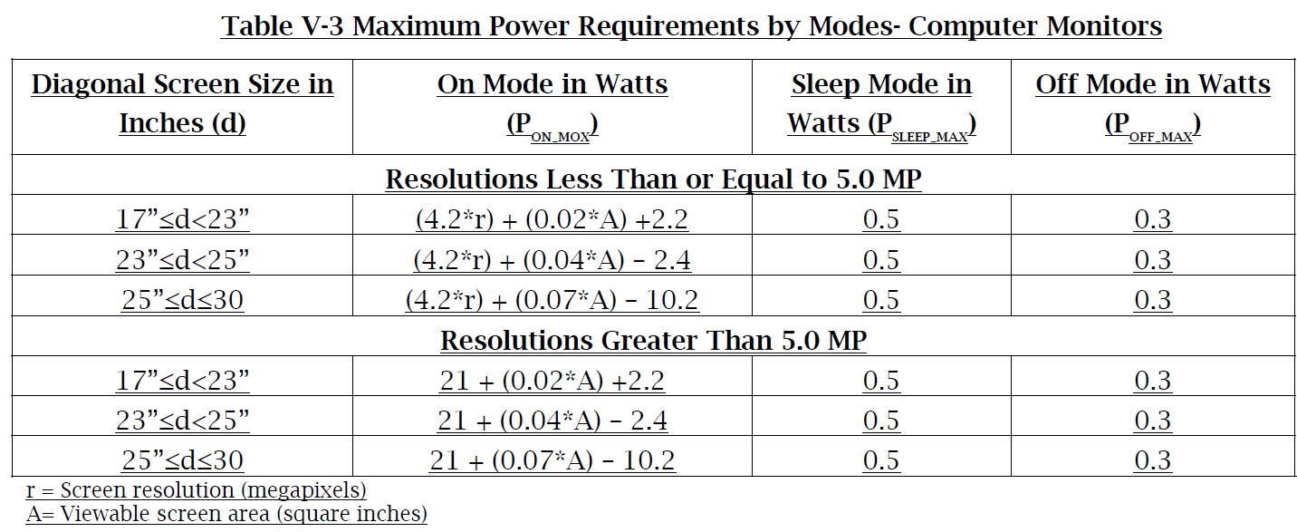
CEC Final Power Requirements

Slide 18
Thank you

Slide 19
CEC – Monitor Update to
Final Draft of Regulation
Part 2: Specifics
Robert White
April 26, 2016

Slide 20
Clarifications for data shown in these slides
Data is an Industry Average estimate
Where not available, some Data has been obtained by HP, being a good representation of the marketplace
Material Cost data is an average, and is “Cost to the OEM”…
“Price increase to the End User” is much higher, and dependent on the
mark-ups each Industry OEM has along its supply chain and
“go to market” models

Slide 21
Analysis of Power Reduction needed (20”~27” Range):
    CEC staff final report:
      “The core opportunity for energy savings regarding computer monitors and signage displays is to reduce the amount of energy used in ON mode.“
      “About 20 percent of the computer monitors in the market today meet the draft ENERGY STAR Version 7.0 standards.”
      “Staff’s analysis of the ENERGY STAR data shows that only about 14 percent of the current models meet the staff’s proposed more stringent
      standards. However, monitors would only need to reduce their power consumption by 3 to 5 watts to comply.”
    Review of power reduction for select sizes:
 | 20” | 21.5” | 23” | 24” | 27”
 | 1600*900 | 1920*1080 | 1920*1080 | 1920*1080 | 1920*1080
E.S. 6.0 limit | 16.5W | 21.1W | 22W | 24.1W | 29W
CEC proposed | 11.7W | 14.9W | 15.4W | 16.7W | 20.3W
Delta | 4.8W | 6.2W | 6.6W | 7.4W | 8.7W
% Reduction | 29% | 29% | 30% | 31% | 30%
Range: 4.8W~8.7W (not 3W~5W to comply)
Average Reduction: 6.98W (31%)
Notes:
Lot 6 form no longer needed, use lot 3 instead .

Slide 22
Cost Assessment – Analysis (CA Savings):
    CEC staff report:
“Monitors would only need to reduce their power consumption by 3 to 5 watts to comply.”
“Total energy saving over the entire life (6yr Residential, 7yr Commercial, 6.6yr Avg.) of the product will be about $29.30”
    Industry
    analysis:
Watts saved |  | Hours use |  | Hours use |  | Average
(Average) |  | Residential |  | Commercial |  | use
 |  | (1 yr) |  | (1 yr) |  | (1 yr)
3 |  | 1533 |  | 2483 |  | 2232
W*Hrs |  | 4599 |  | 7449 |  | 6696
Electricity cost |  | $0.164 |  | $0.147 |  | $0.160
($/KW)
1Yr savings |  | $0.75 |  | $1.10 |  | $1.07
6.6Yr life savings |  | $4.98 |  | $7.23 |  | $7.07
5 |  | 1533 |  | 2483 |  | 2232
W*Hrs |  | 7665 |  | 12415 |  | 11160
Electricity cost |  | $0.164 |  | $0.147 |  | $0.160
($/KW)
1Yr savings |  | $1.26 |  | $1.83 |  | $1.79
6.6Yr life savings |  | $8.30 |  | $12.05 |  | $11.78
Watts saved |  | Hours Sleep |  | Hours Sleep |  | Average
 |  | Residential |  | Commercial |  | use
0.55W to 0.50W |  | (1 yr) |  | (1 yr) |  | (1 yr)
Average
0.05 |  | 4453 |  | 5043 |  | 4888
W*Hrs |  | 222.65 |  | 252.15 |  | 244.4
Electricity cost |  | $0.164 |  | $0.147 |  | $0.160
($/KW)
1Yr savings |  | $0.04 |  | $0.04 |  | $0.04
6.6Yr life savings |  | $0.24 |  | $0.24 |  | $0.26
  Industry calculates savings of:
    $ 7.33 (3W Avg. savings) up to
    $12.04 (5W Avg. savings)
  vs $29.30 estimate by the CEC.
  And, only on new Stock… Installed base has no savings thru the end of its useful life.
Notes:
Lot 6 form no longer needed, use lot 3 instead .

Slide 23
Industry and CEC first need to agree on the “math”
At this time, using the CEC provided data, the numbers do not agree
Either we all agree that we need to reduce on average 3~5W from all monitors, which means:
  $7.33 to $12.04 average power consumption savings per monitor over its lifetime
  Instead of the CEC stated $29.30 average savings per monitor (a 59%~75% ERROR in Savings)
OR
We accept the $29.30 average lifetime savings per monitor, which translates to
  An average power consumption reduction of 12.3W per monitor (instead of 3~5W)
  Signifying a 250% ~ 400% increase in power reduction needs
  Which simply many monitors will not be able to achieve, regardless of the dollars invested in R&D or in more efficient materials
Notes:
Industry believes the average monitor power reduction needed to meet the CEC mandate is:
  7W for the 20” ~ 27” range, without the more restrictive formulas for monitor above 5MP
Industry also believes that we will sell 2.9M monitors/Yr in CA (based on IDC data), Vs 3.6M estimate from CEC

Slide 24
WW, US, and CA monitor landscape
Assuming that California is 12% of the US market.
Our 2.87 million monitor estimate does not correlate to the assertion by the CEC:
“CEC assumes that California annual residential and commercial shipments are about 3.6 million units.” (15% of the US market)

Slide 25
WW monitor landscape (2019 projections)
Based on IDC, DisplaySearch and other industry data
Do not see significant changes:
  Overall monitor volumes decreases
  We see growth on the higher resolution solutions
  Continued declines of the low-cost smaller-sized monitors
    17” and 18.5” sizes have significant decreases
    19.x” size absorbs some of the above, becoming the new entry level monitor size
  Touch not yet a growth story

Slide 26
Regarding the “As Shipped” Requirements
CEC proposes to require that all monitors ship at 200 nits
There is no precedent for this type of restriction in any other WW regulation
There is no precedent on California’s own TV Regulation
For Competitive reasons
For Product placement/Positioning
For Cost Differentiation
The OEM must be allowed to ship each monitor at the performance settings
that fit best with the offering
Industry agrees to set the “test configuration” at 200 nits, for uniform test reporting
Manufacturers should not be unfairly burdened with an “As Shipped” fixed luminance.
These settings are determined based upon customer inputs and is directly related to
positive customer experience.
CEC stated “Consumers can easily increase screen brightness”.
If needed, “Customers can also decrease as easily.”

Slide 27
Out of Scope proposal: monitors 19.x” & smaller
Criteria:
Smaller than 20” monitors TAM is decreasing each year.
These are “Opening Price Point (OPP)” SKUs that can not afford the higher-end technology
Percentage-wise they require a lot of power reduction compared to more mainstream SKUs
Removing these from the CA market would be a significant business impact
Panel Size | Native Resolution | Current | ES 6.0 Limit | ES 7.0 Limit | CEC Final Max ON Power | Percent Reduction Needed
 |  | ON Power | ON Power | ON Power
(in.) |  | (W) (Ave) | (W) | (W) (Est) | (W)
17 | 1440*900 | 14.95 | 14.74 | 7.14 | 10.26 | 31% (4.69W)
17 | 1280*1024 | 15.50 | 15.10 | 9.82 | 10.54 | 32% (4.96W)
18.5 | 1366x768 | 13.45 | 13.65 | 10.46 | 9.53 | 29% (3.92W)
19 | 1280x1024 | 14.77 | 15.95 | 13.59 | 11.22 | 24% (3.55W)
19.5 | 1600x900 | 14.26 | 16.38 | 12.86 | 11.43 | 20% (2.83W)

Slide 28
Out of Scope proposal: monitors 19.x” & smaller
Out of Scope impact:
~10% of the installed base by 2019, and decreasing each year
Panel makers not investing on these “decreasing volume” business
  17” cell design has not changed in 5+ years… No more investments in 18.5”
  No realistic possibility to increase BOM cost with either films or better LEDs
$89 to $119 price points can be seen from multiple OEMs – Web prices
These models are priced for cost sensitive consumers
Alternatives:
Change 18.5” to 23” formula to: (4.2*r) + (0.02*A) +5.1 (if 17” is Out of Scope)
Change 17” to 23” formula to: (4.2*r) + (0.02*A) +7.1 otherwise
CEC data:

Slide 29
CEC proposal: Enhanced Performance Displays Allowance
Two basic allowances:
  10% power allowance for >99% sRGB displays
  50% power allowance for >99% AdobeRGB displays
Per CEC, with these allowances we improve:
  Compliance from 24 to 34 of the sRGB models, out of 68 models (50% non compliant)
  Compliance from 0 to 6 of the AdobeRGB models, out of 10 models (40% non compliant)
  Notes: Some EPD displays today are not ES6.0/ES7.0 compliant
  Notes: These EPD displays already use the high-end and efficient technologies
Current Industry Estimate:
  ~45% compliant for sRGB models (early testing; many failing Sleep or OFF mode)
  ~25% compliant for AdobeRGB models (early testing; failing Sleep and OFF modes)

Slide 30
Industry proposal: Enhanced Performance Displays Allowance
Two basic allowances:
  40% power allowance for >99% sRGB displays
  80% power allowance for >99% AdobeRGB displays
  Eliminate secondary formulas for monitors >5MP
Currently, most of the high-end monitors:
  Already use the best films
  And the most efficient LEDs
  It should be noted that sRGB and AdobeRGB LEDs are by nature less efficient
  Is the segment where new technologies are first introduced,
  and later enabled in Mainstream
  Is the segment with most unknowns…
    While OLED TVs may overall consume less power, not the same for monitors
    HDR monitors would have more stringent requirements than proposed HDR TVs
Not the segment to Regulate,
where innovation could be curtailed just to try to meet power limits
Very small volumes, and not likely to increase much over time due to cost constraints

Slide 31
CEC analysis of Compliance by 1/1/2018 (Sleep & OFF)
Can the business afford to eliminate about 15% of available SKUs
for not meeting Sleep or OFF modes?
The difference between 0.5W Sleep and 1W Sleep is up to $0.37/Yr/Monitor…
Is it Worth Risking Product availability for this amount?
Films, LED efficiency, Cell transmittance design do not affect these modes.
Power Supply efficiency does, but we are already on average, above 89% efficient
15% fail
8% fail

Slide 32
Industry Request: Compliance dates
Jan 1, 2018 is not a feasible compliance date for the Regulation
Industry needs an average of 24 months for a brand-new design cycle, where improvements are researched
Industry needs multiple Panel makers and IC providers to enable improved technologies simultaneously
Industry would not re-design a product with 6~12 months left of lifecycle:
  Need to agree to grandfather any products in MP before Regulation becomes effective
  Need to agree on an “Exemption” process to request non-complaint product to be sold in CA
Industry suggests a later compliance date for the Regulation
On the assumption that the other change requests on this presentation are also agreed to.

Slide 33
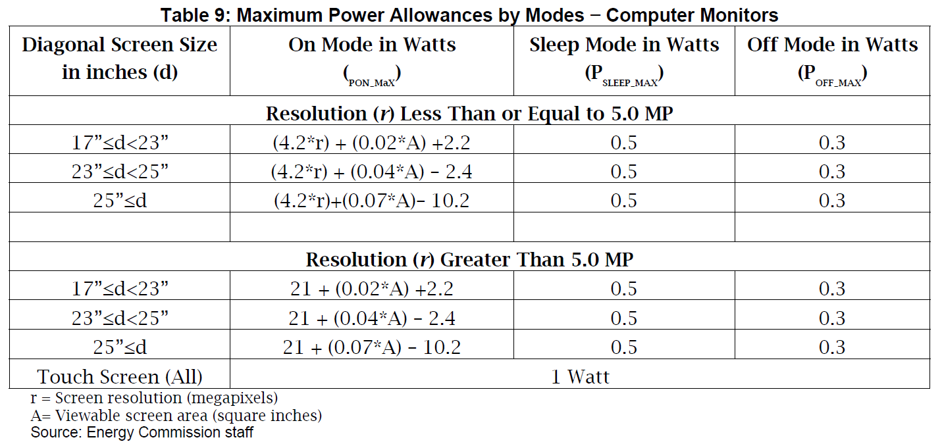
Touch Monitor
Current Status:
We need the 1W allowance in all modes
1W Allowance in ON mode may be OK, if Touch function is not part of the test method
(that is, Touch is not used during test)
In Narrative:
“Computer monitors with touch screen
capability are allowed a maximum of
1 watt allowance added to the
ON mode power maximum.”
In Regulatory Language:
“(6) Computer monitors with touch
screen capability are allowed an
additional 1 watt allowance.”

Slide 34
Thank you

Slide 35
Highlights from the Final CEC proposal
“The proposed regulations are similar to the ENERGY STAR® Version 7.0 standards but are
about 30 percent more stringent.”
“Monitors operate about 30 percent of the time in “on mode,” and most would only need to
reduce power consumption by 3 to 5 watts to comply with the proposed standard.”
“Staff analysis shows that about 14 percent of current models already meet the proposed
regulations.”
“EPA has stated that data analysis of ENERGY STAR-compliant monitors shows that
20 percent of computer monitors sold meet ENERGY STAR specification Version 7.0.”
“To discourage excess energy use of monitors shipped with overly bright screens, staff also
proposes that monitors shall be shipped with screen luminance less than or equal to 200
cd/m2.”

