Slide 1
California Energy Commission
Staff Workshop: Computers, Computer Monitors, and Signage Displays
PCs – Framework/Methodology
Stephen Eastman
Shahid Sheikh
Intel Corporation
April 26, 2016

Slide 2
Segmentation analysis

Slide 3
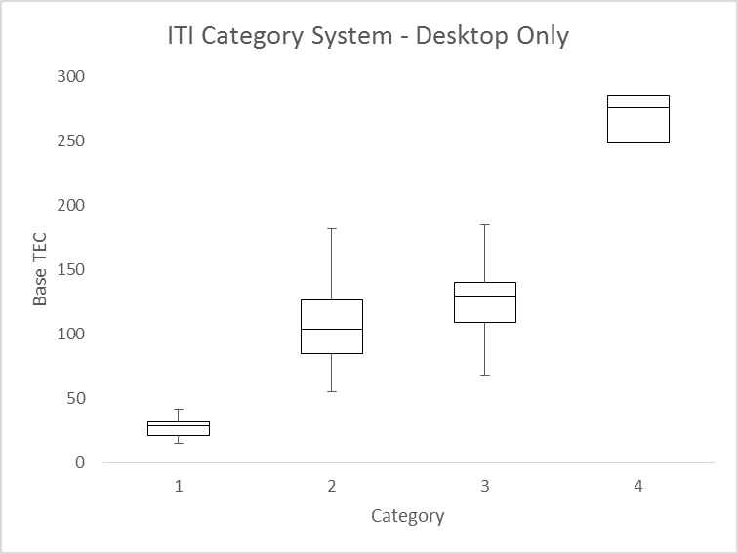

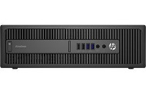


ITI Category System
Works (I/O BW Scalable)
There is a definitive grouping of systems for each category
  Category system based on I/O bandwidth
  The median line for each category continues trend up as I/O BW increases
ITI database of current shipping systems
  Based on 170 Desktop data points
Industry proposed high end exempt systems don’t fit in either category or expandability approach
Industry will propose TEC Targets in Written comments
  Notebooks shows similar results
Base TEC = Measured TEC – CEC Adders
Exempt
DT-2B
DT-1
DT-0

Slide 4
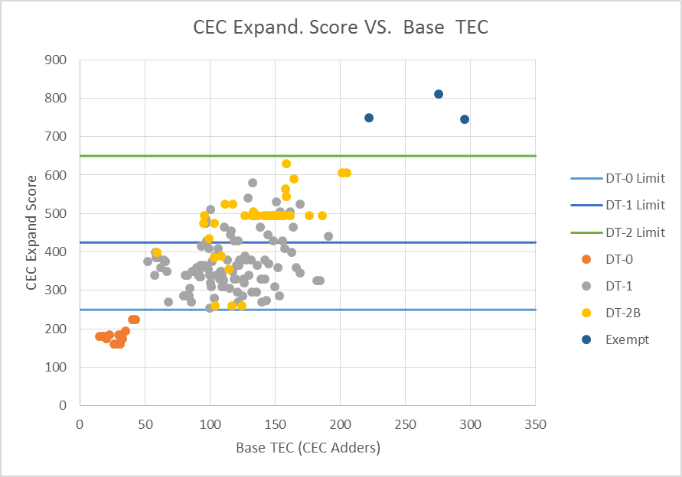
Expandability Score may be workable for Category Criteria
Example values* to use Expandability Score to make Categories
  DT-0 = less than 250
  DT-1 = 250 – 425
  DT-2 = 425 – 650
  Exempt = 650+
*Values are just for illustration purpose - ITI proposal could be different
Base TEC = Measured TEC – CEC Adders

Slide 5
Expandability Adder
Doesn’t Scale Adequately
Expandability score based adder doesn’t expand with real systems
The spread for the adder should be close to the spread for real systems
  Spread for DT-1 is ~10x higher
  Spread for DT-2 is ~18x higher
Future TEC improvements will not likely to close this gap
Base TEC = Measured TEC – CEC Adders
 | CEC Expand-ability Score | CEC Expand-ability Adder (kwh) | Base TEC spread from DT0 Median
DT-0 Median | 180 | -1.0 | 27.6
DT-1 Min | 255 | 2.8 | 55.4
DT-1 Median | 350 | 7.5 | 106.8
DT-2B Median | 495 | 14.8 | 136.4
DT-2B Max | 630 | 21.5 | 429.2
∆8.5
∆79.2
∆22.5
∆401.6

Slide 6
Categories, Target setting, adders, and incentives

Slide 7
Expandability vs. Categorization - I
Expandability
Pros:
Expandability score recognizes power supply provisioning based on higher capability configurations by providing scalability to the TEC requirement
Potential to move from multiple categories to a single desktop category with one base TEC limit.
Easier to verify from a market surveillance - just need to look at the spec sheet (see test con)
Cons:
Current proposal is very preliminary – does not fully account for current form factor differentiation(does not consider soldered down components with the same capabilities…e.g. a PCIe x 16 soldered down w/o a physical slot)
Does not scale Expandability score acknowledges the presence of additional motherboard components by accounting for it in PSU sizing, but the expandability score itself does not sufficiently scale to cover the additional power required by the component itself, e.g. additional NICs, discrete SATA controllers, discrete USB controllers, PCIe switches, premium audio, etc.
Categorization
Pros:
Target setting based on comparing like products within each category
Internationally adopted system – allows global convergence on the approach
Enables industry to design & manufacture products for global markets using common approach
Reduces the number of adders to a manageable number
Scalable category criteria provides implementation flexibility, headroom for configuration variation and allows for future innovation based on future I/O bandwidth
Cons:
Current category criteria based on performance score is no longer scalable (Industry proposing alternative category proposal based on I/O BW)
Perception of loop holes and overly generous headroom (this can be managed based on data and accounting for form factor differentiation, technology feasibility, and cost)

Slide 8
Expandability vs. Categorization - II
Expandability
Cons:
DT configuration complexity makes it challenging to develop an all inclusive “Expandability Score”. There is no mechanism to adopt future power delivery requirements into expandability score, e.g. adding wireless charging dock to an AIO base would factor in the PSU sizing but there’s nothing in expandability score that would tell us how to do this.
Implementation: More difficult to test and verify the “Expandability Score” for a given system and to correctly identify/control the distribution of configurations that may not comply with the limits (definition implies populated slots/ports vs. scoring refers to slots/ports present but not necessary populated)
Adoption: WW regulators may not accept the “Expandability Score” and stay with the category approach they now use. Different energy compliance methods for different regions increase cost and risk.
Categorization
Cons:
Not easy to figure out I/O bandwidth from a market surveillance (this could be easily mitigated by manufacturers providing the information)
Expandability score is a good start but not ready for regulatory approach (CEC MEPs)

Slide 9
CEC Staff Draft 2 Proposal – Concerns & Opportunities
Categories:
  One size-fits-all approach not reflective of international standards, and globally accepted PC category approach (comparing like products within a product category). Freezing expandability score criteria for the next 5-7 years will likely stifle form factor innovation. Scalable product category approach is designed to account for innovation.
  Opportunity: Possible compromise on CEC’s expandability score proposal and Industry I/O bandwidth approach to agree on product category criteria that is scalable.
TEC Target Setting/Energy Savings:
  CEC’s target setting approach based on cost effectiveness assumptions ($18 BOM adder) and technical feasibility assessment not realistic without impacting user experience.
  Industry projections are >$125 BOM adder (best case) through combination of measures (HDD, PSU, VR, MB, etc.) to achieve 50kWh target without compromising user experience.
  In addition to cost, there are lead-time issues. Most HW changes and re-design require > 24 months to enable new solutions in the market (after the final rule)
  Opportunity: Industry will propose targets based on category approach in written comments. Entry level system category targets will likely be lower than one-size-fits-all 50kWh.
9

Slide 10
CEC Staff Draft 2 Proposal – Concerns & Opportunities
Allowances for additional capability:
  Industry agrees with CEC’s proposal to right-size the additional storage adders based on storage type
  Industry appreciates CEC’s intent to simplify memory adder (based on module approach). However, this is not workable given that memory is not always attached as a module (limits FF innovation; limits z-height in mobile systems). May create wrong incentive to user lower density DIMMs (see example).
  Industry views adders should be based on capability and not physical implementations
  CEC did not address industry’s proposal for total system memory bandwidth proposal to account for future innovations and resulting higher bandwidth, in integrated graphics based systems (see attached). Industry will propose adders in the written comments.
  CEC has not addressed any populated slots beyond discrete graphics cards.
  Examples: wireless and high speed Ethernet (10Gb) networking, RAID, Video capture, Audio, Data Acquisitions, NVM storage, Thunderbolt. Range from 2-10+ watts
CEC proposed incentives:
  CEC’s TEC mode weighting incentive to remove end-user capability to disable power management will likely constrain the end-user and impact usage experience (Details to follow)
Industry is committed to working with CEC and other stakeholders
10

Slide 11
Memory adder Comparison
GB of installed Memory |  | 4-GB |  | 8-GB |  |  | 16-GB |  |  | 32-GB |  |  | 64-GB
# of installed DIMMS |  | 1 | 2 | 1 | 2 | 4 | 2 | 4 | 8 | 2 | 4 | 8 | 4 | 8 | 16
CEC Final Draft | 2.5 kWh/DIMM | 2.5 | 5 | 2.5 | 5 | 10 | 5 | 10 | 20 | 5 | 10 | 20 | 10 | 20 | 40
Staff Report 2 proposed approach may encourage the use of more lower capacity DIMMs, which consumes more energy (instead the focus should be to incentivize higher capacity DIMM’s which consumes less energy)
Industry will suggest an appropriate adder in our written comments.

Slide 12
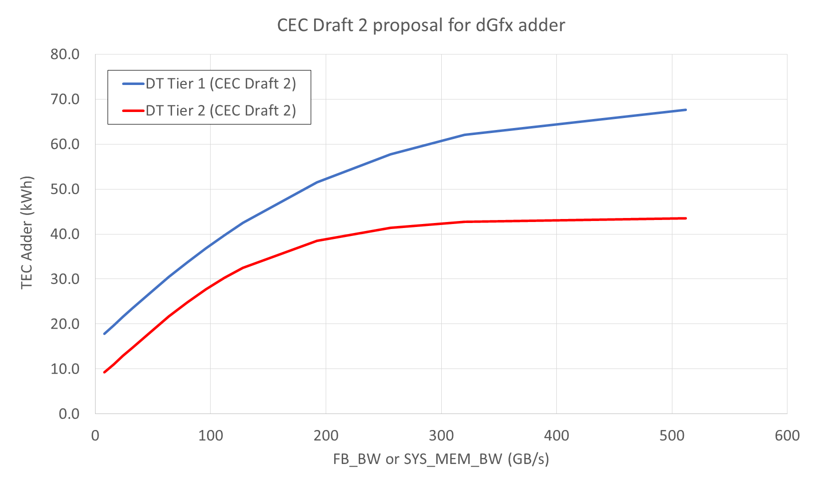
DT/AIO - System Bandwidth Adder Proposal
Display
CPU
GPU
Ctrl 1
Ctrl 2
PCIe
Display
GPU
Ctrl 1
Example SYS_MEM_BW Adder
Integration of dGfx capability into a single CPU/APU/SOC design → dGfx adders approach should carry over to new integrated design.
Threshold for future SYS_MEM_BW
adder (Industry will propose targets)
Today’s SYS_MEM_BW
Part of base TEC
Display
CPU
GPU
Ctrl 1
Ctrl 3
Current CEC proposal (no adder)
Ctrl 2
Lack of future-proofing can inhibit innovation via integration.

Slide 13
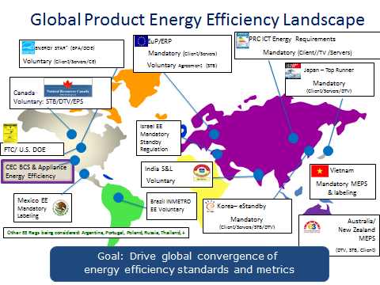
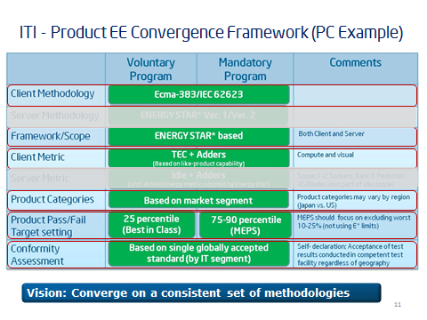
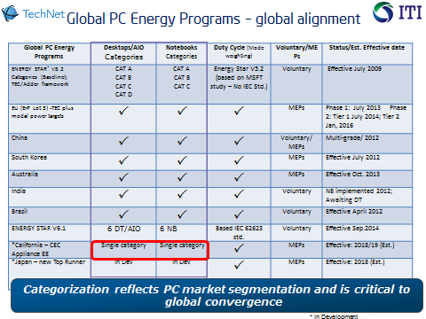
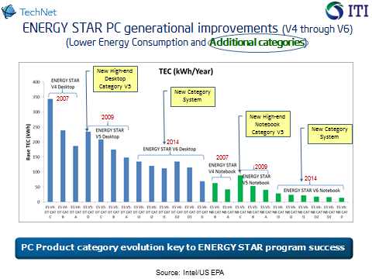
PC Framework & Methodology Summary
Industry designs and manufactures computers for global markets (key focus on innovation, energy efficiency, and customer choice)
PCs are complex – with hundreds of configurations across many consumer and corporate segments (different applications, capabilities and power profiles)
Industry works with global regulators to drive convergence on voluntary and mandatory programs.
MEPs Focus: Data collection, categorization, TEC framework, Int’l standards, targets/adders, exemptions
Key considerations: Technical/cost barriers, lead-time, regulatory impact (energy savings, innovation, cost, economic, product exclusions, etc.)
Goal: Driving global convergence on EE framework and standards
13

Slide 14


Slide 15
Global PC Energy Programs – global alignment
Global PC Energy Programs | Desktops/AIO Categories | Notebooks Categories | Duty Cycle (Mode weighting) | Voluntary/MEPs | Status/Est. Effective date
ENERGY STAR* V5.2 Categories (Baseline); TEC/Adder framework | CAT A CAT B CAT C CAT D | CAT A CAT B CAT C | Energy Star V5.2 (based on MSFT study – No IEC Std.) | Voluntary | Effective July 2009
EU (ErP Lot 3) -TEC plus modal power targets |  |  |  | MEPs | Phase 1: July 2013 Phase 2: Tier 1 July 2014; Tier 2 Jan, 2016
China |  |  |  | Voluntary/ MEPs | Multi-grade/ 2012
South Korea |  |  |  | MEPs | Effective July 2012
Australia |  |  |  | MEPs | Effective Oct. 2013
India |  |  |  | Voluntary | NB implemented 2012; Awaiting DT
Brazil |  |  |  | Voluntary | Effective April 2012
ENERGY STAR V6.1 | 6 DT/AIO | 6 NB | Based IEC 62623 std. | Voluntary | Effective Sep.2014
*California – CEC Appliance EE | Single category | Single category |  | MEPs | Effective: 2018/19 (Est.)
*Japan – new Top Runner | In Dev | In Dev |  | MEPs | Effective: 2018 (Est.)
Categorization reflects PC market segmentation and is critical to global convergence
* In Development

