Slide 1
California Energy Commission
Title: Hydrogen Analysis for Electricity Generation in the 2023 IEPR
Presenter: Jennifer Campagna, Supervisor, Energy Assessments Division
Date: September 8, 2023

Slide 2
Presentation Overview
Background
Analysis Overview
Challenges Overview
Preliminary Takeaways

Slide 3
Background
Senate Bill 1075 (Skinner, Statutes of 2022)
  Study and model potential growth for “green” (clean renewable) hydrogen
  Legislation required analysis of electric and transportation sectors
    CARB Scoping Plan & Senate Bill 100 analysis, 2022 IEPR envision other H₂ uses, particularly hard-to-electrify applications
  Results of SB 1075 analysis in 2023 and 2025 IEPRs
Governor Office actions on hydrogen

Slide 4
Analysis Overview
Power Generation
Scenarios to Evaluate
SB 100 Scenario – 2045
Results Evaluated
Factors Reviewed
Production / electricity needs
Preliminary Takeaways
Challenges with each of the factors
Identified further needs for analysis – SB 100 or other
Ability to generate and store onsite
H₂ delivery options
Costs (monetary and social)
Scoping Plan Scenario – 2045
Estimated potential of H₂ to replace gas burn by 2045
Next Phase
Ongoing analytical efforts
2025 IEPR
Transportation
Setting up Scenarios
Prelim Results (2040)
Next Step
FCEV Stock Counts and Hydrogen Fuel Demand
Refine SB 1075 transportation scenarios
2022 IEPR Freight and Truck Choice Model as starting point
Varying hydrogen fuel and FCEV price series

Slide 5
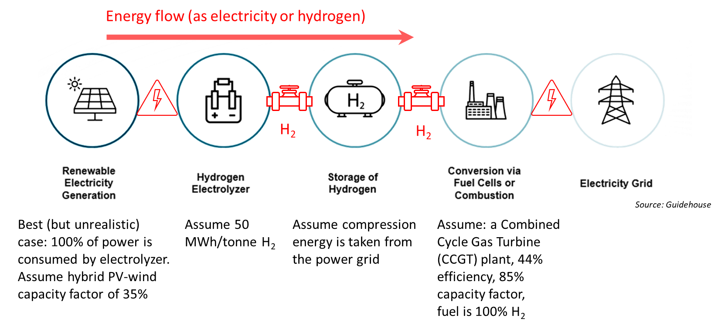
Challenge:
Renewable Energy Needs/Electrolyzers
1 MW of renewable power produces enough H₂ to replace only 0.142 MW of NGCC power: 7x

Slide 6
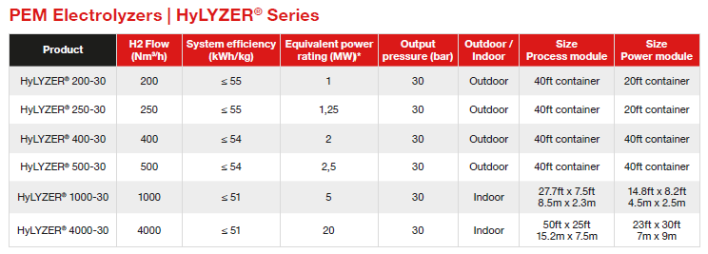
Challenge:
Requires > 500 Large Electrolyzers
Electrolyzer specifications from Cummins show output and physical footprint
Source: Cummins

Slide 7
Challenge:
Massive Delivery Volume
Options for hydrogen delivery to power plant
Trucks:
  Liquefying hydrogen adds cost and requires cooling infrastructure.
  Gaseous form demands compression.
  Unfeasible for power plants due to the immense volume needed.
Pipelines:
  Blending with natural gas (e.g., 5% blending) would not result in clean firm combustion.
  New dedicated hydrogen pipelines – would benefit from co-located facilities.

Slide 8
Challenge: Onsite Production
Onsite electrolysis at power plants resolves delivery problem but still has issues.
GIS review of existing CA gas-fired generators
  Only 33 to 40 have land space nearby to locate electrolyzers
  Does not include renewable generation or water requirements
  Does not include storage requirements to hold hydrogen
    Need almost as many storage tanks as electrolyzers
    Largest liquid H₂ storage tank (owned by NASA) holds 4700 cubic meters of H₂

Slide 9
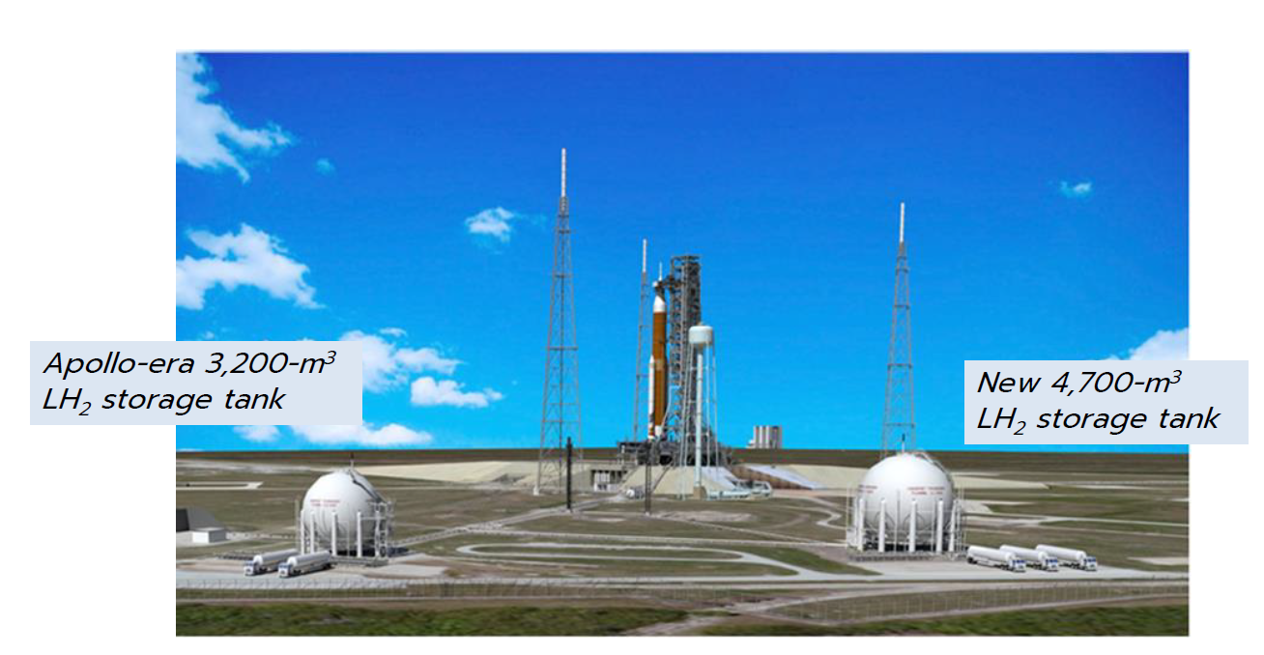
Challenge:
Onsite Production Requires Storage
NASA tank holds <1.2x output of one big electrolyzer’s 4,000 m³
Source: NASA

Slide 10
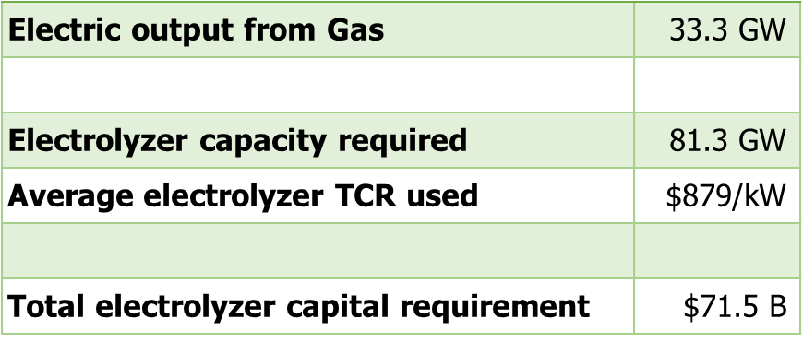
Challenge:
Cost For Electrolyzers
Assume Total Capital Requirement (TCR) of $1500/kw (2023) for electrolyzers and size them to 80% of renewables capacity.
Replacing Scoping Plan’s 215 Bcf CH₄ with H₂ takes about 537 electrolyzers
Average 2023-2045 Capital Outlay (electrolyzer costs fall over time)
Excludes cost of the renewable electricity, compression or liquefaction, delivery, and storage and ignores capacity factor/operating pattern
Production tax credits help (only 10 years unless renewed)

Slide 11
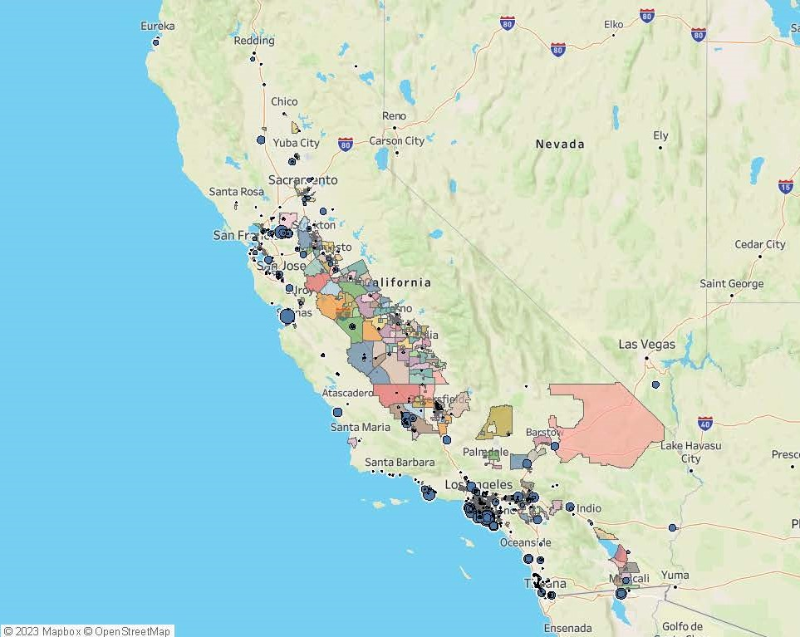
Proximity to DACs
Switching to H₂ does not eliminate combustion
H₂ has greater NOx emissions need controlling.
Prioritize plants in DACs for conversion.
Address in next phase/2025 IEPR.

Slide 12
Preliminary Takeaways
Explored current challenges and identified areas needing additional analysis
H₂ potential => substitute H₂ for CH₄ in 2045 resource mix
Takes 662 Bcf of H₂ (~1.7 Billion kg) to replace the 215 Bcf gas burn shown in Scoping Plan 2045
Requires about 537 large electrolyzers, ignoring hourly burn profile
Operating the electrolyzers will require 7x more renewable electricity than will generate with the H₂
Difficult to move that much hydrogen from production sites to power plants absent new pipelines
33 to 40 power plants may have space to co-locate electrolyzers and avoid delivery issue
Need to store the H₂ from hour produced to hour combusted
Cost of electrolyzers is $163 Billion (assuming purchased over next twenty years and costs come down over time)

Slide 13
Thank you!

Slide 14
Hydrogen Scenarios for Medium- and Heavy-Duty Trucks
Presenter: Quentin Gee, Acting Branch Manager, Energy Assessments Division

Slide 15
Setting Up the Scenario
Fuel cell electric vehicles (FCEVs) are modeled for the following weight classes:
Class 6
19,501 lb to
26,000 lb
Medium Straight Truck
Large Step Van
Sleeper Cab Tractor
Day Cab Tractor
Class 8
33,001 lb &
Over
Notes:
To better understand the role of hydrogen in medium- and heavy-duty transportation, several scenarios were run using the CEC’s IEPR 2022 version of the Freight and Truck Choice Model.
Currently, the model only has hydrogen truck attributes for Class 6 and Class 8 trucks, so these are the only classes for which hydrogen shows up.
The following hydrogen scenarios use updated delivered truck prices for hydrogen trucks that differ from what was used in IEPR 2022.
Truck choice component of model is sensitive to fuel price as an input, and as such, varying fuel price series were modeled.

Slide 16
SB 1075 Scenarios - Hydrogen Fuel Prices
Source: California Energy Commission staff

Slide 17
SB 1075 Scenarios – FCEV Prices
Source: California Energy Commission staff
Notes:
“we’re going to do multiple SB 1075 scenarios; what we’re giving today is a flavor of what those could look like – NOT the final scenario”

Slide 18
SB 1075 Scenarios – FCEV Count
Source: California Energy Commission staff

Slide 19
SB 1075 – Scenario Hydrogen Fuel Demand for FCEVs
Source: California Energy Commission staff

Slide 20
SB 1075 – Scenario FCEV Count by Class in 2040
Source: California Energy Commission staff

Slide 21
Next Steps
Refine inputs for SB 1075 scenarios
Explore potential ways to model scenarios for fuel cell electric buses
Compare outputs with other existing hydrogen adoption scenarios

Slide 22
Thank you.
Quentin Gee
Acting Branch Manager, Advanced Electrification Analysis Branch
Quentin.Gee@energy.ca.gov

