Slide 1
Morton Bay (23-AFC-01), Elmore North (23-AFC-02), and Black Rock (23-AFC-03) Geothermal Projects
August 31, 2023, Informational Hearing, Calipatria, Imperial County
Eric Veerkamp, Project Manager
Siting and Environmental Branch
Siting, Transmission, and Environmental Protection Division

Slide 2
CEC Staff’s Role in an AFC Proceeding
CEC staff is an independent party to the proceeding
Staff is a conduit for public, agency, and tribal input
Staff holds public workshop(s)
Staff prepares objective assessments of the application
    Preliminary Staff Assessment (PSA)
    Final Staff Assessment (FSA)
Staff provides expert witness testimony (technical expertise) at hearing(s)

Slide 3
Staff Assessment Topic Areas
Air Quality
Alternatives
Biological Resources
Cultural and Tribal Cultural Resources
Environmental Justice
Geology, Paleontology, and Minerals
Greenhouse Gas Emissions
Hazards, Hazardous Materials, and Wildfire
Land Use, Agriculture, and Forestry
Noise and Vibration
Public Health
Socioeconomics
Solid Waste Management
Transportation
Visual Resources
Water Resources
Worker Safety and Fire Protection
Facility Design
Power Plant Efficiency
Power Plant Reliability
Transmission and Other Infrastructure
Notes:
The Final Staff Assessment that CEC staff prepares, and that the Commissioners consider in their decision-making on a project, does several things. It analyzes environmental impacts of the project in many different topic areas, as listed above. It also analyzes the project's compliance with federal, state, and local laws, ordinances, regulations, and standards (LORS). This includes the project's compliance with the local agency's General Plan and zoning requirements. The report also includes conditions of certification to mitigate (avoid or reduce) environmental impacts, and to make the project consistent with federal, state, and local LORS. Additionally, the Staff Assessment includes an assessment of the project's engineering.

Slide 4
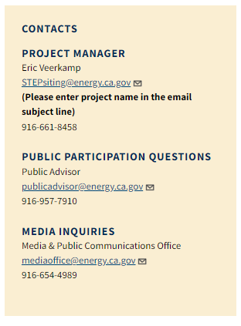
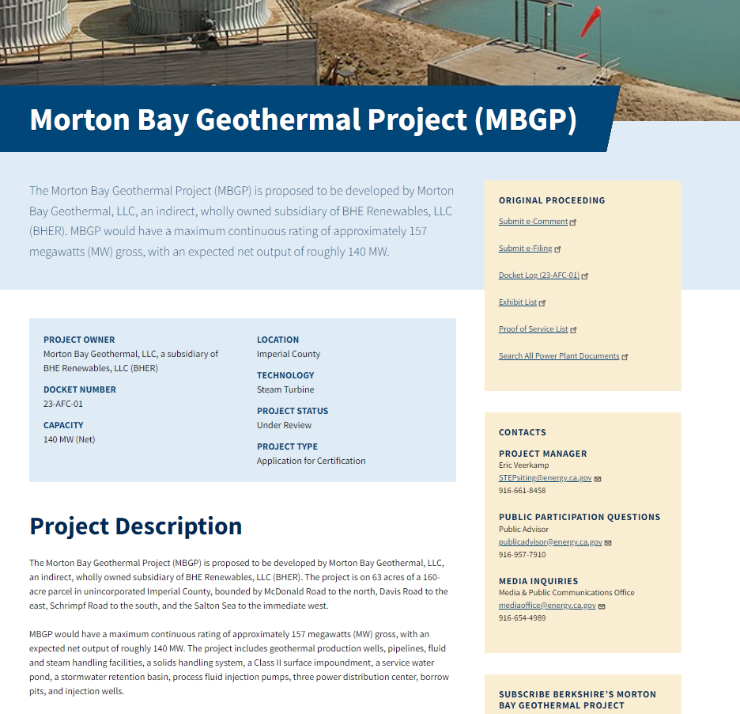
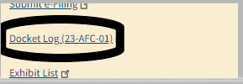
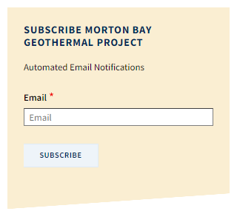
CEC MBGP Project Webpage

Slide 5
Major Issues Identified to Date
Cultural and Tribal Cultural Resources: 1) incomplete archaeological survey, and 2) incomplete identification of tribal resources and impacts assessment
Water Resources: 1) service provider’s ability to provide the required water, and 2) the impact on the regional water supply

Slide 6
Staff’s Proposed Schedule
Data Request Set 1 filed – planned for 8/30/23
Informational Hearing/Site Visit – Today
Staff’s PSA published – 60 Days after data requests satisfied
Comment deadline on PSA – 45 Days after publication
Staff’s FSA published – 60 Days after comment deadline
Evidentiary Hearing – scheduled by the Committee
Presiding Member’s Proposed Decision – scheduled by the Committee
Commission Decision – TBD
Notes:
The Final Staff Assessment that CEC staff prepares, and that the Commissioners consider in their decision-making on a project, does several things. It analyzes environmental impacts of the project in many different topic areas, as listed above. It also analyzes the project's compliance with federal, state, and local laws, ordinances, regulations, and standards (LORS). This includes the project's compliance with the local agency's General Plan and zoning requirements. The report also includes conditions of certification to mitigate (avoid or reduce) environmental impacts, and to make the project consistent with federal, state, and local LORS. Additionally, the Staff Assessment includes an assessment of the project's engineering.

