Slide 1
Non-energy Impacts and Process Evaluation of Integrated Energy Retrofit Packages in California’s Residential Buildings
Request for Comments on Forthcoming Solicitation
Energy-Related Environmental Research
Energy Research & Development Division
July 28, 2023

Slide 2
Housekeeping
All participants muted on Zoom (until Q&A)
Zoom recording
Comments and questions
  Please use “Q&A” feature for substantive comments and questions (not chat).
  Please reserve the “Chat” feature for technical issues, etc.

Slide 3
Why We Are Seeking Your Input?
Forthcoming Grant Funding Opportunity: up to $3M to fund research to assess the non-energy impacts of consolidated packages of electrified retrofit measures in California homes.
To ensure high-impact research, seeking input to inform solicitation development.

Slide 4
Workshop Agenda
Background on EPIC funding program
Initial ideas regarding scope and focus of anticipated solicitation
Seek input from stakeholders on specific discussion questions regarding proposed research.
Input from today’s workshop plus public comments (oral and/or written comments) will help shape the Grant Funding Opportunity.

Slide 5
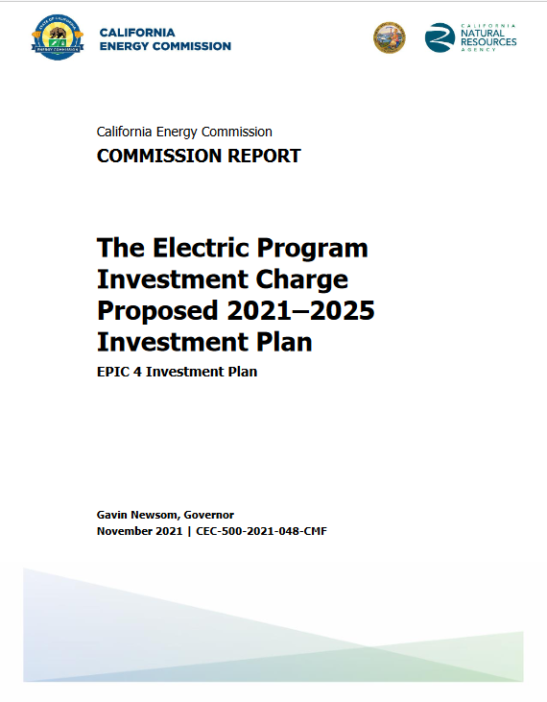
EPIC Research and Development Program
Proposed research supports the CEC’s EPIC 4 Investment Plan:
Initiative 43. Evaluating Air Quality, Health, and Equity in Clean Energy Solutions (pp. 210-215)
To access report: https://www.energy.ca.gov/publications/2021/electric-program-investment-charge-proposed-2021-2025-investment-plan-epic-4
5

Slide 6
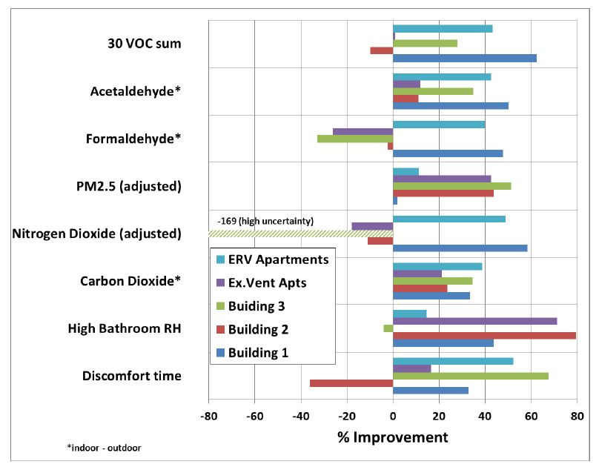
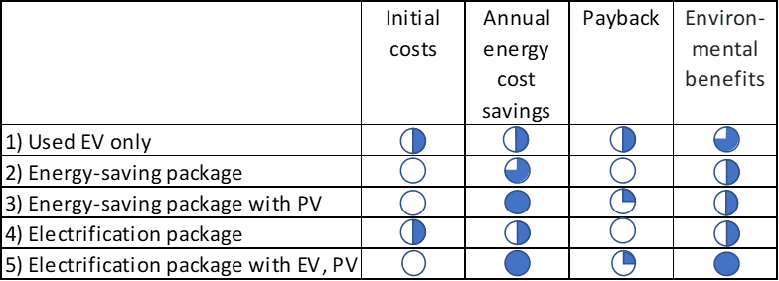

Research Context
Past studies investigated impacts of retrofit packages on AQ, GHG, and costs.
Unique challenges to retrofitting homes, especially existing homes.
Need for more demonstration and pilot projects to determine what works best for residents, understand impacts on indoor air quality and co-benefits.
Summary of IEQ results pre- and post- retrofit (Fisk et al. 2014)
Comparison of used EV, energy-saving packages & electrification packages (Wei et al. in press)
Source: Wei et al. Building Healthier and More Energy-Efficient Communities in Fresno and the Central Valley – Final Report. California Energy Commission. Contract Number: EPC-17-035 (in press).
Source: Fisk, W.J. et al. 2014 Integrating Energy and IEQ Retrofits in Apartments. CEC‐500‐2014‐084.

Slide 7
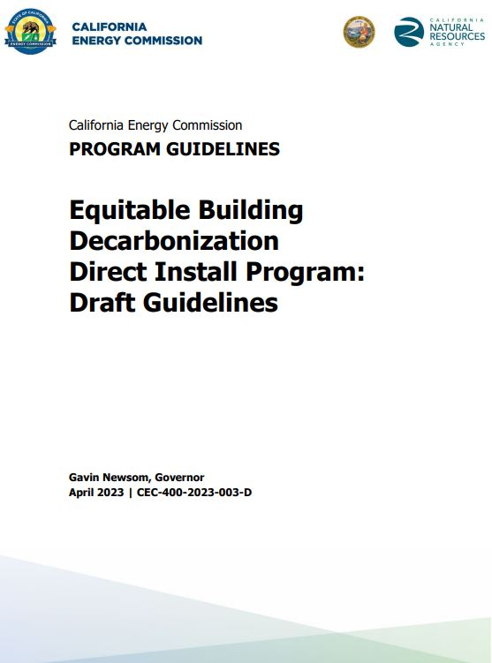
Policies and Programs
CEC’s Assembly Bill 3232 California Building Decarbonization Assessment report
  Retrofit costs a significant barrier to building decarbonization
IEPR, 2021
  Significant investments in retrofits needed to accelerate building decarbonization
  “...the CEC and other relevant agencies should work to quantify the non-energy benefits of reducing building emissions”
CEC’s Equitable Building Decarbonization Program
  Will include a Direct Install Program
Source: Kenney et al. 2021 California Building Decarbonization Assessment. California Energy Commission. Publication Number: CEC-400-2021-006-CMF.
California Energy Commission, Equitable Building Decarbonization Program, https://www.energy.ca.gov/programs-and-topics/programs/equitable-building-decarbonization-program
2021 IEPR Volume I - Building Decarbonization, https://www.energy.ca.gov/data-reports/reports/integrated-energy-policy-report/2021-integrated-energy-policy-report

Slide 8
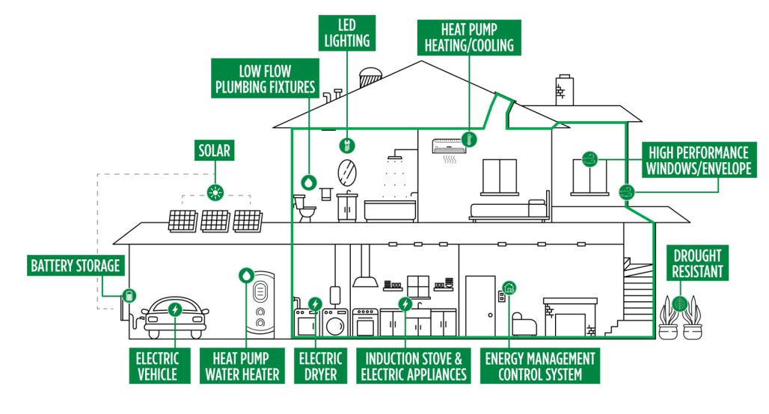

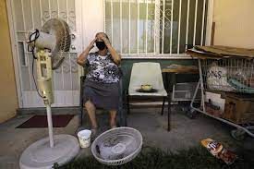
Research Motivation
Decarbonization programs are expected to support installation of multiple technologies and building interventions.
Many households are not aware of non-energy benefits of home electrification (e.g., health, comfort, and net costs).
Source: CEC, IEPR 2021
Source: EPC-17-035 agreement

Slide 9
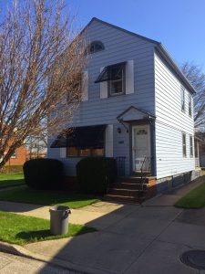
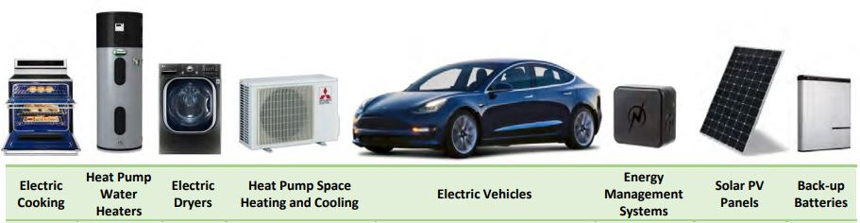
Purpose of Forthcoming Solicitation
Advance science on assessing impact of consolidated packages of electrified retrofit measures on air quality and other impact categories.
Goal: Inform programs that maximize benefits while lowering residents' bills.

Slide 10


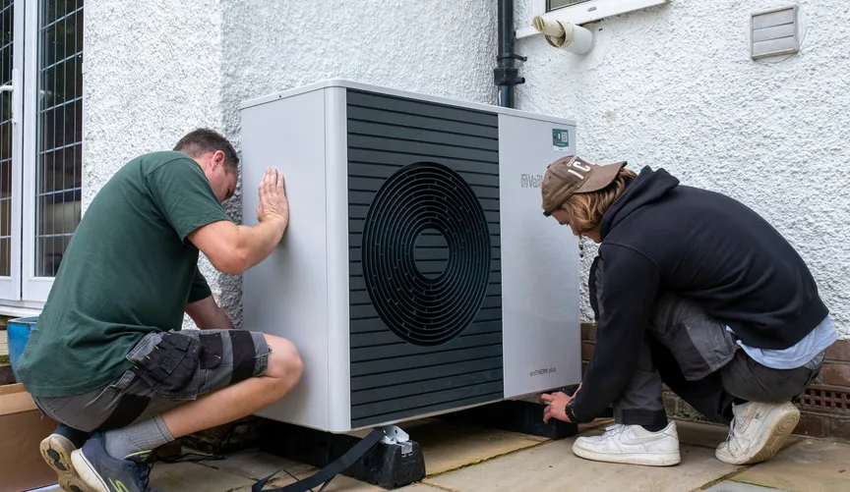


Research Scope
Research will:
  Identify methods to install market-available retrofit technologies and evaluate successes and barriers.
  Measure air quality and other impacts categories pre- and post-retrofitting.
  Map out the non-energy benefits of home electrification.
  Provide guidance for cost-effective building electrification.
Source: EPC-17-035 agreement

Slide 11
Research Focus
Sizable field study focused on LIC and/or DAC homes.
Develop impact metrics.
Measurement of impact metrics before and after installations.
Modelling to scale up an integrated retrofitting approach.
Articulation of strategies for best practices for stakeholders.

Slide 12
Comments and Questions
Three ways to provide feedback or ask questions:
Use the raise hand function in Zoom:
  Zoom Phone controls:
    *6 - Toggle mute/unmute.
    *9 - Raise hand.
  Please introduce yourself by stating your name and affiliation.
Type comments and questions in the question function on Zoom:
  Please provide name and affiliation.
  Please indicate which discussion questions you are commenting on (E.g., 1, 2, etc.).
Submit written comments & questions:
  Send written comments & questions to docket@energy.ca.gov by no later than August 11, 2023, 5 p.m. PST.
    Include docket number 23-ERDD-01 and “Staff Workshop on Non-energy Impacts and Process Evaluation of Integrated Energy Retrofit Packages in California’s Residential Buildings” in the subject line

Slide 13
Discussion Questions
What ongoing or planned research efforts should this work coordinate with or leverage to help inform research goals and increase the impact of this effort?
Which retrofit measures should be prioritized in the homes?
What other impact categories can and should be evaluated?
How should the study approach be structured to provide insights on the following?
  Measurement of performance of new measures for air quality and related impacts.
  Designing buildings and technologies that characterize pollutant chemicals using low-cost air quality sensors.
  Process evaluation for retrofitting homes.
Should a specific housing type be targeted?
The proposed funding for this solicitation is $3 million for one award. Is this funding amount sufficient to support a meaningful study? If not, are there partnerships that could provide additional support?
Any other questions from attendees?

Slide 14
Thank You!
Please submit your written comments by
5:00 p.m. August 11, 2023
Submit electronically through the Energy Commission’s “Research Idea Exchange” docket here: https://efiling.energy.ca.gov/EComment/EComment.aspx (Enter docket # 23-ERDD-01)
Or by email to the Docket Unit at: docket@energy.ca.gov
  Please include docket number 23-ERDD-01 and “Staff Workshop on Non-energy Impacts and Process Evaluation of Integrated Energy Retrofit Packages in California’s Residential Buildings” in the subject line
Or by paper copy to the Docket Unit: California Energy Commission || Docket Unit, MS-4 || Re: Docket No. 19-ERDD-01 || 715 P Street || Sacramento, CA 95814
Visit: https://www.energy.ca.gov/event/workshop/2023-07/staff-workshop-indoor-air-quality-and-co-benefits-integrated-energy-retrofit to view the workshop notice, presentation, and recording (forthcoming).

