Slide 1
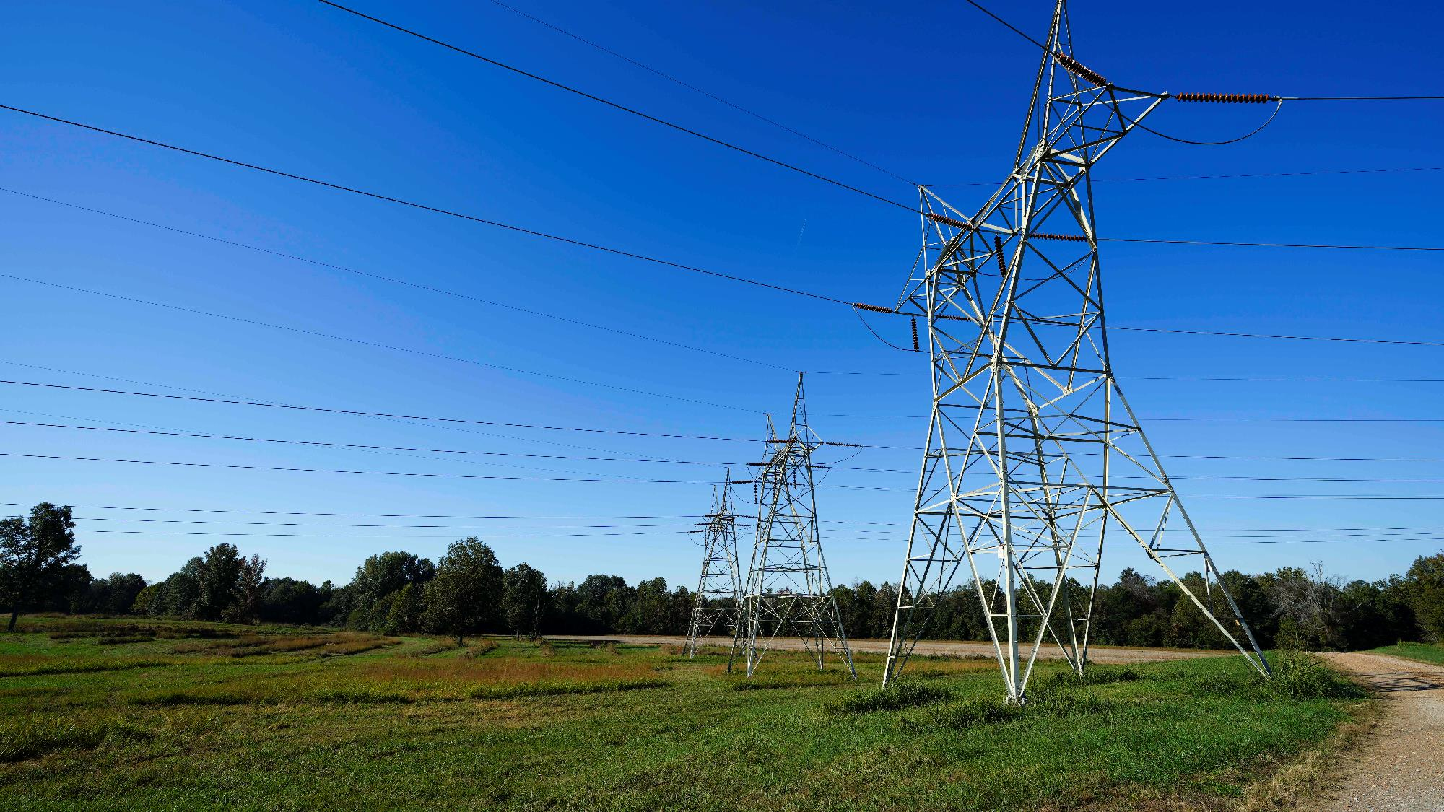

2023 Interconnection
Process Enhancements
July 11, 2023
Jim Shandalov
VP Development & Origination

Slide 2
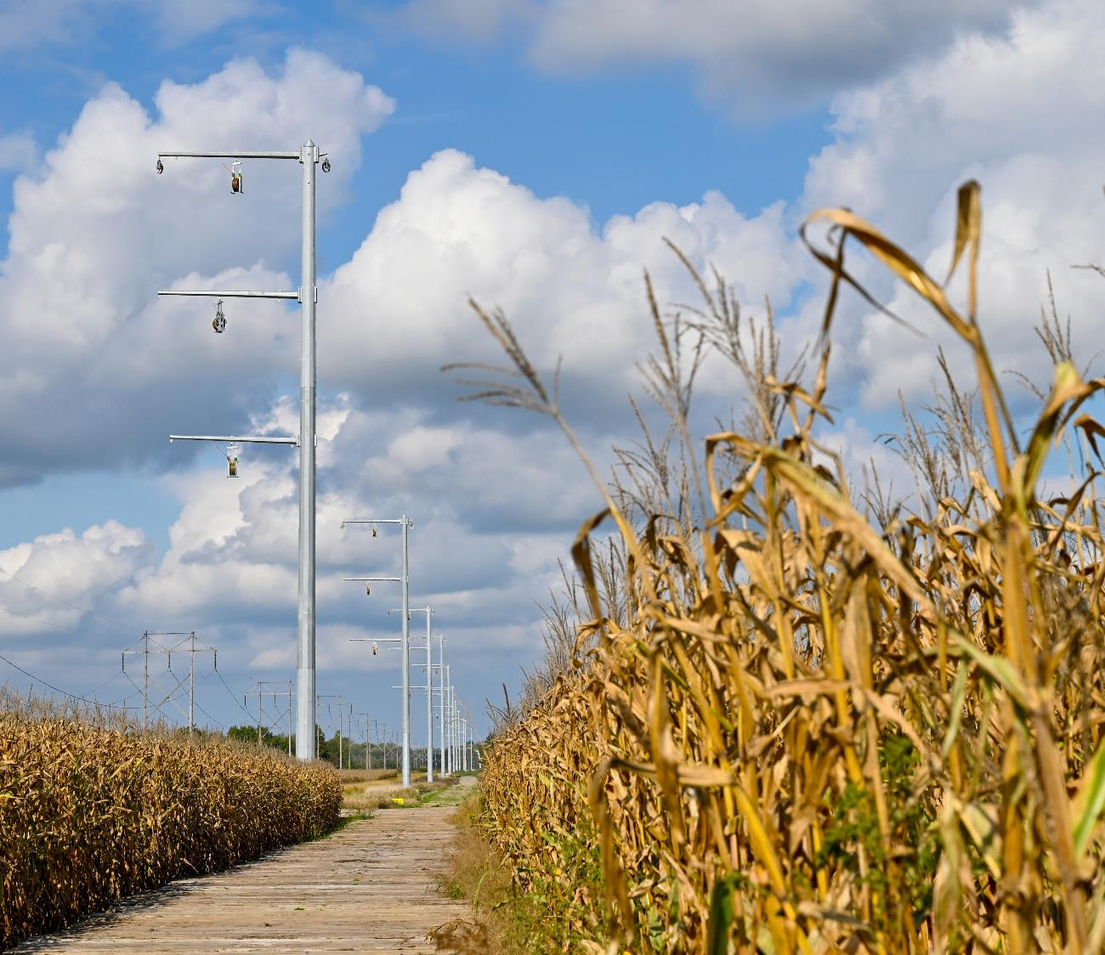
Interconnection

Slide 3
Interconnection reform is needed to reduce processing times and improve the overall efficiency and accuracy of the process
Reform Proposals
1
2
3
4
5
Implement a new, non-refundable
entry fee
Higher study deposits based on project size with limits on refundability
Higher study deposits for network upgrades and interconnection facilities
More stringent site exclusivity requirements and elimination of payment “in lieu of”
Automation and standardization of Phase I interconnection study process
Similar reform measures have recently been approved by FERC and align with the FERC NOPR

Slide 4
The interconnection process is hampered by entry fees and study deposits that are very low compared to overall project costs
1
Implement a new, non-refundable entry fee
Propose adopting a non-refundable $100,000 fee to enter the queue
Will deter more speculative projects from entering the queue
2
Higher study deposits based on project size
In addition to the new entry fee, adopting a $8,000 per MW deposit
Deposit would be 100% refundable up to 30 days following scoping meeting, or before the start of Phase I studies (whichever comes first)
A withdrawal more than 30 days following initial scoping meeting would include a refund of the deposit less any costs incurred by PTOs and CAISO
Modifying the deposit structure would place a more appropriate value on scarce transmission

Slide 5
Upgrade deposits should be increased and become less refundable as the project moves along
3
Higher deposits for network upgrades and interconnection facilities
Propose increasing the Phase I posting from 15% to 25% of identified upgrade costs
Propose increasing the Phase II posting from 30% to 50% of identified upgrade costs
In both cases, 50% of the network upgrades would be refundable and 100% of the interconnection facilities deposit would be refundable (less any costs actually incurred by the transmission owner)
Steadily increasing financial risk can help ensure only serious projects remain in the queue

Slide 6
Site exclusivity is an important assessment of whether or not a project can move forward as planned
4
More stringent site exclusivity requirements and elimination of payment “in lieu of”
Require demonstration of site exclusivity to enter the queue (currently only required to enter Phase II starting with Cluster 15
Eliminate the “pay in lieu of” option for projects entering Cluster 15
Apply site exclusivity requirement at Phase II security posting milestone for Cluster 14 projects
Propose adopting a minimum acreage requirement for generating sites:
Wind generation – 30 acres per MW
Solar generation – 6 acres per MW
Storage/battery – 0.1* acres per MW
This model has been used in other RTO/ISO and has already been approved by FERC
Eliminating the ability to pay “in lieu of” will deter less ready projects from clogging the queue

Slide 7
Timelines can be reduced by maximizing the tools available to existing CAISO resources
5
Automation and standardization of Phase I interconnection study process
The current validation process is extremely manual and requires various iterations of changes per application, which can result in the overuse of staffing resources
CAISO should pursue advancements in new technology to increase the speed and accuracy of modeling for interconnection studies
Automation and use of technology can be incorporated into the input data validation process, model building and model solving
SPP has been exploring solutions to leverage Artificial Intelligence (AI) computing applications and more basic improvements (e.g., data entry and data validation)*
For a relatively small cost, the CAISO could adopt such measures and trim months,
if not years, off the interconnection process, while maintaining accurate and reliable studies

Slide 8

Queue Management

Slide 9
Following the study process, several projects in the interconnection queue do not proceed to commercial operation as expected and need to be removed
Reform Proposals
1
2
3
A one-time, penalty-free ability to exit the queue if new rules are applied
Align Transmission Plan Deliverability (TPD) allocation process with first-ready first-served principles
Other issues that need refining

Slide 10
Developers should be held harmless to unanticipated changes in queue reform
1
A one-time, penalty-free ability to exit the queue if new rules are applied
Given the potential number of proposed changes, allowing developers a one-time, risk free exit from the queue is reasonable
  Exiting projects would still be subject to costs incurred to date but would not be subject to loss of deposits for interconnection facilities or network upgrades
Many of reforms can and should be applied to Phase II of Cluster 14

Slide 11
More mature projects, coming to market sooner, should be awarded deliverability first
2
Align Transmission Plan Deliverability (TPD) Allocation process with first-ready, first-served principles
Need to evaluate the current Affidavit Scoring process associated with the TPD allocation process to determine if it aligns with first-ready, first-served principles
  Projects with highest score, regardless of allocation group, should be prioritized
Propose modifying existing rule (to applicable allocation groups) to increase minimum term of a RA contract from 5 years to 10 years in order for a developer to apply for deliverability
  The minimum fee in lieu-of having an executed contract should increase from $10k/MW to $20k/MW to reflect the significant value of deliverability
  If a project reaches COD, the fee would be refundable; otherwise, not refundable
Most Cluster 13 projects were allocated 0% deliverability and were forced to convert to Energy-Only to remain in the queue, despite being further along in maturity
Under current CAISO tariff, a more advanced project that converted to Energy-Only is automatically ranked lower than an incoming FCDS project (Cluster 14)
This undermines the objective of advancing and prioritizing deliverability for more mature projects

Slide 12
Older queued projects that have executed Interconnection Agreements but have not been built should be held accountable
3
Other issues that need refining
CAISO should terminate projects that have lingered in the queue
Retrospective application of reforms to existing projects
  CAISO should establish a transition process that would allow interconnection customers with projects that meet defined criteria to be legacied
A removal of suspension rights is too stringent but existing language in the CAISO tariff lacks clarity around termination

