Slide 1
Grid Enhancing Technologies
- Interconnection
- ISO/RTO action
- Federal policy proposals and action
Julia Selker
Working for Advanced Transmission Technologies (WATT) Coalition
June 27, 2023

Slide 2
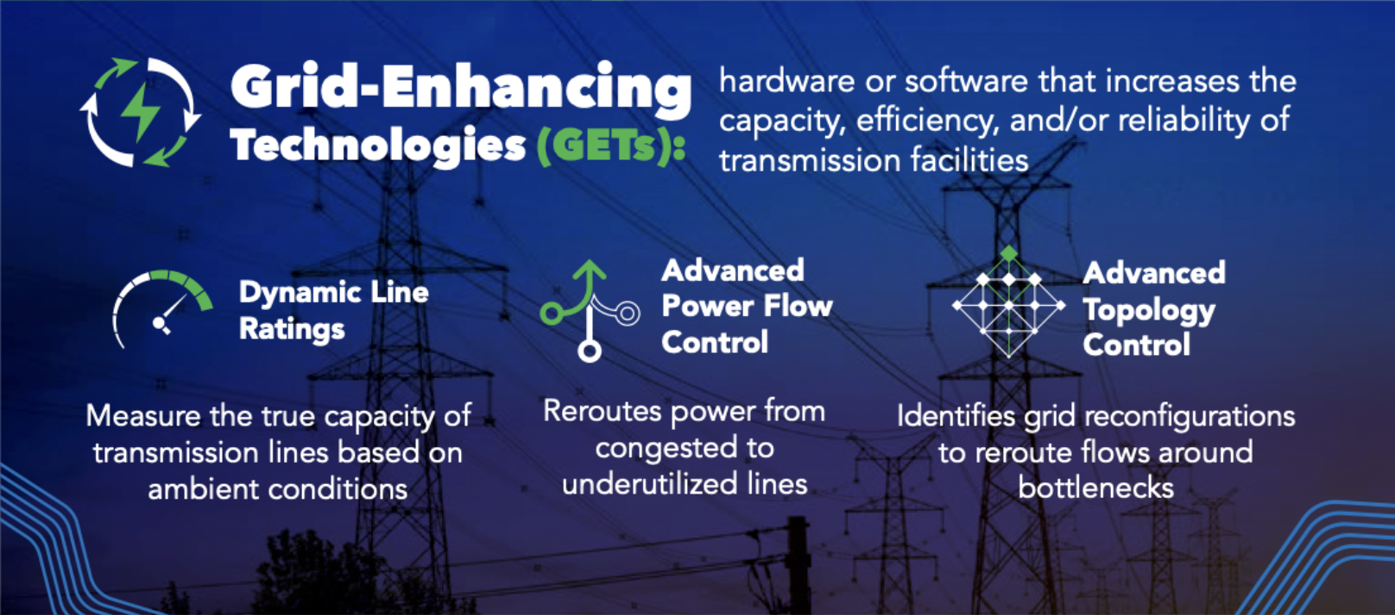
WATT Coalition
Working for Advanced Transmission Technologies
More details on technologies and benefits in an appendix

Slide 3
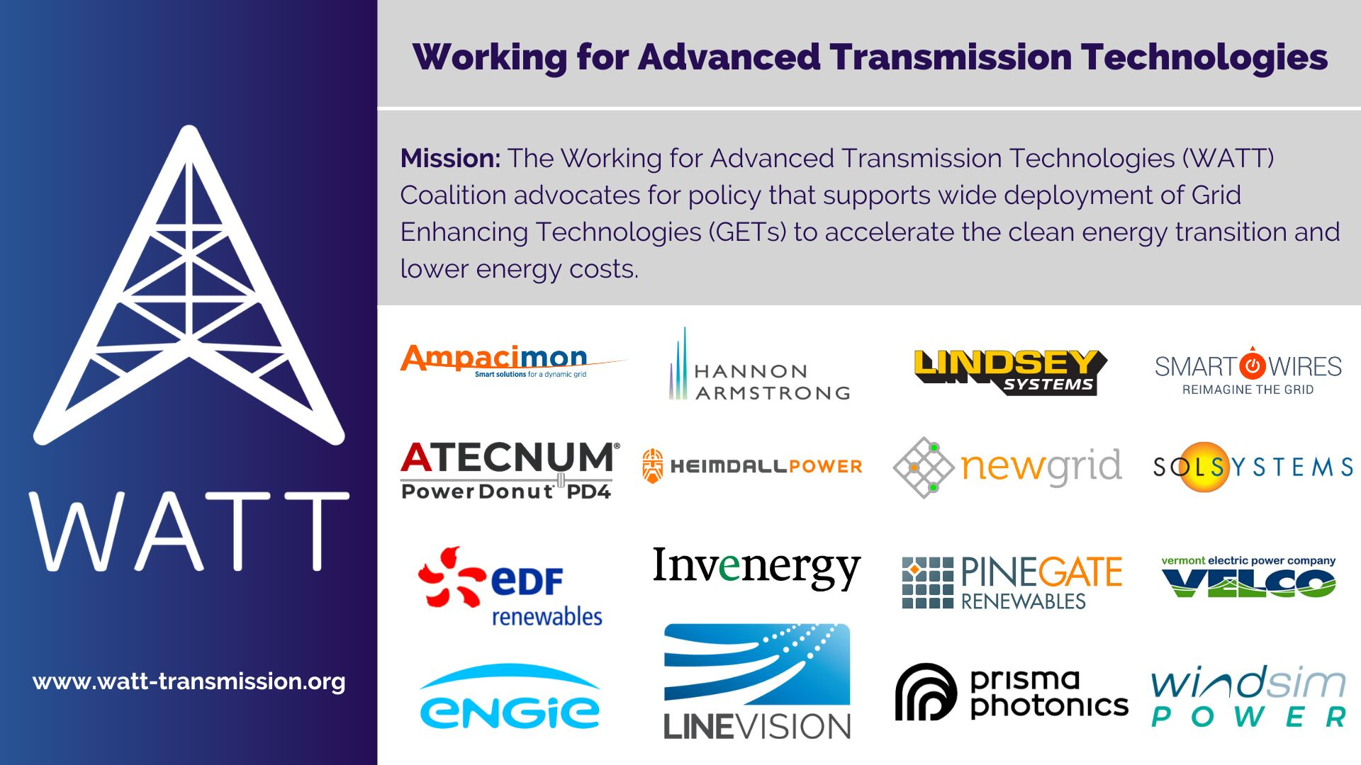


Slide 4
GETs for Interconnection – individual projects
Reduce interconnection costs
Shorten study and construction timelines
Serve as bridge projects
Fewer project withdrawals due to high costs
Cost Savings: DLR could have avoided 1-3% line overloads that would otherwise cost a developer $50-400m
Cleaner energy, faster: GETs deployments are completed in months

Slide 5
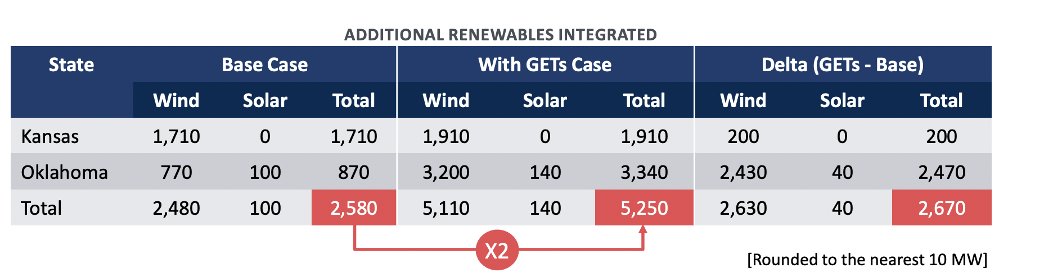
Unlocking the Queue: GETs Double Renewable Capacity on the Existing Grid
Modeling GETs on the Kansas and Oklahoma grids, based on queue projects with signed interconnection agreements the Brattle Group, February 2021
Yearly production cost savings of $175 million against one-time $90 million installation costs
https://watt-transmission.org/wp-content/uploads/2021/02/Brattle__Unlocking-the-Queue-with-Grid-Enhancing-Technologies__Final-Report_Public-Version.pdf90.pdf

Slide 6
Barriers to Adoption
Why are these beneficial technologies not being used?
Awareness
Many planners, utility executives, regulators, and stakeholders are unfamiliar with advanced transmission technologies and their benefits
No Incentive to Innovate
Can’t be blamed for doing things the same way as usual
Lower returns on lower capital cost expenditures

Slide 7
How ISOs can bring GETs into interconnection
Consider GETs as a valid mitigation alternative in interconnection studies
Develop procedures to include GETs and document those in business practice manuals
Report in detail on the evaluation of GETs in interconnection studies (including basis for rejection)
Work with GETs OEMs to develop the models to be used in interconnection studies
Update software to include the GETs models
Also, including GETs in TPP implementation would be transformational.

Slide 8
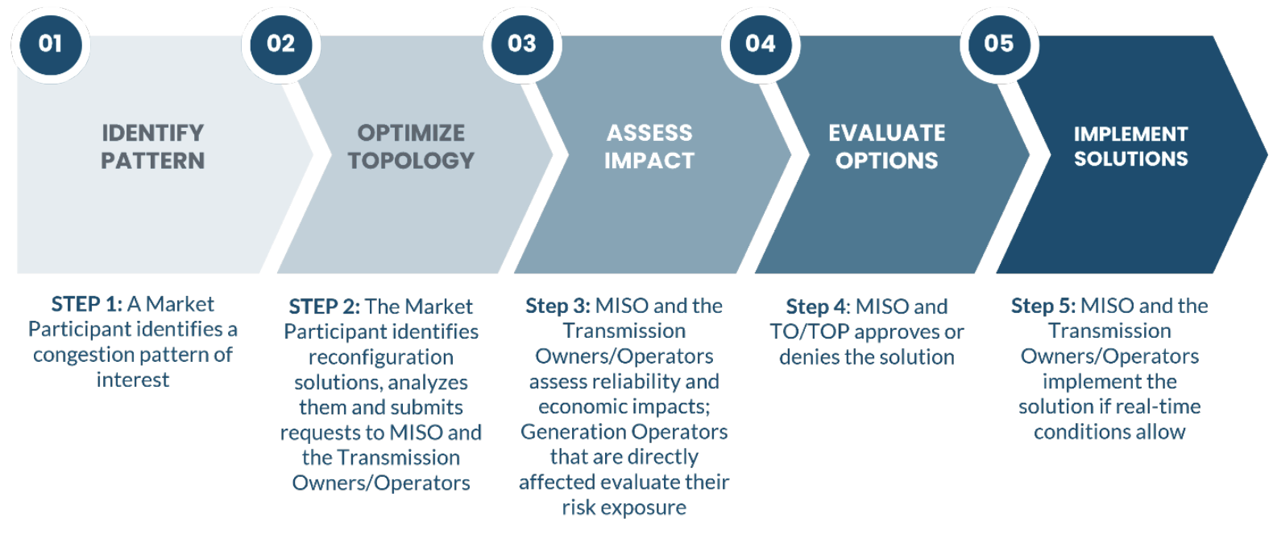
Examples of action by RTO/ISOs
MISO: Congestion Cost
Reconfiguration ->
ERCOT evaluates DLR in economic transmission planning to resolve congestion
CAISO’s economic transmission planning found no viable projects on congestion-mitigation value alone – unclear if they evaluated GETs
FERC Order 881: All RTOs required to accept DLR by 2025

Slide 9
Federal Policy
FERC planning and interconnection NOPRs include GETs
Promising FERC inquiries into GETs requirements, shared savings incentives, and independent transmission monitoring
DOE programs support GETs deployments with state agencies and utilities as eligible applicants
States can include GETs in energy & climate strategies

Slide 10
Possible actions for California
EPIC research: study the economic and reliability value of GETs west-wide on CA imports, or in congested locations in CA.
Shared-savings incentive: CAISO’s tariff could include incentives for TOs who reduce congestion with GETs.
Other?
Note on IPE Track 2 development: transmission capacity unlocked through GETs could allow projects outside of those prioritized by CAISO to interconnect.

Slide 11
Working for Advanced Transmission Technologies
For more information contact
Julia Selker / jselker@gridstrategiesllc.com
www.watt-transmission.org

Slide 12
Appendix

Slide 13
Benefits of Grid Enhancing Technologies (GETs)
Economic, Reliability and Clean Energy Benefits
Cost Savings
  Decreased congestion costs – estimated savings of $2-4 billion per year nationwide
  Lowest cost increase in transmission capacity – often >20% on average
  GETs are very low cost: roughly $0.5k - $25m per installation
  Increased capacity enables lower-cost renewable generation
Cleaner energy, faster
  GETs can double the integration of new renewable energy capacity of a transmission system, without any new lines
  GETs deploy in months for rapid energy transition
Reliability through flexibility and awareness
  Data-driven decisions, real-time visibility, and enhanced control over the system support reliable grid operation

Slide 14
Advanced Power Flow Control
Meets current flexibility needs
— A set of technologies that effectively pushes or pulls power away from overloaded lines and onto underutilized corridors within the existing transmission network
—Serves as a “valve” to control power flow
Technological benefits
— Quickly deployed
— Easily scaled to meet the size of the need
— Able to be redeployed to new parts of the grid when no longer needed in current location
See a deployment in UK, saving customers more than £300 million and adding 1.5 GW of capacity

Slide 15
Dynamic Line Rating
Increases capacity on existing transmission lines
— Calculates ratings based on actual monitored conditions rather than fixed worst-case assumptions
— Even a relatively low amount of wind can cool the line, significantly increasing its rating and reducing curtailments and congestion
Improves reliability
— Provides forecasted ratings up to 48 hours ahead, and improves reliability by alerting operators to conditions such as clearance violations
— Estimates of increased capacity have been 40 percent, 30 to 70 percent, and 30 to 44 percent on three different tests
(US Department of Energy, Dynamic Line Rating Systems for Transmission Lines, April 2014, https://www.smartgrid.gov/files/ SGDP_Transmission_DLR_Topical_Report_04-25-14_FINAL.pdf )
Belgium has been managing its transmission system with widespread use of Dynamic Line Ratings for over a decade.

Slide 16
Advanced Topology Control
Evenly distributes flow over the network
— A software technology that automatically identifies reconfigurations of the grid to route power flow around congested or overloaded transmission elements
— Reconfigurations are implemented through switching on/off existing high voltage circuit breakers
— Optimization increases the transfer capacity of the grid
Congestion and curtailment reduction
— Can reduce congestion by up to 50 percent and improve response to contingencies
— Can reduce renewable energy curtailment by up to 40 percent
See the potential impact of topology optimization in MISO as presented to FERC.

