Slide 1
PG&E’s Proposed Environmental and Social Justice Pilot Study Plan
Elijah DeVaughn
elijah.devaughn@pge.com

Slide 2
Background, Purpose, and Desired Outcomes
Overall Objective: Safety programs and priorities reflect ESJ concerns
Background
The Commission calls for an ESJ Pilot Study in the utilities’ RAMP filing that includes community input
ESJ Pilot Study Purpose
Provide insight into how utilities’ planned risk mitigations impact DVCs
Desired Outcomes
Community stakeholders understand PG&E’s proposed ESJ Pilot Study approach and provide feedback
Questions to Consider
Does PG&E’s plan address the objective of the action item?
Are there concerns with how PG&E plans to address the action items?
Are there alternative approaches PG&E should consider?

Slide 3
RAMP, GRC, and the Risk-Based Decision Framework
ESJ Pilot Study
Four Year Cycle | Risk Assessment and Mitigation Phase (RAMP) 2024 RAMP to be filed on May 15, 2024 Using the S-MAP framework, PG&E files a report identifying its top safety risks and proposed risk mitigation programs for the upcoming GRC period. Incorporates the ESJ Pilot Study Plan
 | General Rate Case (GRC) 2027 GRC to be filed on May 15, 2025 Updated assessment of operational risks and mitigations. Request budget to fund programs
Annual Filing | Risk Spend Accountability Report (RSAR) Filed annually Compares budgets adopted in GRC for safety, reliability, and maintenance programs against actual spend.
As Needed | Risk OIR/S-MAP Schedule driven by regulators with stakeholder influence Determine the risk framework that IOUs use in their RAMP and GRC.
Risk Assessment and Mitigation Phase (RAMP)
Risk OIR/Safety Model Assessment Proceeding
(S-MAP)
Risk OIR / S-MAP
Risk Spend Accountability Report (RSAR)
General Rate Case (GRC)

Slide 4
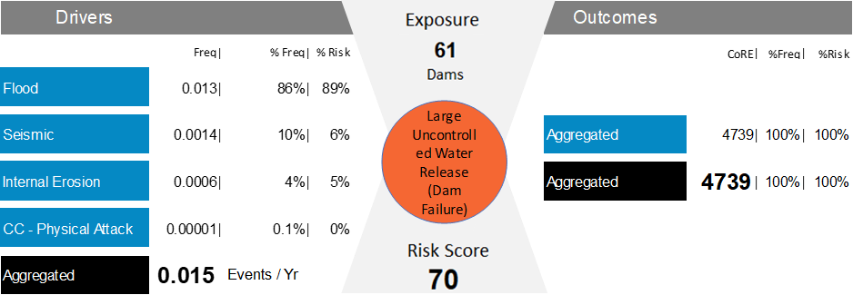
PG&E’s ESJ Goals
Safety programs and priorities reflect ESJ concerns
Accomplish by incorporating them into Risk Analysis
The ESJ Pilot Study is the First Step
ESJ Concerns
How should this be done?
Example Risk Analysis From 2020 RAMP

Slide 5
Proposed ESJ Pilot Study Overview
Utilities are required to consider the following 7 Action Items as part of the ESJ Pilot Study:
  Action Item #1: Identify impacts to Disadvantaged and Vulnerable Communities (DVCs) from risk event consequences and mitigations.
  Action Item #2: Consider investments in clean energy resources.
  Action Item #3: Consider mitigations that improve local air quality and public health.
  Action Item #4: Evaluate how the selection of proposed mitigations may impact climate resilience in DVCs.
  Action Item #5: Evaluate if estimated impacts of wildfire smoke disproportionately impacts DVCs.
  Action Item #6: Estimate the extent to which risk mitigation investments impact and benefit DVCs in relation to non-DVCs.
  Action Item #7: Enhance outreach and public participation opportunities for DVCs to meaningfully participate.

Slide 6
Action Item #1
Identify impacts to DVCs from risk event consequences
  Approach: PG&E proposes to focus on 3 Risks:
  Loss of Containment on a Gas Transmission Pipeline
  Large Uncontrolled Water Release (Dam Failure)
  Wildfire
  Map consequences (in natural units and $) and mitigations located in or impacting DVCs onto CalEnviroScreen areas.
  Discussion: Would this information be a useful first step to understand how communities are impacted by these Risks?

Slide 7
Action Item #2
Consider investments in clean energy resources
  Approach: Explore how risk reduction benefits of the Microgrid Incentive Program (MIP) and Community Microgrid Enablement Program (CMEP) can be represented in RAMP.
  Discussion: Are there other clean energy resource programs that should be considered?

Slide 8
Action Item #3
Consider mitigations that improve local air quality and public health
  Approach: Explore how risk reduction benefits related to Community Air Protection Program (Assembly Bill 617) initiatives can be represented in RAMP.
  Discussion: Are there other considerations for how air quality can be accounted for in PG&E’s safety programs?

Slide 9
Action Item #4
Evaluate how the selection of proposed mitigations may impact climate resilience in DVCs
  Approach: PG&E’s plans to provide an Extreme Climate Scenario Pilot in its 2024 RAMP. Mitigations that are relevant to DVCs will be indicated and explained. Further, information gathered from PG&E’s Resilient Together outreach process will be considered in the analysis.
  Discussion: Are there other approaches to evaluating climate resilience in DVCs and can they be incorporated into RAMP?

Slide 10
Action Item #5
Evaluate if estimated impacts of wildfire smoke disproportionately impacts DVCs
  Approach: Due to lack of detailed studies and information, only broad-based assumptions and analysis can be applied, perhaps followed by identification of what further studies might be needed.
  Discussion: Are there other areas or sources of information that can be used to get a finer-grained view of impacts to DVCs?

Slide 11
Action Item #6
Estimate the extent to which risk mitigation investments impact and benefit DVCs in relation to non-DVCs
  Approach: Using the risk analysis in Action Item #1, forecasted estimates for mitigations will be compared relative to DVC and non-DVC census tracts.
  Discussion: What are the steps that PG&E can take to make this information helpful?

Slide 12
Action Item #7
Enhance outreach and public participation opportunities for DVCs to meaningfully participate
  Approach: Provide PG&E’s Climate Vulnerability Assessment Community Engagement Plan (CEP) and publicly notice a workshop for the CEP. Further, notice and host public workshops for this Pilot Study Plan, implementation, and explanations of PG&E’s RAMP.
  Discussion: Are there education efforts that PG&E can take to demystify the RAMP/GRC filings and analyses?

Slide 13
Thank You
PG&E Contact:
Elijah DeVaughn
elijah.devaughn@pge.com
Commission Staff Contact:
Eddie Schmitt
Edwin.Schmitt@cpuc.ca.gov

