Slide 1
Power Saver Rewards Program
Overview for Disadvantaged Communities Advisory Group (DACAG) meeting on June 16, 2023
Created by Pacific Gas and Electric Company (PG&E), Southern California Edison (SCE) and San Diego Gas & Electric Company (SDG&E)

Slide 2
Background & Overview
Due to increasing energy usage during hot summer months, the California Public Utilities Commission (CPUC) mandated a new statewide program, Emergency Load Reduction Program (ELRP) A.6, to help lessen the load on the grid when it needs it most.
Program eligibility criteria
  Residential customers who: are an electric service customer of the IOU/participating Community Choice Aggregator; have a SmartMeter; and are not enrolled in a conflicting IOU or non-utility energy reducing, peak hour program.
Benefits of participation
  Customers earn $2 per kilowatt hour (kWh) of energy that they reduce during events.
Event triggers
  Events may occur from 4 p.m. to 9 p.m. between May 1 and October 31 and the annual limit for events is 60 hours (or 12 events).Triggered when CAISO issues a day before Flex Alert or an Energy Emergency Alert Watch.
No penalty for not participating
  Participation in event days is entirely voluntary. There are no penalties if customers do not reduce their energy use during a Power Saver Rewards (PSR) event.
Customer notifications
  Customers are notified of an upcoming event the day before through email and/or text message. Push notifications on the mobile app are available for PG&E and SCE customers.
How the amount of energy reduced is determined
  Amount of energy used during an event is compared against the amount used on recent, similar, non-event days during the same time period.

Slide 3
Audience
PG&E 1.7 million
  74% are California Alternate Rates for Energy (CARE) and Family Electric Rate Assistance (FERA) (auto-enrollment continues daily)
  24% are Home Energy Report customers and 2% are other customers that self-enrolled as a result of marketing outreach efforts
  Approximately 50% of CARE customers are also part of the Disadvantaged Communities customer base
Current number of customers enrolled in the Power Saver Rewards Program
SCE 1.9 million
  There is significant overlap between CARE/FERA populations and Disadvantaged Communities
  Approximately 70% of the enrollees are CARE/FERA (auto-enrollment continues daily)
  12% of overall enrollees are both CARE/FERA and high usage; high usage customers performed better
SDG&E 564,000
  Approximately 40% are CARE/FERA
  Approximately 2% self-enrolled due to marketing and outreach efforts

Slide 4
Reaching Disadvantaged Communities
PG&E
    Targets customers in Disadvantaged Communities using email, quarterly newsletter and digital media.
    All program email communications are in English, Spanish, Korean, Tagalog, Chinese and Russian. Some outreach materials (primarily print) are in English and Spanish. Customers with no email address on file receive select communications via direct mail.
    Leverage relationships with 8 Community Based Organizations (CBO) to drive community outreach for Income Qualified Programs & the PSR Program.
    Energy Savings Assistance (ESA) contractors share program details and a leave behind with customers.
SCE
    Multiple campaigns targeting customers in Disadvantaged Communities not enrolled in demand response programs. Utilize email, social, paid and paid search.*
    Marketing materials are provided in Spanish, Vietnamese, Chinese (Traditional Mandarin), Korean, and Tagalog.
    Contracting with 30 CBOs who are driving community outreach for the PSR program.
SDG&E
    Mass media reaches Disadvantaged Communities in English, Spanish, Vietnamese, Aramaic, Arabic, and Chinese.
    25 contracted CBOs and 200 Energy Solutions Partner networks receiving monthly social messaging.
    Earned media and SDG&E social channels: Facebook, Instagram and NextDoor amplify message in English and Spanish.
    ESA contractors provide customer education and a leave behind in English or Spanish.​
*Paid search advertising is a type of digital marketing strategy that allows companies to pay search engines to place their ads higher on relevant search engine results pages with the goal of driving traffic to their site. Pay-per-click — or PPC advertising — is the most common form of paid search.

Slide 5
2022 Program Performance
PG&E
    53% of the customers who earned a bill credit of $200 or more are CARE/FERA
    31% of the customers who earned $200 or more are in Disadvantaged Communities
SDG&E
    42% of the customers who earned a bill credit of $200 or more are CARE/FERA
 | % of participants who earned a bill credit | Average bill credit | Average load reduction per event
PG&E | 98% | $35 | 67 MW
SCE | 99% | $58 | 39 MW
SDG&E | 90% | $20.82 | 12 MW

Slide 6
Preparing For Summer 2023
PG&E
  Continue outreach via multiple channels to educate customers about PSR benefits and encourage enrollment
  Provide CBOs with a variety of training and customer content so they can continue focused outreach in Disadvantaged Communities
  Utilize demographic and geographic data to build a model for acquisition efforts
    Introduce new marketing outreach tactics (Season Start email and Refer-a-Friend test)
SCE
    Continue to auto-enroll CARE & FERA (a proxy for Income Qualified) customers onto the program
    Promote the Climate Response App to better engage income qualified customers on mobile platforms
    Work with CBOs to engage customers in Disadvantaged Communities at community events, through social media and other channels
SDG&E
    Expand efforts to multi-cultural community through additional language segments
    Added additional print outlets to reach multi-cultural and hard to reach communities
    Contracted with a wider CBO network to further amplify the message
    Created specific assets for active event days to increase enrollments
    Integrated messaging into campaigns such as rate education and energy efficiency

Slide 7
Contact Us If You Have Questions
PG&E
Jamie Henderson, Marketing Manager: jamie.henderson@pge.com
Wendy Brummer, Program Manager: wendy.brummer@pge.com
SCE
Randy Robinson Jr., Senior Project Manager: Randy.Robinson@sce.com
SDG&E
Brad Mantz, Demand Response Manager: bmantz@sdge.com

Slide 8
2023 Flex Alert / Power Saver Rewards Outreach:
Community-Based Organizations

Slide 9






About Power Saver Rewards and Flex Alerts
Power Saver Rewards (PSR) was launched in 2022 to create financial incentives for residential customers who reduce their electricity use during a Flex Alert. A Flex Alert is an emergency measure calling on Californians to reduce their energy use when the demand for electricity is high and there is not enough available energy.
Community-Based Organizations (CBOs) conduct general PSR community education as well as quick response outreach during called Flex Alerts.

Slide 10
2023 Flex Alert/ PSR Program Communication Objectives
D D B
Campaign Platform: The Power is Ours
Flex Alert Awareness
Increase understanding of Flex Alerts and the energy-saving behaviors Californians can take to help prevent a power outage.
Power Saver Rewards
Build awareness that with Power Saver Rewards, Californians can get rewarded for saving energy during a Flex Alert.
Flex Alert Alert
Raise awareness that a Flex Alert has been called and encourage people to take an energy-saving action.
Statewide Messaging
HOLISTIC COMMUNICATION OBJECTIVES
Community-Based Organizations - Coordinated SW & Investor Owned Utilities (IOU) Outreach
Ongoing CBO support on a local, regional & state-wide level to educate and build awareness of both the Flex Alert & PSR program in addition to saving money during a Flex Alert if auto-enrolled or to promote enrollment.
IOU/ SW Messaging
IOU Emergency Load Reduction Program Targeted Awareness
Through 1:1 communication, make people aware of enrollment status and provide thorough program education.
IOU Emergency Load Reduction Program Targeted DA and DO Alert
Emergency messaging on a 1:1 level to people enrolled, encouraging them to conserve from 4-9pm and they’ll save money by doing so

Slide 11
How CBOs conduct outreach for the Power Saver Rewards Program
CBOs play a critical role in educating core customer groups on Power Saver Rewards and activating them when a Flex Alert is called.
  Trusted Messengers: CBOs enjoy a high level of trust in their communities, ensuring that their communities both hear and incorporate PSR and FA messaging
  In-Language: CBOs use in-language communication to reach populations that are not comfortable or adept at traditional English communications
  Vulnerable Communities: CBOs emphasize the impacts of power outages to vulnerable communities such as residents with disabilities and seniors which resonates deeply with their audiences
  Local Knowledge: PSR CBOs go to where their communities live, work, congregate and socialize.

Slide 12
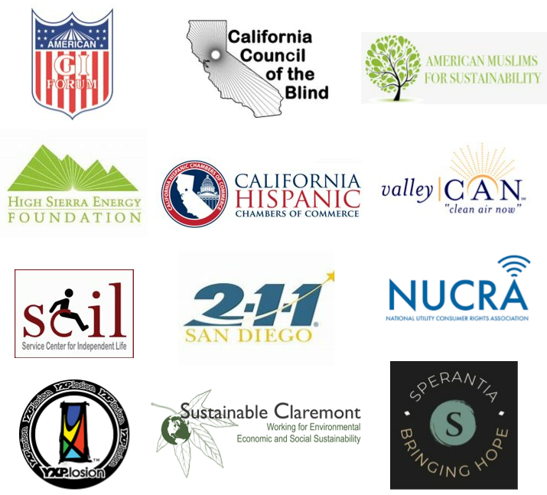
Who are the PSR CBOs?
In total, 26 CBOs submitted proposals requesting over 2.3 million dollars, an 86% increase from last year. With an 800K budget, 12 CBOs were approved for funding. Of the 12 recommended grantees, 7 will do outreach in PG&E territory, 9 in SCE territory, and 4 in SDG&E territory.
Core Customer Groups:
Low-Income (11)
Seniors (11)
Multicultural (11)
Residents with Disabilities (10)
Rural and Agricultural (8)

Slide 13
Types of Outreach
The following are examples of outreach Community-Based Organizations will do on behalf of the Power Saver Rewards program. This includes, but isn’t limited to:
Direct
Community Events
Faith Service Events
Door Knocking
Presentations
Phone Calls
Text Messages
Webinars
Facebook Lives
Indirect
Social Posts
Newsletters
Emails
Radio Announcements
Digital Videos
Earned Media
Websites/Blog Posts

Slide 14
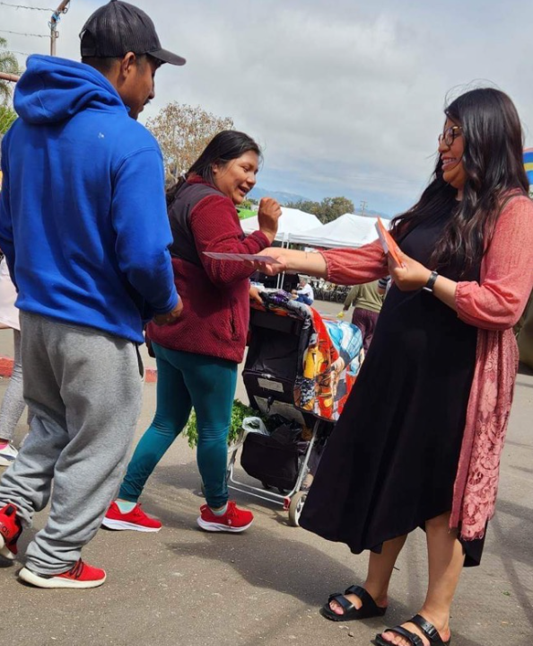
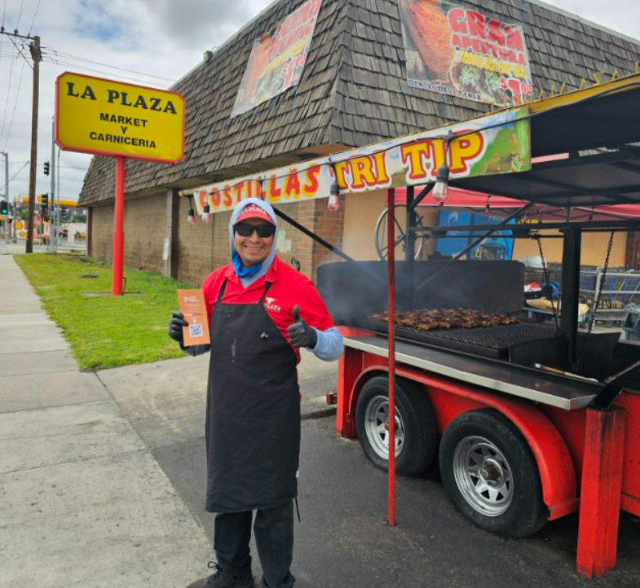
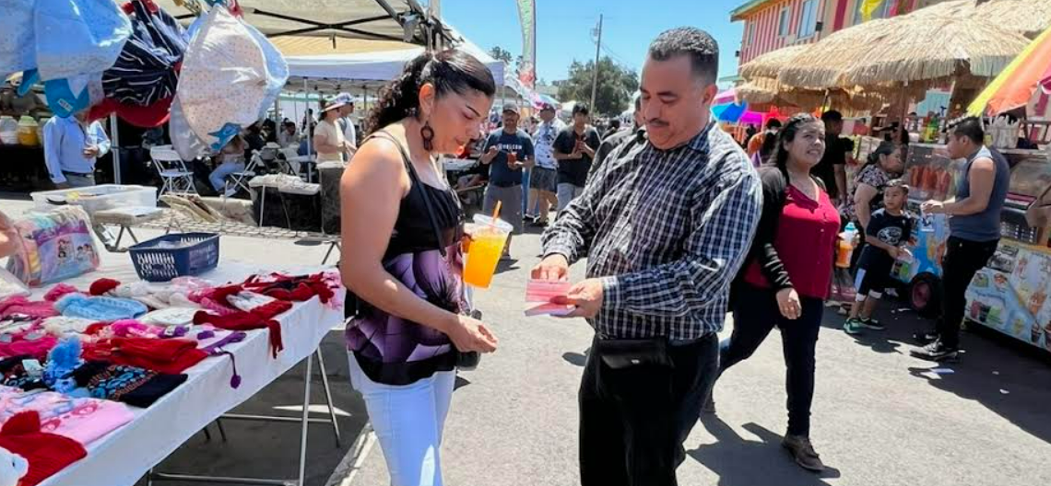
Example Outreach – American G.I. Forum (AGIF)
Nipomo Swap Meet
The AGIF team, a civil rights organization of Latino veterans, attended the Nipomo Swap Meet in San Luis Obispo County on May 21, which attracts attendees from Northern Santa Barbara County and Southern San Luis Obispo County. The team shared the PSR Program message to a specific hard-to-reach multicultural and low-income population. Out of the estimated 4,000 attendees, they directly engaged with 346 residents, most of whom were low-income and multicultural residents. AGIF explained to families that the more energy they reduce during a Flex Alert, the more rewards they earn. They directed people to learn more about how they can earn bill credits through the PSR Program by visiting PowerSaverRewards.org. They conducted outreach in English, Spanish, and Mixteco.

Slide 15
Community Based Organization Impact - 2022
Through in-person events, online webinars, radio shows, canvassing, and more, CBOs reached over 8 million Californians in 2022, educating them on the PSR program. During 2022's 11 Flex Alerts, CBOs had over 64m contacts/impressions throughout California.
Power Saver Rewards Awareness
Events | 495
Doors Knocked | 7,323
Phone Calls | 5,020
Texts | 4,532
Social Media Posts | 727
Radio Spots | 23
Emails | 265,170
Total Reach: 8,071,135
Flex Alert Outreach | 8/17; 8/31-9/9
Phone Calls | 100,350
Texts | 218,790
Emails | 3,608,376
Radio | 31,361,375
Social Media Posts | 1,542
Social Media Reach | 19,570,071
Events | 36
Total Reach: 55,935,206

Slide 16
2023 Priorities
Our core objectives for the program remain the same as last year. We incorporated learnings from Year 2 to optimize outreach strategies and make programmatic processes more efficient for Year 3.
Completed Learnings
Require minimum monthly outreach benchmarks to ensure a steady, regular cadence of events and outreach throughout the grant cycle
Team one-on-one, in-depth training and engagement with grantees, including in-person meetings and joining outreach events
Reporting enhancements to allow for ease of reporting for CBOs and more efficient reporting from DDC
Upcoming Efforts
Increase earned media efforts through 3rd party voices
Leverage success of 2022 program (zero power outages) to drive enrollment and possible bill credits
Increase IOU coordination, outside of issued Flex Alerts

