Slide 1
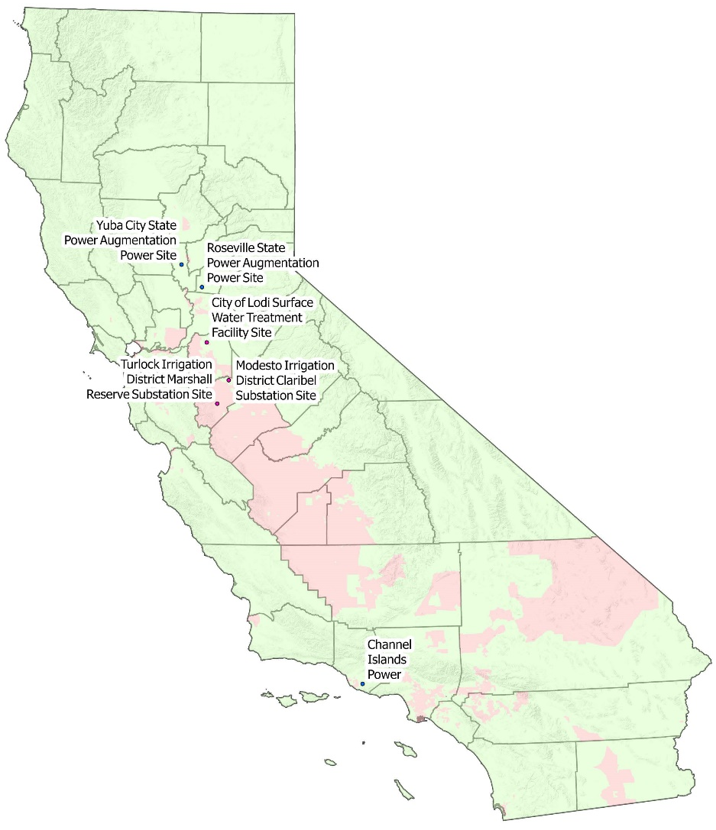
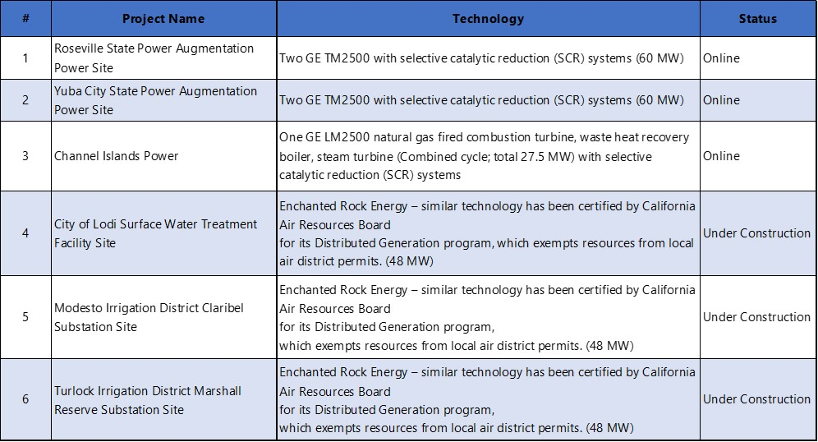

CA Department of Water Resource Power Generation Locations
Sources: Power generation locations information was provided by CA Department of Water Resource. Community type was based on CalEnviroScreen 4.0.

