Slide 1
Item 5: Reappointment of Disadvantaged Communities Advisory Group (DACAG) Members
March 6, 2023 Business Meeting
Mona Badie, Public Advisor
Office of the Public Advisor, Energy Equity, and Tribal Affairs

Slide 2
Benefits to Californians
Inform CEC policies and programs from the disadvantaged community perspective
Advance state equity and environmental justice goals

Slide 3
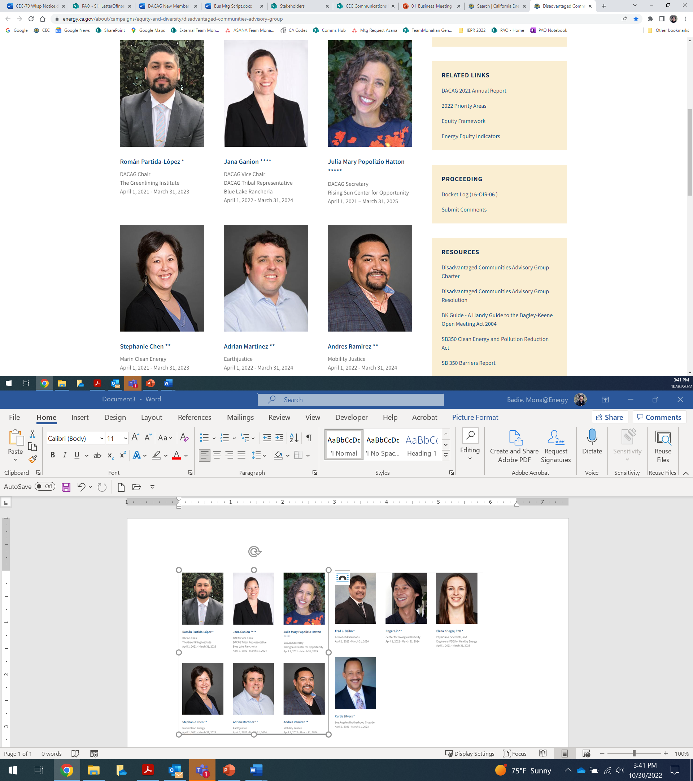
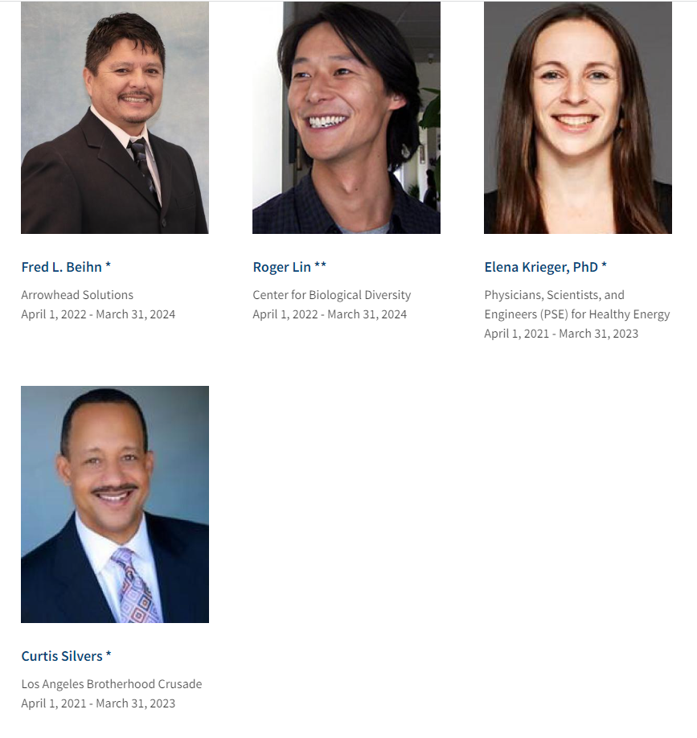
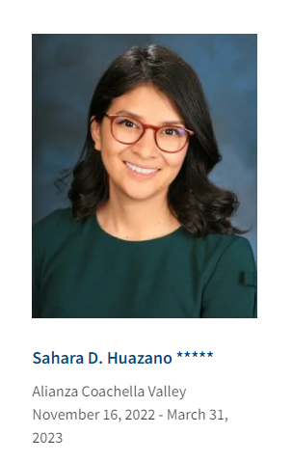
DACAG Overview
11 seats
Members from or representing DACs
Diverse backgrounds, expertise, and geographic locations
5 members with terms expiring March 31, 2023

Slide 4
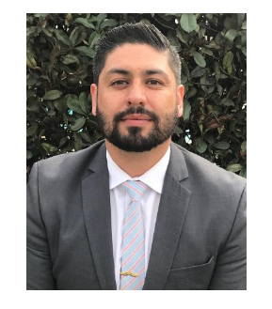
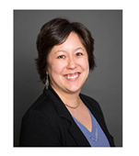
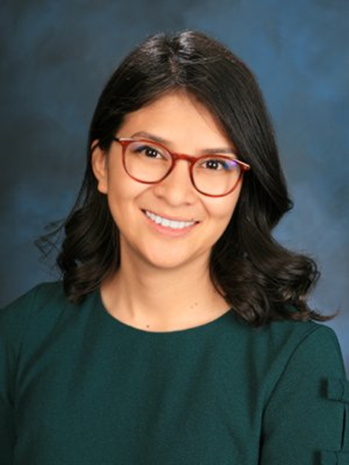
Sahara Huazano, Román Partida-López, and Stephanie Chen
Sahara Huazano
Based in Indio
Director of Programs, Alianza Coachella Valley
Román Partida-López
Current DACAG Chair
Based in San Diego
Transportation Equity Legal Counsel, Greenlining Institute
Stephanie Chen
Based in San Rafael
Director of Legislative Affairs, Marin Clean Energy

Slide 5
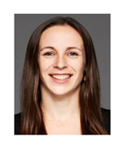
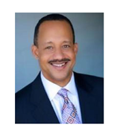
Elena Krieger and Curtis Silvers
Elena Krieger
Based on Oakland
Director of Research, Physicians, Scientists, and Engineers (PSE) for Healthy Energy
Curtis Silvers
Based in Pasadena
Executive Vice President, Los Angeles Brotherhood Crusade

Slide 6
Recommendation
Reappoint Sahara Huazano, Román Partida-López, Stephanie Chen, Elena Krieger, and Curtis Silvers to the DACAG.

