Slide 1
DOE Resources to Improve Energy Efficiency and Competitiveness
INDIGO Workshop
Thomas Wenning, PE
Oak Ridge National Laboratory
April 11, 2023

Slide 2
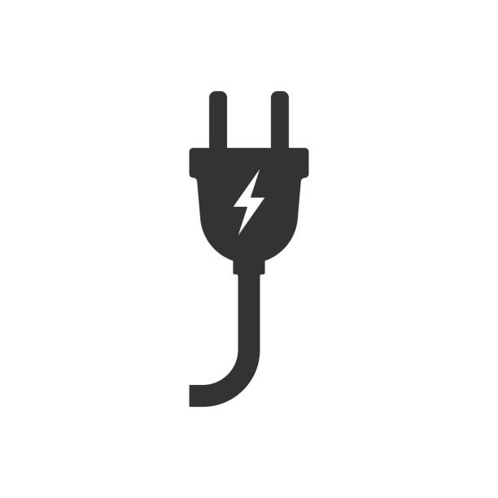
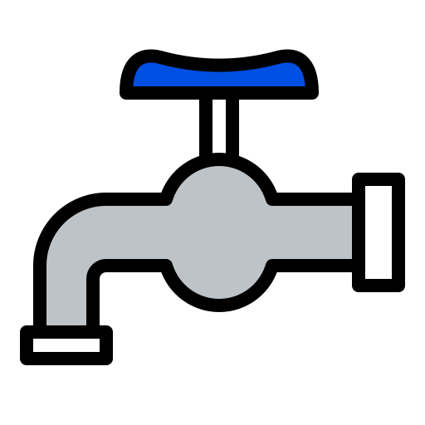



The Better Plants and Better Climate Challenge Programs
The DOE Program partners with leading manufacturers and water utilities to improve energy efficiency and competitiveness in the industrial sector, saving money in the process.
Through Better Plants, partners voluntarily set a specific goal, typically to reduce energy intensity by 25% over a 10-year period across all their U.S. operations.
Through the Better Climate Challenge, Portfolio-wide reduction in GHG emissions of at least 50% in 10 years
Increased
Energy Productivity
Water
Savings
Waste
Reduction
Carbon
Reduction

Slide 3
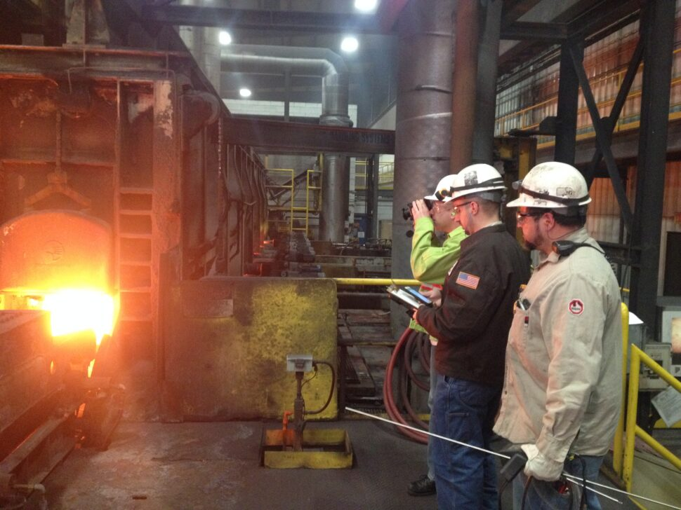
Why Focus on Industrial Energy Efficiency?
Manufacturers spend $200 billion per year on energy to operate their facilities
DOE data demonstrates that most plants have big opportunities to reduce energy use with relatively short payback periods
Industrial energy efficiency helps build national resiliency, economic competitiveness, and a stronger workforce

Slide 4

































































































































































What Market Leadership Looks Like

Slide 5
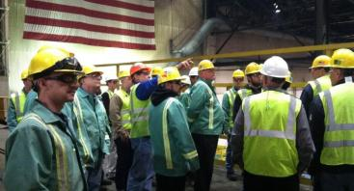
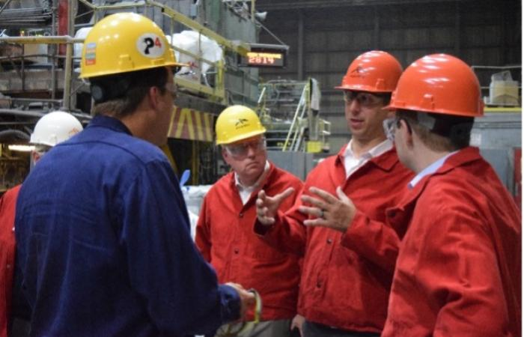
How Does Better Plants Work?
Joining the program is voluntary and there is no cost to participate.
Partners set long-term and strategic energy, water, and waste reduction goals.
DOE works with partners to achieve their energy, water, and waste reduction goals.

Slide 6
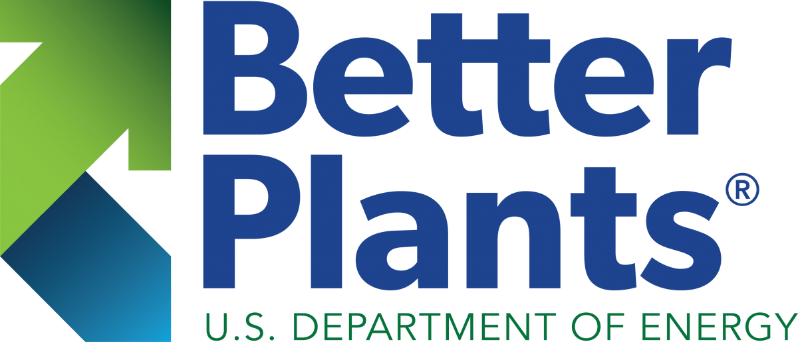
Why Companies Participate in Better Plants
Industry Leadership
Technical Assistance Resources
Developing Innovative, Replicable
Solutions with Market Leaders
National Recognition
Peer to Peer Networking
Better Building Solutions Center
Making Energy Efficient Investments Easier
Tools for Energy Management
Financing Navigator
Diagnostic Equipment Program
Emerging Technologies
Workforce Development
Innovation to Drive Savings
DOE National Labs
Advanced Technology Field Validation
Helping You Meet Your Challenges of Today, and Tomorrow
In-Plant Trainings
Industrial Assessment Centers

Slide 7
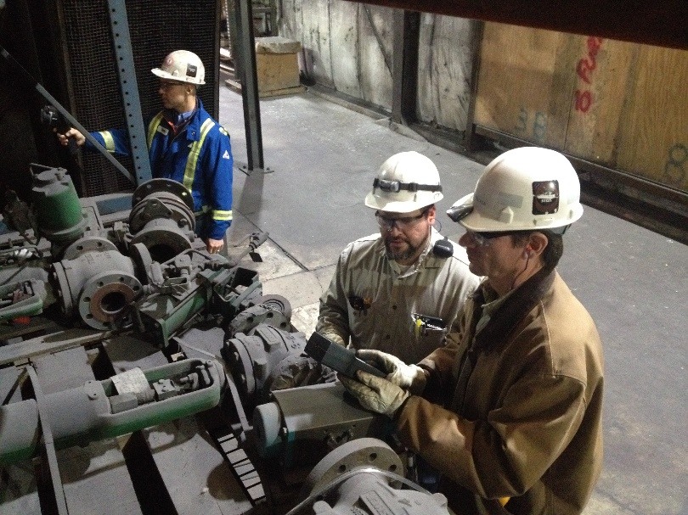
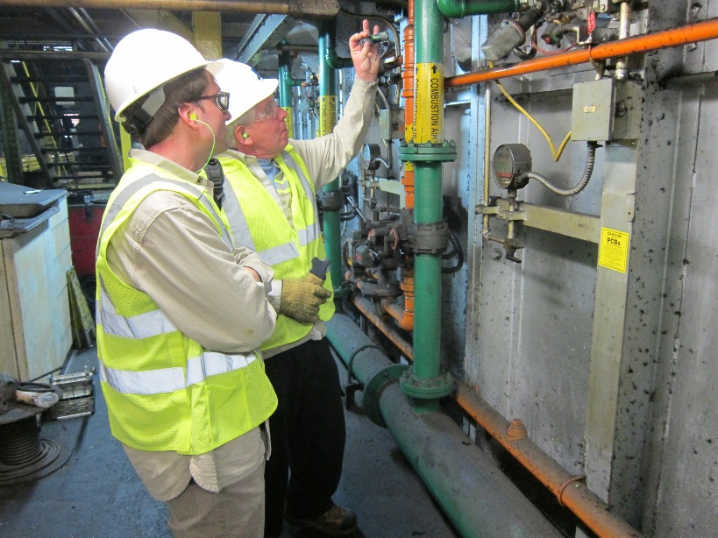
Why Partner with Better Plants?
Consider Partnering If:
Energy is a significant part of operating costs
Want/need technical assistance with energy efficiency
Networking with industry-sector peers & independent experts is helpful
Recognition for energy efficiency/sustainability accomplishments is desired

Slide 8

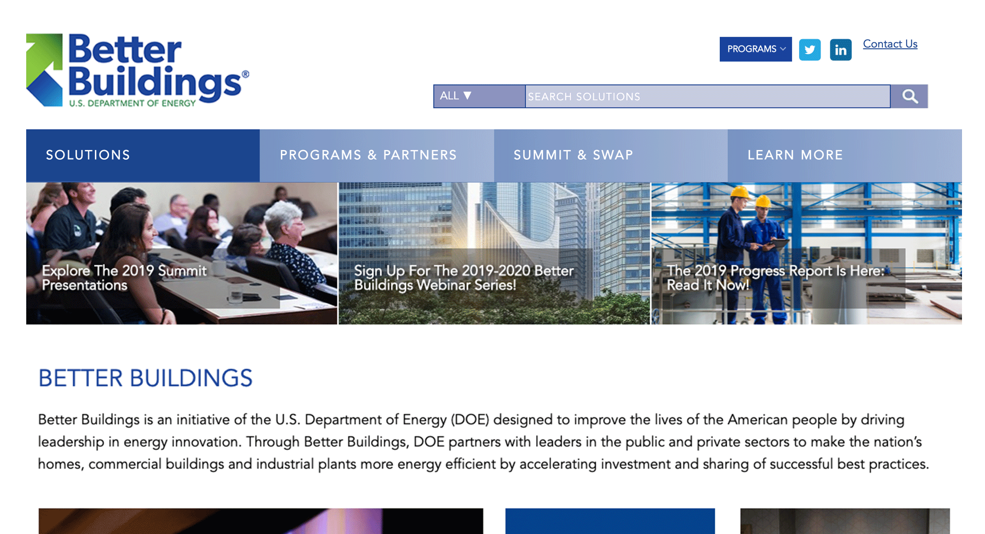
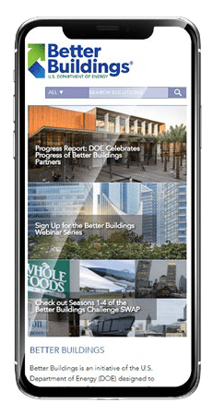

Better Buildings Solution Center
More than 2,500 solutions are available publicly in the Better Buildings Solution Center
  Showcase Projects:
    Successful Energy Savings Case Studies
  Implementation Models (Playbooks):
    Overcome barriers: finance, data, energy management, staff training, partnering with utilities, and more
    Multi-faceted and applicable across sectors
  Technology Focus Area Pages
    13 focus areas, from compressed air to renewables
    DOE tipsheets and publications, software tools, webinars, and contact information for a subject matter expert
  Additional Resources, Toolkits, Case Studies
energy.gov/bbsc
Notes:
Animated screen

Slide 9
Thank you!
Thomas Wenning, PE
Oak Ridge National Laboratory
wenningtj@ornl.gov

