Slide 1
California Air Resources Board:
Industrial Decarbonization
Industrial Decarbonization and Improvement to Grid Operations Program (INDIGO) Workshop
APRIL 11, 2023

Slide 2
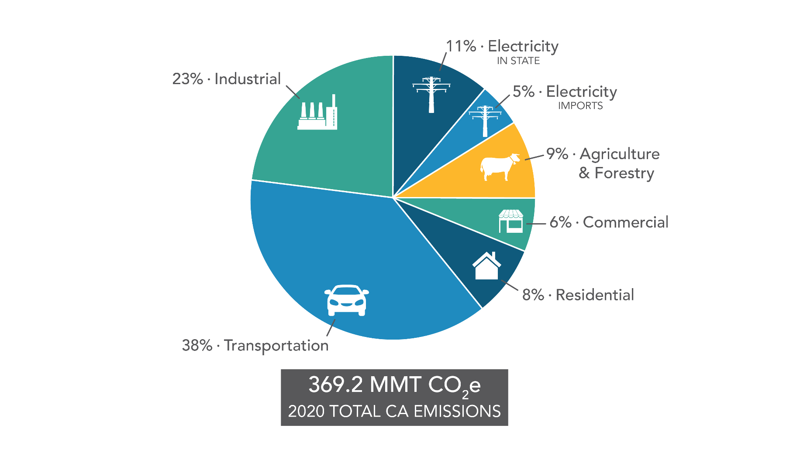
CA GHG Reduction Targets and Sources
GHG Inventory
2020 target (1990 level)
2030 target
(40% below 1990)
2045 target
(85% below 1990)
2045 target
(carbon neutrality)
CARB GHG Inventory, 2022

Slide 3
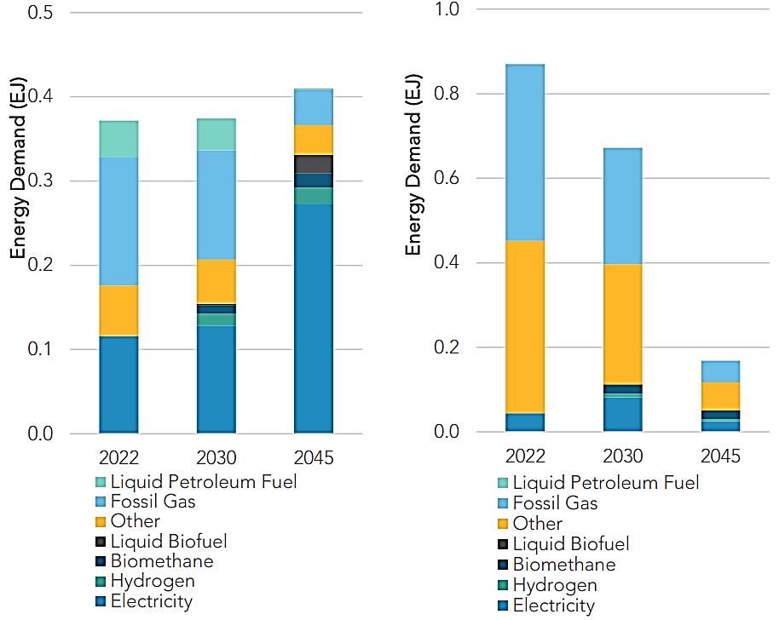
2022 Scoping Plan Update
Carbon neutrality by 2045
  Carbon neutrality by 2045, deploy a broad portfolio of existing and emerging fossil fuel alternatives and clean technologies, and align with statutes and Executive Orders
Industrial energy demand
  Displace fuel use with mix of electrification, solar thermal, hydrogen, and biomethane
  CCS for remaining CO₂ emissions
  Additional policies to support electrification, renewable energy, and alternative fuels are needed
Energy Demand (EJ)

Slide 4

Reducing California’s Industrial Emissions
Energy Efficiency
  Waste heat recovery
Fuel Switching
  Low-carbon hydrogen
  Renewable natural gas
  Other biofuels
Electrification
  Microgrids
  Onsite renewables and storage
Carbon capture and sequestration (SB 905)
Cap-and-Trade
Low Carbon Fuel Standard
Promote pathways
Net-zero GHG Cement Strategy
CCUS Program

Slide 5
Cap-and-Trade Program
Key element of California's overall strategy to reduce GHG emissions
  Economy-wide, declining cap on annual greenhouse gas emissions
Covers large industrial sources, electricity generators, and natural gas and transportation fuel suppliers with emissions ≥ 25k MTCO2e/year
Covered entities must acquire and surrender compliance instruments equal to covered emissions
  One allowance = one offset credit = permit to emit one MTCO2e
Declining
Annual Caps
Steadily Increasing
Price Signal
Target Low-cost Reductions First
Long-Term Price Signal for Clean Technology Investments

Slide 6
Net-zero Emissions in Cement Sector
SB 596: “By July 1, 2023, CARB shall develop a comprehensive strategy for the state’s cement sector to achieve net-zero GHG emissions associated with cement used within the state as soon as possible, but no later than December 31, 2045.”
SB 596 requires CARB to:
  "Evaluate measures to provide financial support and incentives for RD&D of technologies to mitigate emissions of GHGs from the production of cement with the objective of accelerating industry deployment of those technologies"
  "Identify actions that reduce adverse air quality impacts and support economic and workforce development in communities neighboring cement plants"

Slide 7
Resources
2022 Scoping Plan Update:
https://ww2.arb.ca.gov/our-work/programs/ab-32-climate-change-scoping-plan/2022-scoping-plan-documents
Cap-and-Trade Program webpage:
  https://ww2.arb.ca.gov/our-work/programs/cap-and-trade-program
Net-zero Emissions Strategy for Cement Sector:
  https://ww2.arb.ca.gov/our-work/programs/net-zero-emissions-strategy-cement-sector

