Slide 1

Industrial Decarbonization for
Workshop on Implementation of the Industrial Decarbonization and Improvements to Grid Operations Program
Kelly Kissock
April 11, 2023
Notes:
10 minutes, show them one of each thing and why this saves so much energy

Slide 2

Established in 2006 to advance impactful energy and energy efficiency solutions through research, education, and engagement. Home to innovative research centers and programs; has more than 50 affiliated faculty; and hosts an interdisciplinary graduate program in energy systems.
Western Cooling Efficiency Center
Established in 2007 to advance and commercialize efficient cooling, heating and ventilation technologies.
California Lighting Technology Center
Established in 2004 to stimulate, facilitate and accelerate the development and commercialization of energy-efficient lighting technologies and building controls.
Center for Water-Energy Efficiency
Established in 2011 to advance efficiency in water treatment, distribution, wastewater treatment and agriculture.
Low Carbon Materials Center
Established in 2022 to advance low-carbon cement, steel, building and infrastructure materials.
Industrial Decarbonization Solutions Hub Established in 2022 to develop and deploy industrial decarbonization solutions.
Market Transformation Research Program Conducts research at the nexus of technology, policy, and human behavior.
D-Lab and Program for International Energy Technologies
Accelerates the clean energy transition in developing countries and through project-based learning.
Energy Graduate Group
Established in 2017 as an interdisciplinary M.S. and Ph.D. program in energy systems and policy.

Slide 3
CEC Potential Technologies
Energy Efficiency
  Supportive of IAC energy assessments, FPIP
  Support for decarbonization assessments
  Support for energy-efficiency or decarbonization seminars
  Support for electric load shaping
Electrification
  High-temperature heat pumps with process integration
Low carbon fuels
  Definite need, perhaps green H₂ in long term
Others
  Carbon capture (with sequestration) for cement and refining industries

Slide 4
CEC Potential Program Design
Equipment and materials (at least 88% of eligible costs)
  Financial support required for process-integration and re-piping

Slide 5
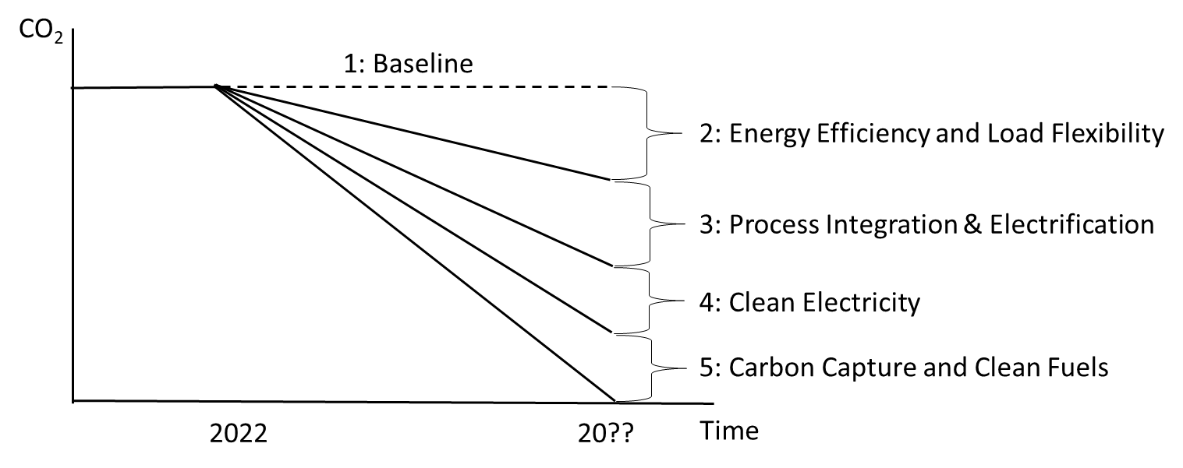
Five Steps to Zero-Carbon Manufacturing

Slide 6
Energy Efficiency
Research and practice continues to indicate 10%-20% (2%-3% per year) savings with paybacks < 2 years
Supportive of IAC and the ‘Integrated Systems + Principles Approach’
Increasing corporate decarbonization interest and targets suggests need for “decarbonization” assessments
Utility/CEC sponsored energy/decarbonization seminars effective at reaching industries not participating in utility rebate programs.

Slide 7
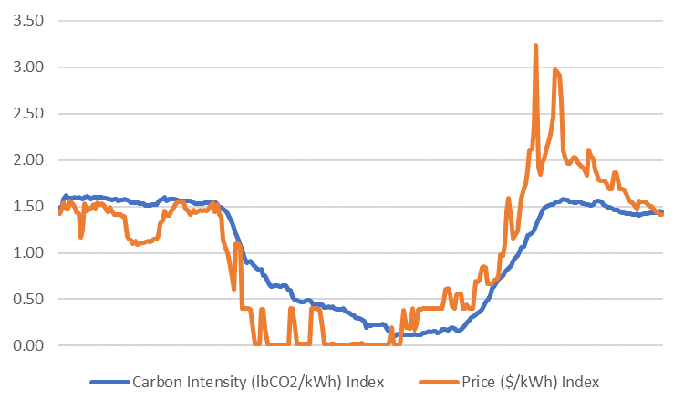
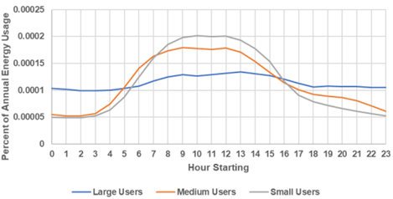
Load Shaping
Hourly CO₂/kWh varies by 6x over a day and is aligned with price.
Moving from flat to daytime dominant demand profile reduces CO₂ by 25%
Requires CEC financial incentive or PUC rate structure reform to eliminate current demand charge disincentive for load shifting.

Slide 8
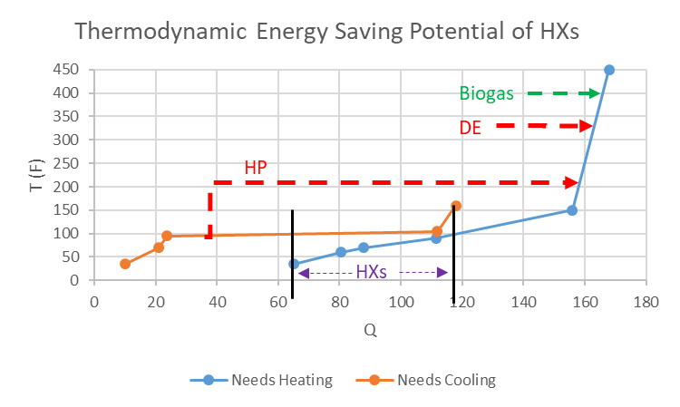
Process Integration for Industrial Heat Pumps
Tool/application development would benefit CEC support

Slide 9
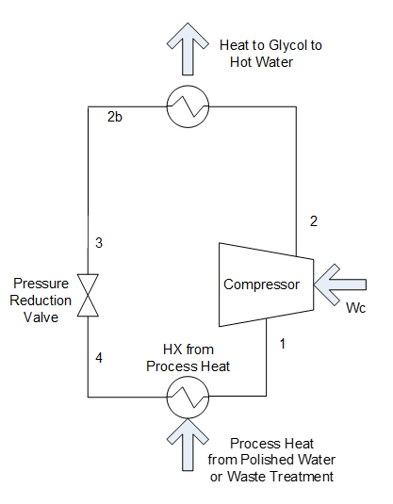
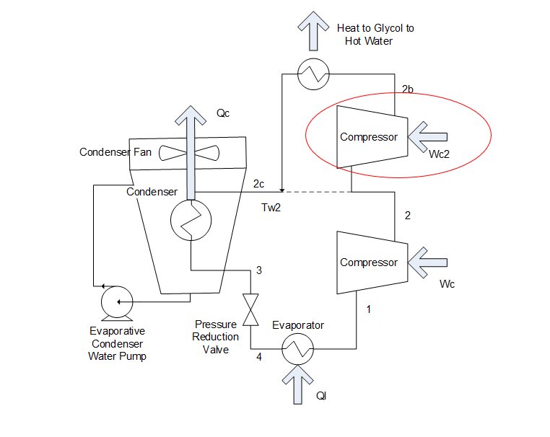
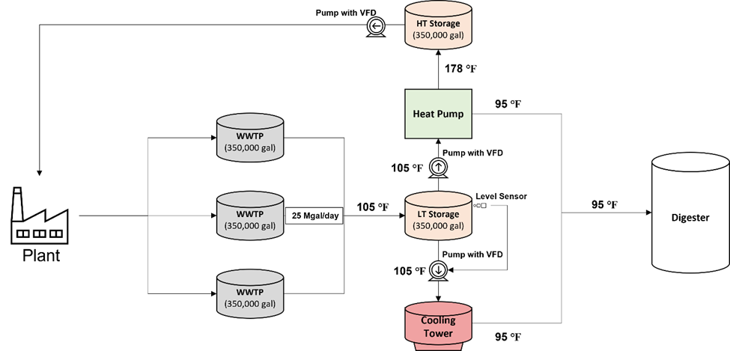
Types of Heat Pump Integration
Process to process System to system Booster compressor

Slide 10
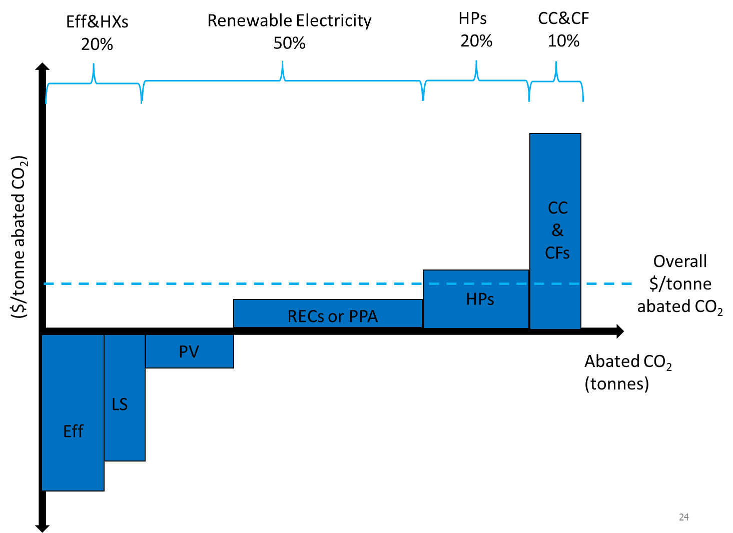
Levelized Cost of Abated CO₂

Slide 11
Thank You!

