Slide 1
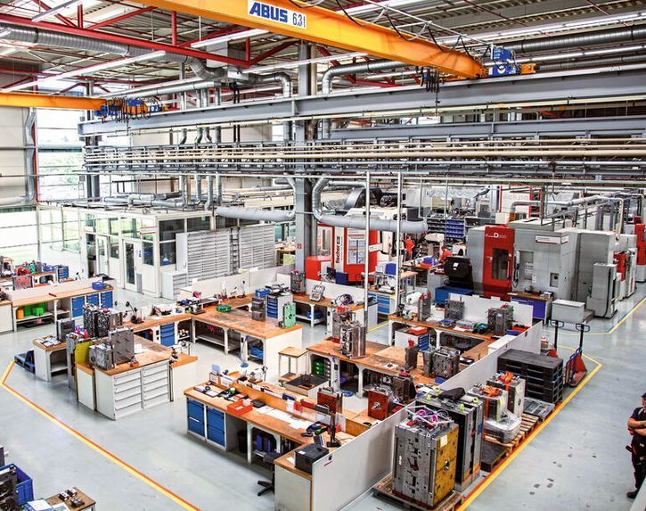



Sustainable Manufacturing Alliance for Research & Training Industrial Assessment Center
Dr. G. P. Li
California Institute for Telecommunications and Information Technology
Integrated Nanosystems Research Facility
Dept. of Electrical Engineering and Computer Science
UC Irvine

Slide 2
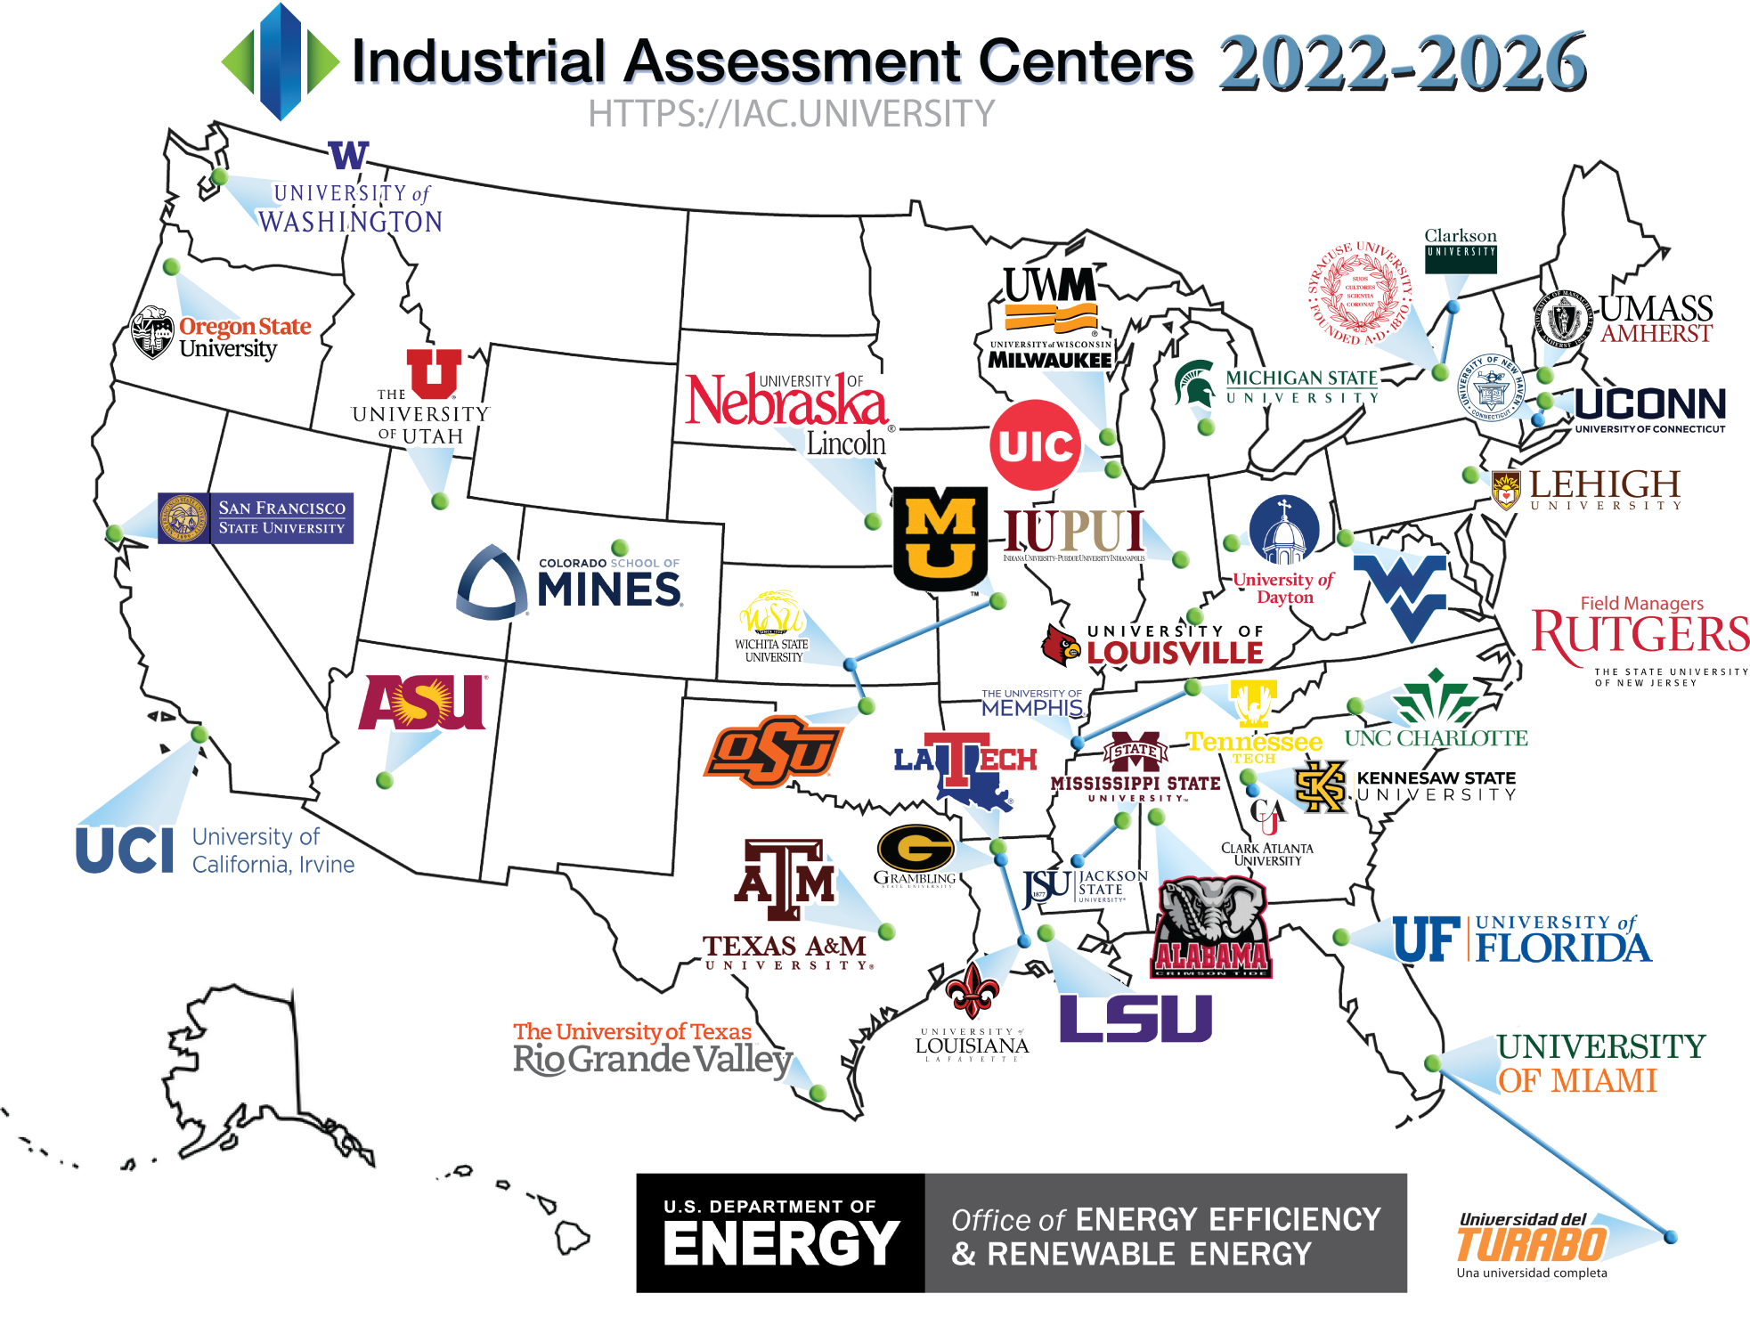





SMART IAC
$ 2,250,000
From DOE over 5 years
Help Small & Medium Manufacturers keep Competitiveness in Sustainability
Workforce Development for Advanced Manufacturing
is organized by
and collaborate with Calit2’s partners in other academic institutions, private industry, and trade associations.

Slide 3


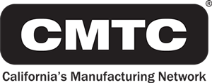
SMART IAC + CMTC to support CA SMMs
>39,000
Small & Medium Manufacturers in CA
Account for
50%
CA’s Manufacturing GDP
The "Go-To" Organization Providing Services & Support for California Manufacturers
Improving California Manufacturing and the Public Good
Help small and medium sized CA manufacturers save energy, improve productivity, and reduce waste
Train the next-generation of energy savvy engineers

Slide 4
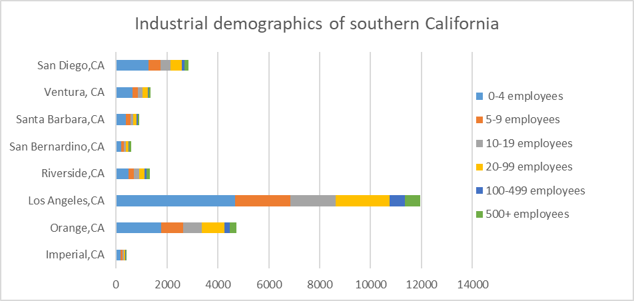



Southern California Industrial Distribution

Slide 5

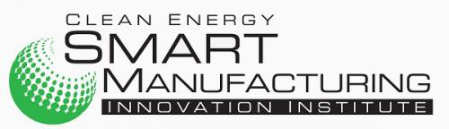
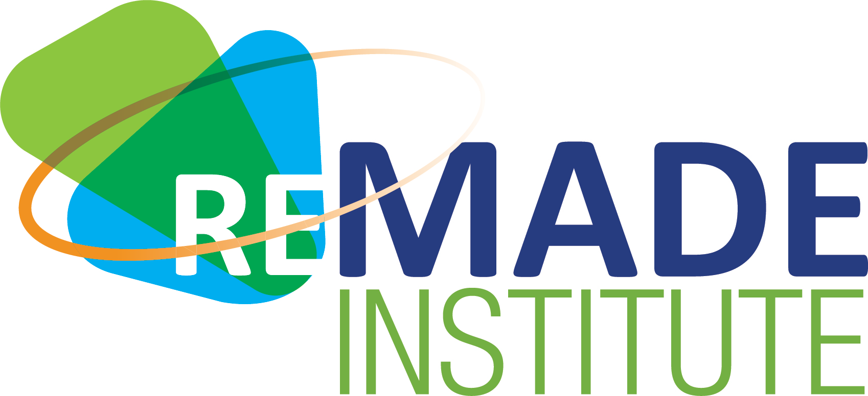
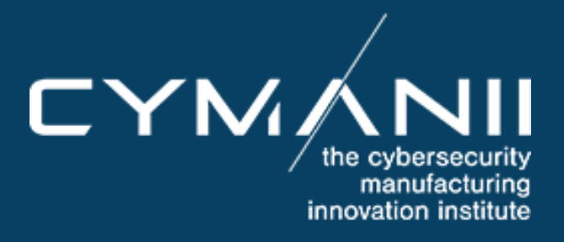
Future S3 Manufacturing for SMEs
Smart, Sustainable, Secured
Cyber-Physical-Human-Environment System Research and Transformation Program funded by 3 DOE Manufacturing USA Institutes
June 2016 DOE announces $70M award for Clean Energy Smart Manufacturing Innovation Institute – CALIT2@UCI is a founding member of the Institute and leading roadmap projects on Smart Connected Workers
January 2017 DOE announces $70M to fund the REMADE Institute (Reducing Embodied-Energy & Decreasing Emissions) through its Manufacturing USA initiative. UCI is a founding member and leading roadmap projects on Life Cycle Assessment
May 2020. DOE announces $70M to fund CyManII. CyManii is a national institute on cyber secure manufacturing coordinating leading universities in cybersecurity, smart and energy efficient manufacturing, secure supply chains, factory automation, and workforce development (WFD). CALIT2@UCI is a founding member and leading virtualization for WFD
These awards engage more than 100 companies matching contributions.

Slide 6






SMART IAC
Decarbonization
Life Cycle Analysis
Smart & Cyber Secured Manufacturing
Low carbon fuel and electrification enabled industrial decarbonization
Estimating and assessing the environmental impacts attributable to the life cycle
Enable deployment of affordable smart manufacturing and mitigate cybersecurity risks for SMMs
Smart & Cyber
Secured Manufacturing
Life Cycle Analysis
Decarbonization
Workforce Development
Industrial Assessment
Workforce
Development
Train the next-generation of energy engineers and professionals
Help SMMs save energy, improve productivity, and reduce waste by providing no-cost technical assessments
Industrial
Assessment

