Slide 1
Industrial Decarbonization
Experiences and Visions from Denmark

Slide 2

the Danish Energy Agency (DEA)
110%
GHG reduction
by 2050
Vision of a climate neutral society in 2045
Danish Energy Agency
GLOBAL
COOPERATION
100%
Green electricity
by 2030
GLOBAL
COOPERATION
SUBSOIL
RESOURCES
AND RISK
PREPAREDNESS
SUBSOIL
RESOURCES
AND RISK
PREPAREDNESS
ENERGY
EFFICIENCY
ENERGY
EFFICIENCY
ENERGY
ADMINISTRATION
ENERGY
ADMINISTRATION
UTILITIES AND SUPPLY
UTILITIES AND SUPPLY
SYSTEM
ANALYSIS
SYSTEM
ANALYSIS
RENEWABLE
ENERGY
RENEWABLE
ENERGY
ENERGY ISLANDS
ENERGY ISLANDS
99.996%
SECURITY OF
SUPPLY

Slide 3

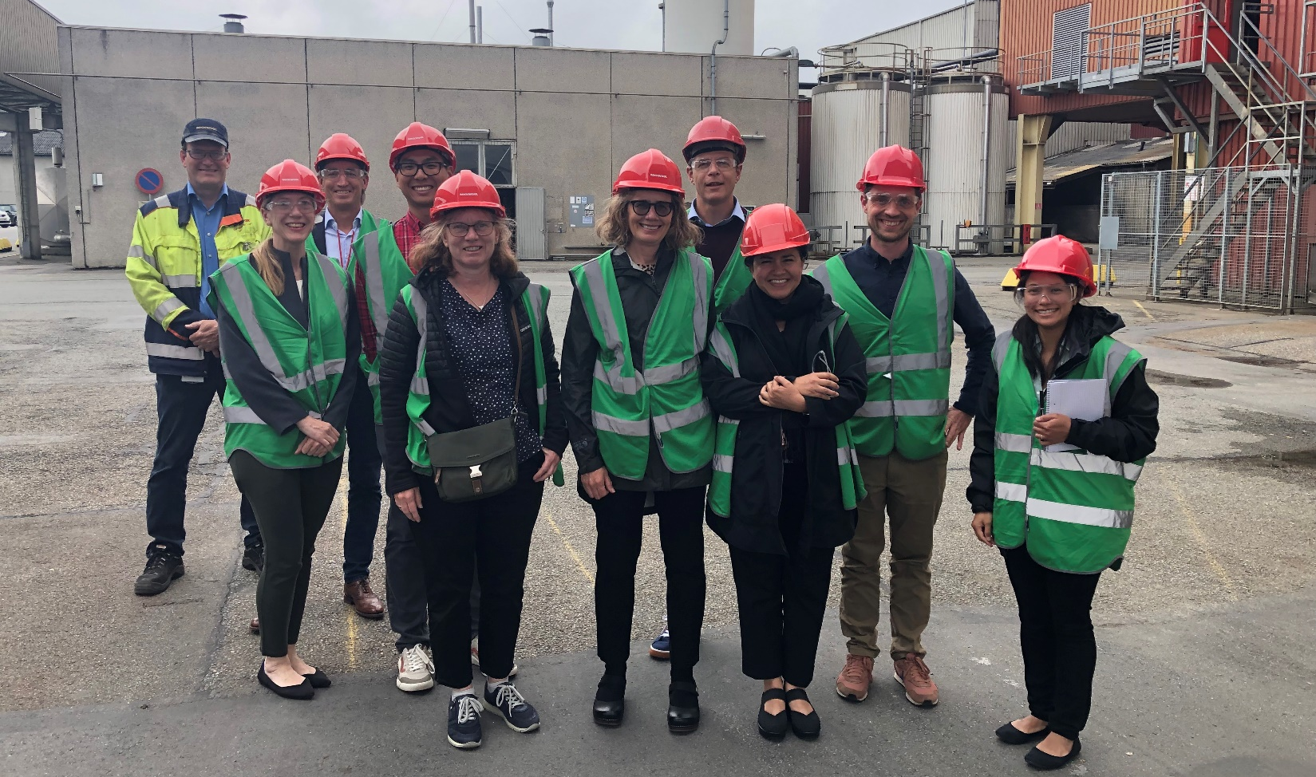
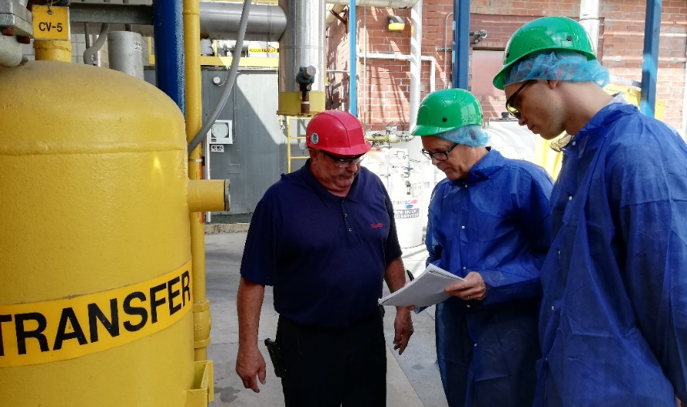
Partnership with California
A MoU since October 2019 between CEC and the DEA on EE in industry and buildings – renewed in 2023
Accelerate green transition in Denmark and California
Collaboration and Exchange with CEC
  Policies and support schemes
  RD&D projects and technologies
  Best practices, lessons learned and networking
  Study tours

Slide 4
Development of energy use in industry
Manufacturing Industry
Industry:
Energy Efficiency and Energy Management
Cogeneration and fuel switching to biomass & biogas
Industrial heat pumps (since early 2000)
Industrial Symbiosis
Government:
Taxes on energy and emissions
“Carrot and Stick” Policies
Information and Guidance
Support for development and demonstration projects

Slide 5
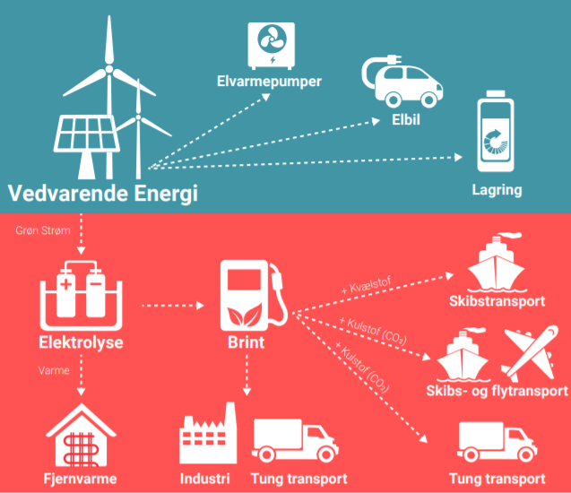
Reaching Net Zero With Electrification
Direct Electrification
Direct electrification most efficient
Heat Pumps
EVs
Renewable Energy
Storage
Shipping
H₂
Shipping and Aviation
District Heat
Industry
Transport
Transport
Indirect Electrification

Slide 6
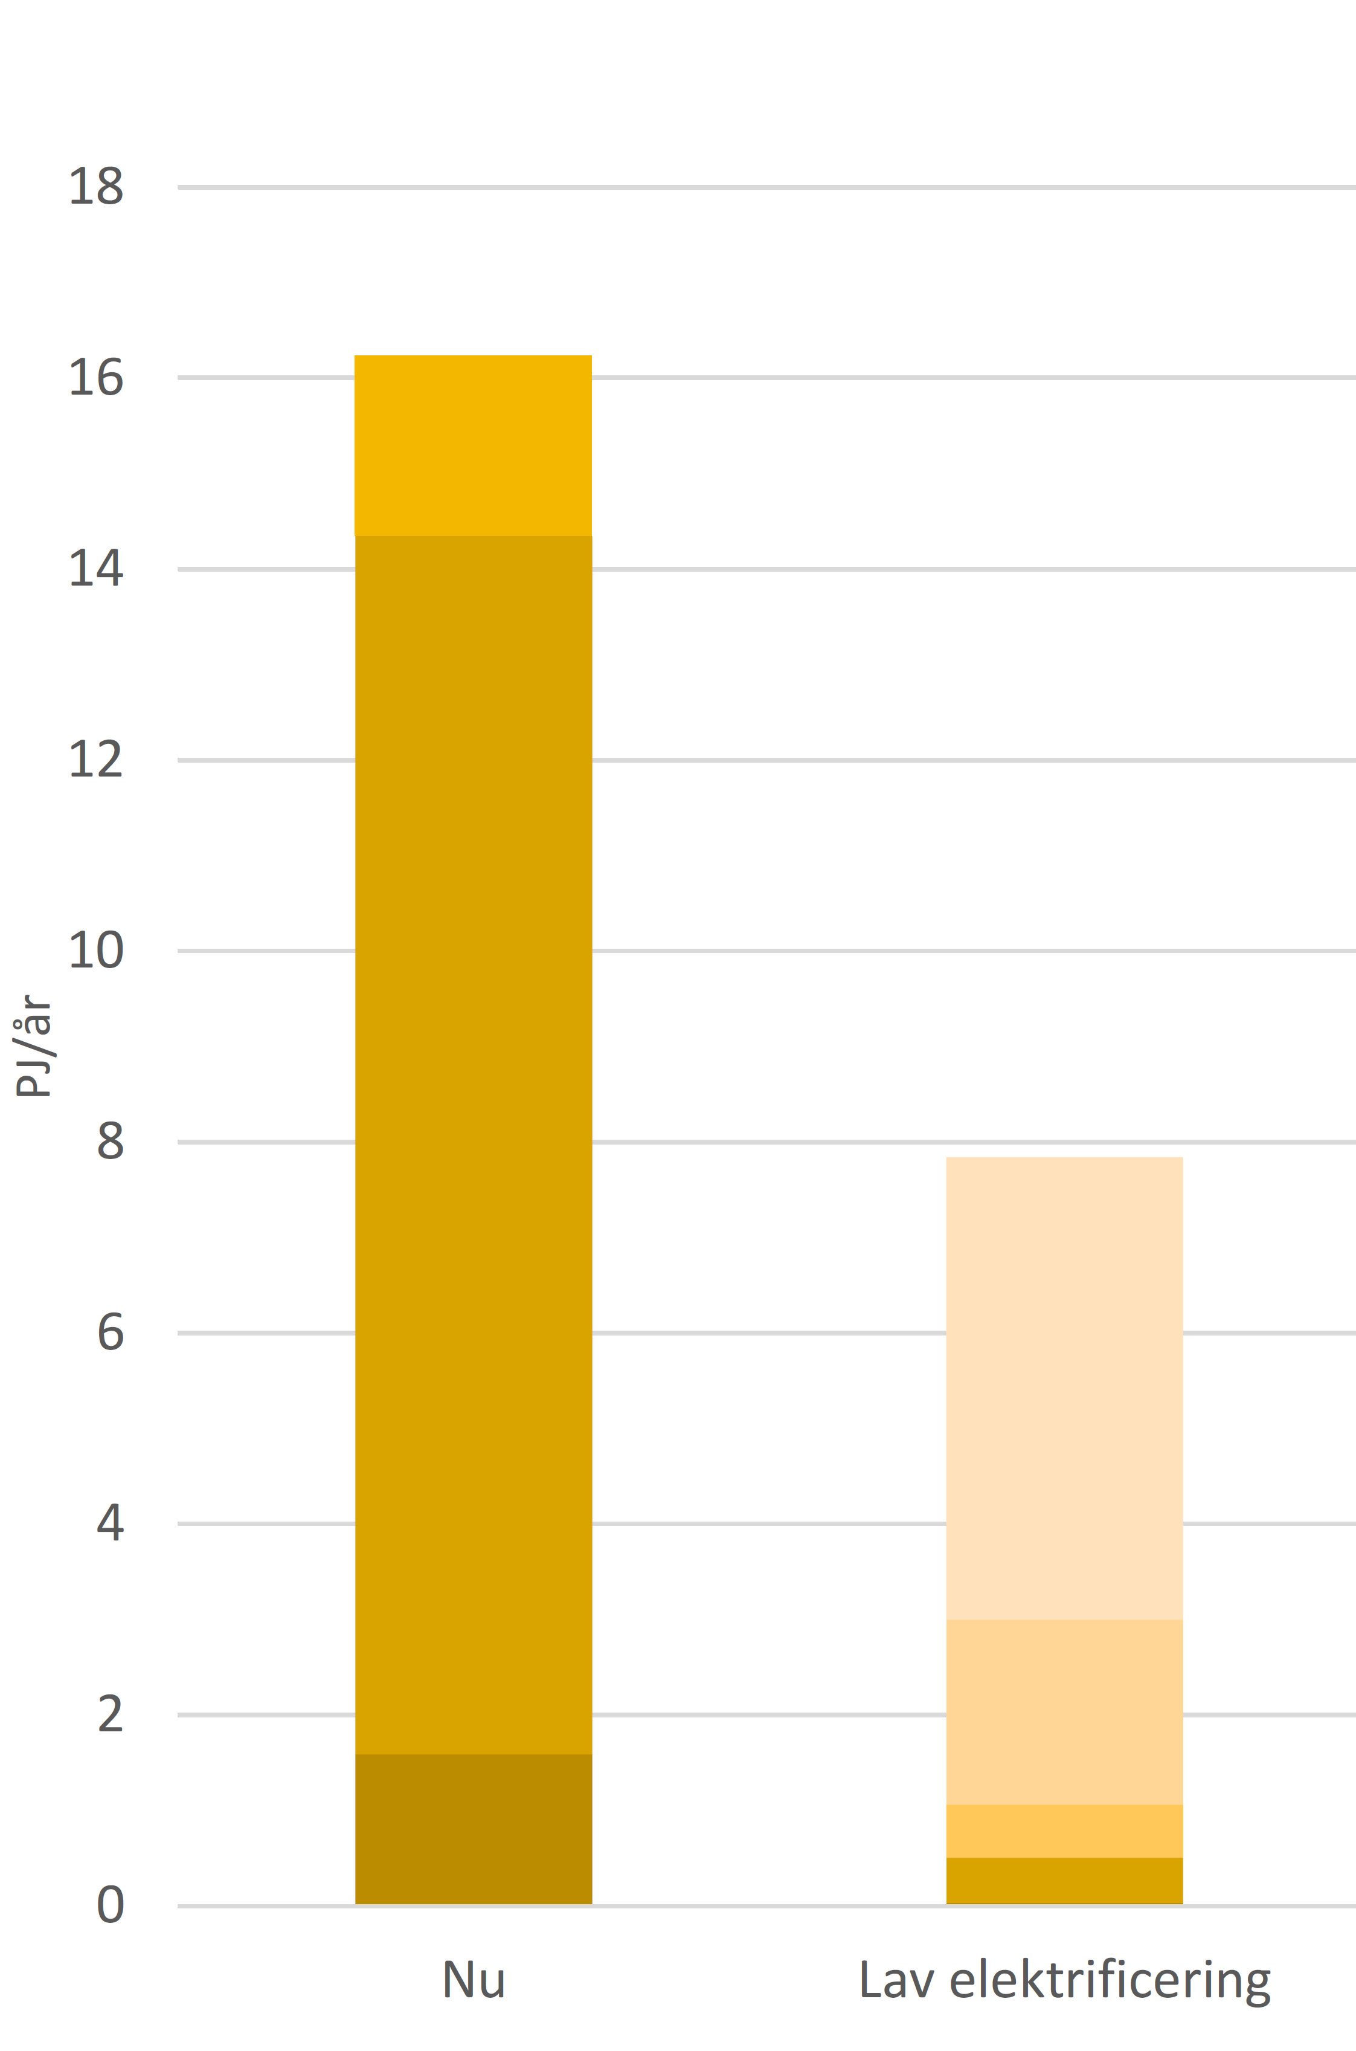
Reaching Net Zero With Electrification
Electrification potential in Food & Beverage Industry
Direct electrification most efficient
Many sectors with a high technical potential for direct electrification
Fuel Use
Energy Use in the Food and Beverage Industry
Final Energy Use [PJ/ year]
Electricity
Use
Today
Full Electrification

Slide 7
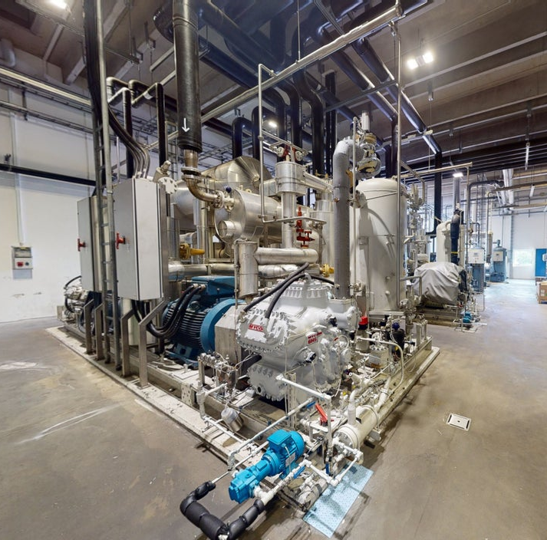
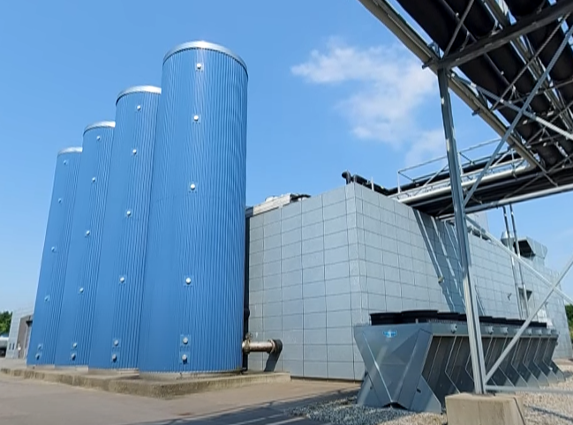
Reaching Net Zero With Electrification
Direct electrification most efficient
Many sectors with a high technical potential for direct electrification
Technologies for direct electrification available and demonstrated
Electrification brings new opportunities for grid support
Industrial heat pumps (< 210°F) and Mechanical Vapor Recompression (MVR)
High temperature heat pumps (< 300°F)
Thermal Energy Storage
Alternative activators (UV light, Microwave...)

Slide 8



Reaching Net Zero With Electrification
Direct electrification most efficient
Many sectors with a high technical potential for direct electrification
Technologies for direct electrification available and demonstrated
Electrification brings new opportunities for grid support
Policy and regulatory support for direct electrification
Reduction of price gap between natural gas and “green” electricity
Long-term initiatives and agreements
Dissemination of funded projects

