Slide 1
Energy Division Low-Income Incentive Programs Presentation
Disadvantaged Communities Advisory Group Meeting
April 21, 2023

Slide 2
Agenda
Energy Savings Assistance Program
Net Billing Tariff
Self-Generation Incentive Program
Solar on Multifamily Affordable Housing Program
Microgrid Incentive Program
Discussion

Slide 3
Energy Savings Assistance (ESA) Program
Kapil Kulkarni, Senior Regulatory Analyst, Kapil.Kulkarni@cpuc.ca.gov
Energy Efficiency Procurement and Portfolio Management Team

Slide 4
Income-Qualified Programs
≤200% FPG
200≤250% FPG
≤250% FPG
Bill Discounts
Direct-Install
CARE
California Alternate Rates for Energy
FERA
Family Electric Rate Assistance
ESA
Energy Savings Assistance
30-35% discount on electric bills
Up to 20% discount on natural gas bills
18% discount on electric bills
No-cost energy efficiency measures and services

Slide 5






High-level Summary of ESA changes
Moves away from goal based on number of households treated, and towards energy savings
Moves away from a homogenous treatment model, and towards a customer-centric treatment model
Up to 50% savings per home

Slide 6
ESA customer segmentation
Demographic | Financial | Location | Health Condition
Housing type/vintage | CARE | DAC | Medical Baseline
Rent vs Own | Disconnected | Rural | Respiratory
Previous vs new participant | Arrearages | Tribal | Disabled
Seniors | High usage | PSPS Zone
Veterans | High energy burden | Wildfire Zone
Hard-to-reach | SEVI | Climate Zone
Vulnerable | Affordability ratio | CARB Communities

Slide 7


ESA Programs available in San Diego
Main ESA
  About $30 million per year over 5+ years ($160 million in total)
  For single family and mobile homes
  Currently being implemented by RHA
Deeper energy savings pilot
  $7 million through 2026
  Target is to achieve up to 50% energy savings per household (compared to up to 5% historical average)
  Solicitation in process
Multi-Family Whole Building (MFWB)
  $175 million through 2026
  Led by SDG&E, a single program for multifamily property residents and owners in Southern CA
  Can apply through:
  https://mcp.customerapplication.com

Slide 8
Net Billing Tariff (NBT)
Christopher Westling, Senior Regulatory Analyst, Christopher.Westling@cpuc.ca.gov
Customer Generation Team

Slide 9
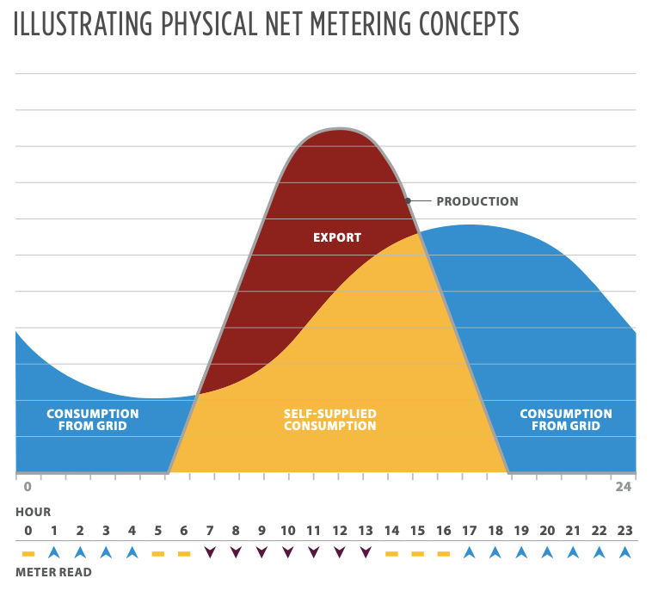
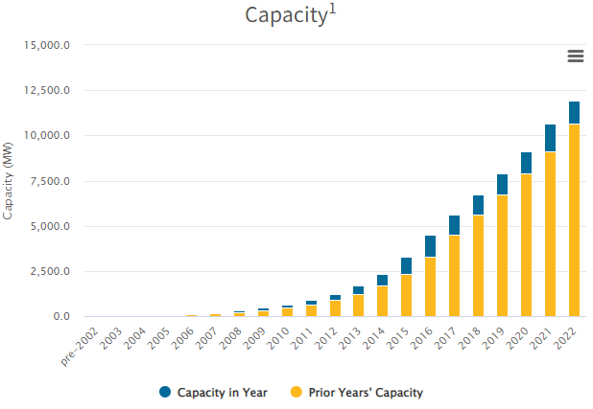
Customer-Sited Solar in California
californiadgstats.ca.gov

Slide 10
Governing Statute & 2016 Decision
Assembly Bill 327 (Perea, 2013) – established Public Utilities Code Section 2827.1, which requires the California Public Utilities Commission (CPUC) to develop a Net-Energy Metering (NEM) tariff (or program) that ensured customer renewable energy systems grow sustainably, that it be based on its costs and benefits, that total benefits exceed its total costs to all customers and that terms of service and bill rules are established.
In 2016, CPUC created NEM 2.0 via Decision 16-01-044
  Made modifications to the NEM 1.0 tariff including interconnection fees, non-bypassable charges, and use of time-of-use rates.
  Decision 16-01-044 committed the CPUC to revisit the tariff in 2019 after further consideration of grid conditions.

Slide 11
Established New Export Compensation
The electric bill credit a customer receives for solar power exported to the grid will be based on the CPUC’s Avoided Cost Calculator (ACC).
ACC hourly values are locked in for 9 years after interconnection for new residential solar and solar + storage customers to provide investment certainty and a reasonable payback period
ACC values are a better reflection of true environmental and grid benefits.

Slide 12
Applies New Import Rates
Applies new “electrification” residential rates that financially incentivize self-consumption of solar power when it is most beneficial for grid reliability and the environment.
These rates promote battery storage, electric vehicles, and heat pump space and water heaters.
There is no grid participation charge.

Slide 13
Complements NEW Incentives
Aligns with the $630 million commitment for low-income residential solar + battery storage incentives through the Self-Generation Incentive Program (SGIP) from the 2023/24 proposed state budget.
Available starting in July 2023.

Slide 14
NEM 1.0 and NEM 2.0 Customers – no changes
The modifications have no impact on customers currently subscribed to the NEM 1.0 or 2.0 tariff.
Existing NEM 1.0 and 2.0 will maintain their current export compensation rates and tariff legacy periods.

Slide 15
Key Takeaways
Realigns the incentives provided through the NEM tariff to –
  Promote customer adoption of solar + storage
  Further supports the customer solar + storage market
  Support equity, grid reliability, and deeper reductions in greenhouse gas emissions
  Encourage electrification of building end-uses

Slide 16
Disadvantaged Communities – Single-Family Solar Homes
(DAC-SASH)

Slide 17
Disadvantaged Communities – Single-Family Solar Homes (DAC-SASH)
AB 327: develop alternatives to increase renewable generation in disadvantaged communities (DAC).
No-cost rooftop solar for low-income homeowners in DACs
Solar installation job training
1721 installations in PG&E, SCE, and SDG&E territories 2019-2022
  56 in SDG&E territory
Evaluation: cpuc.ca.gov/solarindacs under "Events & Documents"
Customer-facing website: energyforallprogram.org

Slide 18
Self-Generative Incentive Program (SGIP)
Justin Galle, Senior Regulatory Analyst, Justin.Galle@cpuc.ca.gov
Grid Planning, Energy Storage, and Non-Wires Alternatives Team
CPUC SGIP Staff:
Gabriel.Petlin@cpuc.ca.gov
Justin.Galle@cpuc.ca.gov
FangYu.Hu@cpuc.ca.gov

Slide 19
About the Self-Generation Incentive Program (SGIP)
Established in 2001, provides financial incentives for the installation of eligible behind-the-meter (BTM) distributed generation and energy storage technologies that meet all or a portion of a customer’s electricity needs
Program has transitioned from peak-load reduction to greenhouse gas (GHG) reduction and resiliency
$813.4 million total ratepayer collections 2020 – 2024: 88% allocated to energy storage
The SGIP Equity Budget provides funding for behind-the-meter storage for low-income and disadvantaged Californians
The Equity Resiliency Budget provides critical resiliency needs for customers in wildfire areas who are medically vulnerable, low-income, or disadvantaged
1.32 GW of capacity installed across nearly 40,000 projects since 2001
Ongoing implementation in proceeding R.20-05-012
Notes:
climate change has moved to the forefront of statewide public policy
.6 GW, 15,700 projects in the pipeline

Slide 20
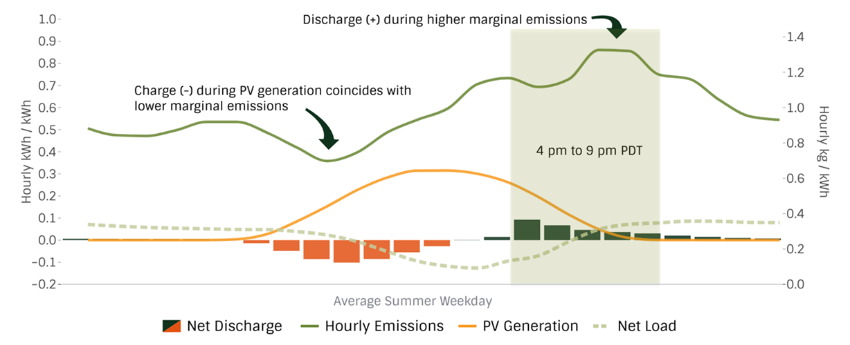
SGIP Evaluation: GHG Emissions
Residential average summer weekday load shape with grid-scale emissions shape
Notes:
Goal of SGIP is to reduce GHG emissions, provide resiliency, possibly see customer bill savings

Slide 21
SGIP Evaluation: Summary Metrics
Customer Resiliency:
Solar + Storage enables customers with SGIP-incentivized projects to ride out multi-day outages
GHG and Reliability:
SGIP has provided modest contributions to GHG reduction and grid reliability with value left on the table
Charging coincident with PV generation is a major driver of GHG reductions
Equity:
Area of underperformance with regulatory focus on improving outcomes

Slide 22
Customer Equity Metrics
Program Underperformance: How Can SGIP Do Better?
Only ~1,000 low-income projects across all budget categories and application stages out of ~56,000 residential projects.
The Equity Resiliency Budget had 6,100 projects completed and 99% of funds allocated. This budget pays $1/watt incentive.
  Low-income households accounted for only1% of these projects, compared to Medical Baseline customers who account for about 66%.
In contrast, almost 40% of the Equity Budget remains unused ($11.6 million) and only 10 projects have been completed in this budget category. This incentive is $0.85/watt.
Low-income customer projects have a cancellation rate across all budget categories of almost 50%, twice as high as residential projects that are not low-income.
Identifying the barriers to low income and tribal customer participation in SGIP is critical.

Slide 23
AB 209 Funding
September 2022 Governor Newsom approved AB 209 which for the first time adds state General Funds into solar and storage incentives through SGIP for residential customers.
$630 million allocated to the CPUC for incentives for eligible low-income residential customers who install either new BTM solar photovoltaic systems paired with energy storage systems or new standalone energy storage systems.
As of January, cut from the Governor's Budget: $270 million for general market residential customers.
Final budget will be adopted by June 15, 2023.

Slide 24
Potential Implications for Low Income AB 209 Funding
Low Participation Level
  Outreach: Low percentage of SGIP participants that are deemed low-income (1.7%). Developers are not targeting this sector and/or low-income customers are unaware of the program.
  Solar Pairing: When selling batteries, developers seek out homeowners who already own solar or are planning to have solar installed. Without an existing solar installation batteries are much less valuable to the customer and harder to sell.
  Competition from Other Sectors/Budget Categories: Higher incentive level of the Equity Resiliency Budget ($1.00/Wh) crowds out interest from developers to seek projects in the Equity Budget ($0.85/Wh). Participating in Medical Baseline Program is an easier path to eligibility.
  Access to Financing: Majority of projects require the host customer to pay the developer up front and the host customer is given the rebate once the application has been processed.
Low Completion Rate
  Onerous Document Requirements: Onerous relative to the Medical Baseline or Electric Well-Pump eligibility pathway in the Equity Resiliency Budget.
    Currently requires both income verification (i.e., proof that household income is 80 percent or less of area median income) and proof of sales restriction or an equity sharing agreement.

Slide 25
SGIP Rule Making ACR Oct 2022: Eight Issue Areas
Ruling directs parties to respond to 38 questions focused on implementing the new AB 209 funding.
Questions grouped into 8 categories:
  Residential Low-Income Eligibility Criteria Across SGIP Budget Categories
  Paying for Upfront System Costs
  Improving Participation of Tribal Customers
  Equity Resiliency Budget Category
  Incentive levels for General Market Customers
  Operational Requirements for SGIP and AB 209 Projects
  Program Structure for AB 209 Funds
  Other SGIP Program Changes
Notes:
Ruling questions seek to understand the primary obstacles to low-income household participation as well as potential programmatic changes that could lead to improved project completion for SGIP low-income customers as well as a variety of other programmatic improvements.
Financial or non-financial barriers for low-income residential customers wishing to participate in SGIP’s Equity or Equity Resiliency Budgets and barriers for developers to enlist low-income customers?
Potential modifications of SGIP eligibility criteria for low-income residential or non-residential customers?
Relevant state and federal definitions
Documentation required, verification, and leveraging external programs
Self-Attestations and safeguards or verification
Deed restricted or resale restricted residence
What should the incentive levels be for AB 209 Low-Income projects for storage and solar?
Should additional costs necessary for project installation costs be eligible for SGIP incentives (e.g., panel upgrades, roofing, wiring, etc.)?
SGIP customers pay upfront or finance their projects and receive the incentive payment after the system is built and operational. If a low-income customer lacks the cash or credit needed to pay the upfront system costs, this could be a barrier to low-income participation.
Should the Commission consider allowing entire or partial upfront payments on behalf of the customer prior to installation for energy storage systems, including solar where relevant, for low-income households?

Slide 26
DACAG Comments on ACR
SGIP should not be first-come, first-served, but rather a controlled deployment for low-income customers to ensure DACs can do the technical work to participate
Fund trusted regional technical assistance supports
Conduct analysis to better understand low-income participation barriers
Allow SGIP projects costs to include electric panel upgrades and roof replacements
Upfront financing needs strong guidelines to avoid exploitation of DACs
Consider self-attestation of income or categorical eligibility through CARE/FERA participation

Slide 27
Upcoming CPUC Decision in SGIP Proceeding
Energy Division is working to provide support to enable a Decision to be adopted as close to July 1st as reasonable, so that funds can be expended after FY 23 begins
  Proposed Decision will be mailed, with another opportunity for comments and replies
  Final Decision adopted roughly one month later
  Schedule and timeline of this Decision is set by the Commission
There will be a timeline after Decision adoption to update SGIP database, handbook, and other operational changes needed before incentive claim reservation opens

Slide 28
Solar on Multifamily Affordable Housing (SOMAH) Program
AB 693 (2015) implementation to incentivize low-income multifamily solar
Sarah Lerhaupt, Senior Regulatory Analyst, srh@cpuc.ca.gov
Customer Generation Team

Slide 29

SOMAH
Key Components of the statewide SOMAH Program:
A budget of up to $100 Million or 10% of auction proceeds annually, whichever is less, from the electric IOU's Greenhouse Gas Auction Proceeds for this solar program. Collected from 2016 through June 2026.
Encourages solar system installations in disadvantaged communities.
Supports job training, especially in disadvantaged communities.
Emphasizes that incented solar systems lower tenant energy bills.
Develop, by December 31, 2030, at least 300 megawatts of installed solar generating capacity.
SOMAH is offered in:
Pacific Gas & Electric, Southern California Edison, San Diego Gas & Electric, PacifiCorp, and Liberty territories
SOMAH Program Administration team:
Center for Sustainable Energy, GRID, California Housing Partnership Cooperation, & Association for Energy Affordability

Slide 30
SOMAH Eligibility & Incentives
Qualified multifamily properties must be or have:
Existing and deed-restricted (income restrictions for most or all tenants)
5 rental units minimum
Located in an eligible IOU territory
Sub-metered tenant units
Allocate majority of future solar bill credits to tenants
And either:
  Located in a disadvantaged community (per Cal Enviro Screen Map) or
  80% of tenant households are at 60% of area median income or less
Incentives
Incentive amounts adjust down based on use of tax credits.
Adopted in 2023
$1.19 per AC Watt for common area
$3.50 per AC Watt for tenant areas

Slide 31
SOMAH Virtual Net Energy Metering (VNEM) Tariff
VNEM allows a property with many utility customer accounts to receive bill credits from solar exports to the grid.
The solar system is separate and has a dedicated export meter.
Bill process distributes solar export credits to benefiting accounts (property owner/common area and tenant accounts).
Property owner determines allocation of export credits.
SOMAH Estimated Tenant Bill Savings via VNEM
Average of $54/monthly
Average monthly savings of 84%
(Source: Verdant Program Evaluation October 2021)
VNEM Solar Panel
VNEM Meter
Energy to Grid
Tenant & Property Owner Monthly Bills
Allocate kWh to offset consumption
Excess kWh bought by IOU

Slide 32
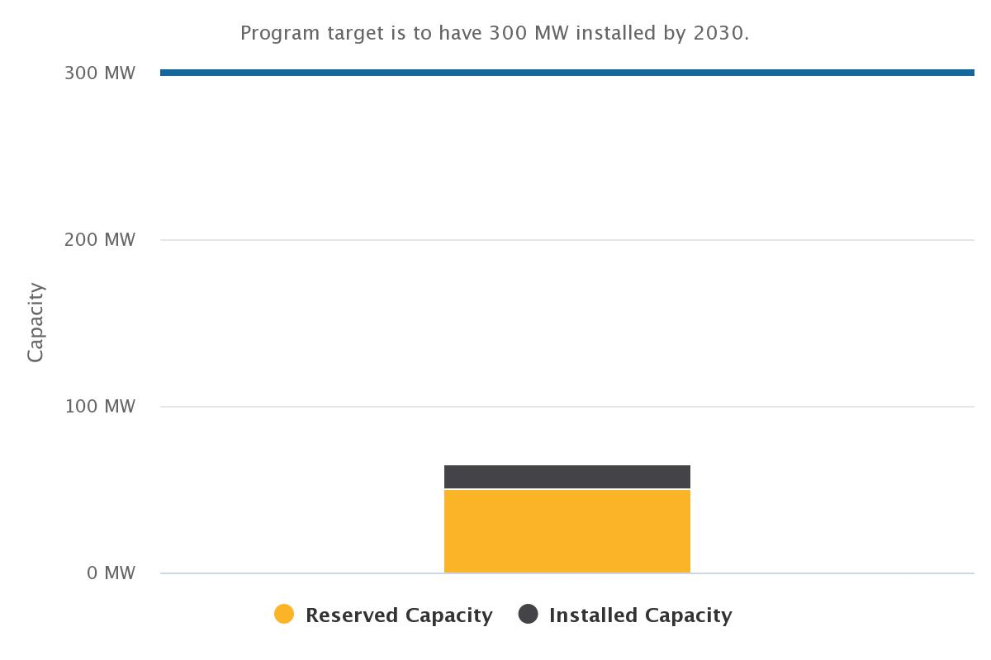
SOMAH Progress to Goal
20% of 300 MW Goal Achieved
Installed Capacity 14.49MW
  88 projects
  8,068 tenant units
  39% located in DACs
  $27.2M in incentives
Reserved Capacity 47.14MW
  326 projects
  25,324 tenant units
  30% located in DACs
  $97.6M in estimated incentives
Source: April 2023, CPUC Distributed Generation Statistics

Slide 33
SOMAH Successes and Challenges
Successes
Property owners are allocating a higher % of solar credits than required
  Required: 51% or more
  To-date: 88.6% average
DAC participation
  DAC SOMAH participation is 30%
  30% of Eligible Properties are in DACs
Challenges
Serving tribal properties
  Lack of qualified multifamily housing
Program leveraging is limited
Few projects in rural areas
Fall off in new applications

Slide 34
SOMAH & Tribal Communities
Tribal land has a shortage of housing stock and resources supporting the development of additional housing
  SOMAH PA has only identified 14 likely eligible MF properties statewide
SOMAH requires properties are deed-restricted, affordable MF housing
  Tribal housing agreements are not identical to those offered by state or federal government
  SOMAH PA is developing a guide for Tribes on how to assess and confirm the long-term affordability status of otherwise eligible MF properties
Cultural competency
  SOMAH PA has representation from tribal community members on their Advisory Board
  SOMAH PA has worked with non-profits to provide additional training to staff to support better marketing, outreach and education

Slide 35
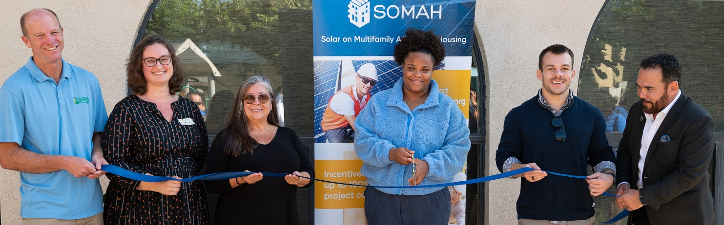
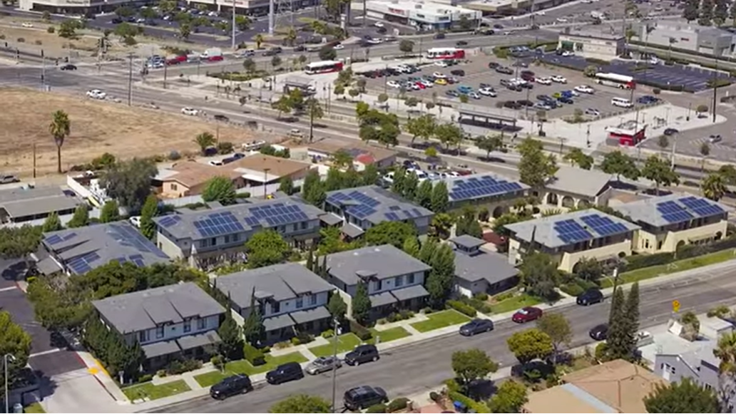
SOMAH in San Diego
Trolley Trestle transitional housing campus in Chula Vista.
SOMAH Program provided $48,000 in incentives
25.6 kilowatt solar installation
Serving 10 living units and common areas
“Over 10 years, we’re looking at an excess of $600,000 savings. For a community services nonprofit that amount really makes an impact because we don’t have to write grants for it and can plan for the funding to come in on a regular basis.”
Mauricio Torre, SBCS vice president of Program Operations
Learn more at SOMAH Strengthens SBCS Community | SOMAH (calsomah.org)

Slide 36
Microgrid Incentive Program
Patrick Saxton, Senior Utilities Engineer, Patrick.Saxton@cpuc.ca.gov
Grid Resiliency and Microgrids Team

Slide 37
Overview of Microgrid Incentive Program (MIP)
$200 million of ratepayer funding for in-front-of-the-meter community microgrids.
  Service territories of SCE, SDG&E, and PG&E.
  Disadvantaged and vulnerable communities and tribal communities facing grid outages.
  More complex projects with longer islanding duration and serving multiple customers.
Early OCT : Within 180 days upon issuance of the decision, the utilities shall make available the Microgrid Incentive Program Handbook.
Early JUL 2024: The first MIP application window* opens no later than nine (9) months after the publication of the MIP Handbook.
APR 6: Commission Decision approved the MIP Implementation Plan.
Apr
May
Jun
Jul
Aug
Sept
Oct
Nov
Dec
Jul 2024
* IOU Program Administrators will provide community outreach and consultation to interested applicants prior to opening the application window.
Notes:
This form of community microgrid will supply electricity across a segment of a Distribution System to multiple customers during Island Mode.
The $200M program is split between $180M project incentives and $20M in administration cost.
The Proposed Decision appropriates $83,340,000 for SCE, $17,460,000 for SDG&E, and $79,200,000 for PG&E.

Slide 38
Microgrid Incentive Program Funding
Each project may receive up to $15M of ratepayer funding.
  $14M for the project – helping to cover the costs of new generation and storage resources.
    Includes $25K project application development grant for eligible applicants.
  $1M for interconnection allowance for any necessary upgrades to distribution grid.
  And separately up to $3M allowance for Rule 2 “special facilities” required for islanding the microgrid (e.g., recloser).
Notes:
Application Development Grant: A one-time, optional, limited, MIP-funded grant to disadvantaged community (DVC) MIP Applicants who submit an eligible MIP application and request such reimbursement.
While the MIP application must meet the program’s eligibility criteria, it does not need to be awarded a full MIP incentive award in order to receive the Application Development Grant.

Slide 39
Program Objectives
Fund clean community microgrids supporting the critical needs of disadvantaged and vulnerable populations most likely to be impacted by electrical outages.
  Advance microgrid technology for climate response resiliency;
  Advance system benefits of microgrids equitably to disadvantaged and vulnerable communities (DVCs) for the purpose of public health, safety, and welfare;
  Alleviate the potential that existing inequities would worsen for counties hardest hit by climate change and de-energization impacts with already vulnerable populations and too few ratepayers; and
  Inform future regulatory action for the benefit of all customers.

Slide 40
Project Criteria
Located in disadvantaged and vulnerable community or eligible facilities serving these communities.
Located in an area at higher risk of electrical outages:
  Tier 2 or Tier 3 High Fire Threat District
  Area that experienced a prior PSPS event;
  Location prone to strong, damaging earthquakes; or
  Receives service from top one percent of worst performing circuits for reliability.
Be a community microgrid that:
  Interconnects to a distribution line operating at 50 kilovolts or below;
  Provides a minimum of 24 consecutive hours of energy in island mode; and
  Aggregate emissions in island mode are no greater than equivalent grid power.
Notes:
The MIP has two project eligibility categories: community eligibility and technical eligibility.
The MIP does not specify eligibility criteria for applicants and therefore does not rule out any type of applicants. The applicant or the owner could include, but not be limited to, a local government, one or more community-based organizations, or a project developer.

Slide 41
Five-Stage Process
Community Outreach: On-the-ground, organized effort to increase awareness and understanding of the MIP to encourage disadvantaged and vulnerable community participation.
Consultation and Application: Support potential application submission by helping to identify resiliency options, MIP eligibility requirements, and community microgrid technical considerations.
Application Evaluation: Determine application eligibility, project scoring and prioritization, MIP incentive awards, and identification of grid upgrades for interconnection and safe operation.
Project Development: Execution of a Microgrid Operating Agreement (MOA), project development leading to commercial operation, and establishment of project milestones to inform incentive award progress payments.
Project Operations: Operation of the MIP project in partnership with the utility and its safety and operational requirements.
Notes:
Community Outreach and Consultation
Prior to opening the MIP Application window, the Program Administrators will conduct the first two stages of the MIP process.
Stage 1 Community Outreach: Involves an organized, multi-pronged approach to increasing MIP awareness, encouraging MIP applications, and providing education in disadvantaged and vulnerable communities.
Stage 2 Consultation and Application: Involves a 2-part process to support disadvantaged and vulnerable communities in identifying:
1) resilience options and MIP Eligibility requirements; and
2) community microgrid technical considerations in support of potential Application submission.

Slide 42
MIP Handbook
Each utility’s Microgrid Incentive Program Handbook will be made available on their website in early October 2023.
The handbook will include:
  An overview of how the MIP works;
  Information on community microgrid implementation, including key project design considerations;
  MIP application development grant information;
  Application intake window(s) information;
  Eligibility, scoring, and prioritization protocols;
  Timeline and instructions on moving through each step in the MIP lifecycle process;
  Special considerations for tribal governments; and
  A pro forma Microgrid Operating Agreement (MOA).
Notes:
The microgrid operating agreement is an umbrella agreement covering the project’s development, operation and maintenance, and contract terms and conditions. It defines and documents the roles and responsibilities of the Utility and the MIP Awardee. It incorporates by reference or addendum all other contracts and agreements that are required for the safe and reliable development and operation of the project. It is enforceable and subject to the oversight jurisdiction of the CPUC.

Slide 43
Thank you

