Slide 1
California Tribal Energy Resiliency Alliance (C-TERA)

Slide 2

U.S. DOE Grid Resilience and Innovation Partnerships Program (GRIP)
GRIP Grid Innovation Program
$5 billion for innovative approaches to transmission, storage, and distribution infrastructure to enhance grid resilience and reliability.
Enhance grid flexibility and improve resilience of nation’s power grid against extreme weather and climate change.
Accelerate deployment of transformative projects to help ensure reliability of power infrastructure, ensuring all American communities have access to affordable, reliable, clean electricity anytime, anywhere.
Innovative approaches (e.g., advanced technologies, innovative partnerships, deployment of projects planned through innovative processes, etc.)
https://www.energy.gov/gdo/grid-resilience-and-innovation-partnerships-grip-program

Slide 3
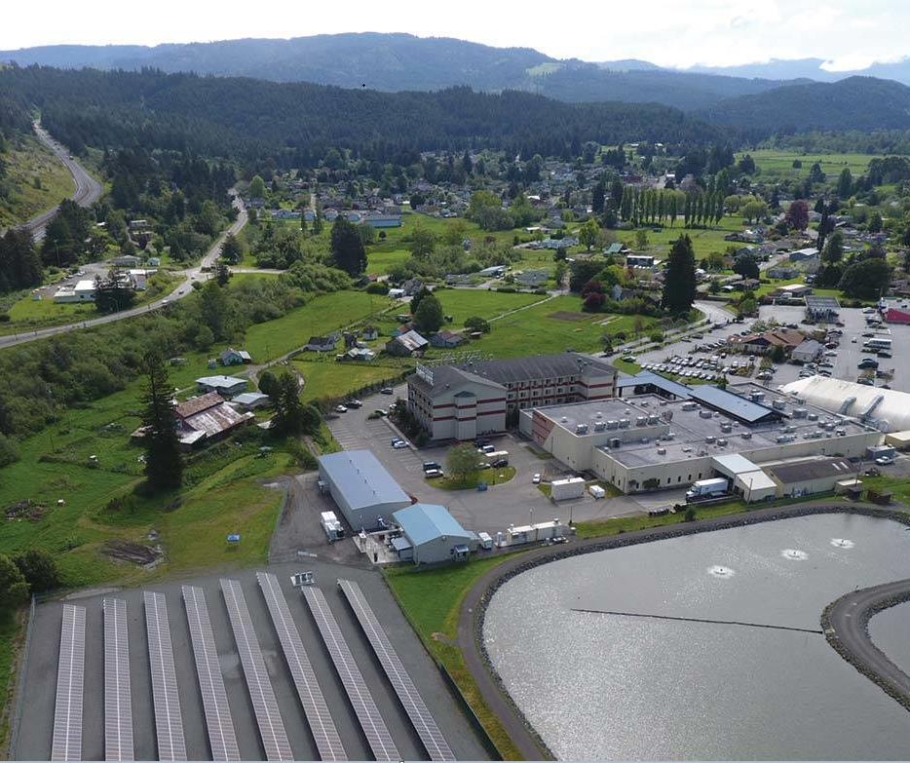
CEC GRIP Application Focus
California Tribal Energy Resiliency Alliance (C-TERA): Develop and deploy a proposed portfolio of grid-serving clean energy projects:
Serve the specific needs of Tribal communities and their critical facilities and provide resilience for the Tribes and adjacent communities.
17 proposed projects totaling approx. $500M ($250M federal funds/$250M non-federal funds).

Slide 4
C-TERA Projects
Community Microgrids
Front-of-meter microgrids for a specific section of the distribution system, with DER integrated at the neighborhood, community, or landscape scale.
Campus & Facility Microgrids
Behind-the-meter microgrids for a specific building or campus, powered by DER behind the meter. Scale depends on the size of facility, from households to large campuses.

Slide 5
Technical Assistance Hub
C-TERA Technical Assistance (TA) hub will deliver holistic support for Tribal Energy Sovereignty by offering:
  Services to support clean energy projects through the project
  life cycle, including needs assessment, financial planning, project planning, construction, operations, and maintenance.
  Services to support community engagement.
  Services to support economic and workforce development.
  Services to ensure Tribes are positioned to access future funding opportunities, such as grant writing support.
Notes:
C-TERA Hubs will provide lessons learned and serve as a model to expand TA into other communities.
Lots of lessons learned.

Slide 6
Proposed Support Services
TA Hub
Community Engagement & Awareness
Technical Support
Vendor and Contractor Networks
Workforce and Business Development
Policy Support and External Outreach
Notes:
Existing information

Slide 7
C-TERA Application Team Organization
Tribes
Sub-applicants/Sub-recipients
CEC
Grant Applicant/Recipient
DOE
Funding Agency
Prosper Sustainably Team
App Management (w/CEC)
Project Developer
Schatz Energy Center
Technical (w/CEC)
Project Developer
GRID Alternatives
WFD (w/CEC)
TA Funding Administrator
Project Developer
Application Development Working Groups
Developer / Technical
Working Group
Tribal Outreach/ Project Management
Working Group
TA Hub, WFD + Enterprise
Working Group

Slide 8
C-TERA Engagement
C-TERA Engagement to Date:
  Weekly engagement with C-TERA tribal project teams (strategy discussions on C-TERA vision, community benefits, workforce and enterprise development, and more)
  Presentation to Northern CA Tribal Chairman’s Association and Southern CA Tribal Chairman's Association
  CEC/CPUC Tribal En Banc (March 2)
  Tribal TA Hub Listening Session (April 17)
  Public TA Hub Listening Session (April 18)
  Numerous 1-on-1 discussions
  And more

Slide 9
C-TERA Timeline
C-TERA Proposal Development
(Ongoing)
If Awarded, Kickoff C-TERA
(Q1 2024)
Additional Engagement on TA Hub Development
(2024 - Post DOE Award)
C-TERA Application Due
(May 19, 2023)

Slide 10
Thank You!

