Slide 1
Staff Workshop on Implementation of the Industrial Decarbonization and Improvements to Grid Operations Program
Energy Research and Development Division, California Energy Commission
April 11, 2023 Ilia Krupenich

Slide 2
Agenda
Time | Item
9:30 am | Welcome
9:40 am | Opening remarks – Commissioner McAllister (9:40-9:50)
9:50 am | Industrial Program Overview and public comments (9:50-10:30)
10:30 am | Government panel and public comments (10:30-11:20)
11:20 am | Closing morning remarks – Commissioner Monahan (11:20-11:30)
11:30 pm | Break (11:30-12:30)
12:30 pm | Industrial panel and public comments (12:30-2:00)
2:00 pm | Public questions and answers (2:00-2:50)
2:50 pm | Closing remarks
3:00 pm | Adjourn

Slide 3
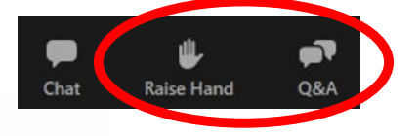
Housekeeping
Participants will be muted during the presentation
Input your questions in the Zoom Q&A
Presentation and recording available:
  https://www.energy.ca.gov/programs-and-topics/programs/industrial-decarbonization-and-improvement-grid-operations-indigo
Submit Comments:
  https://efiling.energy.ca.gov/EComment/EComment.aspx?docketnumber=23-ERDD-04

Slide 4
Commissioner McAllister

Slide 5
Industrial Program Overview

Slide 6
Program Overview
Established the Industrial Grid Support and Decarbonization Program in the 2022-2023 Budget and AB 209*
$90 million for financial incentives
  Provide significant benefits to the electrical grid
  Reduce emissions of greenhouse gases
  Achieve the state’s clean energy goals
  Exceed compliance requirements
Program hereafter called Industrial Decarbonization and Improvements to Grid Operations Program (INDIGO program)
* AB 209

Slide 7
Eligible Industrial Facility
  A facility involved with manufacturing, production, and processing of materials and related support facilities
    Examples: chemicals, metals, nonmetallic minerals, cement, glass, electronics, and pharmaceuticals.
    Excludes projects that benefit an oil or fossil gas production, processing, or refining facility and geologic storage
Notes:
Per AB 209…

Slide 8
Eligible Project/Technology
  Advanced technologies and equipment capable of doing at least one of the following:
    Provide significant benefits to the electrical grid
    Maximize reduction of greenhouse gas emissions
    Reduce air pollution in under-resourced communities.
Notes:
Per AB 209…

Slide 9
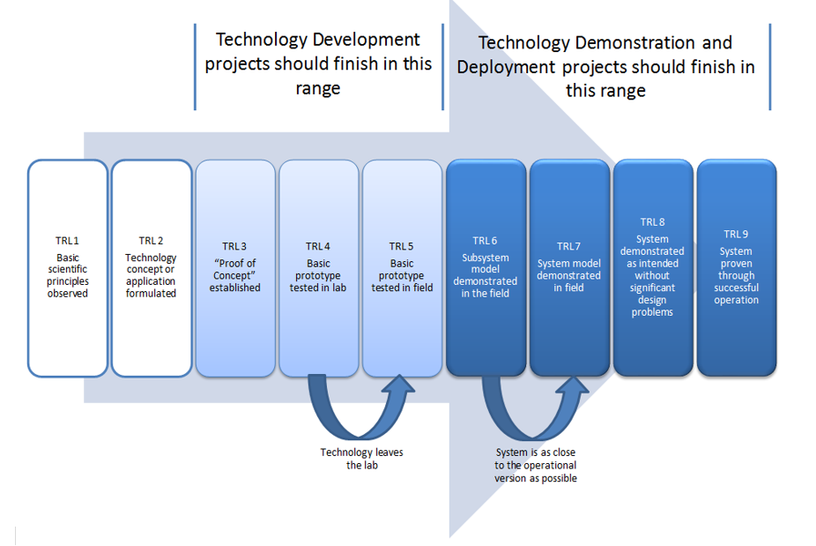
What is an advanced technology?
Technology Readiness Level

Slide 10
What is an advanced technology?
  Technologies that have been tested in the field (TRL 8-9), but not widely used in California
  Technologies under development
  (TRL 5-7), but ready for demonstration in the field

Slide 11
Potential technologies?
Energy Efficiency
Materials efficiency
Electrification
High temperature heat pumps
Low Carbon Fuels
Energy thermal storage/recovery
Smart manufacturing
System efficiency
Innovative chemistry
Strategic energy management
Load flexibility/ demand response controls
Non-contact heating
Innovative separations
Biofuels
Renewable hydrogen
Alternative feed stocks
Others
Carbon capture and utilization
Circular economy integration
Combined heat and power with zero carbon fuels

Slide 12
Potential Program Design
Element | Description
Eligible Applicants | Industries, aggregators, administrators
Demonstration Sites | Must be at a California industrial facility
Max Grant per Applicant | Up to $16M; CEC grant covers up to 75% of eligible costs
Eligible Items for Grant | Equipment and materials (at least 88% of CEC funds requested) M&V (up to 2%) Engineering and design (up to 10%)
Minimum CEC $ Spent in CA | At least 50% of grant funds must be spent with CA companies Preference points for over 50%.
Solicitation Stages | 1st Stage=abstract; 2nd stage=full proposal with feasibility study prior to funding the full build out
* M = million
Notes:
Eligible applicants: open to anyone but must be a CA based company (industries, aggregators, administrators). Aggregators could be more applicable to demand response/load flexibility programs
CA industry: facility that manufactures, produces and processes materials, and related support facilities (e.g., warehouses, wastewater treatment)
Funding groups: Total of $81M available for grants, separated by large GHG emitters versus other emitters. Cement plants are all over 500,000 MT, other large industrial facilities like glass and steel are less than 500,000 MT. Group separation provides for diversity of applicants and participation. The percentages can be adjusted.
Maximum grant amount is based on the legislation that limits a recipient to no more than 20% of the allocated funds. Eligible items for the grant include equipment, materials, M&V, engineering. We are not including administrative, project management, permitting, installation or other costs but these can be included as match. Reason: Want to fund more projects, rather than a few; requiring match will ensure that industries also are committed to the project.
Minimum CEC funds spent in CA – want to encourage use of CA vendors, suppliers, manufacturers, businesses and labor. If they spend at least 50% they will get points during scoring; if they spend less than 50%, they will get no points.
Minimum match required is 25%. Eligible match can be for installation, permitting, administration and out of state costs
Solicitation stages: want to make the solicitation process efficient for both applicant and the CEC and adapting DOE-like process: 1st stage: applicant submits an abstract (pass/fail); 2nd stage for those passing the first phase, applicants will submit full proposal and proof of technology readiness—applications will be evaluated against a scoring criteria and highest ranking proposals will receive funds to complete engineering and design prior to full build out of the project. The reason for the multiple steps is to avoid committing funds for equipment and materials upfront—until CEC staff is confident that the technology has a high likelihood of successful implementation. This will be crucial for demonstrations of new technologies, or those with permitting or other challenges. CEC considering contracting for technical assistance (e.g., interagency agreement with UCI) to review engineering/design documents prior to full build out.

Slide 13
Proposed Grant Funding Allocation Steps
    Detailed project planning (CEC grant for engineering/design; balance w/match)
      Assurance that the project plan is technologically, financially, and legally viable, with buy-in from relevant local and community stakeholders.
      Complete engineering, construction, and commercial-scale designs; risk management plan showing technology readiness; and financial plan for project completion.
    Project development and permitting (to be covered with match)
      Finalize project development plans, commercial agreements, financial structure, and project economic updates.
      Complete permitting, safety, security, and community engagement plans.
    Installation and construction (CEC grant for equipmt/material, balance w/match)
      Provide regular status updates and reports.
      CEC to closely monitor progress and evaluate it against the plans developed previously to assess performance.
    M&V and Operation (CEC grant for M&V, balance w/match)
      Provide regular status updates and reports.
      Complete pre- and post-M&V and assess project performance vs proposal goals.

Slide 14
Proposed Stage 1 Scoring of Abstract (pass/fail)
Criteria for the abstract:
1. The abstract is received by the due date and time specified in the solicitation.
2. The abstract is for an eligible project at an eligible industrial facility.
3. The budget shows at least 50% of the CEC grant funds will be spent with California companies.
4. The abstract satisfactorily describes the project (e.g., key technologies, purpose, and objectives aligned with program requirements; technology gap to be addressed; results of previous pilot or bench-scale tests; total cost of the project (CEC and non-CEC amount).
5. The abstract satisfactorily describes how the project would significantly benefit the electric grid, reduce GHG emissions, or reduce emissions of criteria air pollutants.
6. The abstract describes how it plans to leverage other federal, state, or other funding for match.
7. The abstract Identifies a preliminary project development plan and timeline, any key risks and challenges that could impact the project, and possible mitigation strategies.
8. The abstract identifies the qualifications, experience, capabilities, and resources to design, develop, build, and operate the proposed project (subcontractors, project partners).
Must pass all criteria to move to Stage 2
Notes:
1. Abstract summary content:. 1) description of technology gap or issue that project is targeting, 2) explanation of how proposed project will address the gap or issue; 3) results of previous pilot or bench-scale tests; 4) estimated benefits (energy savings, greenhouse gas emission reductions, electrical load reductions, and local air quality improvement); 5) estimated costs of the project and subsequent operation/maintenance of equipment; 6) path to market and market size estimates (technology potential to contribute to achievement of the state’s goals); 7) current/potential partners, including: industrial facilities willing to adopt technology, equipment manufacturers, environmental justice and community based organizations.

Slide 15
Proposed Stage 2 Scoring – Full Proposal
Criteria | Points
Technical merit and need: Describes and quantifies how the project will provide significant benefits to the electric grid including smart grid management, maximize GHG emission reductions, and/or reduce air pollution in under-resourced communities; competitive advantages of the proposal and technologies; and factors for project economic viability. | 20
2. Technical approach: Describes work performed, goals, objectives, and metrics to assess project performance; identifies factors for success, risks, barriers, and mitigation measures. | 30
3. Scalability, replicability and market impact: Describes how the technology can be scaled to overcome challenges to maximize penetration in hard to electrify or decarbonize industries, and how the technology can be replicated both within the industry and to other industries. | 10
4. Team qualifications: Experience, financial stability, and capability to successfully complete the project. | 10
5. Budget and Cost-Effectiveness: Reasonableness of requested funds relative to the scope of the work and inclusion of approaches to reduce indirect costs and leverage additional funding. | 5
Total Base Points Must achieve at least 70% of base points to be considered for preference points | 75 52.5
Notes:
1. Technical merit and need: describe the technological advancement and innovation that will result in significant benefits to the electrical grid, maximizes reduction of GHG emissions and/or reduces air pollution in under-resourced communities
2. Technical approach: describes the technique, approach, and methods for performing the work described in the Scope of Work and Schedule, including adequacy of time, funds, and other resources; describes the goals, objectives and metrics to assess project performance, baseline and target values of these metrics, identifies the reliability that the project and site recommendations as described will be carried out if funds are awarded, identifies and discusses factors critical for success, in addition to risks, barriers, and limitations and provides a plan to address them.

Slide 16
Proposed Stage 2 Scoring – Preference Points
Criteria | Pts
5. CEC Funds Spent on CA based companies | 10
6. Impacts and benefits: Describes how the project will provide the biggest impact for the state’s investment, compared to other Stage 2 applicants: (Lowest CEC funds spent per peak kW reduced) / (applicant’s CEC funds spent per peak kW reduced) x 5 pts (Lowest CEC funds spent per MT GHG reductions) / (applicant’s CEC funds spent per MT GHG emission reductions) x 2.5 pts (Lowest CEC funds spent per unit of criteria pollutant reduced) / (applicant’s CEC funds spent per unit of criteria pollutant reduction in under resourced communities) x 2.5 pts | 10
7. Project site located in and benefiting low income, disadvantaged, and/or tribal communities and has letters of support from one or more community-based organizations | 10
Total Preference Points | 30
Percentage of CEC funds spent on CA based vendors/suppliers/manufacturers/engineer-design/M&V subcontractors | Percentage of Possible Points
≥ 75% | 50%
≥ 95% | 100%

Slide 17
Proposed Funding Allocation and Timeline
Program Component | Tentative Budget | Tentative Schedule
Demonstration Grants – Field Tested Technologies (see Slide 10) | $53M | Summer 2023
Technologies Ready for Demonstration (see Slide 10) | $8M | Summer 2023
Federal Cost Share | $20M | GFO-22-902*
Technical Assistance & Admin Costs | $9M | On-going
Total | $90M
* Link to Cost Share for Federal Funding Opportunities for Industrial & Food and Beverage Projects

Slide 18
Questions for Stakeholders
    Besides grants, should we consider other incentives (e.g., zero or low interest loans, loan guarantees)?
    Eligible project/technologies
      Are we missing any advanced technologies that can help industries reduce GHG emissions and provide relief to the grid?
      What are barriers to implementation?
      How can these technologies be replicated in other industries?
      Should we target one specific industry, if so which one and why?
    Program design
    How would limiting the grant to specific items (e.g., equipment, materials, engineering design, and M&V) impact the project?
    Any comments on the proposed performance-based funding allocation (slide 13)?

Slide 19
Questions for Stakeholders (continued)
    Scoring and Evaluation
    Any comments on the abstract and full proposal scoring?
    Any suggestions for alternate methods for scoring "impacts and benefits" that meet the requirements of the law as follows:
      Provide significant benefit to the electrical grid
      Maximize reduction of greenhouse gas
      Reduce air pollution in under-resourced communities

Slide 20
Questions and Comments
Ways to ask questions in Zoom
Use the raise hand feature in Zoom and you will be called on to unmute yourself
Zoom phone controls:
  *6 – Toggle mute/unmute
  *9 – Raise hand
Type your question in the Q&A Box in Zoom
Remember for verbal questions:
Introduce yourself by stating your name and affiliation
Keep questions under 2 minutes to allow time for others

Slide 21
Written Comments
Submit Comments to our docket by 5:00 p.m. on April 26, 2023:
  https://efiling.energy.ca.gov/EComment/EComment.aspx?docketnumber=23-ERDD-04
See workshop notice for instructions on submitting comments by mail or email
https://efiling.energy.ca.gov/GetDocument.aspx?tn=249434
For the presentation, recording and view all comments submitted to the docket:
  https://www.energy.ca.gov/programs-and-topics/programs/industrial-decarbonization-and-improvement-grid-operations-indigo

Slide 22
Other technologies for consideration?
As we are still developing the program, please provide the following information on your technology or project and submit it to the docket:
  name of technology, applicability to various industries (e.g., cement, glass, etc.)
  benefits provided and justification for why it should be added (please consider core benefits of this program discussed earlier)
  commercially available or under development?
  estimated capital and operating costs
  potential environmental impacts, permitting and other considerations?
  references for more information

Slide 23
Government Panel
California Air Resources Board – Mark Sippola
U.S. Department of Energy – Emmeline Kao
Danish Energy Agency - Fabian Bühler

Slide 24
Government Panel
Provide 5-7 minute introductions about your agency and role in industrial decarbonization and/or industrial grid support
******
Are there target markets that should be emphasized?
What technologies/strategies would have the most impact in helping California achieve deep decarbonization and why?
How can these decarbonization activities also help support the electric grid during peak periods?
With our limited funding, how can we leverage our funds to have lasting impact beyond our grants?

Slide 25
Public Questions for the Government Panel

Slide 26
Commissioner Monahan

Slide 27
BREAK
Afternoon session will begin at 12:30 pm

Slide 28
Industrial Stakeholder Panel
California Large Energy Consumers Association – Christian Lenci
California Manufacturers Trade Association – Robert Spiegel
UC Davis – Dr. Kelly Kissock
Industrial Assessment Centers
  UC Irvine – Dr. G.P. Li
  SF State University – Dr. Ahmad Ganji
U.S. Department of Energy – Tom Wenning
Lawrence Berkeley National Laboratory – Jingjing Liu
Pacific Gas and Electric Company – Albert Chiu
Center on Race, Poverty, and the Environment – Dan Ress

Slide 29
Industrial Panel Questions
Brief 5 min introductions about your organization and role in industrial decarbonization and/or industrial grid support
*****
Are there target markets that should be emphasized, and why?
What technologies/strategies would have the most impact in helping California achieve deep decarbonization and why?
What technologies/strategies will benefit under resourced communities while also decarbonizing industries?
How can we build mutually beneficial relationships between project developers and local communities?
How can these decarbonization activities also help support the electric especially during peak periods?
With our limited funding, how can we leverage our funding to have lasting impact?

Slide 30
Public Questions for the Industrial Panel

Slide 31
Questions for Stakeholders
    Besides grants, should we consider other incentives (e.g., zero or low interest loans, loan guarantees)?
    Eligible project/technologies
      What are examples of advanced technologies (at TRL 9 by the end of the project) that we should consider?
      What are barriers to implementation?
      How can these technologies be replicated in other industries?
      Should we target one specific industry, if so which one and why?
    Program design
    How would limiting the grant to specific items (e.g., equipment, materials, engineering design and M&V) impact the project?
    Any comments on the proposed performance-based funding allocation?

Slide 32
Questions for Stakeholders (continued)
    Scoring and Evaluation
    Any comments on the abstract and full proposal scoring?
    Any suggestions for alternate methods for scoring impacts and benefits that meet the requirements of the law as follows:
      Provide significant benefit to the electrical grid
      Maximize reduction of greenhouse gas
      Reduce air pollution in under-resourced communities

Slide 33
Questions and Comments
Ways to ask questions in Zoom
Use the raise hand feature in Zoom and you will be called on to unmute yourself
Zoom phone controls:
  *6 – Toggle mute/unmute
  *9 – Raise hand
Type your question in the Q&A Box in Zoom
Remember for verbal questions:
Introduce yourself by stating your name and affiliation
Keep questions under 2 minutes to allow time for others

Slide 34
Written Comments
Submit Comments to our docket by 5:00 p.m. on April 26, 2023:
  https://efiling.energy.ca.gov/EComment/EComment.aspx?docketnumber=23-ERDD-04
See workshop notice for instructions on submitting comments by mail or email
https://efiling.energy.ca.gov/GetDocument.aspx?tn=249434
For the presentation, recording and view all comments submitted to the docket:
  https://www.energy.ca.gov/programs-and-topics/programs/industrial-decarbonization-and-improvement-grid-operations-indigo

Slide 35
Workshop Recording
Workshop recording is available at:
  https://energy.zoom.us/rec/share/gemLYOTkXTljI5Fob8vKGYx2aevo4VoOcJHTnA2Bul2109pBwr71sgA7K3ImL4dk.HSC9VSUDovM_oFmS?startTime=1681230642000

Slide 36
Other technologies for consideration?
As we are still developing the program, please provide the following information on your technology or project and submit it to the docket:
  name of technology, applicability to various industries (e.g., cement, glass, etc.)
  benefits provided and justification for why it should be added (please consider core benefits of this program discussed earlier)
  commercially available or under development
  estimated capital and operating costs
  potential environmental impacts, permitting and other considerations
  references for more information

Slide 37
Other Ways to Engage
Sign up on EmpowerInnovation.net to get access to:
  Funding opportunities from the CEC and others
  Curated resources and events, and
  Connections to people and organizations
FIND A PARTNER
Announce your interest in this funding opportunity and message other interested parties to find potential partners.
RESOURCES & TOOLS
Browse the collection of resources for clean tech innovators including Resource Libraries, Funding Sources, Tools, and Databases.
Notes:
Talking Points:
We encourage anyone interested in applying for a CEC grant to join Empower Innovation, the newest tool in the CEC’s Energy Innovation Ecosystem.
Empower Innovation is an online platform designed specifically for the cleantech community, and provides a great networking opportunity for individuals and organizations exploring our funding opportunities.
On Empower Innovation, you will find a community of cleantech entrepreneurs, developers, technology adopters, and community-based organizations. You will also be able to see the latest funding announcements from the CEC.
The "Find a Partner" feature allows you to announce your interest in a specific funding opportunity and view other interested parties to find potential partners in a trusted environment.
The site address for this solicitation with Empower Innovation is at the bottom of the slide.

Slide 38
Thank You!
Notes:
Thank you all for interest and attending this workshop.

