Slide 1
Staff Workshop on the
Food Production Investment Program
Energy Research and Development Division
California Energy Commission
Cyrus Ghandi, Eleanor Oliver, Matthew Stevens
April 18, 2023

Slide 2
Housekeeping
This workshop is being recorded on Zoom.
Today’s presentation and recording will be made available at:
https://www.energy.ca.gov/event/workshop/2023-04/staff-workshop-food-production-investment-program
Submit comments via the Food Production Investment Program Docket, No. 23-ERDD-05:
https://efiling.energy.ca.gov/Ecomment/Ecomment.aspx?docketnumber=23-ERDD-05

Slide 3
Agenda
09:30 am to 12:00 pm
Welcome
Opening Remarks
Existing Program
New AB 209 Requirements
Proposed Program Changes
Stakeholder Panel Discussion
Public Questions and Comments
Next Steps and Ways to Engage

Slide 4
Angela Gould
Deputy Director
Energy Research & Development Division

Slide 5







FPIP Benefits to California
Awarded​
56 Projects​
$117.8M​
Animal Feed & Ethanol
4
11
Prepared Food Producers
Projected Annual Emissions Reduction​
Beverage, Breweries, & Wineries
11
11
Meat & Rendering
161,650 MT CO2e*​
Dairy Processing
7
12
Fruits, Nuts & Vegetables
*Preliminary staff estimate – actual results will be quantified during project measurement & verification​.

Slide 6
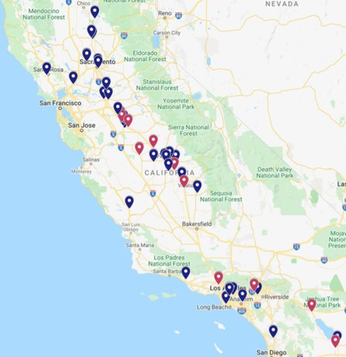
Current FPIP Project Locations
46 project sites (85%) are benefiting a disadvantaged and/or low-income community.

Slide 7
Program Background
PROGRAM | Existing | Proposed
POLICY | AB 109 & SB 856 | AB 209
FUNDING SOURCE | California Climate Investment | Governor's General Budget
AMOUNT | $117.8M (no funding remaining) | $25M (current) $40M (planned in next FY)
REPORTING | CARB | CEC (Legislature)
FOCUS | Reduce GHG emissions | Maximize reduction of GHG emissions, provide benefits to the electrical grid, reduce air pollution in under-resourced communities

Slide 8
New AB 209 Requirements
Provide financial incentives for the implementation of eligible projects at eligible industrial facilities.
  Eligible facility: facilities that are directly involved in food production and processing, and related support facilities.
  Eligible project: advanced technologies and equipment: enhance electric grid reliability, electrify processes, energy storage and renewable energy, energy efficiency, novel decarbonization technologies. Projects to exceed compliance requirements.
Preference focus on projects that can do at least one of the following:
  Provide benefits to the electric grid (prioritize projects reducing demand during net peak periods)
  Maximize reductions of GHG emissions
  Reduce air pollution in under-resourced communities

Slide 9
Proposed Changes
Eligible Industries (Applicants)
Funding Requirements
    Tier Structure
    Match
    Eligible Cost
Eligible Technologies
Evaluation Criteria

Slide 10
Eligible Industries
Existing Requirements
Located in California
Must be the food processing facility (not subcontractor or technology developer)
North American Industry Classification System (NAICS) codes 311 (Food Manufacturing) and 3121 (Beverage Manufacturing)
Proposed Requirements
Located in California
Must be the food processing facility (not subcontractor or technology developer)
North American Industry Classification System (NAICS) codes 311 (Food Manufacturing) and 3121 (Beverage Manufacturing)
Will consider adding refrigerated warehousing and storage (NAICS code 493120) to eligible facility types, and will consider additional food industry supporting facilities upon request

Slide 11
Funding Requirements
PROGRAM | Existing |  | Proposed
TIER | Tier 1 – Drop-in technologies | Tier 2 – Emerging technologies | One Group
GRANT AWARD SIZE | $100,000 to​ $6,000,000 | $2,000,000 to $8,000,000 | $500,000 to $3,000,000
MIN MATCH FUNDING | 35% of grant award​ | 15% of grant award​ | 25% of grant award​
ELIGIBLE COSTS | Equipment​ M&V | Equipment​ M&V Design Engineering | Equipment​ M&V
MULTIPLE TECHNOLOGIES BUNDLED | Allowed | Allowed | Allowed
MULTIPLE FACILITIES BUNDLED | Allowed | Not Allowed | Allowed

Slide 12
Eligible Technologies
Current & Keep*
Internal metering and software, and controls
Compressors​
Machine drive upgrades​
Mechanical dewatering​
Motors and variable frequency drives​
Process equipment insulation
Steam traps, condensate return, heat recovery
Waste heat to power​
Renewable energy microgrids​
Low/Zero-carbon fuels
Solar thermal
Add/Modify
Industrial heat pumps
Packing equipment
Electrification of fossil fueled equipment coupled with renewable energy production and storage
Refrigeration system optimization - ultra-low GWP systems
Ultra-low global warming potential refrigerants
Remove
Drying Equipment
Industrial cooking equipment
Boilers, economizers, evaporators
Renewable energy generation, including biogas production
*Additional technologies will be considered upon request.

Slide 13
Evaluation Criteria
Remove preference points for large emitting entities (Capped and Uncapped).
Prioritize projects that provide benefits to the electric grid.
Existing Criteria
Proposed Criteria
Bundled Entity Description for each tier | Points
Projects in a capped facility*, along with any facility(ies) under the same ownership, can be bundled in one application | 10
Projects in a facility that emits between 10,000 and 25,000 metric tons of CO2e annually, along with any facility(ies) under the same ownership, can be bundled in one application | 5
Projects in a facility that are not obligated to report to CARB annually for CO2e emissions | 0
Bundled Entity Description | Points
Percentage reduction in demand during net peak periods across all FPIP-funded technology(ies). Points will be awarded on a sliding scale based on the percentage of reduction in demand during net peak periods, with 10 percent or greater in net peak reduction receiving 10 points (e.g., a 5.5% reduction will receive 5.5 points) | 0-10
*California Air Resources Board, Mandatory GHG Reporting – Reported Emissions, https://ww2.arb.ca.gov/mrr-data

Slide 14
Panel Discussion
Dr. Ahmad Ganji
Director
SFSU Industrial Assessment Center
Erick Watkins
Director of Engineering
Pacific Coast Producers
John Ahrens
Program Director of
Microgrid Competency Center, North America
Schneider Electric
Jingjing Liu
Program Manager and Researcher
LBNL

Slide 15
IAC Experience in Food Processing Plants
Ahmad R. Ganji
Professor of Mechanical Engineering
Director of Industrial Assessment Center (IAC)
San Francisco State University
CEC Workshop on Food Production Investment Program
April 18, 2023

Slide 16


Industrial Assessment Center (IAC)
IAC is a US DOE Program, continuously operating since 1976
There are 37 IACs in the country
IAC at San Francisco State University (SFSU) is one of the four IACs serving the industrial plants in California
SFSU IAC has served the industrial establishments for over 30 years
SFSU IAC has performed comprehensive energy assessment of over 600 industrial and process plants
Majority of plants we have served are food processors

Slide 17
Industrial Assessment Center (IAC) Projects
Our recommended projects include,
  Electrical and gas (NG and LPG) energy efficiency measures
  Renewable energy measures
  Demand management measures
  Cogeneration (CHP) measures
  water saving measures
Historically about 60% of the recommended projects are implemented!

Slide 18
Potential Energy Savings in Selected Industrial Facilities
Type of Plant | No. of Plants | No. of Opp. | % Elect. Savings | % Gas Savings | Overall Payback
Tomato Processing | 9 | 8 - 13 | 7 - 30 | 1 - 12 | 0.5 – 3.3
Winery | 15 | 4 - 14 | 5 - 39 | 0 - 23 | 0.5 – 4.8
Nut Processing | 3 | 7 - 17 | 12 - 16 | 4 - 6 | 1.1 – 1.8
Fresh Fruit & Vege. | 12 | 6 - 16 | 7 - 39 | 0 - 23 | 0.1 – 2.7
Juice Production | 5 | 10 - 19 | 3 - 33 | 2 - 32 | 0.7 – 3.5
Carbonated Drink | 4 | 8 - 15 | 12 - 32 | 0 - 26 | 1.0 – 3.5
Milk Processing | 4 | 7 - 18 | 9 - 22 | 5 - 44 | 0.5 – 1.1
Cheese Plant | 5 | 6 - 12 | 4 - 16 | 0 - 16 | 0.4 – 3.7
Source: IAC-SFSU Data, through 2015

Slide 19






FPIP Stakeholder Meeting
Erick Watkins
Director of Engineering

Slide 20
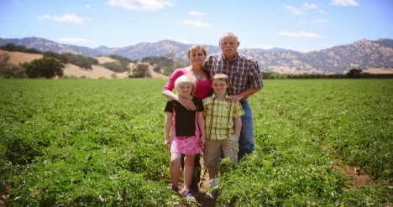

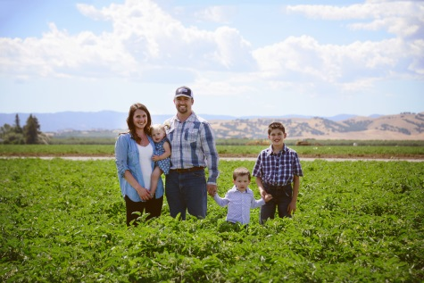
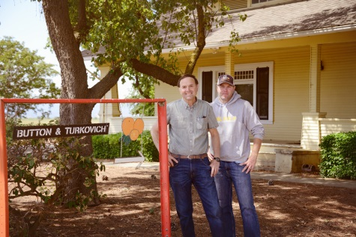

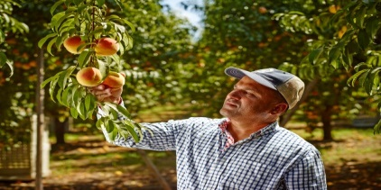
About Us
PCP is an Agricultural Cooperative founded in 1971 and owned by over 160 family-farms located in Central and Northern California. Hundreds of third and fourth generation family farmers partner with us to provide the ripest tomatoes, peaches, apricots, grapes, and pears each harvest. Picked at the peak of flavor and packed under strict United States food safety regulations, our products deliver fresh quality foods.
Our farms are strategically placed near our Processing Plants. For example, conventional tomatoes are grown & picked within a 16-mile radius of our Woodland tomato facility — making the trip from the field to can in less than 4 hours!

Slide 21
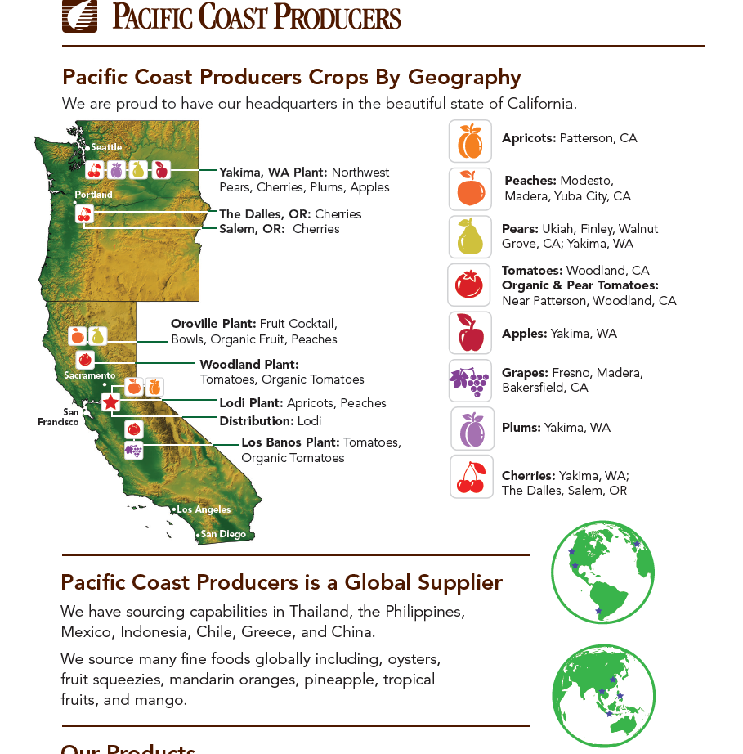
Pacific Cost Producers Crops By Geography

Slide 22

Approved Project List
Thor Evaporator – 1
Thor Evaporator – 2
Boiler
Refrigeration Upgrade
Vertical Hot Breaks
Air Compressor

Slide 23
John Ahrens
Program Director of
Microgrid Competency Center, North America
Schneider Electric

Slide 24
Jingjing Liu
Program Manager
LBNL

Slide 25
LBNL’s related research
Demand Response Research Center
https://buildings.lbl.gov/demand-response
PI: Mary Ann Piette
Led original development of OpenADR in 2002, funded by CEC
CEC CalFlexHub – LF for price response
CPUC DR Potential Study (Phase 4)
DR field demo work
Demand Flexibility metrics benchmarking
Testbeds
Industrial Applications
https://industrialapplications.lbl.gov/
Strategic Energy Management / 50001 Ready
Industrial Energy Systems
US industrial and commercial motor system market assessment
Water-Energy Nexus
CHP
Technical Assistance / Better Plants
Notes:
“Eligible facility” shall include, but not be limited to, a facility that is directly involved in food production and processing, and related support facilities.
Talking Points:
Compare current to proposed requirements for eligible industries
Location
NAICS Codes

Slide 26
Panel Question 1
What barriers or challenges significantly hinder food processing facilities from obtaining a carbon-neutral future in the mid to long term?
What are the biggest opportunities, and how can FPIP help?

Slide 27
Panel Question 2
What are the main opportunities to achieve net peak load reduction in the food processing industry, and how should they be evaluated/scored?

Slide 28
Panel Question 3
How often do food facilities engage and collaborate with their respective (or surrounding) communities?
What strategies can food facilities take to ensure communities receive meaningful benefits from FPIP projects?

Slide 29
Questions and Comments
Type your question/comment in the Q&A window
or
Raise your hand, and you will be called on to unmute yourself.
Introduce yourself by stating your name and affiliation.
Keep questions/comments under 2 minutes to allow time for others.

Slide 30
Panel Q&A

Slide 31
Public Q&A

Slide 32
Ways to Engage
✓Sign up to receive the FPIP Announcements:
  https://public.govdelivery.com/accounts/CNRA/signup/31897
✓ Solicitation Process:
  Solicitation documents, once released, will be available at the CEC funding opportunity website: https://www.energy.ca.gov/fundingopportunities/solicitations
✓ Join the Team:
  The Energy Research and Development Division is hiring! For hiring opportunities at CEC visit: https://www.energy.ca.gov/careers

Slide 33
Next Steps
Please submit written comments by:
E-commenting directly to the docket:
  https://efiling.energy.ca.gov/EComment/EComment.aspx?docketnumber=23-ERDD-05
  Include “Food Production Investment Program” in subject line.
E-mailing to docket@energy.ca.gov by no later than 5:00 p.m. on May 12, 2023
  Include docket number 23-ERDD-05 and “Food Production Investment Program” in subject line.
Mailing a paper copy to:
California Energy Commission
  Docket Unit, MS-4
  Docket No. 23-ERDD-05
  715 P Street, Sacramento, California 95814
CEC staff to compile and consider feedback when developing future solicitations.

Slide 34
Thank You!

