Slide 1
Gas R&D Program FY 2023-2024 Budget Plan
January 24, 2023

Slide 2
Agenda
Welcome and Overview
Staff Presentations and Clarifying Questions
Hydrogen Infrastructure Safety
Building Decarbonization
Entrepreneur Development
Leveraging Federal Opportunities
General Questions and Public Comment
Adjourn

Slide 3
Announcements
This workshop is being recorded and will be posted at:
https://www.energy.ca.gov/events
Gas R&D Budget Plan documents and workshop materials, including this presentation, will be posted at: https://efiling.energy.ca.gov/Lists/DocketLog.aspx?docketnumber=16-PIER-01
Please type your comments and questions in the Q&A window.
Participants will be muted during the presentation.
Sign up for updates on “Energy Research and Development”:​ https://public.govdelivery.com/accounts/CNRA/signup/31719

Slide 4
Introduction
Research and development to support the transition to clean energy, greater reliability, lower costs, and increased safety for Californians.
  Benefits California citizens.
  Not adequately addressed by competitive or regulated entities.
$24 million annual budget, funded by a surcharge on gas consumption in California.
  Energy efficiency, renewable technologies, conservation, environmental issues, and transportation.
  Supports state energy policy.

Slide 5
State Energy Policy Drivers
  SB 32 (2016)
    Aims to reduce GHG emissions to 40% below 1990 levels by 2030.
EO B-55-18 and AB 1279 (2022)
  Establishes statewide goal to achieve carbon neutrality as soon as possible and no later than 2045.
Integrated Energy Policy Report
  Policy recommendations that conserve resources, protect the environment, ensure energy reliability, enhance the state's economy, and protect public health and safety.

Slide 6

Developing Initiatives
Informed by:
Gas R&D objectives
CPUC resolutions
Equity considerations
Discussion with stakeholders
  Docket: https://efiling.energy.ca.gov/Lists/DocketLog.aspx?docketnumber=16-PIER-01

Slide 7
Developing Initiatives
CPUC Resolution G-3584
For FY 2022-2023 and subsequent plans, CEC should:
Consider the findings from the Assembly Bill 3232 (Friedman, 2018) report.
Consider the findings from the 2019-2020 initiative: Long-Term Technological Development Strategy to Meet Aggressive Statewide Decarbonization Goals.

Slide 8
Developing Initiatives
Diversity & Equity Commitment
To meet CECs commitment to diversity and equity, Energy Commission staff:
Engage with disadvantaged and underrepresented groups throughout the state.
Improve CEC's application and grant management process to relieve administrative burdens.
Continue to encourage participation at community meetings.

Slide 9
Developing Initiatives
Stakeholder Feedback
The California Energy Commission would like to hear your thoughts on the proposed initiatives.
Comments can be provided to the PIER Gas Docket until January 31, 2023: https://efiling.energy.ca.gov/Ecomment/Ecomment.aspx?docketnumber=16-PIER-01

Slide 10
Initiative Themes
FY 2023-24 proposed research initiatives are framed around decarbonization.
Initiative Themes:
Hydrogen Leakage Mitigation
Building Decarbonization
Entrepreneur Development
Leveraging Cost Share Opportunities
Notes:
briefly touch on how these initiatives support decarbonization

Slide 11
Hydrogen Leakage Detection, Monitoring, and Prevention
Topic Area: Hydrogen Leakage Mitigation
Presenters: Sean Anayah, Peter Chen, and Qing Tian

Slide 12
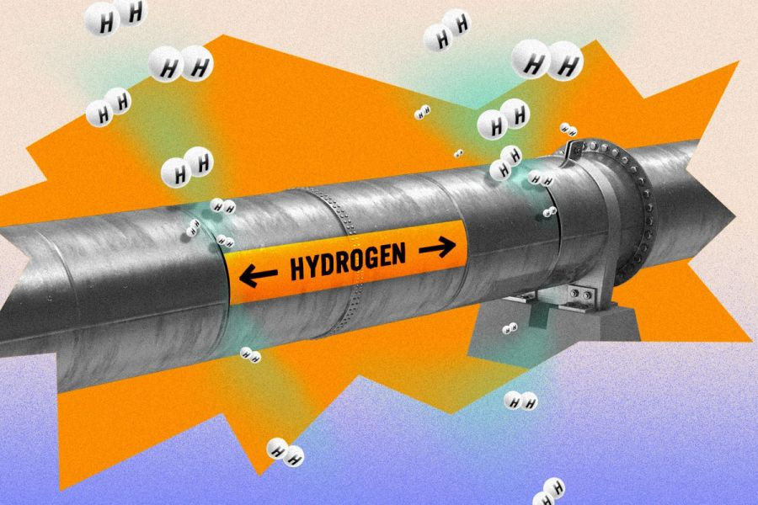
Background
New investments underway to scale-up clean hydrogen for difficult-to-decarbonize sectors.
Hydrogen leakage can lead to safety risks, economic loss, and indirect global warming impacts.
Limited data on hydrogen leakage rates.
Gaps exist in technologies and methods for detection at sub-ppm levels, quantification, monitoring, and mitigation.
Source: Emerging Tech Brew
Notes:
Hydrogen has potential to support decarbonization of key sectors including heavy transportation, industrial processes, power generation, and the gas system. Many public and private investments are underway to scale-up and lower costs of clean hydrogen production, distribution, and end-use in California. However, without appropriate mitigation measures, this expansion of hydrogen infrastructure can also exacerbate hydrogen leakage, which can lead to safety risks, economic losses, and indirect global warming impacts.
There is limited data on hydrogen leakage rates for existing and future production, distribution, and end-use pathways.
Gaps exist in commercially available hydrogen sensor technology capable of low detection thresholds and methods for preventing and mitigating leakage throughout the supply chain.
Recent climate science has highlighted hydrogen’s indirect global warming effect. When leaked into the atmosphere, hydrogen breaks down and interacts with other molecules in a way that can increase the concentrations of greenhouse gases like methane, ozone, and water vapor. Hydrogen leakage also results in safety risks and loss of a high value fuel.
Recent climate science has highlighted hydrogen’s indirect global warming effect by extending the lifetime of methane and other GHGs in the atmosphere. Hydrogen leakage also results in safety risks and loss of a high value fuel.

Slide 13
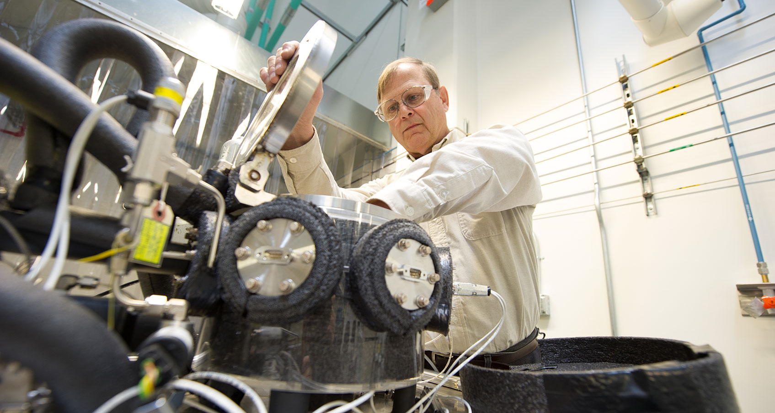
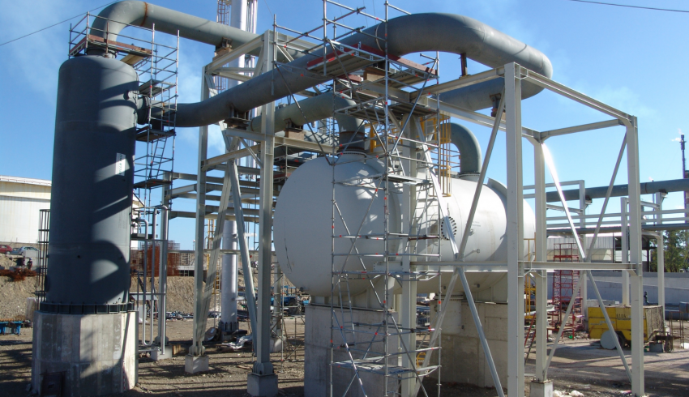
Innovations
Conduct R&D to improve the sensitivity, accuracy, durability, scalability, and cost of hydrogen detection and quantification technologies.
Gather data to improve understanding of hydrogen leakage rates along the supply chain (e.g., production, delivery, storage, end-uses).
Develop hydrogen leakage prevention solutions for key points in the supply chain where leaks may be concentrated.
Source: NREL
Source: Columbia University
Notes:
This initiative consist of 3 primary elements:
Conduct research to improve the sensitivity, accuracy, durability, and cost of hydrogen sensors and leak detection technologies.
Gather data to improve understanding of hydrogen leakage rates from specific points in the supply chain (i.e., production, delivery, storage, refueling stations).
Develop hydrogen leakage prevention solutions (can include technologies or strategies/mitigation plans) for key points in the supply chain where leaks may be concentrated.

Slide 14
Benefits
Advance hydrogen leakage detection, quantification, and prevention products to support emerging hydrogen supply chains.
Obtain data to inform and implement mitigation and prevention strategies.
Minimize safety, economic, and indirect global warming impacts of leakage as hydrogen scales up as a decarbonization pathway.
Notes:
The initiative will help advance hydrogen sensor products to market that can facilitate low-cost leakage monitoring along the supply chain.
Better understand hydrogen leakage rates and implement strategies to mitigate and prevent leakage from critical points.
Minimize GHG impacts and ensure safety as efforts continue to scale-up hydrogen in California.

Slide 15
Air Pollutant Exposure Assessment in California Residences
Topic Area: Building Decarbonization
Presenters: Maninder Thind & Susan Wilhelm
Notes:
The topic of this initiative is air pollutant exposure assessment in California residences to illuminate health implications of different fuels—namely fossil gas and alternatives such as electricity.
The goal of this work is to provide a basis for quantifying health impacts of decarbonization.

Slide 16
Background
- Exposure data is extremely limited.
- Difficult to characterize due to complexity of problem.
- Support building decarbonization, maximization of health benefits.
- Exposure assessment framework will advance accounting for benefits.
Notes:
Currently, data on exposures to cooking-related indoor air pollutants in California residences is extremely limited. The paucity of exposure data derives in part from the complexity of the problem, which involves human behaviors related to, for example, cooking and ventilation; as well as technology attributes associated with air pollution emissions. [Picture showing measurement devices indoors and data collection]
To plan and execute building decarbonization in a manner that maximizes health and equity benefits, it is critical to understand the distribution of air pollution exposures and associated health impacts across a range of housing types, climate zones, and cultural and sociodemographic contexts. [Picture showing indoor air pollution/houses]
The proposed initiative will advance an exposure assessment framework that contributes to quantification of health benefits of residential electrification in California as well as monetization of associated health benefits. This initiative will deliver a more complete and robust exposure assessment framework than a related initiative from FY 2021-2022 alone can support.
This initiative will be coordinated with EPIC 4 efforts (initiative 43, Evaluating Air Quality, Health, and Equity in Clean Energy Solutions) to deliver an indoor health assessment tool to aid policymakers in quantifying benefits of current and future electrification.
This initiative addresses CPUC’s direction in Resolution G-3571 (p. 15) to support research to “Quantify and document impacts to indoor air quality from natural gas appliances and the potential technically feasible improvements and potential risks to indoor air quality that could be achieved from fuel blending or electrification.”

Slide 17
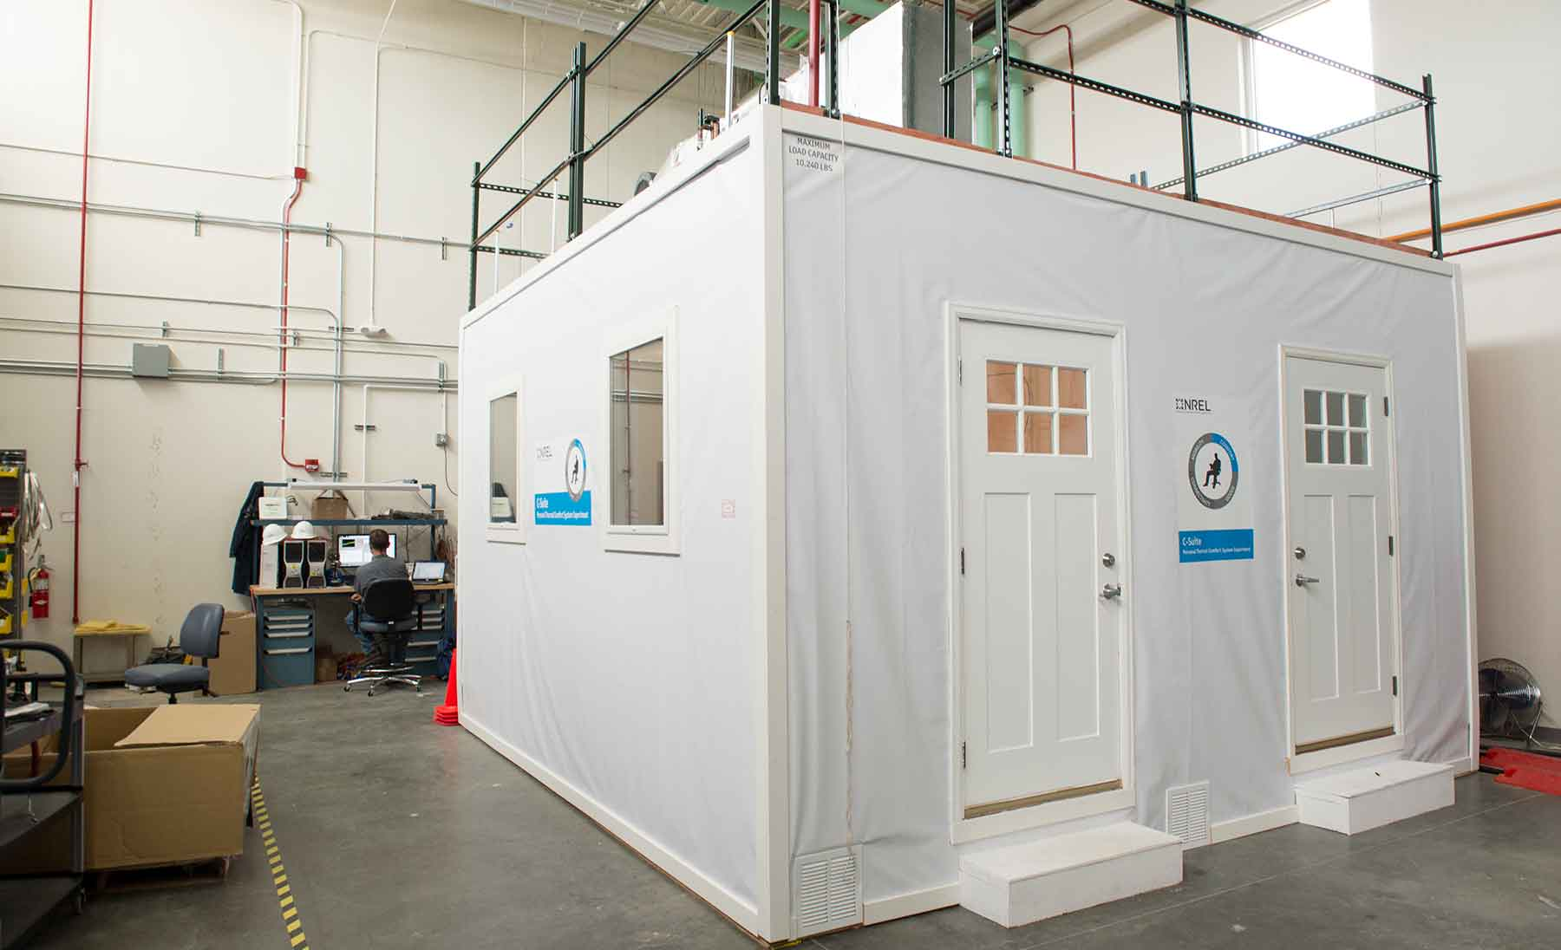

Innovations
Rigorous basis for quantitative exposure assessment: laboratory and field measurements.
Laboratory work will link cooking patterns to concentrations of health-damaging pollutants (e.g., PM_{2.5}, NO₂) in controlled settings.
Fieldwork needed to characterize factors that are strong determinants of exposures (e.g., appliance use patterns, ventilation).
Exposure framework will enable quantification of health benefits across diverse households.
Source: NREL
Source: PSE Healthy Energy
Notes:
[first bullet] One of the big innovations here, which responds to input we got at a public workshop in 2022, is that this initiative will involve both laboratory and field research. Given the diversity of California households and what goes on in them, this two-pronged approach is our best bet at cost-effectively characterizing determinants of exposure in a way that lends itself to quantitative assessment.
[second bullet] Lab work will link cooking patterns to emissions and concentrations of health-damaging pollutants in controlled settings.
[third bullet] Fieldwork will characterize factors that strongly influence exposures, including both building attributes and behaviors associated with appliance and ventilation use.
[fourth bullet] This initiative will deliver an exposure assessment framework that enables quantification of health benefits associated with kitchen electrification across diverse California households.

Slide 18
Benefits
Support building decarbonization policy that maximizes health and equity benefits.
Support future efforts to monetize health impacts of electrification (possible leverage point for funding).
Inform evaluation of impacts of building electrification programs.
Notes:
Benefits:
Support for building decarbonization in a way that maximizes local benefits– health, equity
Support future efforts to monetize health impacts– as noted before this be a leverage point
Also, we may have the opportunity to partner wth building electrification programs to empirically quantify benefits
==

Slide 19
California Sustainable Energy Entrepreneur Development (CalSEED) – Low Carbon Gas
Entrepreneur Development
Presenter: Michael Ferreira

Slide 20

Background
Modeled after EPIC-funded CalSEED:
  Supported over 90 startups; over $190M of follow-on funding.
Provide starting capital to develop proofs-of-concept into prototypes.
Focus on Technology Readiness Levels 2-4.
Initiated 2021 – Program begins 2023, 1st Solicitation release 2024.
Notes:
This initiative builds on the CalSEED program established under the first three EPIC investments plans by funding a complimentary small grants program for technologies that decarbonize existing uses of fossil gas.
The EPIC funded program started in 2016 and has since supported over 90 startups who have gone on to raise over $190 million in follow on funding.
The CalSEED Low Carbon Gas program will provide entrepreneurs starting capital in the form of $150,000 grants to develop their ideas into proof of concepts, as well as mentoring, technical consulting and business development services.
This program will fund technologies that are at a Technical Readiness Level of 2-4, for innovations to move from a collection of scientific principles and experiments to validating the basic functionality of a prototype or pilot project, ultimately demonstrating proof of concept and performance. The focus will be on scientific breakthroughs that are early stage, higher risk, and higher reward.

Slide 21
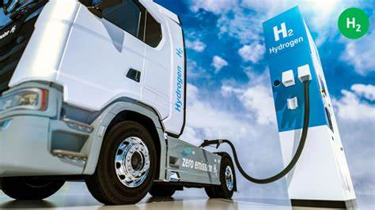
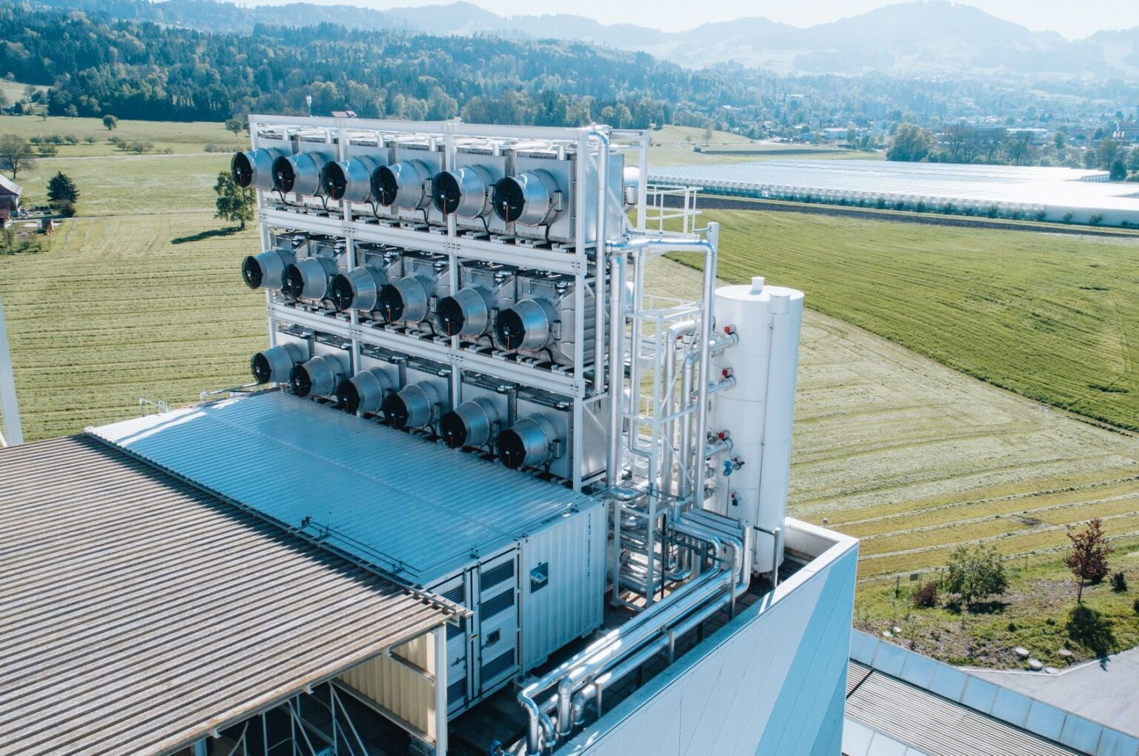
Innovations
Pathway for intellectual property to go from lab to commercial venture.
Possible technology areas :
  Industrial processes
  Carbon capture
  Medium- and heavy-duty transportation using hydrogen
  Hydrogen production and infrastructure
Source: Hydrogen-Central
Source: Climeworks
Notes:
Early stage funding is critical in cultivating a robust pipeline of clean energy entrepreneurship in the state. This small grant program fills a crucial gap in cleantech funding as Venture capital usually favors later-stage, less risky innovations.
Providing small amounts of funding can set up these companies to be successful when applying to larger funding opportunities and attracting interest and investment from the private sector. In addition, this program provides a path for intellectual property developed at research institutions to spin out of the lab and into commercial ventures.
Technology areas of focus may include hard to electrify opportunities such as industrial heating, medium- and heavy-duty transportation as well as technologies that can improve gas infrastructure safety.

Slide 22
Benefits
Advancing/supporting robust cleantech ecosystem in California.
Increased safety from technologies that can predict, detect, and repair gas infrastructure threats.
Cost effective solutions to decarbonize hard-to-electrify existing uses of fossil gas.
Improved air quality through development of fossil gas alternatives.
Notes:
One overall benefit of the CalSEED LCG program is advancing the clean energy economy by funding promising cleantech start ups in the early stage of development.
Additionally, by decarbonizing the fossil gas sector, this program will lead to improved health from reduced GHG emissions and criteria air pollutants as well as greater safety from technologies that can improve infrastructure

Slide 23
Federal and Private Cost Share
Topic Area: Cross Cutting
Presenter: Claire Sweeney

Slide 24
Background
Modeled after EPIC-funded federal cost share solicitation:
  Successful in leveraging > $100M in DOE funds.
Federal solicitations require 20% to 50% cost share.
Private funding sources will also be allowed:
  Examples: Breakthrough Energy Ventures, ClimateWorks Foundation.
Providing cost share opportunities attracts funding and projects to California.
GFO
Add FOAs
Proposal Review
NOPA-phase 1
DOE Award
NOPA-phase 2
CEC grant approval
Notes:
This is a new initiative for the Gas R&D program, and we are modeling it after our EPIC-funded Federal cost share initiative, through which the CEC has seen success with cost-share opportunities in the past. For example, in 2020, the CEC awarded $3 million in EPIC program cost-share funds to LBNL for a U.S. DOE’s Energy-Water Desalination Hub, which is a five-year $100 million contract. Developing clean energy technologies sometimes requires more funding than a company or project can secure from a single source. Additionally, federal funding opportunities require cost-share, such as the opportunities available in the Federal Infrastructure Investment Jobs Act and the Inflation Reduction Act of 2022. Here is diagram of the steps in the CEC cost share award process.

Slide 25
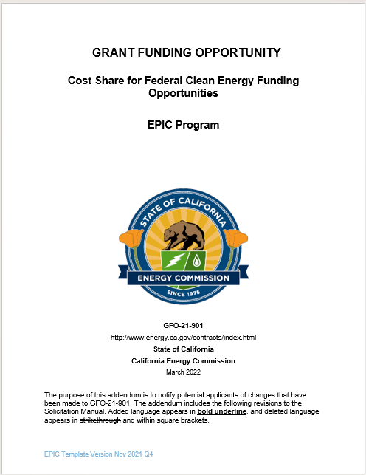
Innovations
Opportunity to fund innovations in industrial decarbonization, transportation, other areas aligned with the Gas R&D program.
Federal Infrastructure Investment and Jobs Act (IIJA) and the Inflation Reduction Act (IRA) have potential funding:
  Regional Clean Hydrogen Hub - ARCH₂ ES (estimated $1B/award)¹
  Regional Direct Air Capture Hub (estimated $3M to $500M/award)²
  Industrial Decarbonization and Environmental Reduction Demonstration to Deployment (estimated $35M-$500M/award)³
Source: CEC Website
(Example of EPIC Cost Share GFO)
¹ Clean H2 Hub FOA: 0002779
² Regional Direct Air Capture Hub FOA: DE-FOA-0002735
³ Notice of Intent: DE-FOA-0002935
Notes:
A cost-share initiative would increase the impact of the Gas R&D Program by allowing us to partially fund more projects than would otherwise be possible while also helping to attract funds to California from private and federal funding sources. We see a lot of potential in industrial decarbonization and transportation, which are promising cost share areas that are aligned with Gas program goals. The Federal Infrastructure Investment Jobs Act and the Inflation Reduction Act are examples of the type of federal funding opportunities that we can leverage. Potential opportunities for cost share funding include supporting Regional Clean Hydrogen Hub, Regional Direct Air Capture Hub, and Industrial Decarbonization grants. The picture on the right shows the current federal cost share GFO using Electric Program Investment Charge funding.

Slide 26
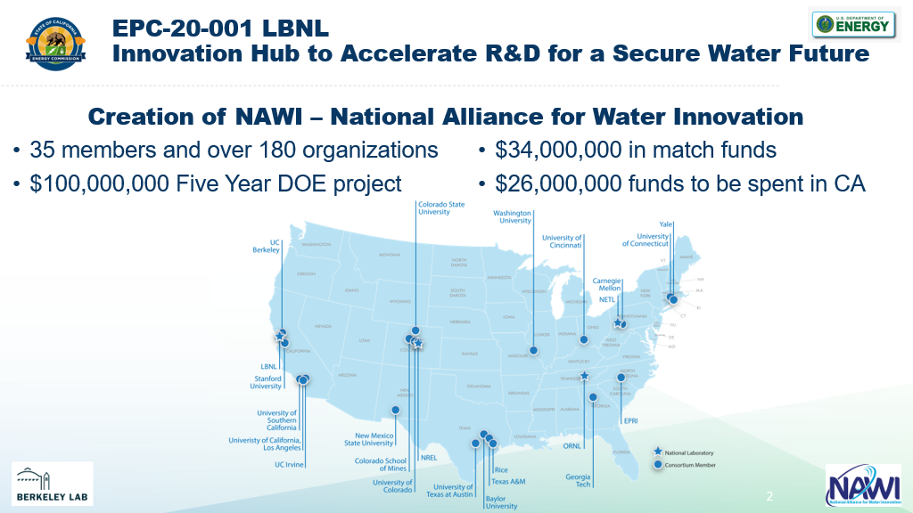
Benefits
Increase impact of state funding.
Attract funding and projects to California, resulting in market growth and jobs.
Potential to provide localized benefits, such as air quality improvement.
Support companies/entrepreneurs/researchers developing clean energy technologies.
Coordinate/collaborate with federal agencies on mutually beneficial projects.
Increase competitiveness of California-based organizations.
Source: National Alliance for Water Innovation
(Example of EPIC Cost Share)
Notes:
To recap, the CEC has seen success with cost-share opportunities in the past through our EPIC program and we see the same potential in using state gas R&D funding to leverage federal and private funding and increasing the overall impact to the state. This could result in market growth and creating jobs, providing localized benefits such as local air quality improvement, and supporting companies, entrepreneurs, and researchers to develop clean energy technologies. Other benefits include coordination and collaboration with federal agencies on projects with mutual interest and increasing the competitiveness of California-based organizations through leveraging additional funding sources. The picture on the right illustrates the leverage potential. The CEC provided $3M in cost-share funding and this enabled the National Alliance for Water Innovation to obtain a $100M grant from the DOE.

Slide 27
Possible Research Initiative Topics:
FY 2024-2025
Gas Decommissioning: Supporting equitable, safe, and cost-effective decarbonization of California's gas system.
Gas System Safety: Deploying innovations to detect and reduce fugitive emissions.
Transportation: Advancing innovative onboard hydrogen storage and fuel system solutions.
Renewable Generation: Enhancing fuel-flexible power generation.
Entrepreneur Development: Continuing investments in CalSEED – Low Carbon Gas.
Notes:
Before we move on to public comment, we wanted to share some of the topics that we are thinking about for the next budget plan. These topics may change and we will conduct further scoping to develop selected topics, but wanted to share them as part of our slightly longer term plan for what we plan on further developing.
For Gas Decommissioning, our research concept focuses on supporting….

Slide 28
Questions for Stakeholders
What are some resources that can help inform the research initiatives?
Please provide a summary of use cases or opportunities that would benefit from these proposed initiatives.
Are there any recommended research approaches that could strengthen any of the initiatives?
What are example performance metrics or targets that could be used to determine project success?
Are there other priority areas that the Gas R&D Program should consider? If so, please provide the proposed scope and a justification, including the urgency for the topic.

Slide 29

Public Comments
Please submit your question or comment in the Question and Answers window.
  ​Facilitator will read questions and Team Leads will provide responses.

Slide 30
Next Steps
Comments can be provided to the PIER Gas Docket until January 31, 2023: https://efiling.energy.ca.gov/Ecomment/Ecomment.aspx?docketnumber=16-PIER-01
  Energy Commission staff will consider these comments while developing the FY 2023-24 Gas R&D Proposed Budget Plan.
Proposed Budget Plan will be submitted to California Public Utilities Commission for consideration by April 1, 2023.
Solicitations derived from this Budget Plan may be released shortly thereafter, contingent on California Public Utilities Commission approval.

Slide 31

Connect with Us
The Energy Commission can be found on most social media platforms: Facebook, YouTube, Twitter, and LinkedIn.
Energize Innovation provides access to the CEC R&D project resource libraries, tools, and databases.
www.energizeinnovation.fund/

Slide 32
Thank You!

