Slide 1
Assigned Commissioner’s Ruling Seeking Comments on Improving Self-Generation Incentive Program Equity Outcomes and Assembly Bill 209 Implementation
Proceeding No. R.20-05-022
Presented to Disadvantaged Community Advisory Group (DACAG)
Gabe Petlin, CPUC Energy Division, Supervisor Grid Planning and Energy Storage
November 18, 2022

Slide 2
About the Self-Generation Incentive Program (SGIP)
SGIP, established in 2001,provides financial incentives for the installation of eligible behind-the-meter (BTM) distributed generation and energy storage technologies that meet all or a portion of a customer’s electricity needs
Over the years, the program focus has transitioned from peak-load reduction to greenhouse gas (GHG) reductions and resiliency as climate change has moved to the forefront of statewide public policy.
In 2017, Decision (D.) 17-10-004 established the SGIP Equity Budget to provide funding for behind-the-meter storage for low-income and disadvantaged Californians.
The Equity Resiliency Budget was established in 2019 by D.19-09-027 with the goal of providing critical resiliency needs to Californians living in areas heavily impacted by wildfires who are medically vulnerable, low-income, or disadvantaged.
In 2020, the Commission issued D.20-01-021, which authorized the collection of ratepayer funds totaling $166 million per year from 2020 to 2024 across the four program administrators, pursuant to SB 700 (Wiener, 2018). This decision increased the financial incentive budget for energy storage technologies to 88% of total SGIP funding.

Slide 3
Problem Statement: SGIP Equity Outcomes are Underperforming –How Can SGIP Do Better?
Approx. 1,000 low-income projects across all budget categories and all application stages (included cancelled projects) out of approx. 56,000 residential projects.
The Equity Resiliency Budget has seen over 6,100 projects completed and its funds exhausted. This budget pays $1/watt incentive.
  Low-income households account for about 1% of all paid residential Equity Resiliency projects, compared to Medical Baseline customers who account for about 66% of all paid residential Equity Resiliency projects.
In contrast, a second SGIP budget category, the Equity Budget is not fully subscribed. As of early October 2022, almost 50% of the Equity Budget remains unused ($11.6 million) and only 10 projects have been completed in this budget category. This incentive is $0.85/watt.
Furthermore, low-income customer projects have a cancellation rate across all budget categories of almost 50%, twice as high as residential projects that are not low-income.
Identifying the barriers to low income and tribal customer participation in SGIP is critical.

Slide 4
AB 209 Adds $900mm to SGIP with 70% Going to Low Income Customers
In September 2022, Governor Newsom approved AB 209, which amends Pub. Util. Code Section 379.6 and adds Section 379.10 to guide legislatively appropriated state General Fund monies into solar and storage incentives through the SGIP for California residential customers.
The Legislature set aside $900 million to the Commission starting in Fiscal Year 2023-24 as referenced in Budget Addendum to the 2022 California State Budget.
AB 209 states that 70% ($630 million) of the funding must be directed towards funding incentives for eligible low-income residential customers who install either new BTM solar photovoltaic systems paired with energy storage systems or new energy storage systems. This funding will be referred to as AB 209 Low-Income Incentives throughout this document.
AB 209 further specifies that 30% ($270 million) of the funding must be directed towards incentives for residential customers who install new behind-the-meter energy storage systems. (not income restricted)
Given the large amount of funding from the 2022 California State Budget and the experience gained from implementing the Equity Resilience and Equity budgets, and the program overall, the CPUC issued an Assigned Commissioner Ruling (ACR) in October seeking comments from parties on implementing the AB 209 incentives and issues related to improving outcomes for low-income customers.

Slide 5
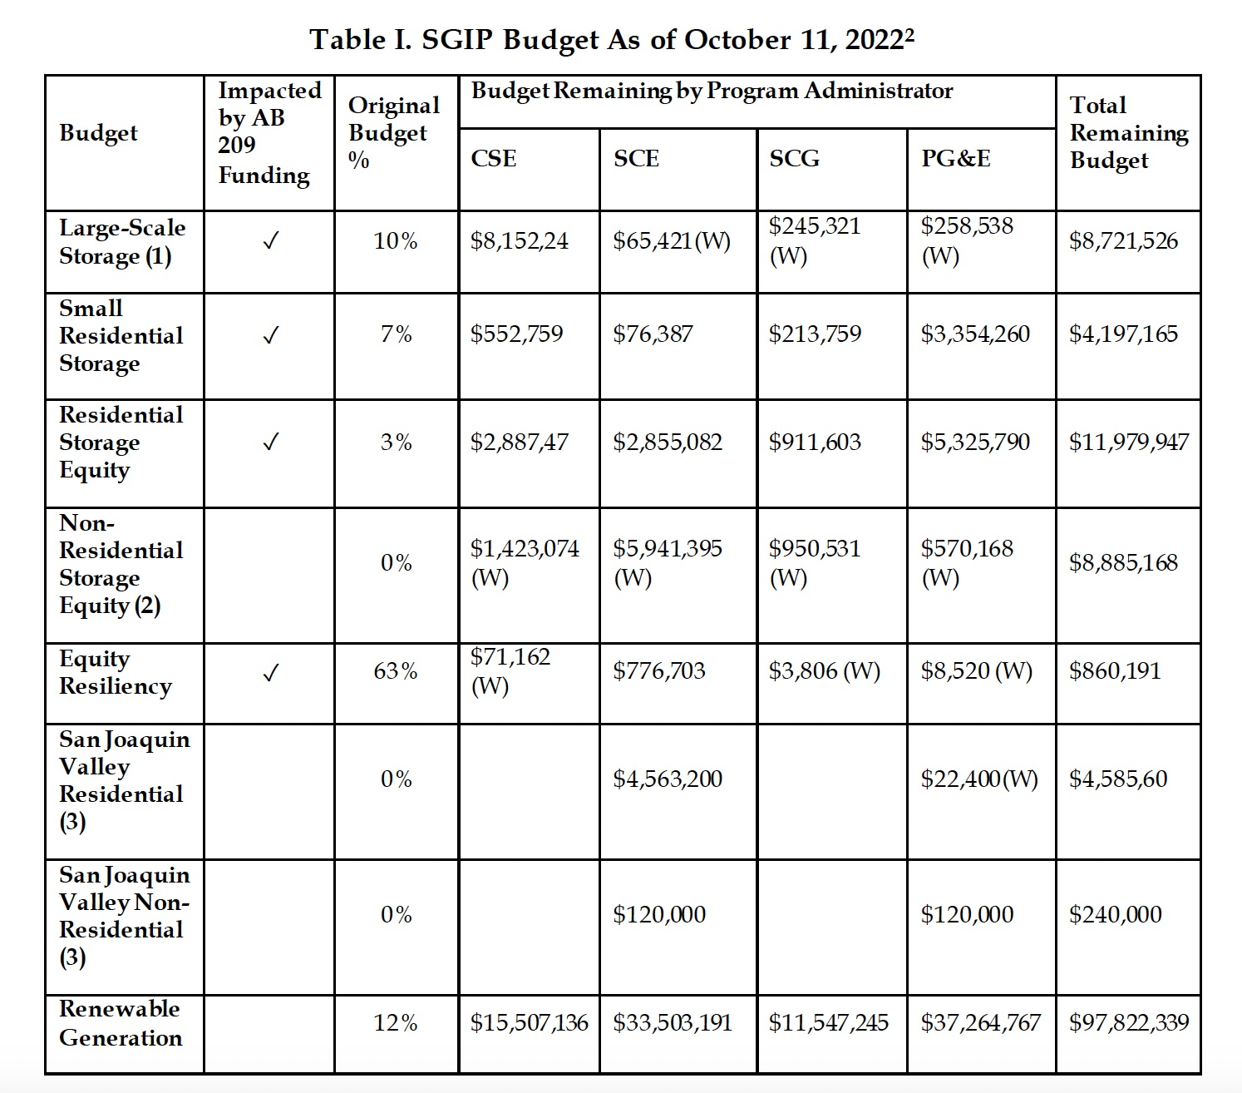
Four Residential SGIP Budget Categories Potentially Impacted by AB 209 Funds Starting July 1, 2023
Table Notes:
W - Waitlist status
(1) Includes residential storage >= 10 Kw –only residential storage is impacted by AB 209 funding.
(2) 2020-2024 authorized collections suspend further collections for non-residential equity storage once existing carryover is exhausted.
(3) Pursuant to D.19-09-027, SJV Pilot Program has a $10 million set-aside funded from SCE and PG&E’s unused non-residential equity budget.
Note: Available budget amounts may change frequently due to project cancelations and new incentive reservations.

Slide 6
SGIP ACR: Eight Issue Areas and 38 Questions
Ruling directs parties to respond to questions focused on implementing the new AB 209 funding source and understanding the primary obstacles to low-income household participation as well as potential programmatic changes that could lead to improved project completion for SGIP low-income customers as well as a variety of other programmatic improvements.
Overarching question is how to allocate $900mm across residential budget categories.
  Residential Low-Income Eligibility Criteria Across SGIP Budget Categories
  Paying for Upfront System Costs
  Improving Participation of Tribal Customers
  Equity Resiliency Budget Category
  Incentive levels for General Market Customers
  Operational Requirements for SGIP and AB 209 Projects
  Program Structure for AB 209 Funds
  Other SGIP Program Changes

Slide 7
Residential Low-Income Eligibility Criteria Across SGIP Budget Categories
SGIP PAs and developers have shared informally and anecdotally that the requirement that participants reside in a resale restricted house and the associated documentation has been especially onerous.
Eligible multifamily housing is defined as all of the following:
  At least five rental units. • Operated to provide deed-restricted low-income housing.
  Either located in a DAC or at least 80% of households ≤ 60% of area median income.
Eligible single-family criteria are defined as all of the following:
  Single-family low-income residence.
  Sold at an affordable housing cost to a low-income household.
  Subject to income verification and a resale restriction or qualifying equity sharing agreement for which the homeowner does not receive a greater share of equity than described in paragraph (2) of subdivision (c) of Section 65915 of the Government Code, with a public entity or nonprofit housing provider organized under Section 501(c)(3) of the Internal Revenue Code that has as its stated purpose in its articles of incorporation on file with the office of the Secretary of State to provide affordable housing to lower income households

Slide 8
Types of Questions on Residential Low-Income Eligibility Criteria
2/3. Financial or non-financial barriers for low-income residential customers wishing to participate in SGIP’s Equity or Equity Resiliency Budgets and barriers for developers to enlist low-income customers.
4. Potential modifications of SGIP eligibility criteria for low-income residential customers?
  * How to define low income * Relevant state and federal definitions
  * Documentation required, verification and leveraging external programs
  * Self-Attestations and safeguards or verification
  * Deed restricted or resale restricted residence
5. Single low-income definition or sliding scale and corresponding incentive levels
6. Are changes needed to the non-residential host customer eligibility requirements for Equity and/or Equity Resiliency Budgets?

Slide 9
Questions on Paying for Upfront System Costs
SGIP customers pay upfront or finance their projects and receive the incentive payment after the system is built and operational. If a low-income customer lacks the cash or credit needed to pay the upfront system costs, this could be a barrier to low-income participation.
7. Should the Commission consider allowing entire or partial upfront payments on behalf of the customer prior to installation for energy storage systems, including solar where relevant, for low-income households? If so, what mechanism should be used to provide these payments and to whom (e.g., the developer, the host customer, or some other party)? What learnings from the PG&E and SCE upfront payments pilots are relevant?
8. Are there other program changes that should be considered to mitigate financial barriers and how should the change be implemented?

Slide 10
Next Steps and Timeline
December 2 – Opening Comments Due
December 16 – Reply Comments Due
Q1 2023 – Workshop if necessary
Q1 2023 – Proposed Decision (tentative)
Q2 2023 – Decision (tentative)
Q2 2023 – Implementation of program changes, e.g. Advice Letters, Handbook updates, website and database updates etc.
July 1, 2023 – AB 209 new funding is available for customer applications to SGIP.
The overarching goal is seamless integration of new funding and program improvements into the SGIP program.

Slide 11
Contact Information
CPUC SGIP Staff:
Gabriel.Petlin@cpuc.ca.gov
Fang.Yu.Hu@cpuc.ca.gov
Thank you !

