Slide 1




Electricity Supply Strategic Reliability Reserve
CALIFORNIA DEPARTMENT OF WATER RESOURCES
CEC Business Meeting, November 16, 2022
Jorge Quintero, P.E.

Slide 2
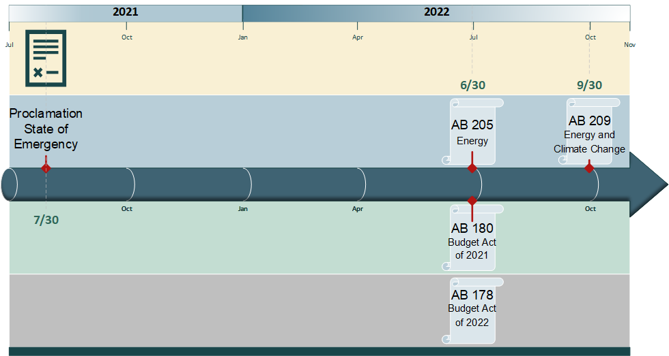
Legislative Drivers

Slide 3
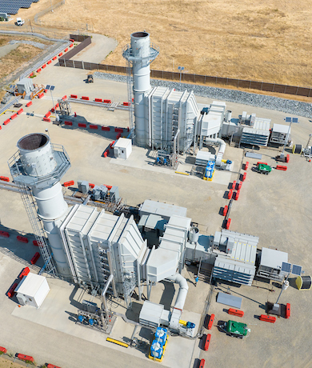
California Department of Water Resources (DWR)
Tasked to deploy and manage additional energy resources to safeguard the State’s energy
grid through a newly created
Strategic Reliability Reserve

Slide 4
California Benefits from Electricity Supply Strategic Reliability Reserve
Acts as insurance policy and safeguards the statewide electrical grid
Provides additional energy reserves during extreme and combined events (heat waves, wildfires, and droughts)
Helps to avoid power shortages and outages for millions of Californians
Supports California’s transition to a clean energy future

Slide 5
DWR’s Role
Identify, prioritize and select new generation projects
Develop/execute contracts and oversee engineering, procurement and construction of projects
Implement state certification and environmental compliance
Administer Electricity Supply Strategic Reliability Reserve Fund
Coordinate with State agencies (CAISO, CARB, CEC, CPUC, SWRCB, etc.) and report progress

Slide 6




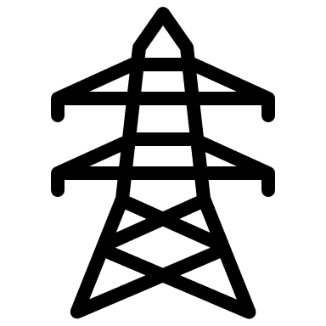
Eligible Types of Projects
Energy storage
≥ 20 MW
Extended Operations of
Retiring Facilities
Emergency & Temporary Power Generators > 5MW
Zero-Emission
Fuel Technology Generation
Import Energy
& Import Capacity Products

Slide 7
2022 Investments
200 MW of emergency and temporary power generators
1,400 MW of imported energy / capacity imports

Slide 8
Planned Investments
(2023 and beyond)
360 MW of emergency and temporary power generators
2,850 MW extended operations of retiring facilities

Slide 9
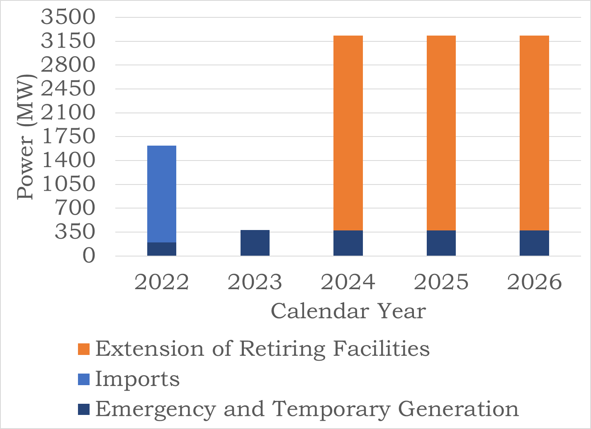
Electricity Supply Strategic Reliability Reserve MW

Slide 10
Next Reporting Update
Written report to the Joint Legislative Budget Committee January 31, 2023
Quarterly Update at the February 2023 CEC Business Meeting

Slide 11




Follow us on social media
CADWR
CA_DWR
calwater
cadepartmentofwaterresources

