Slide 1
Item 15: Zero-Emission Drayage Truck and Infrastructure Pilot Project (GFO-20-606)
October 12, 2022 Business Meeting
Marc Perry, Energy Commission Specialist I
Fuels and Transportation Division
Medium- and Heavy-Duty Zero-Emission Technologies Branch

Slide 2
Benefits to Californians
Reduced emissions
Increased economic activity
Large-scale infrastructure demonstration

Slide 3
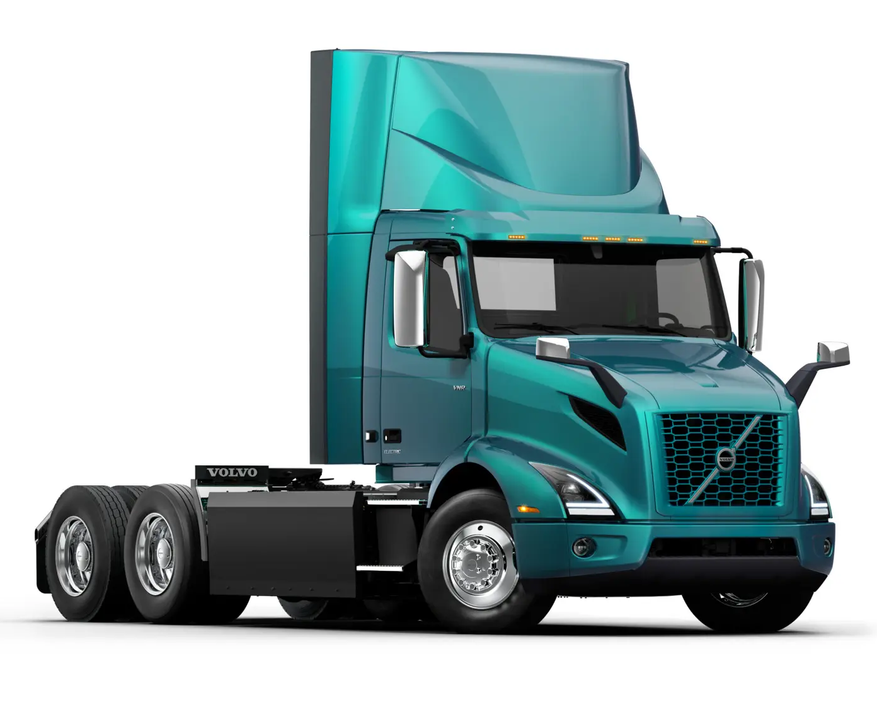

Overview of San Joaquin Valley Air Pollution Control District (SJVAPCD) (ZVI-22-014)
25+ Direct Current Fast Chargers
Battery Electric Storage System
Renewable Energy Generation and Distributed Energy Resources
Workforce Training & Development
Credit: Volvo Trucks North America

Slide 4
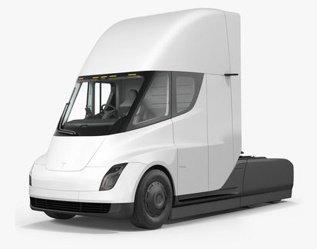

Overview of SJVAPCD (ZVI-22-015)
8 Direct Current Fast Chargers
Battery Electric Storage System
Workforce Training & Development
Credit: Tesla

Slide 5
Staff Recommendation
APPROVE​
Two grant agreements with SJVAPCD.
ADOPT​
Staff’s determination that the two actions are exempt from CEQA.

