Slide 1
Advancing Precipitation Enhancement Strategies
Request for Comments on Forthcoming Solicitation
Energy-Related Environmental Research
Energy Research & Development Division
September 29, 2022

Slide 2
Housekeeping
All participants muted on Zoom (until Q&A)
Zoom recording
Comments and questions
  Please use “Q&A” feature for substantive comments and questions (not chat).
  Please reserve the “Chat” feature for technical issues, etc.

Slide 3
Why We Are Seeking Your Input?
Forthcoming Grant Funding Opportunity: up to $2M to advance the science and practice of precipitation enhancement for increasing hydropower potential and enhancing water resources for the electricity sector more broadly.
To ensure high-impact research, seeking input to inform solicitation development.

Slide 4
Workshop Agenda
Background on EPIC funding program
Initial ideas regarding scope and focus of anticipated solicitation
Seek input from stakeholders on specific discussion questions regarding proposed research.
Input from today’s workshop plus public comments (oral and/or written comments) will help shape the Grant Funding Opportunity.

Slide 5
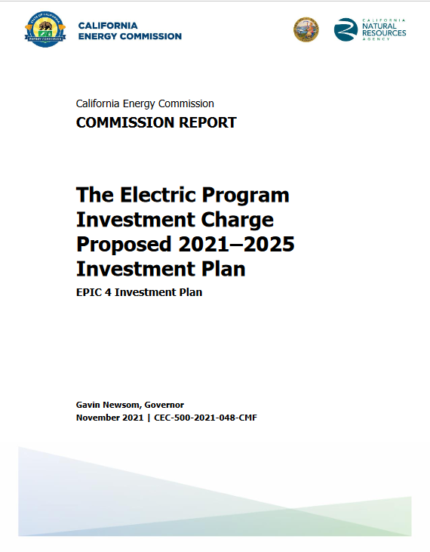
EPIC Research and Development Program
Proposed research supports the CEC’s EPIC 4 Investment Plan:
Initiative 44. Integrating Climate Resilience in Electricity System Planning (pp. 215-221)
To access report: https://www.energy.ca.gov/publications/2021/electric-program-investment-charge-proposed-2021-2025-investment-plan-epic-4
5

Slide 6
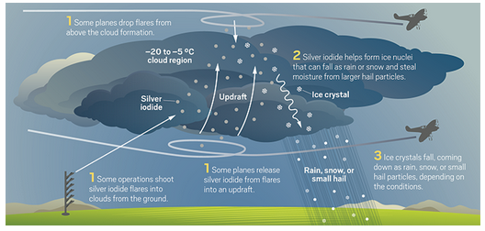
Research Context
Cloud seeding operations conducted for more than 70 years
Recent scientific advances enable improved verification and modeling

Slide 7
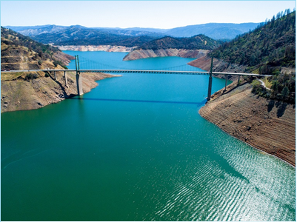

Research Motivation
Electricity Sector can benefit from increase precipitation and surface run-off
  Hydroelectric power: an important source of zero-carbon, dispatchable electricity
  Run-off captured to ease electricity demand
Lake Oroville, May 2021.
Source: DWR (2021) https://water.ca.gov/News/Blog/2021/July/Oroville-Update-7-9-2021

Slide 8
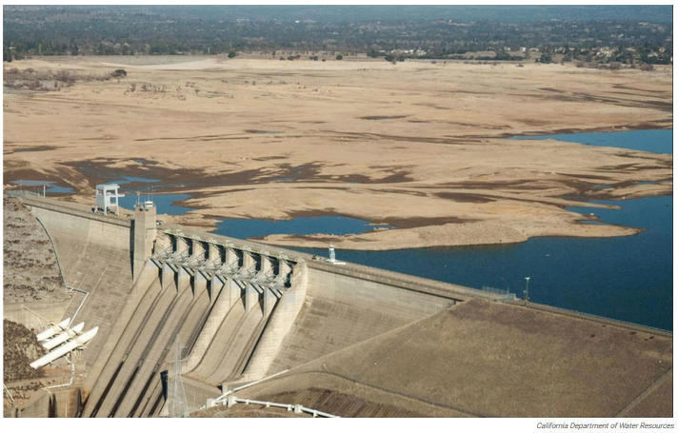
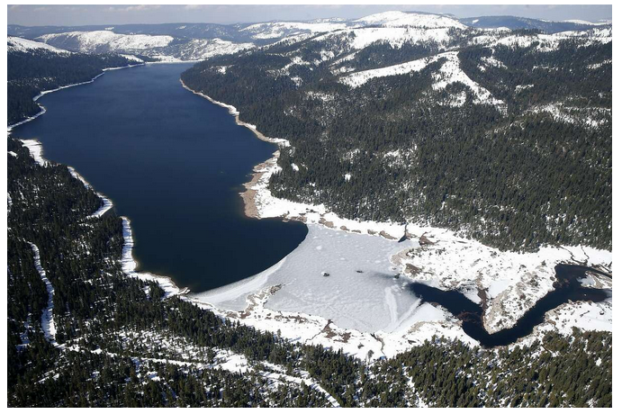
Purpose of Forthcoming Solicitation
Advance science-based strategies for precipitation enhancement to increase hydropower potential and water resources for the electricity sector
  Improve understanding of efficacy and benefits
  Contribute to more effective cloud-seeding practices in a changing climate
Notes:
First picture: Folsom – dry in Jan 2014. Source: DWR
Second picture:
French Meadows Reservoir (part of the Middle Fork American River watershed). Managed by Placer County Agency.
2017 – wet winter after the drought brought reservoirs brimming at levels not seen in decades.
source- The Chronicle (https://www.sfchronicle.com/business/article/Winter-rains-boost-hydropower-reduce-greenhouse-11013172.php)

Slide 9
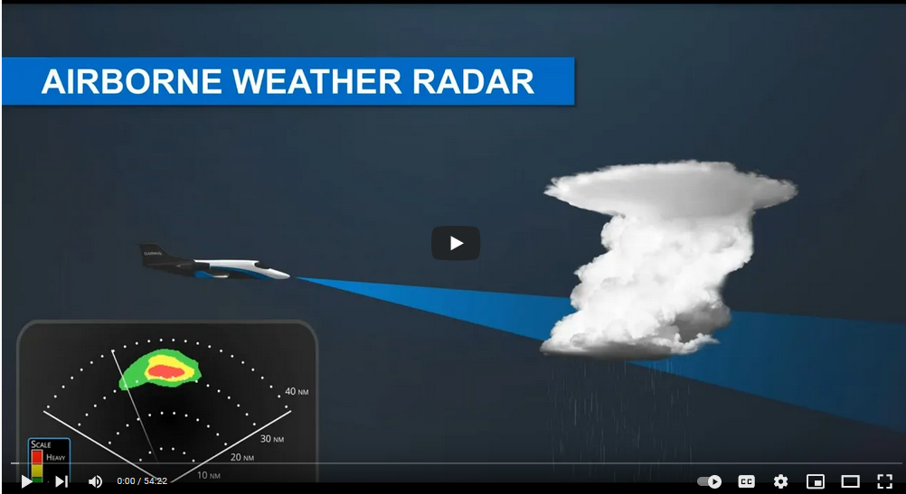
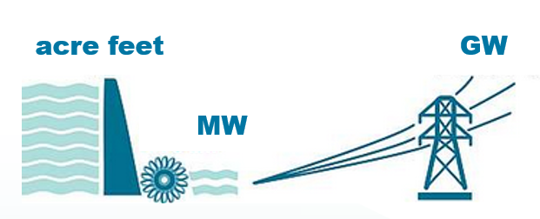
Research Scope
Research will address:
  Improved validation of the efficacy of specific cloud seeding
  Assessment of benefits of cloud seeding using meaningful metrics meaningful to the electricity sector
  Coordination with relevant precipitation enhancement and electricity sector experts and stakeholders

Slide 10
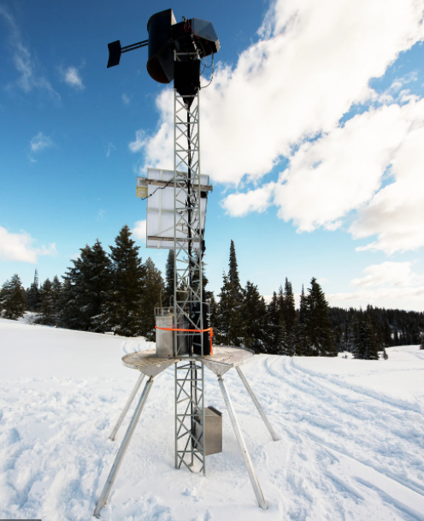

Research Focus
Research projects may include:
Assessment of:
  Effects of background aerosols on enhancement
  Impact of higher temperatures
  New seeding and transport agents
Development of new strategies and tools to:
  Forecast and detect seeding opportunities
  Improve targeting and transport modeling

Slide 11
Comments and Questions
Three ways to provide feedback or ask questions:
Use the raise hand function in Zoom:
  Zoom Phone controls:
    *6 - Toggle mute/unmute.
    *9 - Raise hand.
  Please introduce yourself by stating your name and affiliation.
Type comments and questions in the question function on Zoom:
  Please provide name and affiliation.
  Please indicate which discussion questions you are commenting on (E.g., 1a, 1b, 2, etc.).
Submit written comments & questions:
  Send written comments & questions to docket@energy.ca.gov by no later than October 14, 2022, 5 p.m. PST.
    Include docket number 19-ERDD-01 and “Staff Workshop on Advancing Precipitation Enhancement” in the subject line
Notes:
There are three ways to provide feedback to the discussion questions:
1. Use the raise hand function. If you’re on the phone it is *9 to raise your hand and *6 to unmute. Please introduce yourself by stating your name and affiliation
2. You can also submit your comments in the Q&A function on Zoom. Please do not use the chat function for this. Please explicitly note which discussion question you are commenting on to help us correlate the comments to the appropriate discussion question. Also please include your name and affiliation.
3. You can also submit your comments in written form to the docket. Directions are located on this slide and in the notice for the workshop. Please submit by October 14 5pm
And please note that all input from today’s workshop plus any written comments submitted to the docket will inform the final development of this funding opportunity.

Slide 12
Discussion Questions
What would improve the scope and/or focus of the effort, given the total of $2 million available?
How can the effort outlined best complement, build on or leverage other relevant efforts (pilots, projects, data, research, etc.)?
How can the effort outlined best deliver high-impact, actionable results?
Are there other research gaps that are higher priority for advancing precipitation enhancement strategies for California than those identified here?
What other stakeholders would be important to include in ongoing efforts?

Slide 13
Thank You!
Please submit your written comments by
5:00 p.m. October 14, 2022
Submit electronically through the Energy Commission’s “Research Idea Exchange” docket here: https://efiling.energy.ca.gov/Ecomment/Ecomment.aspx?docketnumber=19-ERDD-01
Or by email to the Docket Unit at: docket@energy.ca.gov
  Please include docket number 19-ERDD-01 and “Staff Workshop on Research to Support a Climate Resilient Transition to a Clean Electricity System” in the subject line
Or by paper copy to the Docket Unit: California Energy Commission || Docket Unit, MS-4 || Re: Docket No. 19-ERDD-01 || 715 P Street || Sacramento, CA 95814
Visit: https://www.energy.ca.gov/event/workshop/2022-09/staff-workshop-advancing-precipitation-enhancement-strategies-augment to view the workshop notice, presentation, and recording (forthcoming).

