Slide 1


Equity Implications in Building Decarbonization
Shelly Lyser | Aug 30, 2022
CEC’s Staff Workshop on Building Decarbonization and Electric Vehicle Charging Equipment Website
Panel 2: Tools and Resources

Slide 2
Overview
Available customer programs and pilots
Equity implications
Promoting equity in access, funding, program design
The Public Advocates Office

Slide 3
Available Incentives
Limited-term Pilots:
Building Initiative for Low-Emissions Development (BUILD Program)
Technology and Equipment for Clean Heating (TECH Initiative)
SCE’s ESA Building Electrification Pilot
Programs:
Self Generation Incentive Program
Energy Efficiency Portfolios
Energy Savings Assistance Program

Slide 4

Barriers to Equitable Access
  Low income and disadvantaged customers face:
  Low home ownership rates
  Complex financial arrangements for low-income multifamily housing
  Insufficient access to capital
  Building age-related hurdles
  Remote community locations
Source: CEC’s SB 350 Barriers Study
The Public Advocates Office

Slide 5

Affordability Challenges
We are in an electric rates crisis
Funding decarbonization programs without cost-effectiveness requirements (spending $1 ratepayer funds to create $1 or more of ratepayer value) will worsen inequity by increasing all ratepayer bills unsustainably
Risk to low income customers of increased bills when switching from gas to electric appliances

Slide 6
Apply Equitable Funding Sources and Standards
Don’t fund programs through rates, and only use cap and trade funds when benefits exceed costs
Reduce rates: fund non-cost effective programs using State General Fund and Federal funds
Fix Volumetric rates
Learn from ongoing pilots
Stop incentivizing gas measures that compete with fuel switching measures – e.g. gas appliances
Continue codes and standards improvements
The Public Advocates Office

Slide 7
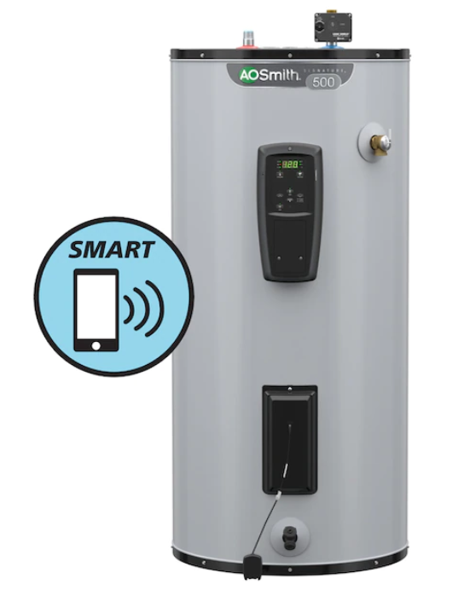
Program Design to Improve Affordability
To prevent increasing individual bills –
Pair fuel switching measures with insulation improvements
Customers enroll appliances in demand response
Target certain climate zones and key gas system locations
Account for grid reliability
The Public Advocates Office

Slide 8
Questions?
The Public Advocates Office

