Slide 1
Item No. 5: Application for a Small Power Plant Exemption for the CA3 Backup Generating Facility (21-SPPE-01)
August 10, 2022
Susan Cochran, Hearing Officer
Hearing and Advisory Unit, Chief Counsel’s Office

Slide 2
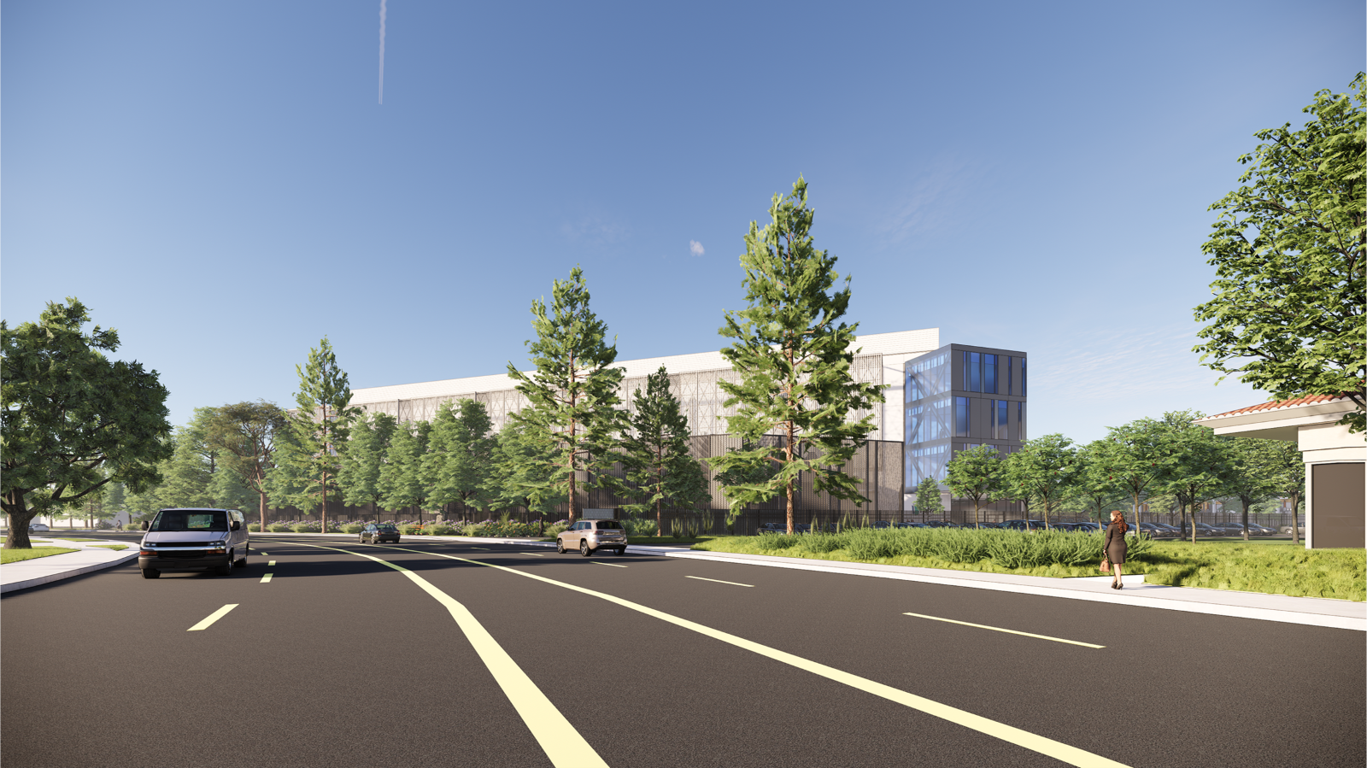
CA3 Backup Generating Facility
(21-SPPE-01)
Application for Small Power Plant Exemption

