Slide 1
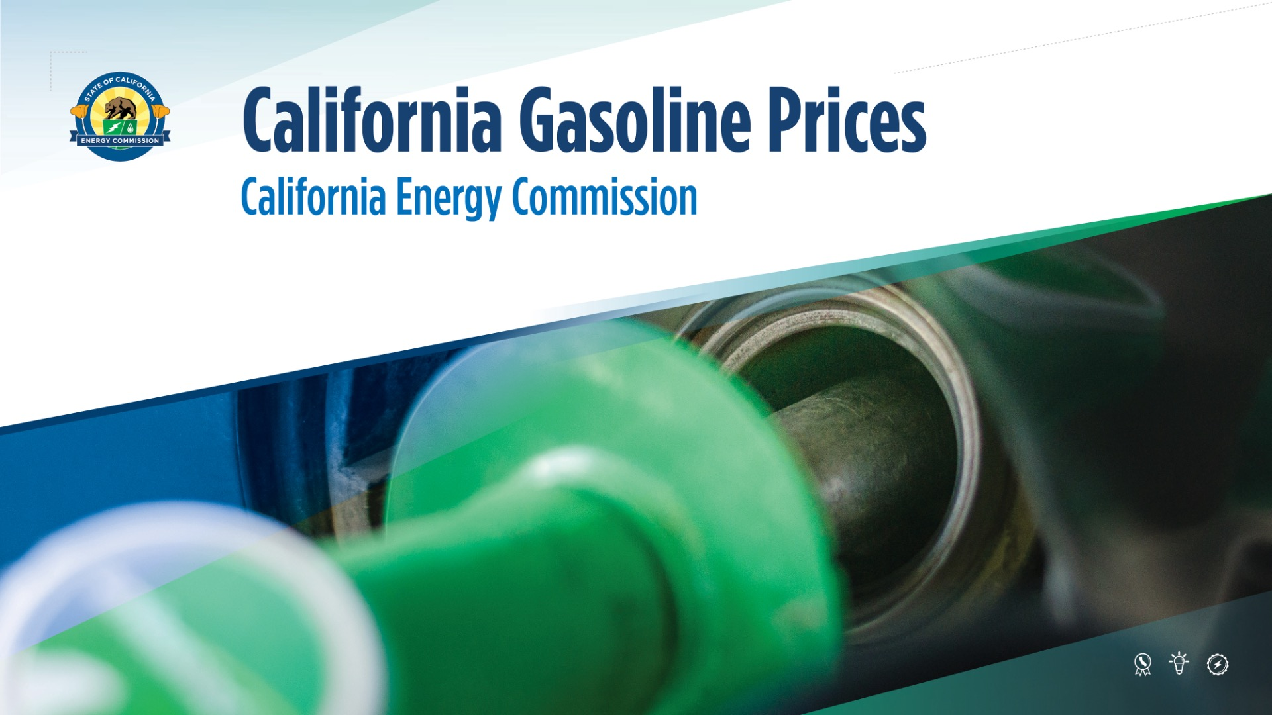
CALIFORNIA GASOLINE PRICES

Slide 2



CALIFORNIA ENERGY COMMISSION ROLE
Data
Analysis
Emergency Response

Slide 3
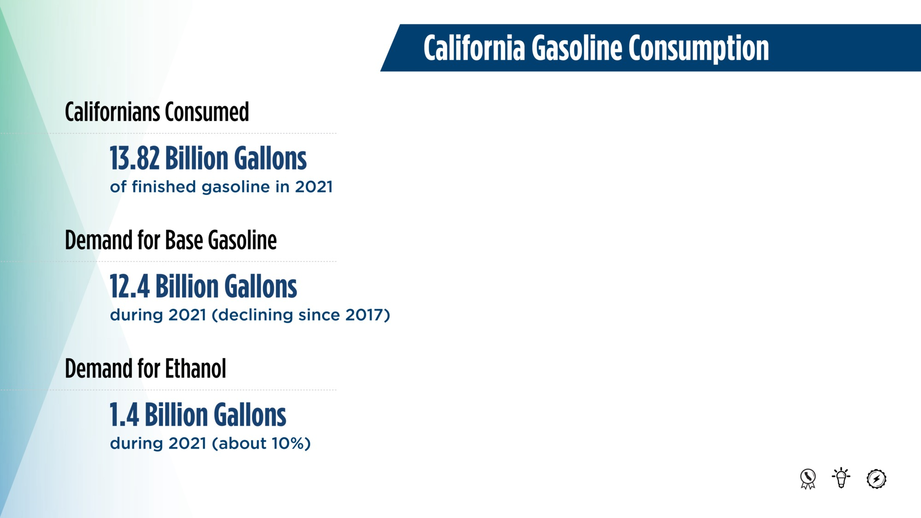
CALIFORNIA GASOLINE CONSUMPTION

Slide 4
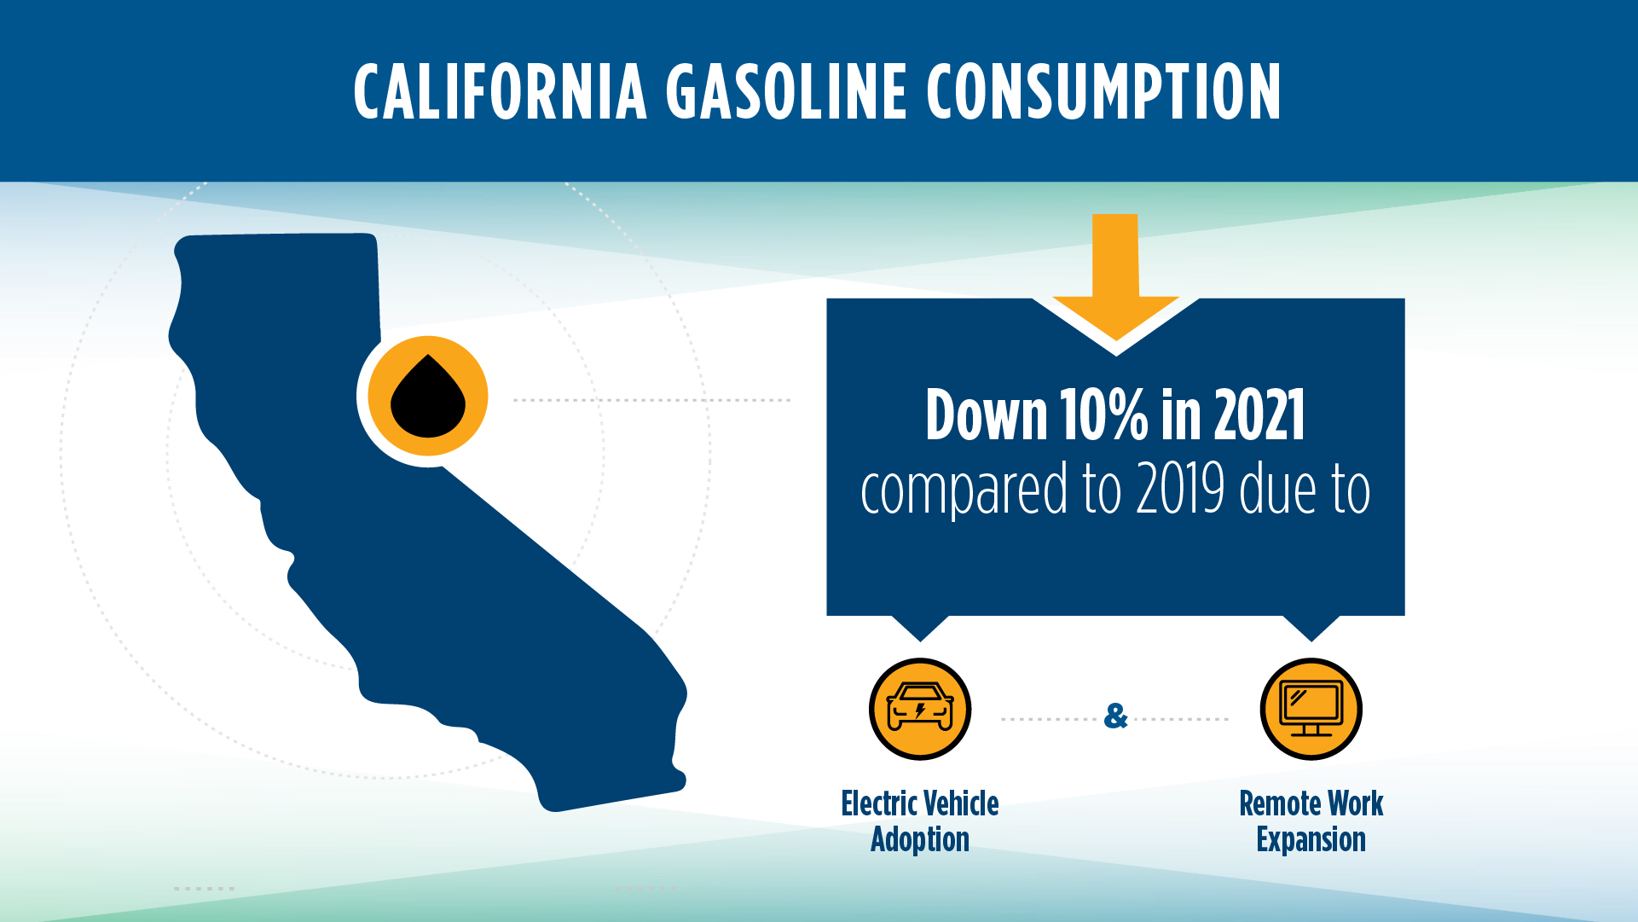
CALIFORNIA GASOLINE CONSUMPTION

Slide 5

CALIFORNIA CRUDE OIL SOURCES

Slide 6
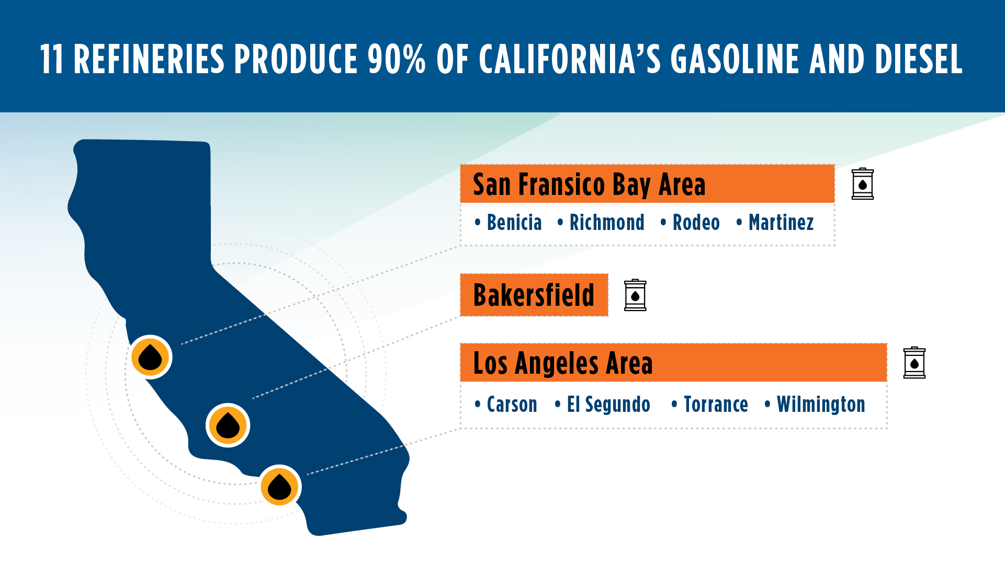
11 REFINERIES PRODUCE 90% OF CALIFORNIA’S GASOLINE AND DIESEL

Slide 7
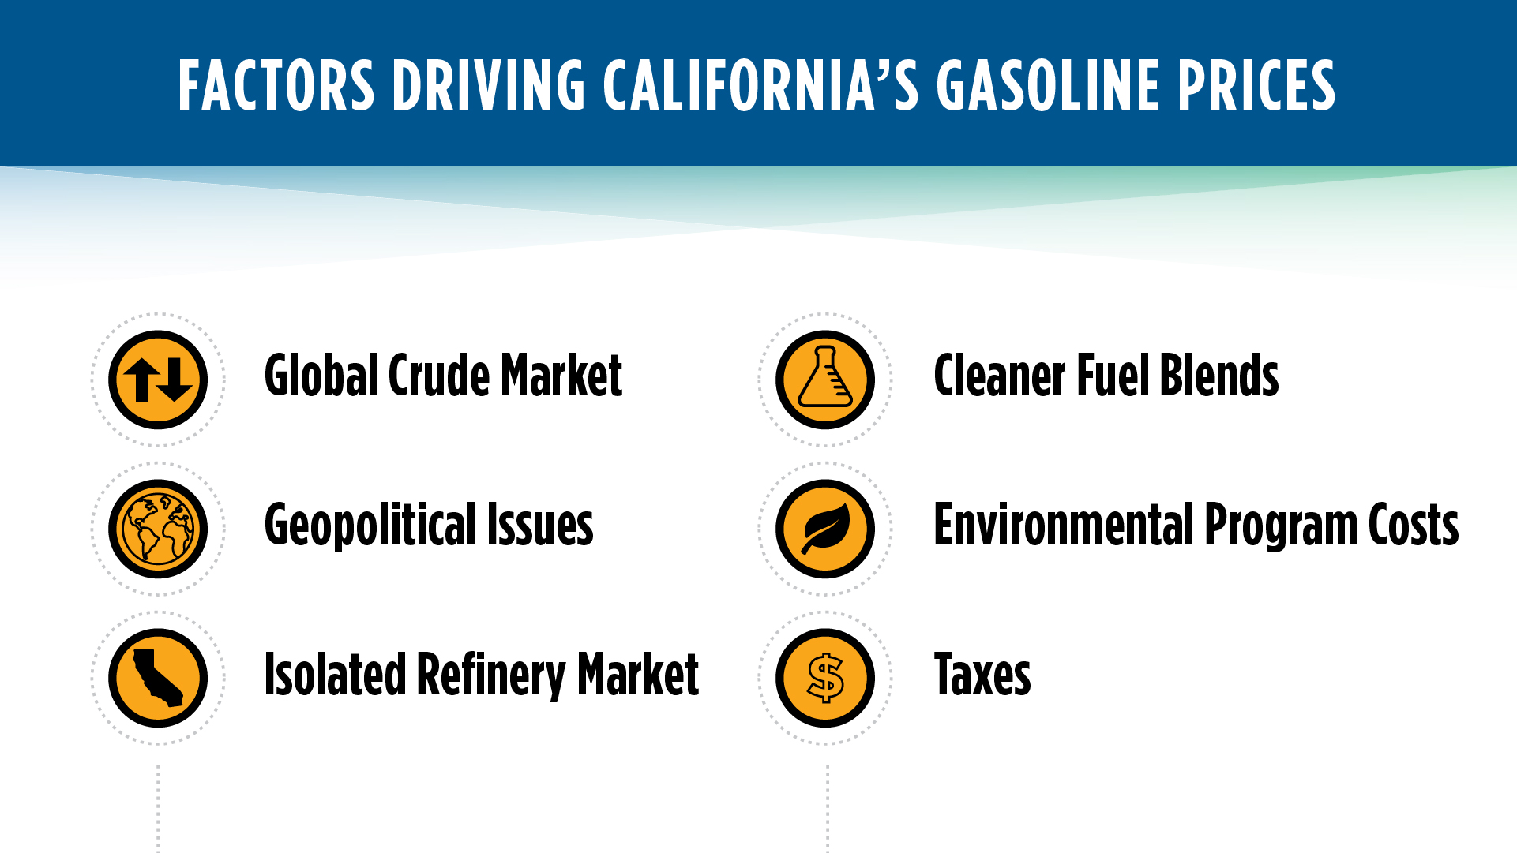
FACTORS DRIVING CALIFORNIA’S GASOLINE PRICES

Slide 8
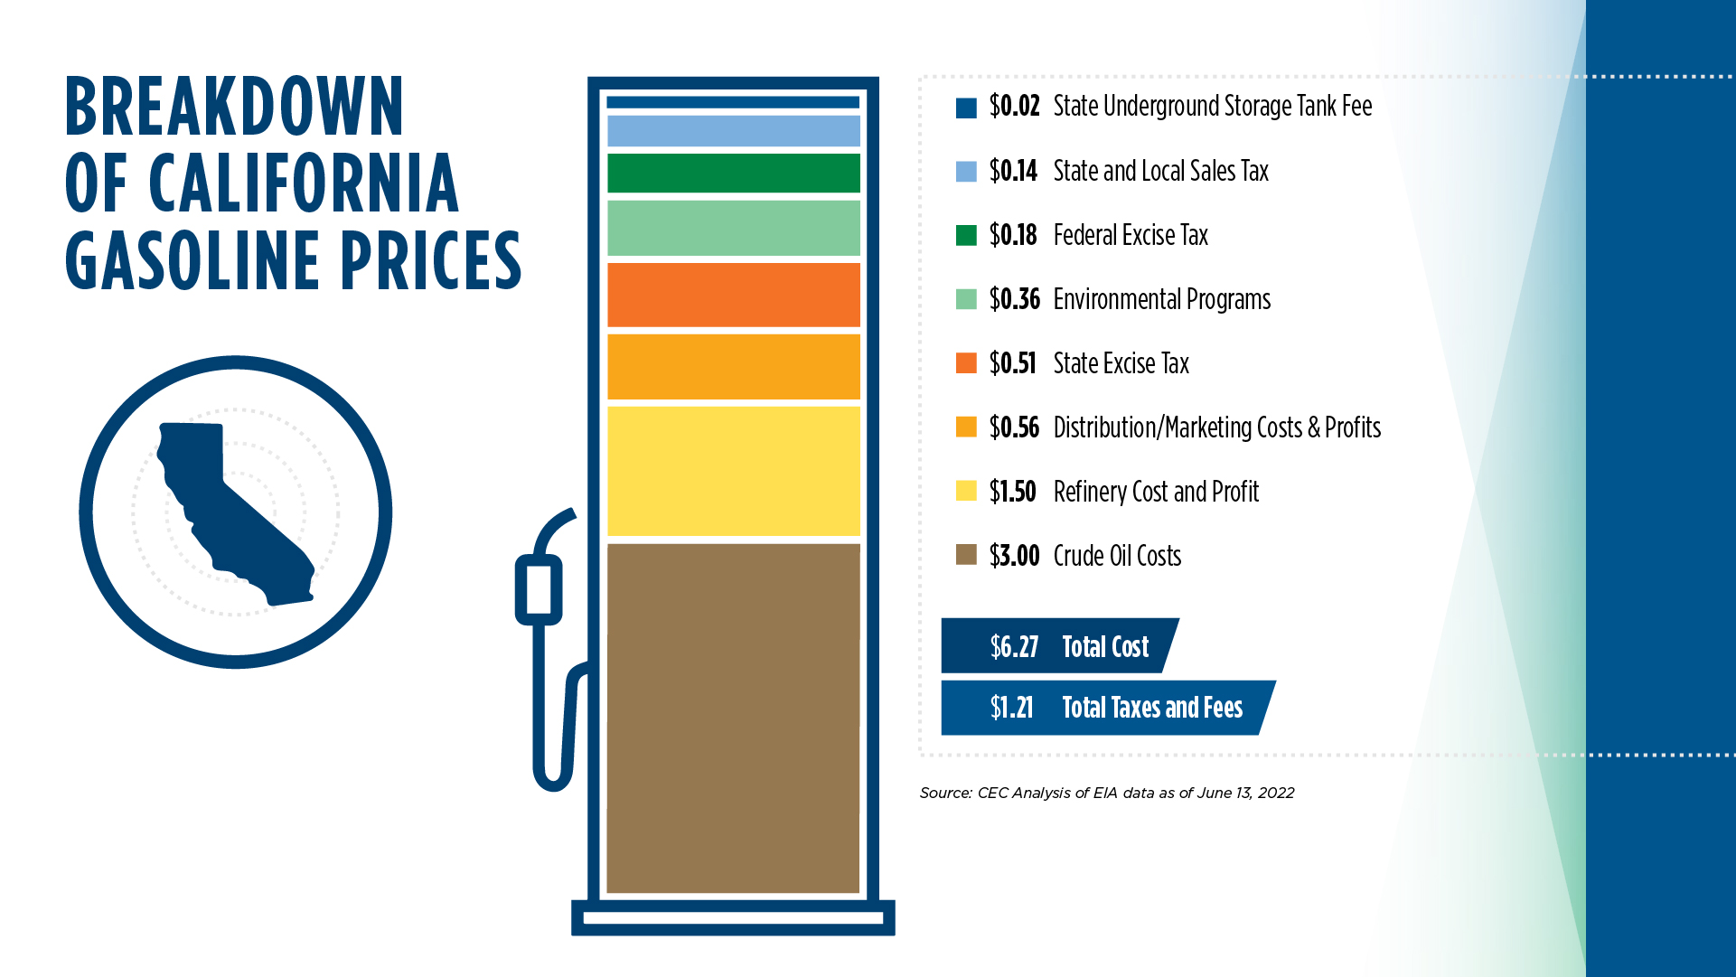
BREAKDOWN OF CALIFORNIA GASOLINE PRICES

Slide 9
2019 GASOLINE PRICE REPORT
2019 GASOLINE PRICE REPORT
“CEC staff concluded that the primary cause of the residual price increase is simply that California’s retail gasoline outlets are charging higher prices than those in other states.”
“While all California retailers have increased their retail margins above the national average, brands such as 76, Chevron, and Shell have increased those margins far beyond their competitors.”
“The price of gasoline in California is unregulated and companies can charge prices based on what consumers are willing to pay. However, if competitors fix prices or employ false advertising practices, this may be unlawful. Additional investigation is necessary to determine whether either has occurred.”

Slide 10
Thank You!

