Slide 1
Item 6: Small Power Plant Exemption (SPPE) for the San Jose City Backup Generating Facility (19-SPPE-04)
July 13, 2022 Business Meeting
Deborah Dyer, Hearing Officer
Chief Counsel's Office

Slide 2
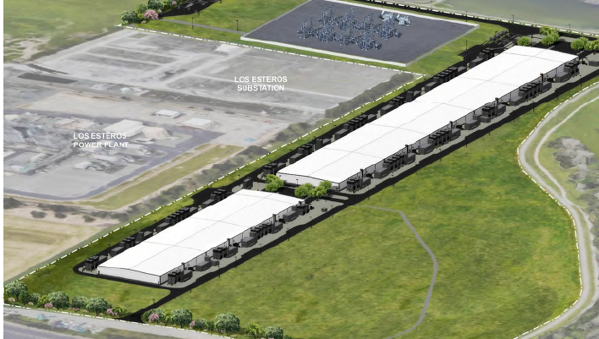
San Jose City Backup Generating Facility 19-SPPE-04
Application for Small Power Plant Exemption

