Slide 1

How Renewable are Renewable Fuels?
Robert L Freerks, Ph.D.
11 June 2022
Cornell Olin Lecture Series
Producing Truly Renewable Fuels from Waste Feedstocks
Notes:
This presentation compares the Carbon Intensity (CI) or GHG emissions of fuel per unit energy value (gCO2e/MJ) of renewable fuels produced from different feedstocks and by different technologies. GHG emissions or CI for “renewable” fuels vary from essentially that of fossil fuels to as much as 4X lower than fossil fuels. Energy crops have less impact on GHG emissions than most people believe, and some “renewable” fuels are little better than the fossil fuel baseline used for comparison of fuel GHG emissions.

Slide 2
Current Fuels Produced from Biomass Feedstocks
Ethanol– EPA D6 RINS at 77,330 Btu per RIN (Renewable Fuel)
Produced primarily from Corn
Other starch products and sugars also can be used
Biodiesel—EPA D4 RINs with 1.5 Multiple of RIN credit (Renewable Fuel)
Renewable Diesel—EPA D4 RINs with 1.7 Multiple of RIN (Renewable Fuels)
Produced from Used Cooking Oil, Animal Fats, Vegetable Oils (collectively known as FOG)
EtOH, BD or RD from Advanced feedstocks, EPA D5 Advanced Biofuel
From selected feedstocks with RIN Multiple based on fuel type ( Corn Oil, cover crops, algae, biowastes)
EtOH, BD or RD from Cellulosic Feedstocks, EPA D3/7 Cellulosic Biofuel
Produced from biomass and waste feedstocks but not from agricultural feedstocks (Grains, Oils, Sugars, etc.)
Notes:
Approved Pathways for Renewable Fuel | US EPA
Ethanol is the highest production volume of “Renewable” fuel at 16 billion gallons per year (gpy) or roughly 1 million bbl/day. This represents about 700,000 gpy of gasoline gallon equivalent of fuel production as EtOH has 2/3rds the energy content of hydrocarbon-based gasoline fuel.
Biodiesel (BD) production, primarily from soy oil and other seed oil crops was 1.6 B gpy or 104,000 bbl/day. Renewable diesel fuel (RD) is approximately 1 B gpy or 65,000 bbl/day but slated to expand significantly with multiply refinery conversions and expansion of RD facilities.
Total petroleum consumption is 23 million bbl/day per EIA with matching production. AEO2022_narrative_graphs_production.pptx (live.com)
BD/RD production represents 8% of total diesel fuel production.

Slide 3
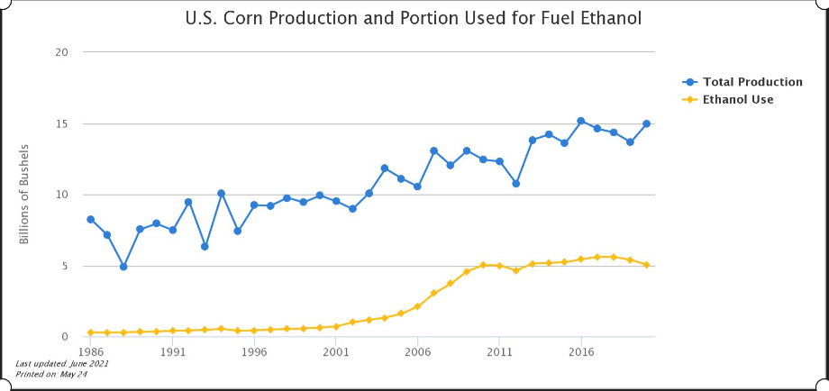
Current “Renewable Fuels”
Ethanol
Produced from Corn on airable land
  2.8 gal of EtOH per Bushell of Corn
  165 bushels per acre yield
  93.4 million acres planted
  143,692 sq. mi. of land area
  48,408 sq. mil devoted to EtOH
Notes:
Alternative Fuels Data Center: Maps and Data - U.S. Corn Production and Portion Used for Fuel Ethanol (energy.gov)
Per available data, the yield of ethanol from corn is 328 gal per acre. Quick Answer: How Much Corn Goes To Ethanol? - Corn farm (derthickscornmaze.com). With 16B gpy production, this equates to 48.7 million acres of land or 76,220 sq mi of land dedicated to EtOH fuel production.
Estimates of 33 to 40% of corn production is for ethanol production. Alternative Fuels Data Center: Maps and Data - U.S. Corn Production and Portion Used for Fuel Ethanol (energy.gov)

Slide 4
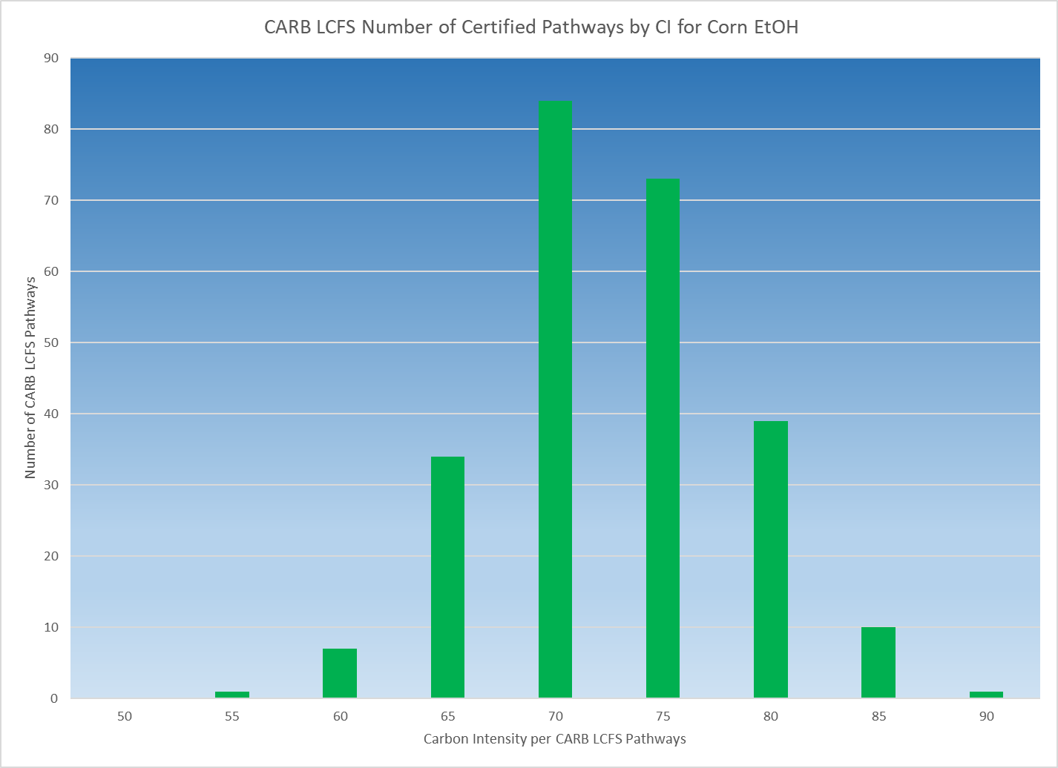
Ethanol Carbon Intensity
Ethanol CI average per CARB is 70 gCO2e/MJ
27% reduction from Fossil Fuel Baseline
Requires substantial fossil fuel input to produce—Soil prep, fertilizers and herbicides/insecticides, harvesting
Substantial land area for feedstock cultivation
No actual emissions benefits
  Fuel injection and catalytic converters eliminate need for oxygenated fuels in gasoline ICE’s
Notes:
California Air Resources Board data shows that the CI of ethanol ranges from 50 to 85 gCO2e/MJ and is centered at about 70. California attracts the lowest CI Ethanol and other fuels as the Low Carbon Fuel Standard rewards lower CI fuels and penalizes conventional and high CI fuels. Thus there is no economic incentive to move high CI EtOH to California skewing the average CI of EtOH consumed in CA to the lower end of the range. Dashboard | California Air Resources Board See Fig 5.

Slide 5
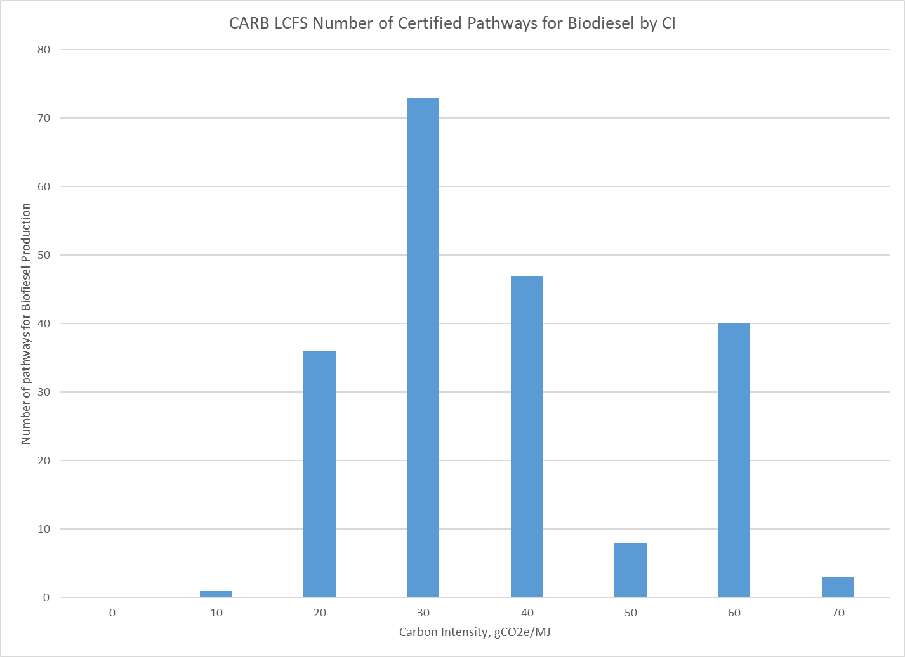
Biodiesel Carbon Intensity
Biodiesel (BD) produced by trans-esterification of Fats, Oils and Greases (FOG)
CI of fuel highly dependent on CI of feed
  Waste FOG has lowest CI
  UCO and Animal fatty wastes are limited in supply
  Essentially all low CI products sold to Calif.
  Expansion of production will be from oil seed crop feedstocks, mainly soy oil
Notes:
Dashboard | California Air Resources Board
Biodiesel CI is skewed due to the significant difference in CI of Fats, Oils & Greases (FOG) used. Animal fats and Used Cooking Oil (UCO) have very low CI as they are waste streams whereas seed oils such as soy oil incur energy costs for growing and harvesting as well as a substantial Indirect Land Use Change assessment of 29.1 gCO2e/MJ making seed oil derived BD (and RD) less desirable to market in California. Thus, the high number of fuel production pathways using waste oils feedstocks vs seed oil feedstocks. BD from waste oils average 30 CI whereas BD from soy oil averages 60 CI which is essentially the impact of iLUC for using agricultural land for energy production.

Slide 6
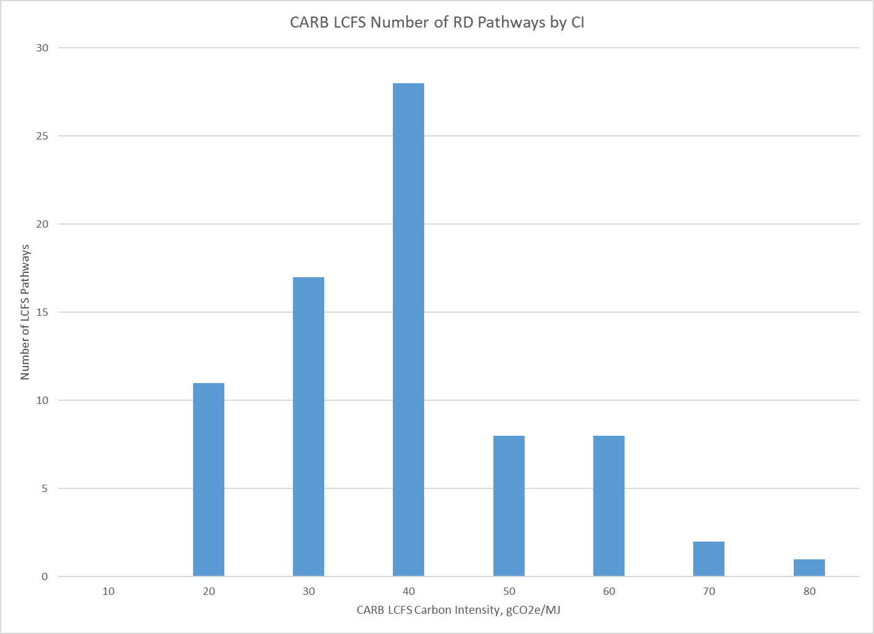
Renewable Diesel Carbon Intensity
RD produced by hydroprocessing FOG into paraffinic (non-oxygenated) diesel and propane
CI highly dependent on feedstocks
Much produced in Singapore from UCO/Animal fats
Imported into CA to capture LCFS value
Growth of RD dependent on seed oil production
Notes:
Used cooking oil, a renewable fuels feedstock, nearly 'tapped out' in U.S.
Used cooking oil, a feedstock fueling America's renewable diesel boom, is running in short supply, according to U.S. refiner Valero.
The refiner is expanding its renewable diesel production capacity in St. Charles, Louisiana as part of its joint venture with Diamond Green Diesel. The plant should be able to produce an additional 400 million gallons per year of renewable diesel by the fourth quarter of 2021, executives said on the refiner's first-quarter earnings call on Thursday.
The fuel will be made from feedstocks such as used cooking oil, animal tallow and distillers corn oil, said Martin Parrish, senior vice president of alternative fuels at Valero.
Animal tallow and used cooking oil are deemed less carbon intense than soybean and other vegetable oil and thus generate more tradable credits under California's low-carbon fuel standard.
This has driven up prices and demand for the feedstocks as refiners and other producers compete for supply to profit off of state and federal regulations and tax credits.
"Used cooking oil is pretty close to being tapped out right now in the U.S.," Parrish said.
Renewable diesel has been tremendously profitable for Valero, an early mover that secured ample supply of advantaged feedstocks with low carbon intensity.
Valero's renewable diesel segment a record operating income in the segment of $203 million in the first quarter of 2021.
"The biggest advantage is the carbon intensity score of those oils, those waste oils, compared to a veg oil or compared to the soybean oil in most jurisdictions," said Parrish.
The refiner expects to be able to sell into Canada and other states that adopt low carbon fuel standards.
"By having our robust pretreatment system, our location, our ability to run anything is just a huge advantage," he said.
Most UCO now goes to RD production vs BD production. Renewable Diesel Backs into UCO | BiodieselMagazine.com

Slide 7
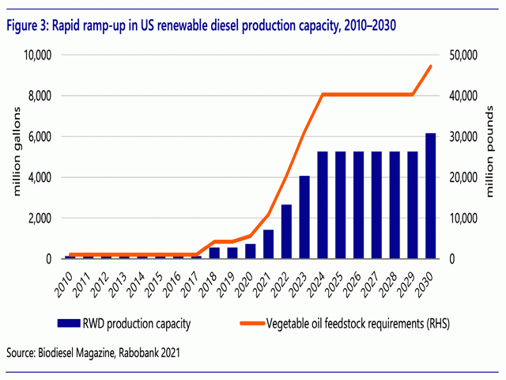
Land Use Change For Soy Oil Production
Current RD production, 6 B GPY (391,390 bbl/day) requires 30 billion lbs. of soy oil
30 Billion lbs. of soy oil requires 2.54 billion bushels soybean production
At 50 bushels/acre yield, this is 50.85 million acres under cultivation or 80,000 sq. mi.
Refinery conversion to RD production at 47,600 bbl/day requires 14,730 sq. mi. land area. Multiple plants of this capacity are proposed
CARB LCFS Pathways for Soy to RD have CI of 54 to 56 gCO2e/MJ, 29.1 gCO2e/MJ due to iLUC
Seed oils cannot provide volume of RD needed without consequences
Notes:
Renewable Diesel Plants Could Outstrip Soybean Acres, Soy Oil Supplies
Renewable Diesel Plans Could Outstrip Soybean Acres, Soy Oil Supplies (dtnpf.com)
OMAHA (DTN) -- Analysts are having a hard time modeling out the soybean oil needs in the near term and long term as more renewable diesel projects are announced. For now, forecasts call for higher soybean prices, expanded acreage, and not enough soybean oil to go around.
If everything is built out as projected, farmers would have to add tens of millions of acres of soybeans and yield increases to keep up with the crush demand. To hit the numbers, soybean production would have to grow by roughly 3.6 billion bushels by 2030.
USDA's Economic Research Service this week projected soybean oil will see greater demand starting in 2022, while Rabobank offered a similar outlook projecting greater crush capacity starting in 2023 as more renewable diesel facilities come online.
current-pathways_all.xlsx (live.com)
If this capacity expansion could be delivered, it would represent a massive shift in the U.S. biofuel industry. Already the growth of renewable diesel production is impacting feedstock markets, with many analysts identifying growth in renewable diesel as a factor contributing to recent record soy oil prices. It is difficult to see how the millions of metric tons of vegetable oil that would be needed to supply a 5 billion gallons a year industry could be delivered. Predicted increases in domestic soy oil production could support perhaps another 300 million gallons of production, and increased utilization of waste and residual oils another 150 million gallons. Beyond this, increasing production would mean either dramatic unforeseen expansion of domestic soy and canola area, dramatic increases in canola and palm oil imports, or massive displacement of feedstock from other uses (or a combination of the three). Domestic biodiesel production is likely to be strongly impacted, with waste oils and fats in particular diverted to renewable diesel production for supply to the West Coast.
Animal, vegetable or mineral (oil)? (theicct.org)

Slide 8
Sustainable Aviation Fuel
Airline Commitment to Net Zero growth in GHG emissions from 2022 forward
Goal to be carbon neutral by 2050
Hydrocarbon fuels are only possible way to fuel aircraft
Electrification not feasible due to extremely low energy density of batteries
Hydrogen not feasible due to cost, safety, infrastructure issues
Ethanol not viable fuel due to low energy density and corrosive nature of fuel
DOE BETO Proposing SAF Grand Challenge to produce 3 Billion gallons of SAF by 2030 and 35 Billion gal of SAF by 2050
Notes:
Sustainable Aviation Fuel Grand Challenge | Department of Energy

Slide 9
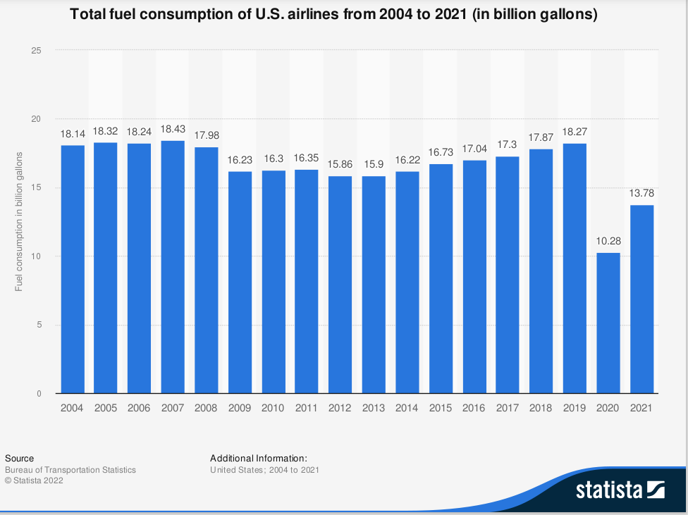
SAF Needed to meet Net Zero by 2050
Total Fuel Consumption of US Airlines
from 2004 -2021 (in billion gallons)
Jet Fuel consumption is recovering from 2020 low
As of 2021, jet fuel consumption is 13.78 Billion GPY or 900,000 bbl/day (1.2 million in 2019)
Typical biofuels plant will produce 2,000 bbl/day
Need 450 facilities to replace all jet fuel with SAF and will still not be carbon neutral unless CI reduced to zero or below
Growth in Airline Industry will double demand for fuel by 2050
CONFIDENTIAL INFORMATION © 2022 STRATEGIC BIOFUELS
ALL RIGHTS RESERVED
PAGE | 9
Notes:
2022 Jet Fuel production is nearing the normal volumes seen in 2019, pre-COVID.
Biofuels plants must be located near feedstock sources to minimize transport of low density material. Radius of collection reduces both transportation cost and Carbon Intensity for delivery of feed to processing site. Densification can help, but extra handling of feedstock adds to operational cost.
Used cooking oil, a renewable fuels feedstock, nearly 'tapped out' in U.S. (hydrocarbonprocessing.com)
One major issue with airlines is that they need to account for GHG reductions, not just the nominal use of “Renewable” SAF. CI matters to ICAO (Int’l Civil Aviation Org) that monitors airlines’ progress towards Net Zero pledges. Thus high CI fuels such as Alcohol-to-Jet based off corn starch has a very high CI and contributes little to meeting goals. Production volumes are also very low. What is needed is high production volume of low CI fuels that materially impact net GHG emissions.

Slide 10
Feedstocks for RD/SAF Production
Starches/Sugars
High CI for production of feedstocks
Alcohol to Jet fuel consumes 2 gal EtOH/gal SAF produced with high CI for production
FOG
Low CI FOG (UCO, Animal Fats) tapped out (per Diamond Green CEO)
High CI for growing oil crops and massive land use as well as Food-For Fuel issues
Waste Feedstocks
No FFF issues, low CI for aggregation and delivery, multiple sources of over 1B tons/yr
Gasification/Fischer-Tropsch conversion to HC fuels most viable pathway
Allows sequestration of Process CO2 or utilization via addition of Hydrogen to process
High yield of fuel per ton of feedstock
Notes:
Crop-based biofuels: the ENVI committee also voted in favour of amendment CA7 which limits crop-based biofuels to no more than half the share of the overall biofuel use in transport and specifies biofuels from palm oil and soy to be phased by 2023. This has been another key NGOs demand for years as crop-based biofuels compete with food production over land, fuel agricultural sprawl at the expanse of natural habitats and promote destructive industrial agricultural practices.
Bioenergy: important step towards protecting forests & food security taken by the EU ENVI Committee (birdlife.org)

Slide 11
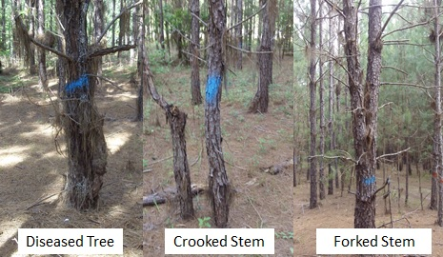
Advantages of Waste for Fuel Production—Forest Residues
Forest Waste and Residues are preferred feedstock for fuel production
Plantation forests exist for timber production
  Managed forests generate waste through thinnings and harvest residues
  Thinning required to grow harvestable trees for lumber
  Residues from harvesting have no economic value
Municipal Solid Waste available in large quantities in all areas
  Per EISA 2007 (RFS), economically recoverable plastics must be removed
  ¹⁴C dating used to measure biogenic content of fuel for credit purposes
FR341/FR410: Marking First Thinnings in Pine Plantations: Potential for Increased Economic Returns (ufl.edu)

Slide 12
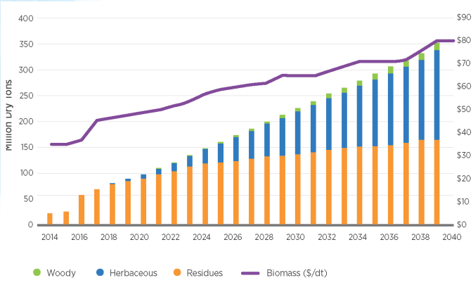
ORNL Demand Scenario to 2040
Woody Biomass Availability
Current contracts for forest waste from harvesting timber crops for lumber range from $20 to $40/ton
Long term fixed price contracts for life of facility
Tracking of source to comply with RFS requirements for fuel production
True waste woody biomass (mill redsidues, etc.) for biomass power (RFS certification not required)
Notes:
Billion Ton Study (energy.gov)
2016 Update to Billion Ton Study shows majority of waste will come from forest residues. These are leftovers from sustainable forest management practices to maximize saw log growth in Southern Yellow Pine plantations. Currently, the vast majority of management waste and harvest residues are left to rot or are burnt to remove from the forest. Collection costs are minimal and most cost is in transportation to fuel production facility.

Slide 13
Efficient Conversion of Waste to Fuel
Highest yield of fuel from waste feedstocks is via gasification, F-T conversion
High Temperature gasification converts all carbon in feedstock to CO, H2 and CO2
POX used to remove tars (aromatics which are difficult to convert at lower gasifier temperatures.
Syngas conditioning for removal of poisons, sulfur and nitrogen contaminants
Water-Gas shift to adjust H2/CO for best F-T performance
Mild hydroprocessing to convert waxy syncrude to fuels—diesel, jet and some naphtha
Yields of 1.6 bbl/ton for BTL with CCS and 4.6 bbl/ton with BTL with CCU (e-fuels)
  Far higher yield than Cellulosic Ethanol processes (1.06 bbl EtOH/ton or 0.67 BOE/ton)

Slide 14
Additional Benefits of Gasification
Gasification and syngas cleanup produce a pure stream of CO2 by necessity
CO2 removed from syngas after all other steps
WGS produces significant amount of CO2 during shift to H2, but captured and used
CO2 available for sequestration or utilization
CO2 capture with additional H2 production via electrolysis allows very high conversion of biogenic Carbon into fuel.
  93% conversion of carbon in waste can be turned into fuel.
Notes:
Cellulosic Ethanol production requires separation of cellulose and hemicellulose from feedstock. Bark, stems, leaves, etc., are not used in process. Multistep process required to prepare feedstocks for biological conversion to ethanol. Extremely time consuming process requiring 7 to 10 days for conversion of cellulose to ethanol. Final produce is not drop-in replacement for fuel. SAF production requires dehydration and oligomerization followed by hydrotreating and distillation to produce jet fuel and other products (gasoline/diesel fuel). Yield is 1 gal HC Fuel per two gal EtOH processed.
Biomass gasification utilizes all components of feedstocks producing syngas which is converted into fuel within minutes of being fed to gasifier. CapEx for process is high, but feedstock utilization is also high and costs are low.

Slide 15
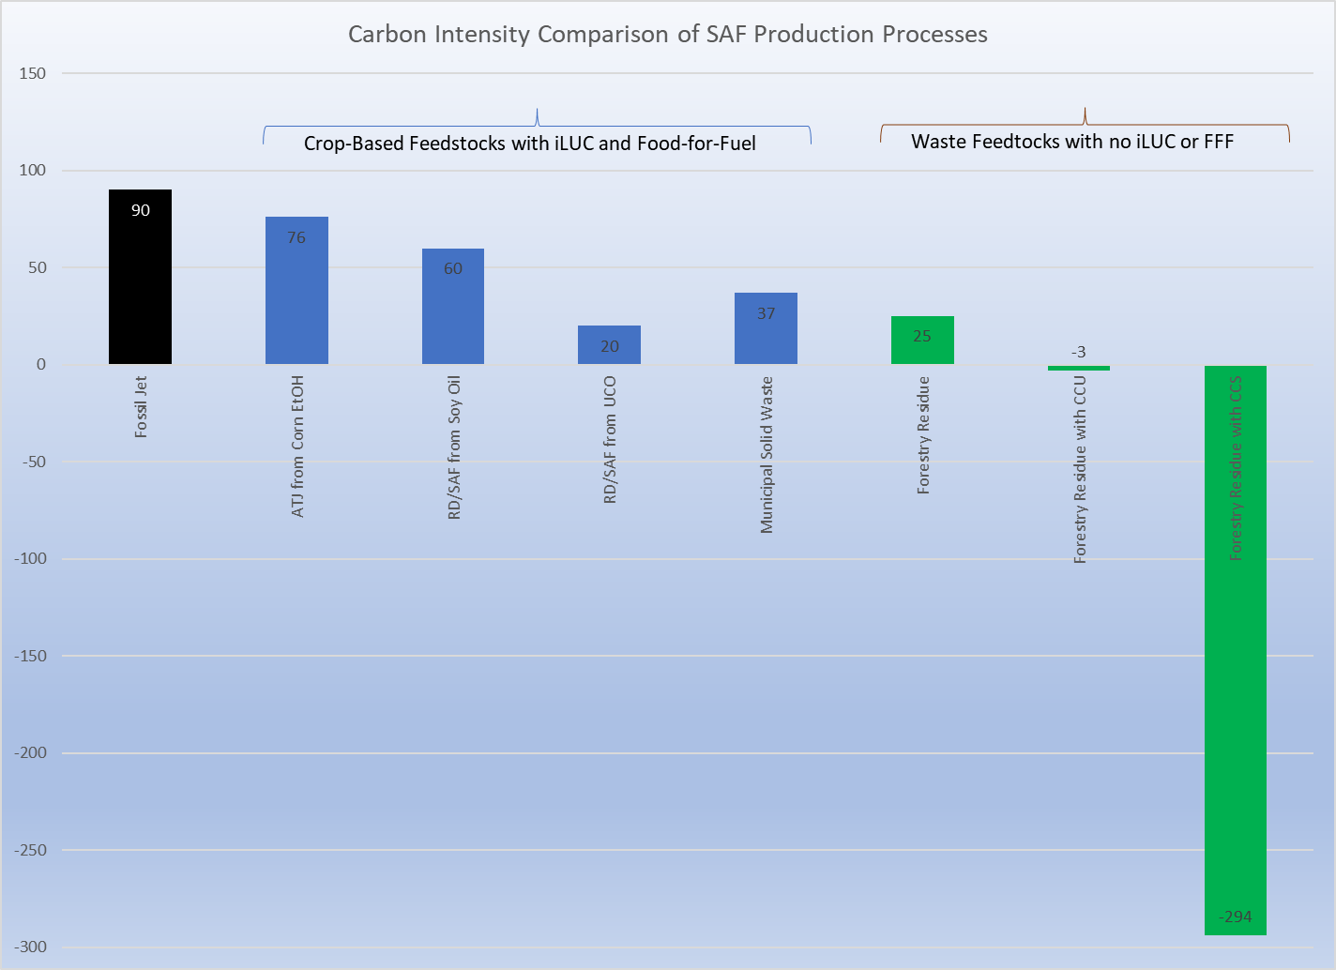
Comparison of CI of SAF/RD Feedstocks and Production Processes
CARB Fossil Fuel Baseline for Gas/Diesel
ATJ uses 2 gal EtOH/gal SAF produced
  Incurs CI for EtOH production
  Yields Gasoline/SAF/Diesel
Soy Oil has 29.1 gCO2e iLUC penalty
UCO lowest FOG feed but supply limited
MSW & Forest Residues true waste feeds
CCU with Electrolysis produces 4X more fuel than CCS option
Notes:
CI as the feedstock must be grown incurring all the associated production emissions and iLUC assessments. Expansion of soybean crop area will cause reevaluation of the iLUC assessment as well. UCO and animal fats are limited in supply so although they produce fuel with a relatively low CI, growth in production is limited. MSW gasification can produce lower CI fuels from waste feedstocks, but until the process is coupled with CCS it will not have exceptionally low CI. The 37 listed is for the current CARB LCFS pathway, but more recent values of CI are probably in the 20 CI range. Forestry waste and agricultural waste can produce high volumes of SAF but at moderate CI. However, coupling CCS with the process is easy as CO2 is already sepeasrated from the syngas prior to F-T synghesis and can be sequestered. This yield SAF production with a CI of -110. If biomass power with CCS is added to the process, further reduction in CI down to -300 is possible. The economic returns in terms of RFS and LCFS credits makes this approach economically viable.
Plant design trade-off are CCS which produces very low CI fuel or CCU which produces much more fuel volume but at higher CI. Economic analysis determines which is most advantageous to project.

