Slide 1
GFO-21-403 Pre-Application Workshop
Grant Funding Opportunity for the California Electric Homes Program
Renewable Energy Division
June 28, 2022 | 10:00 am

Slide 2

Workshop Agenda
Welcome Introductions
  Virtual Housekeeping
Program Overview
Solicitation Overview
Application Documents
Application Evaluation
Application Submittal
Next Steps
Questions & Answers
Adjourn

Slide 3
Virtual Housekeeping
Workshop conducted remotely via Zoom and is being recorded
Virtual participation via Zoom or telephone will be available during the Q&A period
Grant Funding Opportunity Webpage: https://www.energy.ca.gov/solicitations/2022-06/gfo-21-403-california-electric-homes-program-calehp
Written questions about this solicitation send to Commission Agreement Officer:
Kevyn Piper, email: Kevyn.Piper@energy.ca.gov,
Subject: GFO-21-403
Deadline: Tuesday, July 12, 2022 by 5:00 PM

Slide 4
Program Overview

Slide 5

Overview: California Electric Homes Program (CalEHP)
Statewide incentive program to increase market transformation for new market-rate single-family and multi-family residential buildings in:
Building efficient all-electric homes
Installation of residential energy storage
CEC is seeking to award a grant for a 3rd party to design and implement its own program within the framework provided
Authorized from AB 137 (Ting, Chapter 77, Section 17, Statutes 2021)
Budget Authorized from SB 170 (Skinner, Budget Act of 2021)

Slide 6
Solicitation Overview
Grant Funding Opportunity (GFO) for the California Electric Homes Program

Slide 7

Solicitation Overview: Eligible Applicants
Solicitation is open to any public or private entity
Applicant must have relevant qualifications in designing and implementing incentive programs
Applicants must be able to provide technical assistance to builders on building design and energy storage
Applicants must accept the California Electric Homes Program Solicitation Terms and Conditions, without negotiation
Applicants must be registered with the California Secretary of State and be in good standing to enter into an agreement with the CEC: https://www.sos.ca.gov/
Solicitation Manual pg. 9 - 10

Slide 8
Solicitation Overview: Solicitation Process
Pre-Solicitation Workshop
Solicitation Posted
June 13, 2022
Pre-Application Workshop
June 28, 2022
Applications Due
August 1, 2022
Notice of Proposed Award (NOPA)
August 22, 2022*
CEC Business Meeting
December 2022*
Administrator finalizes Program Design with CEC’s input
Administrator Launches Program
Start Receiving Incentive Applications

Slide 9
Solicitation Overview: What is the purpose of this solicitation?
Seeking block grant administrator to design and implement an incentive program and provide technical assistance for the CalEHP.
Administrator will distribute at least $58.125 million in incentives for efficient all-electric homes and installation of energy storage systems in new market-rate residential construction throughout California
Solicitation is a competitive grant solicitation

Slide 10

Solicitation Overview: What is expected from the applicant?
Applications to this solicitation should include an overall program development and implementation plan that is aligned with the Statute and the CalEHP Guiding Principles, and includes:
  Incentive program implementation plan
  Outreach and advertising plan
  Technical assistance plan
  Technical advisory group plan
  Administrative budget
  Program timeline
  And all other requirements listed in the solicitation

Slide 11

Solicitation: Program Requirements
Propose an Incentive Program Plan that incorporates:
  Program development
  Incentive structure
  Process for application review
  Funding mechanism
  Implementation timeline with detailed milestones
  Description of all phases of the incentive program
  Propose an Outreach and Advertisement Plan
    Plan workshops to solicit stakeholder input on incentive program design
  Create a plan as to how applicant proposes to reach potential incentive recipients throughout California
Solicitation Manual pg. 10 - 13

Slide 12

Solicitation: Program Requirements Cont.
  Propose a Technical Assistance Program Plan that:
    Provides potential CalEHP incentive applicants technical assistance to successfully deploy all-electric and energy storage equipped homes.
    Provides hands-on application assistance.
    Provides information on project eligibility, design, permitting, etc.
    Provides technical input as needed to resolve any barriers to participation in the incentive process.
Solicitation Manual pg. 13 - 14

Slide 13

Solicitation: Program Requirements Cont.
Propose a Technical Advisory Group (TAG) plan that includes:
  An approach to creating the TAG.
  Potential TAG members, comprised on diverse professionals depending on the expertise, interest, and availability.
  TAG members ability to add valuable input that ensures the success of the program.
  A description of how the TAG will be utilized to inform program improvement and support outreach efforts.
Solicitation Manual pg. 14

Slide 14

Solicitation: Program Requirements Cont.
Program Budget:
A total of $65,625,000 is available for this solicitation
  At least $58,125,000 is available for incentives
  Up to $7,500,000 is available for 3rd Party Administrator support costs
Note: Applicant must provide justifications for the budgeted costs allocated in the budget forms.
Solicitation Manual pg. 5-6

Slide 15
Solicitation: Program Requirements Cont.
Reimbursable costs are costs incurred after executing an agreement with CEC
Costs incurred will be for one or both of the following:
  Incentives paid out to builders in accordance with program design and implementation
  Eligible administrative support costs incurred to develop and implement the program
The Recipient is to forecast the amount of incentive funds needed to cover approved incentive payments and submit a request to CEC for payment
Administrative support costs will be reimbursed in arrears
Solicitation Manual pg. 16

Slide 16
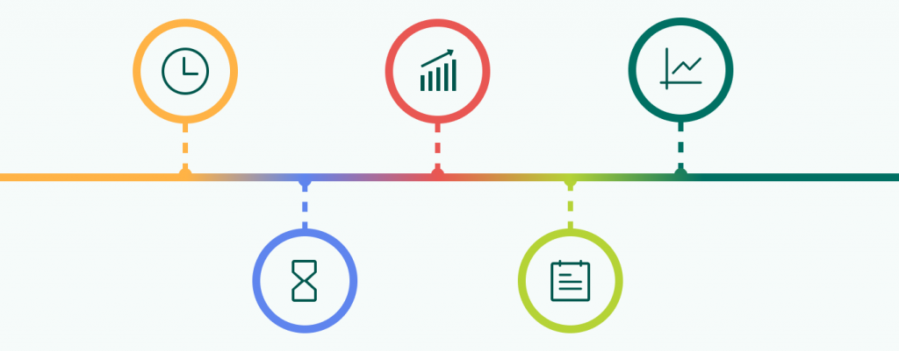
Solicitation: Program Requirements Cont.
Propose program Timeline that includes:
Incentive program target launch timeline
Milestones from program launch to closing
Timeline for incentive fund processing and distribution
Program performance that includes specific steps with timelines
Reporting to CEC
Solicitation Manual pg. 12-15

Slide 17
Solicitation: Program Requirements Cont.
  Examples of other Applicant requirements:
  Develop processes and procedures to mitigate actual or perceived conflicts of interest with potential incentive applicants.
  Develop process that processes incentive applications and pay incentive funds in an expeditious way.
  Develop an incentive application appeal and extension process.
  Develop a robust method of tracking funding and incentive applicant data.
  Develop a regular reporting process to provide data to CEC.
Solicitation Manual pg. 15

Slide 18
Application Documents

Slide 19

Application Documents: Organization
Required documents for submission are:
Application Form
Program Narrative
Scope of Work and Instructions
Schedule of Products and Due Dates
Budget Forms
Resumes
Contact List
Letters of Support/Commitment
Past Performance Reference Forms
CalEHP Terms and Conditions
CalEHP Guiding Principles
Conflict of Interest
Solicitation Manual pg. 3, 18

Slide 20
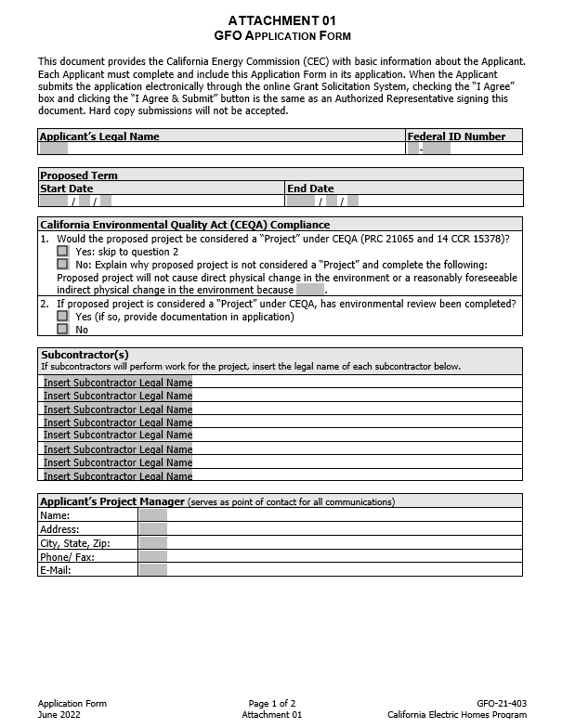
Application Documents: Application Form (Attachment 1)
Applicants must include all requested information in the application form, such as who the authorized representative of the entity submitting is, and list of subcontractors, if applicable.
Signature on the application form is waived.
Solicitation Manual pg. 18 - 19

Slide 21

Application Documents: Program Narrative
Limited to 20 pages.
Program Narrative must include:
A clear description of the proposed program design
A detailed description of the approach to develop and implement the proposed program.
An explanation of how the program will be implemented through the tasks described in the Scope of Work.
Justification for the costs allocated to tasks in the budget forms
Respond to the scoring criteria described in the solicitation manual
Solicitation Manual pg. 19 - 23

Slide 22
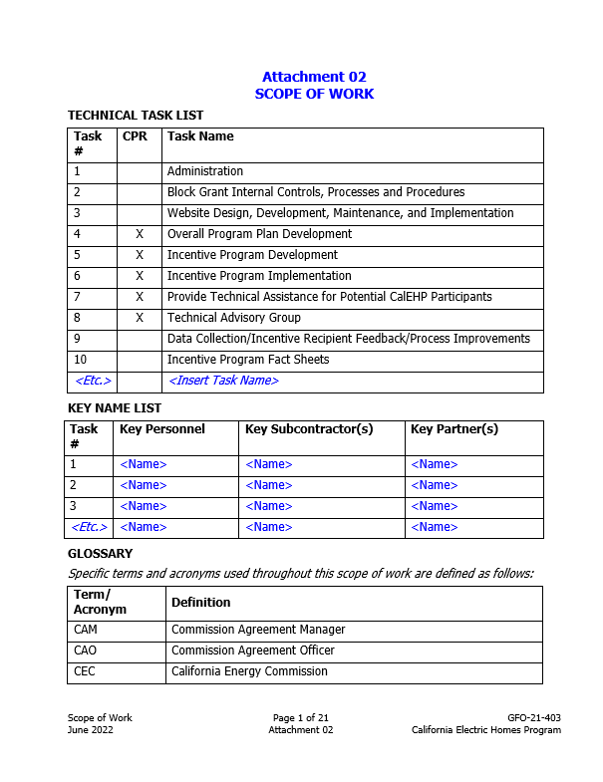
Application Documents: Scope of Work and Instructions (Attachments 2&3)
Tell us exactly what you are proposing to do in your project.
Identify what will be delivered to the CEC.
Be sure to include in the technical tasks:
  At least one product deliverable per task.
  Address requirements in Section II.B under Program Requirements.
Attachment 3 provides applicants instructions on how to fill the Scope of Work
Solicitation Manual pg. 23

Slide 23
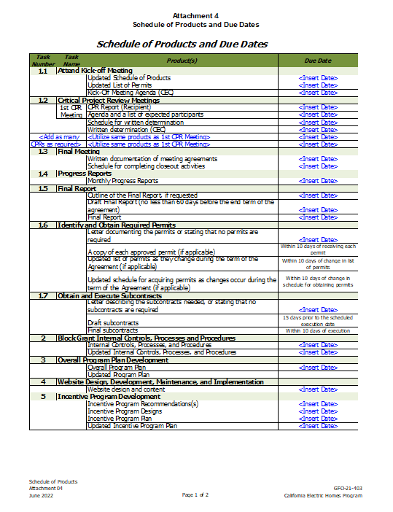

Application Documents: Schedule of Products and Due Dates (Attachment 4)
Product deliverables that correspond with the Scope of Work.
Realistic dates on when product deliverables can be completed.
Solicitation Manual pg. 24

Slide 24
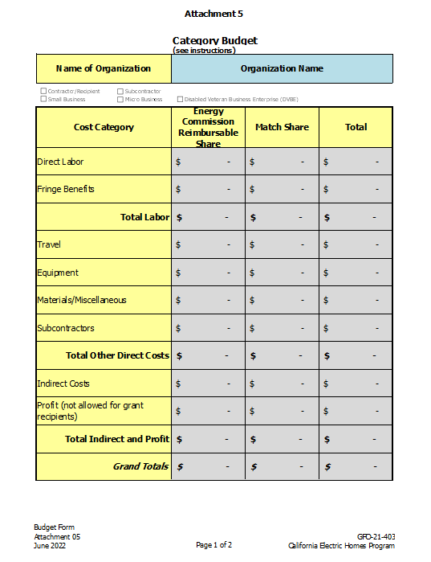
Application Documents: Budget Forms (Attachment 5)
Prepare a budget for up to $7.5 million in administration costs.
Identify how CEC funds will be spent to complete the project.
All rates in the budget form is the maximum amount allowed to be billed, CEC will only reimburse for actual expenses incurred
All costs must adhere to the Terms and Conditions
Attachment is provided as an excel and has instructions to aid applicant
Solicitation Manual pg. 24 - 26

Slide 25

Application Documents: Resumes
Applicants must include resumes for key personnel identified in the application.
Resumes are limited to a maximum of 2 pages each.
Solicitation Manual pg. 26

Slide 26
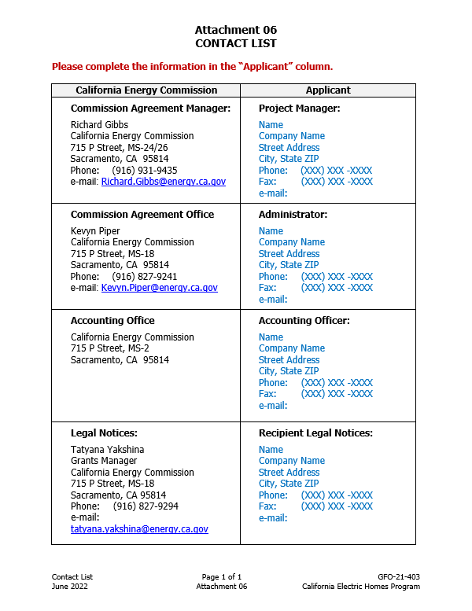

Application Documents: Contact List (Attachment 6)
Applicants must include a completed Contact List by including the appropriate points of contact for the Applicant.
The CEC will complete the CEC points of contact during agreement development.
Solicitation Manual pg. 26

Slide 27

Application Documents: Letters of Support or Commitment
Follow guidelines provided for commitment and support letters.
Support letters describe a program stakeholders’ interest or involvement in the program.
Any program partners that will make contributions to the program must submit a commitment letter.
Limit of two pages per letter.
Solicitation Manual pg. 26

Slide 28
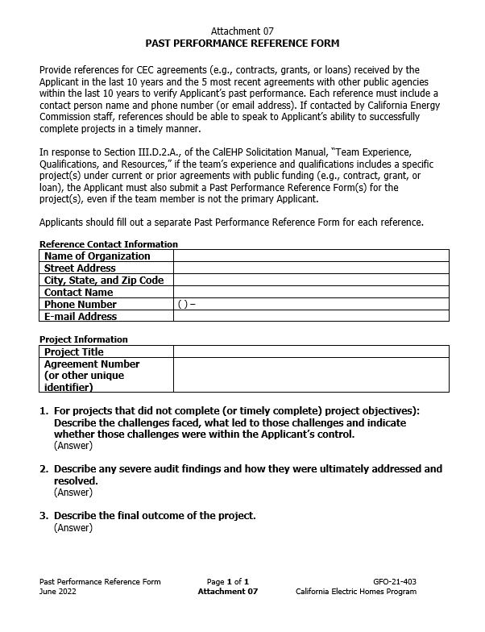
Application Document: Past Performance Reference Form (Attachment 7)
Provide references for:
  Agreements (e.g., contract, grant, or loan) with the CEC received by the Applicant in the last 10 years.
  The five most recent agreements with other public agencies received by the Applicant within the past 10 years.
References may be contacted by CEC staff.
Applicants should fill out a separate Past Performance Reference Form for each reference addressed in the Program Narrative.
Solicitation Manual pg. 27

Slide 29
Application Documents: Solicitation Attachments 8, 9, & 10
CalEHP Terms & Conditions (Attachment 8):
Please read through CalEHP's terms and conditions before submitting an application. They are not negotiable.
CalEHP Guiding Principles (Attachment 9):
The CEC has developed these Guiding Principles to be utilized as the overarching objectives for program design, implementation, and administration of the California Electric Homes Program.
Conflict of Interest (attachment 10):
Applicants must review and abide by the Conflict of Interest terms and conditions.
Solicitation Manual pg. 27 - 28

Slide 30
Application Evaluation

Slide 31

Application Evaluation: How will my application be evaluated?
Stage One: Application Screening
Administrative Screening (Pass/Fail)
Technical Screening (Pass/Fail)
Stage Two: Application Scoring
Technical Evaluation (Evaluation Criteria)
Solicitation Manual pg. 29 - 31

Slide 32
Application Evaluation: Application Screening
The application will be screened for the following administrative screening criteria:
The application is uploaded to CEC’s portal by the due date as specified the solicitation.
The applicant has not included a statement that is contrary to the required authorizations and certifications.
The application will be screened for the following technical screening criteria:
The applicant is an eligible applicant.
The program is an eligible program.
The applicant passes the past performance screening criterion.
Solicitation Manual pg. 29

Slide 33
Application Evaluation: Application Screening Cont.
CEC staff will screen applications per criteria in section IV.A.4 of the Solicitation Manual.
The Applicant may be disqualified due to severe performance issues characterized by significant negative outcomes under one or more prior or active CEC agreement(s) within the last 10 years.
Any applicant that does not have an active or prior agreement that equates to no severe performance issues therefore would pass this screening criteria.
Solicitation Manual pg. 29 - 30

Slide 34
Application Evaluation: Application Screening Cont.
Grounds for Rejection:
CEC reserves the right to reject an application for the following circumstances:
The application contains false or intentionally misleading statements
The application is intended to mislead the State in its evaluation
The application does not literally comply or contains caveats that conflict with the solicitation, or is otherwise non-responsive
Applicants must pass BOTH the administrative and technical screening criteria, or the application shall be disqualified and eliminated from further evaluation.
Solicitation Manual pg. 30 - 31

Slide 35
Application Screening: Application Scoring
Technical Evaluation:
Applications passing all screening criteria will be submitted to the Evaluation Committee
Evaluation Committee applies the scoring scale to the evaluation criteria.
Ensure the application provides a clear and complete response to each scoring criteria
Applications must obtain a minimum passing score of 70% or 84 points in order to be considered for funding.
Scoring Criteria | Possible Points
1. Team Experience and Qualifications | 35
2. Implementation and Technical Readiness | 40
3. Budget | 25
4. Innovation and Benefits | 20
Total Possible Points | 120
Minimum Points to Pass | 84
Solicitation Manual pg. 31, 33 - 35

Slide 36
Application Screening: Application Scoring Cont.
% of Possible Points | Interpretation | Explanation for Percentage Points
70% | Adequate | Response adequately addresses the requirements being scored. Any omission(s), flaw(s), or defect(s) are inconsequential and acceptable.
75% | Between Adequate and Good | Response better than adequately addresses the requirements being scored. Any omission(s), flaw(s), or defect(s) are inconsequential and acceptable.
80% | Good | Response fully addresses the requirements being scored with a good degree of confidence in the Applicant’s response or proposed solution. No identified omission(s), flaw(s), or defect(s). Any identified weaknesses are minimal, inconsequential, and acceptable.
85% | Between Good and Excellent | Response fully addresses the requirements being scored with a better than good degree of confidence in the Applicant’s response or proposed solution. No identified omission(s), flaw(s), or defect(s). Any identified weaknesses are minimal, inconsequential, and acceptable.
90% | Excellent | Response fully addresses the requirements being scored with a high degree of confidence in the Applicant’s response or proposed solution. Applicant offers one or more enhancing features, methods or approaches exceeding basic expectations.
95% | Between Excellent and Exceptional | Response fully addresses the requirements being scored with a better than excellent degree of confidence in the Applicant’s response or proposed solution. Applicant offers one or more enhancing features, methods or approaches exceeding basic expectations.
100% | Exceptional | All requirements are addressed with the highest degree of confidence in the Applicant’s response or proposed solution. The response exceeds the requirements in providing multiple enhancing features, a creative approach, or an exceptional solution.
Solicitation Manual pg. 32

Slide 37
Application Submittal

Slide 38

Application Submittal: Submission Requirements (Electronic only)
The only method of application submittal is the CEC’s Grant Solicitation System, available at: https://gss.energy.ca.gov
Grant Solicitation System (GSS) "How to Apply" presentation document: https://www.energy.ca.gov/media/1654
Solicitation Manual pg. 17

Slide 39
Application Submittal: GSS System Requirements
First time users must register as a new user to access system.
Electronic files must be in Microsoft Word (.doc, .docx) and Excel (.xls, .xlsx) formats, unless originally provided in the solicitation in another format.
Until further notice, any requirement in CEC solicitations to provide a signature is waived (even if it is in the screening criteria). No signature, even electronic is necessary.
  Notice on CEC’s waiver of the signature requirement appears here: https://www.energy.ca.gov/funding-opportunities/solicitations
Solicitation Manual pg. 17

Slide 40
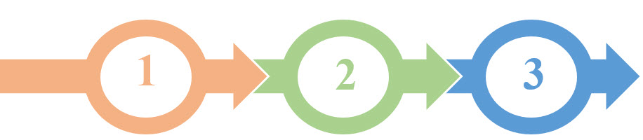
Application Submittal: GSS User Account & Structure
Register as a New User (prior to application submittal day)
Log In
Three Step Application Process:
  Select Solicitation (GFO-21-403)
  Upload Files
    Select documents for upload
    Tag files with document type
    Designate confidential documents (if applicable)
  Review and Submit
All three steps must be complete BEFORE the deadline

Slide 41
Application Submittal: GSS Warning
START THE PROCESS EARLY!
Applications must be fully submitted BEFORE August 1, 2022 at 11:59pm
The GSS system will shut off at the deadline
Applications in the process of being submitted prior to the deadline will NOT be accepted after the deadline
Applications will NOT be accepted after the deadline
Note: Successful application submittal will generate an automatic email to the applicant that appears as such:

Slide 42
Next Steps

Slide 43
Next Steps: After Application Scoring
Notice of Proposed Award: Shows list of applicants, scores, and who is selected to be the CalEHP Administrator
Agreement Development: Proposal documents will be processed into a legal agreement.
Failure to Execute: The Energy Commission reserves the right to cancel the pending award if an agreement cannot be successfully executed with an applicant.
Program Start: Recipients may begin work on the program only after the agreement is fully executed (approved at an Energy Commission business meeting and signed by the Recipient and the Energy Commission).

Slide 44
Next Steps: Key Activity Dates
Activity | Action Date
Solicitation Release | June 13, 2022
Pre-Application Workshop | June 28, 2022
Deadline for Written Questions by 5:00pm | July 12, 2022
Anticipated Distribution of Questions/Answers | July 20, 2022
Deadline to Submit Applications by 11:59 pm | August 1, 2022
Anticipated Notice of Proposed Award Posting | August 22, 2022
Anticipated Energy Commission Business Meeting | December 2022
Solicitation Manual pg. 5

Slide 45

Questions?
Three ways to ask questions:
Please state your name and affiliation. Keep questions under 3 minutes to allow time for others.
Use the raise hand function in Zoom
  Zoom Phone Controls:
  *9 – to raise hand
  *6 – To mute/unmute
Type questions in the Zoom Q&A Box
Submit written questions about this solicitation
Send written questions to Kevyn.Piper@energy.ca.gov
Deadline: July 12, 2022 5:00 p.m. PST
Note that an official CEC response will be provided in writing and posted on the GFO webpage in approximately two weeks after written questions deadline.

Slide 46
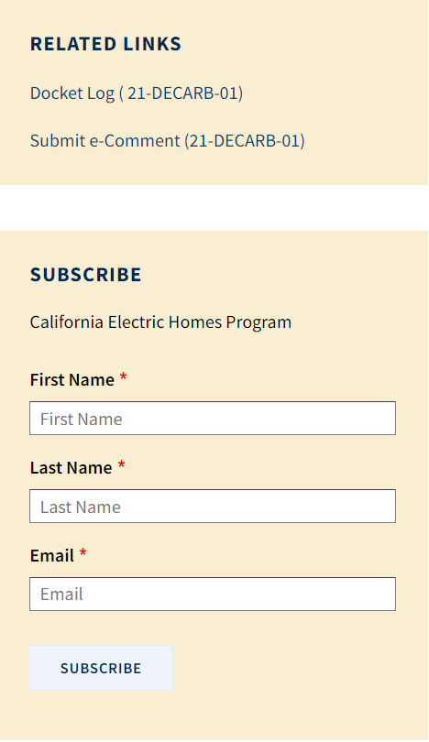
General Program Contact
CalEHP contact for non-solicitation related general questions and comments
Email:
CalEHP@energy.ca.gov
Docket for Public Comment:
https://efiling.energy.ca.gov/Ecomment/Ecomment.aspx?docketnumber=21-DECARB-01
Webpage:
https://www.energy.ca.gov/programs-and-topics/programs/california-electric-homes-program-calehp

Slide 47
Thank You for Participating!
Applications are due August 1, 2022, by 11:59pm

