Slide 1
Establishing a Long-Term Gas Research Strategy to Achieve Aggressive Statewide Carbon Neutrality Goals
Technology Stakeholder Workshop
June 16, 2022
Contractor Presentation

Slide 2
Today’s Agenda
Time | Items
25 minutes | Background Describe the objectives, purpose, and focus for this initiative and workshop Overview of current CA gas use, decarbonization policies, and gas system structure Provide summary of takeaways from the community workshop and workshop survey Overview of gas decarbonization pathways considered
70 minutes | End Use Technologies Overview of end use decarbonization technologies Discuss research needs and role of CEC Gas Research Program to address them Signposts to consider associated with gas end use decarbonization
50 minutes | Production, Transport, Storage and Safety Technologies Overview of decarbonization opportunities for supply chain segments Discuss research needs and role of CEC Gas Research Program to address them Signposts to consider associated with gas system decarbonization
5 minutes | Closing

Slide 3
Purpose of Research Strategy Project
The purpose of this project is to produce a long-term research strategy to help decarbonize California’s gas system by 2045.
The strategy is expected to produce prioritized research recommendations that include all stages in the supply chain (production, transmission, storage, and distribution for low carbon fuels) and all gas end use sectors, except for utility-scale power generation.
These recommendations will inform future research on technology development, deployment, and demonstration in the CEC’s Gas Research Program to help transition to a net-zero carbon gas system.

Slide 4
RD&D Supported and Research Areas
Types of RD&D CEC Supports
Research Areas
Research recommendations produced by the project will include the following:
  Scientific, Social, and Techno-Economic Analysis - Developing new knowledge and tools that can inform energy policy and planning decisions
  Technology Development - Developing early-stage technologies at lab or prototype level (TRL 3-5).
  Technology Demonstration and Deployment - Demonstrating later stage technologies or systems at a scale that will reflect actual operating, performance, and financial characteristics and risk (TRL 6-9).
Research recommendations produced by the project must be within the following Research Areas:
  Research Areas:
  Energy-related Environmental Research
  Gas Infrastructure Integrity, Sustainability, and Security
  Industrial, Agricultural, and Water Innovation
  Renewable Energy and Advanced Generation
  Transportation
  Building Decarbonization
TRL stands for Technology Readiness Level (TRL). TRL Assessment Guide: https://www2.lbl.gov/dir/assets/docs/TRL%20guide.pdf
Recent annual reports and investment plans available at:
https://www.energy.ca.gov/energy-rd-reports-n-publications/energy-research-and-development-investment-plans-and-annual

Slide 5



Objectives for this Workshop
This is the second of two stakeholder workshops on this initiative. The first workshop covered community considerations of decarbonization.
Obtain feedback on emerging decarbonization technologies, their benefits, challenges and potential given market trends and decarbonization pathways
Discuss research needs that persist with emerging technologies that limit their adoption compared to current gas technologies
Gain insight into potential signposts and adoption pathways related to these technologies

Slide 6
Principles Guiding Long Term CEC Gas Decarbonization Research Strategy
The CEC’s Gas Research Program has an annual budget of $24 million to support CA’s gas decarbonization efforts, focusing on addressing strategic technology-oriented challenges.
Community, Equity, and Environmental
Gas End-Use
Production, Transport, and Storage
Examples of CEC RD&D Areas of Study:
Environmental and equity impacts of hard-to-electrify sectors and applications across CA’s communities
Determine attractiveness of clustering strategies for hard-to-decarbonize sectors in communities (jobs, economic impacts, vs. risks)
Examples of CEC RD&D Areas of Study:
Research for end uses that are and will remain critical to California’s decarbonized economy, including:
Industry and agriculture
Transportation
Distributed power
Examples of CEC RD&D Areas of Study:
Support determination of viability of using existing gas infrastructure to support decarbonization
Ensure the resilient and sustainable operation of the gas supply chain with minimal leakage loss
CEC RD&D Does Not Focus On:
Developing new policy or regulations
Operating educational programs to inform community members
Running workforce training and development programs
CEC RD&D Does Not Focus On:
Implementing technologies at scale
Transition cost support for end users
Sourcing fuel to end user
Implementing safety protocols/standards
Providing cost support for stranded assets
CEC RD&D Does Not Focus On:
Implementing technologies at scale
Implementing safety protocols and standards
Implementing operation and maintenance requirements and standards

Slide 7
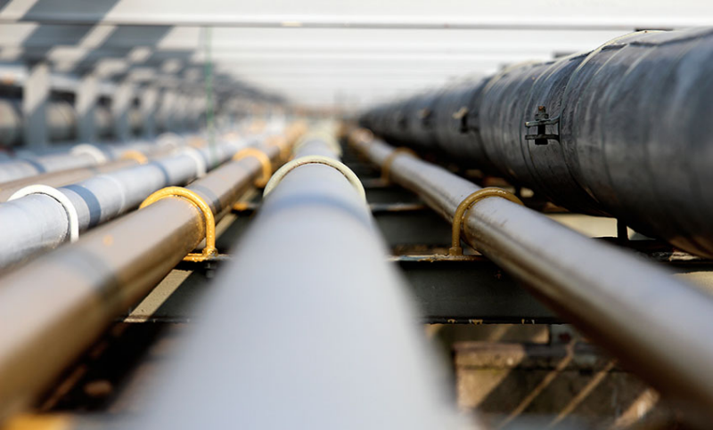
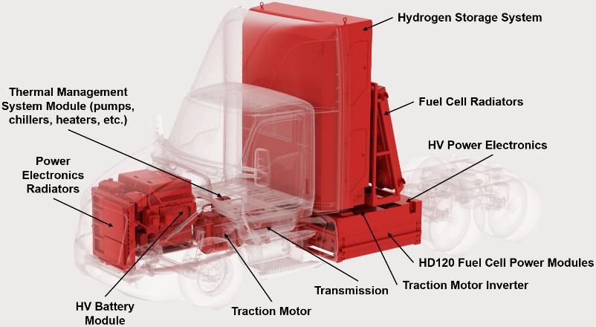
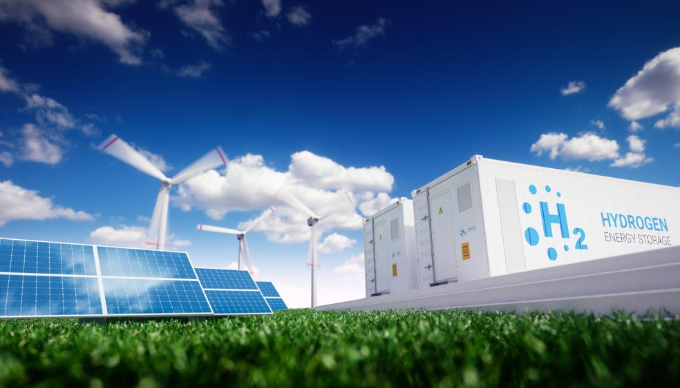
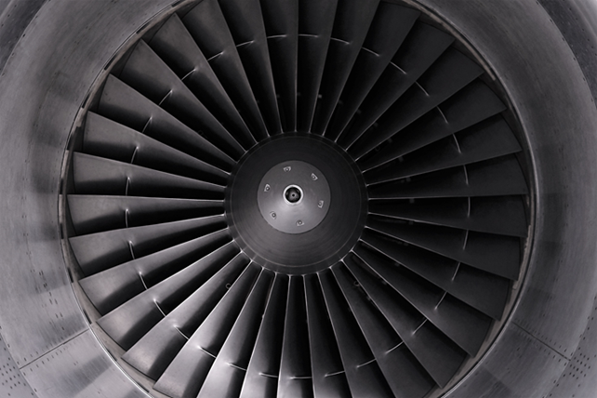
Examples of Current CEC Gas Research
Hydrogen (H₂) Blending into Existing California Natural Gas Pipelines
H₂ Fuel Cells (FC) for Heavy Duty Trucks
Technology demonstration and deployment
Improve FC efficiency, lower costs and assess feasibility of on-board storage.
Pilot test and demonstration
Assessing natural gas system modifications required to maximize hydrogen blending levels
Source: Energy Post
Emerging Renewable Hydrogen Production
Residential Methane (CH₄) Emissions
Technology development and demonstration
Investigating the potential and readiness of earlier stage hydrogen production systems
Scientific, behavioral, and techno-economic analysis
Improve CH₄ emission inventory and develop cost-effective programs to reduce emissions
Source: Forbes

Slide 8










Gas System Overview
The following outlines the key features with respect to different parts of the gas supply chain that have been explored in our research efforts
Industry
Buildings
Transportation
Distributed generation
Organic Waste and Biomass
Renewable Energy
End Uses
GAS
Storage
Production
Renewable gas, Hydrogen
Transport
Pipelines, liquid, H₂ chemical carriers
Underground (including geologic formations) and above ground

Slide 9
CA Gas Use and Decarbonization Policies
2020 CA Fossil Gas Consumption by Sector
SB 32: Requires the state to reduce greenhouse gas (GHG) emissions to 40% below 1990 levels by 2030; The SB 32 Climate Change Scoping Plan: CARB created and maintains a comprehensive, multi-year program to reduce GHG emissions in California
SB 100: Requires the state to achieve 100% renewable and carbon-free electricity by 2045 and 60% renewable electricity by 2030
SB 350: Requires the CEC to establish annual targets for statewide energy efficiency savings
SB 1383: Requires the state to establish a strategy to reduce emissions of short-lived climate pollutants by 2030, methane and hydrofluorocarbons (HFCs) by 40% and black carbon by 50%.
AB 3232: Requires the CEC to assess the potential to reduce GHG emissions from residential and commercial buildings by 40% of 1990 levels by 2030
EO B-55-18: Sets a goal that the entire California economy achieve carbon neutrality by 2045 and achieve and maintain net negative emissions thereafter
EO N-79-20: Sets a goal of 100% zero emission vehicles (ZEV) for passenger cars, light duty trucks, and drayage vehicles by 2035 and medium- and heavy-duty vehicles by 2045
Integrated Energy Policy Report (IEPR): Provides an overview of major energy trends and issues facing the state and is updated biennially (use hyperlink to access 2021 IEPR)
Source: CEC
Buildings (commercial and residential) currently consume more than 50% of CA fossil gas

Slide 10
CA Decarbonization Policy Goals Timeline
2030: GHG emissions 40% below 1990 levels (SB 32) and specifically for buildings (AB 3232)
2030: Reduce methane and HFCs by 40% from 2013 levels (SB1383)
2025: Reduce organic waste disposed in landfills by 75% from 2014 levels (SB1383)
2045: Carbon neutrality and net negative emissions thereafter (EO B-55-18)
2030
2045
2023: 1 million ZEVs on the road
(EO N-79-20)
2025: 1.5 million ZEVs on the road
(EO N-79-20)
2030: 5 million ZEVs on the road
(EO N-79-20)
2030: 60% renewables for electricity (SB 100)
2035: 100% ZEVs for off-road and drayage trucks
(EO N-79-20)
2045: 100% zero-carbon electricity (SB 100)

Slide 11
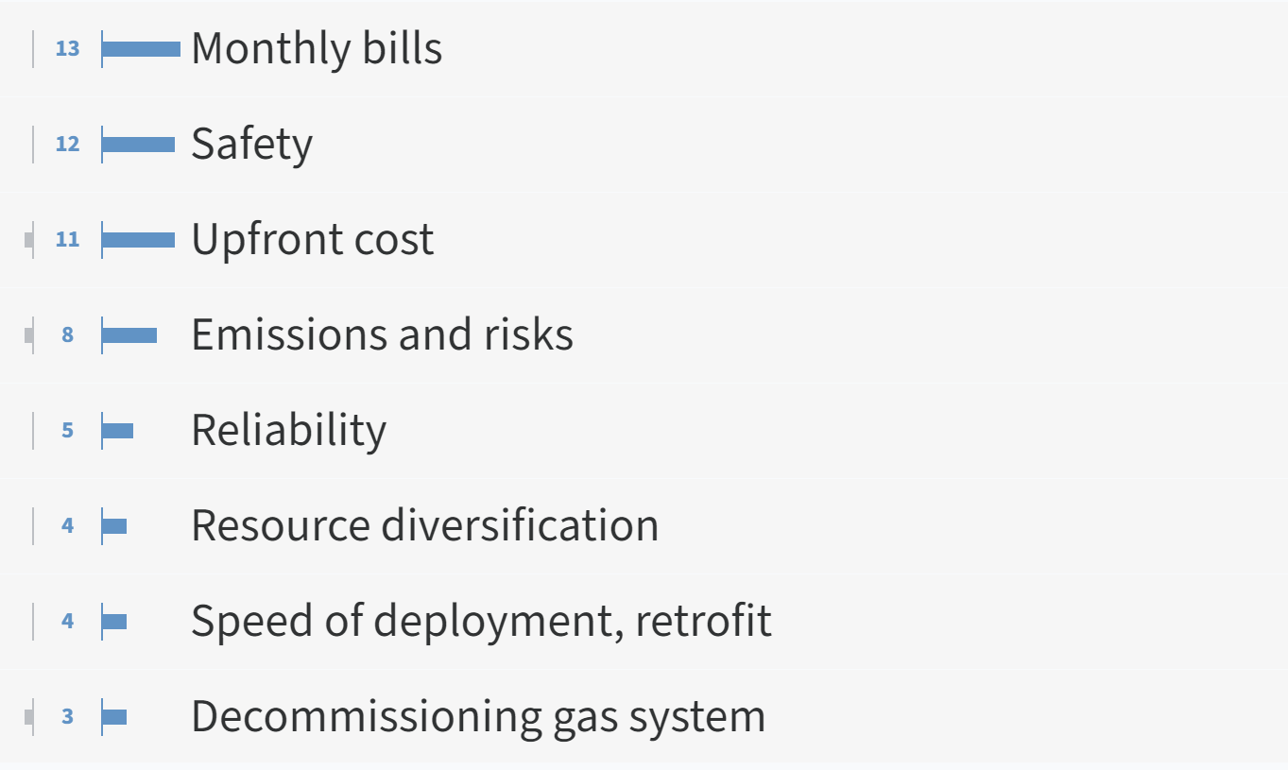

Community, Equity, and Environment Workshop Takeaways
The workshop held June 9th focused on community, equity, and environmental considerations regarding decarbonization. The following are some of the key takeaways provided by stakeholders:
What do you think are the most important concerns for your community that you think CEC research should place an emphasis on?
Percent of respondents that identified the following as a top 3 community benefit of the gas decarbonization transition

Slide 12
Pre-Workshop Form Responses
This slide will be populated immediately prior to the meeting based on responses received to the Google form.
The Google form will remain open for the week following this workshop. If you have not had the chance to fill it out, we would greatly appreciate your input.

Slide 13
Gas Decarbonization Strategies
Using electricity to fuel technologies that currently use fossil gas
Using low-carbon hydrogen to replace select gas end-uses (e.g., heat, transportation)
Methane from renewable sources, reducing dependence on fossil gas
Capture CO₂ to mitigate impacts of emissions
Electrification
Clean Hydrogen
Renewable Gas
CCU
CEC electricity research program (EPIC) leads work in this area
Emissions highly dependent upon electricity generation mix
Preferred solution for:
New residential and commercial buildings
Light and medium duty vehicles
Commuter rail
Emissions highly dependent upon hydrogen production process
Active discussion that ~10-15% H₂ can be blended with fossil gas using current infrastructure
Preferred solution for:
Industry and process heating
Select transportation applications
Limited use in buildings (e.g., CHP in large buildings)
Fuel produced from biomass and waste sources, such as landfill gas and agricultural feedstocks
Limited by the amount of readily available feedstock
Can be a carbon neutral fuel
Preferred solution for:
Industrial processes designed to operate using methane
Captures CO₂ before it is released to the atmosphere.
Captured CO₂ can be utilized as carbon feedstocks
Retrofitted or built at industrial sites or large generators
Preferred solution for:
Hard to decarbonize industrial processes
Gas Technology Efficiency Improvements
Gas System Strategic Decommissioning

Slide 14
Gas Decarbonization Strategies Challenges
Decarbonization depends on generation source and reliability.
H₂ has distinct physical and chemical characteristics to CH₄, presenting fuel switching challenges.
Feedstock variation and location create challenges for efficient scaling.
Technoeconomic challenges limit widespread adoption.
Electrification
Clean Hydrogen
Renewable Gas
Carbon Capture and Utilization (CCU)
Key Challenges:
Not feasible for some end uses
Increasing load on electric grid can cause strain and affect reliability
Electricity generation sources must have low or no emissions
Clean electricity is primarily generated via renewable resources which require land, are mostly intermittent, and are currently costly
Lack of long duration electricity storage is a limiting factor
H₂ vs. CH₄ (methane):
~1/3 volumetric energy density
Flame temperature ~300^{O}C higher
Flame speed ~10 times faster
Molecule ~24% smaller
~1/16 the minimum ignition energy to initiate combustion
H₂ gas has no odor and flame is minimally visible in daylight
Uncertain compatibility with depleted oil and gas wells for underground storage
Feedstocks:
Used for producing renewable gas can be heterogeneous and require cleaning before use
With high moisture content require drying before processing
Are limited, varied and geographically spread making it difficult to scale fuel production
Key Challenges:
Costs are high and variable ranging from $15-$120 per ton of CO₂ captured
Regeneration requires large amounts of energy
Struggle with dilute sources of CO₂
May compete for limited water resources
Limited current utilization pathways for captured carbon
Gas System Strategic Decommissioning
Changing overall demand and end uses for gaseous fuels reduces the need for extensive pipeline infrastructure.

Slide 15
End Use Technologies

Slide 16
End-Use Technologies
The following outlines the key decarbonization pathways beyond electrification that apply to different sectors
Industrial
Distributed Generation
Transportation
Relevant technologies- hydrogen combustion (space and water heating, process heating) and carbon capture and utilization
Relevant technologies- CHP, reciprocating engine, microturbine, linear generator, fuel cell
Relevant technologies- fuel cell, H₂ fueling
Priority subsectors- cement, food processing, chemicals, plastics, rubber
Priority subsectors- Industrial facilities and large buildings or campuses
Priority subsectors- Non-road vehicles (e.g., agricultural, construction), rail, harbor
CC for high emitting processes that are hard to electrify and CO₂ utilization processes
Renewable gas for carbon feedstock dependent processes
H₂ for high temperature processes that are difficult to electrify
Electrification of lower heat processes and steam
Provides localized generation of energy for buildings or industrial facilities
Hydrogen or hydrogen gas blends can be used to fuel distributed power systems
Solar panels and wind turbines to source distributed electricity generation
Hydrogen to support heavier duty vehicles on and off road.
Hydrogen refueling to meet distributed demand for H₂ from off road vehicles.
Electrification of most of the light duty on road transportation
Buildings
Electrification will be the primary path to decarbonize building heating, cooking, and other appliances.
Large buildings and campus settings may use gaseous fuels for CHP or district heating.

Slide 17







Hydrogen Combustion Technologies
Hydrogen (H₂) combustion technologies are promising to replace the combustion of fossil fuels across multiple end uses, especially high heat industrial processes that are difficult to electrify.
Technologies Considered by Sector
General Obstacles to Adoption
Notable Obstacles
Safety concerns surrounding combustion of H₂ | H₂ embrittlement of materials | Complex retrofit solutions to withstand H₂ | Leakage of H₂ from system
Industry
Large Buildings
Direct air heaters
Boilers and furnaces
Other Obstacles
CHP*
Also applies for industry
End use NO_{x} emissions | Corrosion from wet H₂ flame | Technology design limiting lifespan and durability | Insufficient/ ineffective safety standards and protocols
Cement
Process heating
Cement kilns
Water boilers
Air heaters

Slide 18
Lead, Support, or Monitor?
CEC Gas Research Program’s potential roles in addressing RD&D needs
Lead
CEC Gas Research Program is well positioned to provide a leadership role in addressing this research need.
Support
Efforts have leadership from other source(s) including other programs within the CEC (EPIC, Clean Transportation), but CEC Gas Research Program can play a valuable supporting role.
Monitor
CEC Gas Research Program is unlikely to have significant impact on the trajectory or pace of progress but can monitor developments to inform research.

Slide 19
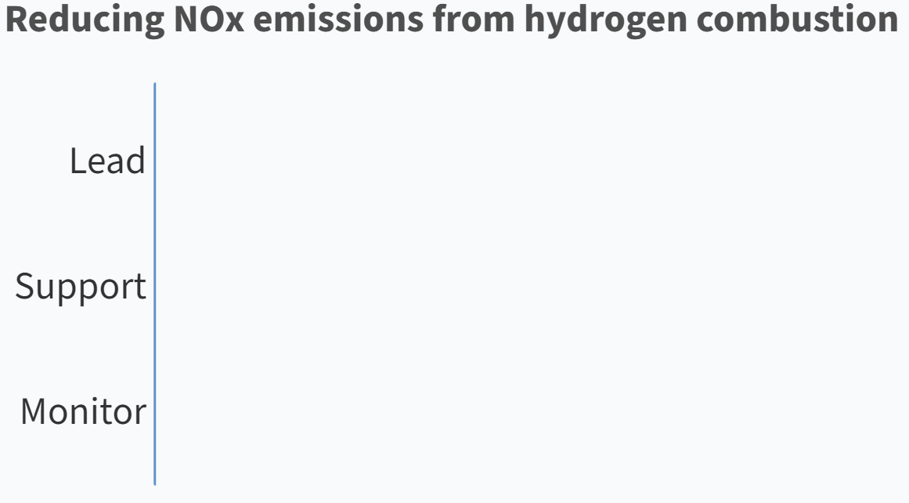

Interactive Exercise
We will utilize the polling tool PollEV for several interactive elements of the presentation. This slide provides an overview of the tool and how we will utilize it.
Instructions
Go to the link that we have posted in the chat.
For each research need, select the option you feel fits best (Lead, Support, or Monitor).
If you would like to modify a response, click the trash icon (on the right) and make a new selection.
Once you respond to one research need, click “Next” on the top right of the page. Repeat until you reach and click the “Finish” button.
Keep the link open as we will use this throughout the presentation.
Illustrative
There will be opportunities for some discussion, and you may also submit follow up comments via this docket link (note “Guidehouse Long-term Study” in the subject line).

Slide 20
Hydrogen Combustion Poll
Research Needs
Poll Question
Address safety concerns related to H₂ use (e.g., leakage, flashback, ignition, flame visibility)
Reduce NOx emissions from H₂ combustion and quantify impacts to air quality
Develop H₂ burners for high temperature applications (flame dimensions, speed, and temperature)
Minimize degradation of end use equipment due to H₂ combustion characteristics and general properties
Improve combustion control and flame detection systems for H₂
Develop standards for H₂ use for industry and large buildings or campuses
Please respond to the following poll to the best of your abilities:
?
Select the role you think the CEC Gas Research Program should have for each of the following research needs (Lead, Support, or Monitor)

Slide 21





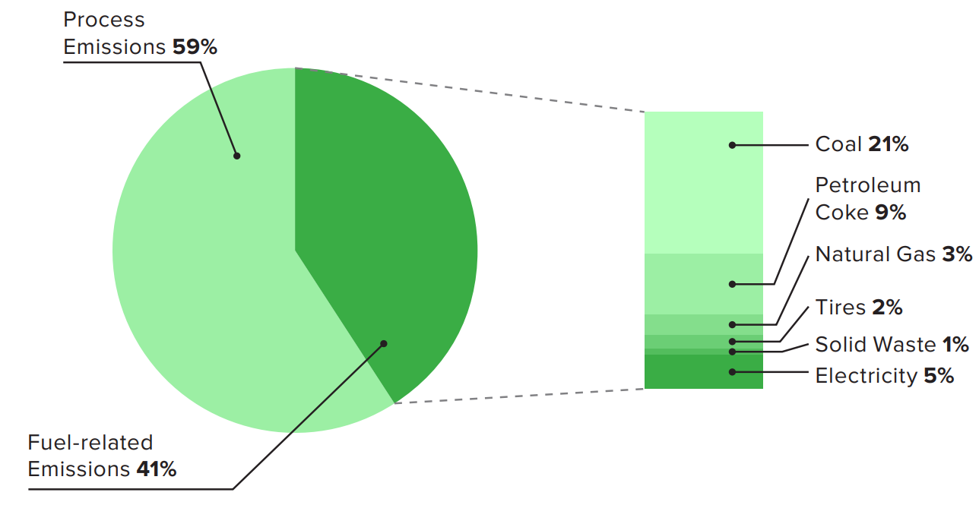
Carbon Capture and Utilization (CCU) Technologies
Carbon capture (CC) refers to the capturing of emitted CO₂ from industrial processes before it reaches the atmosphere. Carbon utilization refers to the use of the captured CO₂ in industrial processes or to produce other high value products.
CCU Overview and Potential in CA
Obstacles to Adoption
Notable Obstacles
Low capture and utilization efficiency | Complex retrofit to existing processes | Inflexible material requirements (membranes, solvent, sorbents) | Leakage from system (CO₂)
Post-combustion
Carbon Capture
Captured Carbon Utilization
Bioenergy
(e.g., cement, plastics)
Other Obstacles
Sources of CO₂ emissions in CA’s cement industry
Technology degradation limiting lifespan and durability | High maintenance effort (membranes, solvent, sorbents) | Resource availability for application (e.g., water) | Sensitivity to contaminants from emissions gas mixture

Slide 22
Carbon Capture & Utilization Poll
Research Needs
Poll Question
Reduce energy required to regenerate carbon capture material
Improve reactivity and selectivity of capture material
Reduce degradation and toxicity of capture material
Improve carbon capture efficiency and scalability
Improve efficiency of downstream treatment and transport of CO₂
Identify new potential areas for CO₂ utilization
Improve the purity of captured CO₂ and its transport to points of use
Improve sourcing of metal oxide waste from industry for CO₂ utilization
Please respond to the following poll to the best of your abilities:
?
Select the role you think the CEC Gas Research Program should have for each of the following research needs (Lead, Support, or Monitor)

Slide 23



Distributed Generation Technologies
Distributed generation (DG) refers to decentralized power generation at a local level. California’s vision for DG is to displace diesel and fossil gas with alternative, decarbonized fuels such as renewable gas and H₂.
Decarbonized DG Technologies
Obstacles to Adoption
Notable Obstacles
Complexity of installation and integration | Inflexible material requirements (components of FC) | Sensitivity to fuel contaminants | High and variable fuel cost
Linear Generator
Fuel flexible
No combustion
Electricity
Alternative Fuel Combustion CHP
Renewable gas and H₂
Recips and microturbines
Electricity and heat
Other Obstacles
H₂
H₂
High maintenance effort | Poor resistance to operating environment | Complex and expensive fuel supply if pipeline is not available | Commercial production limited due to technology design
Modular Fuel Cell
Hydrogen
No combustion
Electricity
Fuel Cell CHP
Hydrogen
No combustion
Electricity and heat

Slide 24
Distributed Generation Poll
Research Needs
Poll Question
Demonstrate clean, efficient, and reliable performance under realistic and diverse conditions
Improve fuel flexibility of distributed generation technologies
Enhance longevity of distributed generation systems
Enhance ease of installation and systems integration (e.g., modular design)
Improve resistance to fuel impurities
Reduce material costs needed for manufacturing and installation
Reduce design complexity for enhanced manufacturability
Improve ease of maintaining and repairing distributed generation systems
Reduce criteria pollutant emissions (e.g., NOx) and quantify impacts to air quality
Please respond to the following poll to the best of your abilities:
?
Select the role you think the CEC Gas Research Program should have for each of the following research needs (Lead, Support, or Monitor)

Slide 25









Fuel Cells for Transportation
Fuel cell electric vehicles (FCEVs) utilize hydrogen as their main fuel source and can be used for many types of vehicles but are especially relevant in heavy duty on and off-road applications.
Transport Applications Considered
Obstacles to Adoption
Notable Obstacles
Technology and design limiting lifespan and durability | Poor resistance to operating environment (off-road) | Low process efficiency (relative to BEVs) | Complex refueling infrastructure
Agricultural tractor
Construction vehicles
Harbor craft
Other Obstacles
Trucks
H₂ fueling needs
FC system size and weight (curb weight and payload impacts) | Safety concerns surrounding flammability of H₂ | Fuel storage (on-board) capacity | Inflexible component material requirements
Rail
Bus
Aviation
Onboard storage

Slide 26
Fuel Cells for Transportation Poll
Research Needs
Poll Question
FC power system integration for emerging mobile off-road applications
Development of mobile H₂ fueling systems
Development of efficient, high-flow permanent H₂ refueling system
Co-locating permanent H2 refueling infrastructure with multiple end-uses
Balancing increased energy density of highly compressed or liquid H₂ with safety concerns
High H₂ purity requirements and contaminant sensors
FC vehicle design standardization (e.g., weight restrictions, manufacturing, subcomponents)
Improve hydrogen onboard storage systems (e.g., specific weight and volume, cost)
Improve fuel cell technology performance (e.g., efficiency, cost, durability)
Please respond to the following poll to the best of your abilities:
?
Select the role you think the CEC Gas Research Program should have for each of the following research needs (Lead, Support, or Monitor)

Slide 27


Signposts for End Uses
What signposts will direct or have an impact on future decarbonization decisions and pathways?
Technical
Policy
Market
Alignment on attractive CO₂ utilization pathways
Lower barriers and streamlined approvals for siting and installing low carbon or carbon reducing technologies
Alignment of public perception toward CCU
Acceptance of using green ammonia as fuel or H₂ carrier
Financing and market structures supportive of equipment transition and CCU projects
2035: 100% zero emission off-road vehicles and drayage trucks where feasible (N-79-20)
Alignment on industrial processes where electrification is not feasible
Alignment on transportation types needing alternatives to battery electric power
Acceptance of liquid H₂ as a viable option for transportation
2045: Carbon neutrality and net negative emissions thereafter
Development and acceptance of geographic clustering of end users
2030: Achieve hydrogen cost targets set by DOE Hydrogen Shot of $1/kg for clean H₂
National Signpost
California Signpost

Slide 28
End Use Discussion
What are the most pressing gas end uses that need attention and research?
Which research needs are expected to be addressed by industry without CEC support?
Are there other notable end use technologies or decarbonization strategies that we have not identified?
Are there other notable signposts that we have not identified?

Slide 29
Gas Production, Transport, and Storage Technologies

Slide 30
Gas Supply Chain
The following outlines the key features with respect to different parts of the gas supply chain
Production
Transport
Storage & Safety
Renewable Gas Production
Anaerobic digestion
Gasification of biomass waste
Clean Hydrogen Production
Electrolysis
Non-electrolytic clean H₂
New H₂ Pipelines
Develop new pure H₂ pipelines to meet end use demand
Existing Gas Pipelines
Utilize existing gas pipelines systems originally designed for fossil gas to blend in H₂ and renewable gas
Hydrogen Storage
Consider location (above or under ground) and duration (short or long term) of storage to enhance resiliency of energy system
Leakage Detection & Mitigation
Detection technologies
Additives for safety such as odorants
Efficient leakage mitigation strategies

Slide 31





Renewable Gas and Clean H₂ Production Technologies
Renewable gas (biomethane or biogas) refers to methane produced from waste streams viewed as carbon neutral.
Clean H₂ production is primarily water splitting using energy sources with no emissions, renewable electricity or solar heat.
Renewable Gas Production
Obstacles to Adoption
Notable Obstacles
Low production efficiency (high energy inputs) | High maintenance effort required (tar formation) | Limited lifespan and durability | Variable feedstock supply and cost
Anaerobic Digestion
Gasification
Organic matter is broken down by bacteria to produce biomethane or renewable gas.
Uses high temperature to oxidize biomass into syngas without combustion.
Other Obstacles
Clean H₂ Production
Limited adoption due to complex design | Inflexible location (dependence on natural resources) | Sensitivity to fuel contaminants from feedstock | Inflexible materials required (catalysts, membranes, bacteria)
Photocatalytic water splitting
Biomethanation
Microbial electrolysis
H₂S
H₂
Contaminant free H₂
O₂
CH₄
NH₃
H₂
H₂
Biomass derived syngas to hydrogen
Organic waste to hydrogen

Slide 32
Renewable Gas and Clean H₂ Production Poll
Research Needs
Poll Question
Improve efficiency (e.g., anaerobic digestion, photocatalysis, waste conductivity)
Durability of materials (e.g., refractory, photocatalysts, bacterial electrodes)
Non-energy related impacts of anaerobic digestion (e.g., water consumption, odor, pollution)
Gasification process control systems
Feedstock pre-processing required (e.g., drying, cleaning, sorting, grinding)
Feedstock related challenges (moisture, feeding, supply, inflexibility)
High cost and difficult scalability of catalysts, membranes, and microbial cultures
Please respond to the following poll to the best of your abilities:
?
Select the role you think the CEC Gas Research Program should have for each of the following research needs (Lead, Support, or Monitor)

Slide 33


Hydrogen Transport via Pipelines
Options for pipeline transport of H₂ include (1) the development of a new unique pipeline to supply pure H₂ to end users or (2) retrofitting the existing fossil gas pipelines to be able to withstand blends of H₂ and fossil gas.
Pipeline Transport Pathway Comparison
Obstacles to Adoption
Area | New H₂ Pipelines | Existing Gas Pipelines
Notable Obstacles
Low system efficiency (compression, energy content, leakage) | H₂ embrittlement of materials (existing infrastructure) | Complex solutions for retrofitting infrastructure (for higher H₂ blends)
$$$$
New siting, planning, permitting, pipeline construction, etc.
$$
Testing and certification of infrastructure, where necessary
Cost and Effort
100% H₂
10-15% H₂
Other Obstacles
H₂ Capable
Designed to transport
pure H₂
May transport 10-15% H₂ by volume with minimal retrofit
Complexity of integration/ installation (new systems) | Challenging logistics (processes for permitting) | High maintenance effort
Ease of obtaining pure H₂
H₂
H₂
H₂
HENG
CH₄
Targeted supply of H₂ to points of end use
Gas separation needed near points of H₂ end use

Slide 34
Hydrogen Transport via Pipelines Poll
Research Needs
Poll Question
Develop safe, efficient and cost-effective pipeline retrofit solutions (e.g., coating technology) for H₂ capability
Understand limits of retrofitting existing pipelines for H₂ transport and when new pipelines are necessary
Increase the limit on H₂ blending in existing pipelines
Reduce high capital costs of new H₂ pipeline installation
Develop efficient compressor equipment that can withstand H₂
Minimize the variation in H₂ concentration in the blended gas throughout the pipeline system
Please respond to the following poll to the best of your abilities:
?
Select the role you think the CEC Gas Research Program should have for each of the following research needs (Lead, Support, or Monitor)

Slide 35






Hydrogen Storage and Safety Technologies
Hydrogen storage technologies look at short-term aboveground options or long-term (seasonal) underground storage.
Gas system level safety challenges include effective odorization of gas, leakage detection and mitigation, and cyberthreats.
Storage Technologies
Obstacles to Adoption
Aboveground
Underground
Notable Obstacles
Technologies: High pressure tanks, chemicals (green ammonia)
Formations: Salt caverns, depleted oil field, underwater
Low volumetric energy density of gaseous H₂ | H₂ embrittlement of materials | Leakage from system | Complex solutions for retrofitting existing storage facilities
Duration: Days or weeks
Duration: Seasonal
System Safety Concerns
Other Obstacles
Cyber- security threats | Sensitivity to fuel contaminants (energy carriers, depleted oil fields) | Complexity of integration/ installation (system planning) | Challenging logistics for application (limited underground sites)
Leakage
Odorization
Cyberthreats

Slide 36
Storage and Safety Poll
Research Needs
Poll Question
Improve leakage detection, prevention, and mitigation (e.g., odorants, pipeline monitoring)
Investigate the feasibility of using existing gas storage facilities to store H₂
Enhance forecasting of H₂ storage capacity based on H₂ production and demand
Address energy carrier concerns (e.g., toxicity, corrosiveness, separation from H₂)
Evaluate potential for green ammonia as a H₂ carrier or direct use
New pipeline O&M and in-line-inspection procedures fit for H₂ integration
Improve gas meter compatibility with H₂
Please respond to the following poll to the best of your abilities:
?
Select the role you think the CEC Gas Research Program should have for each of the following research needs (Lead, Support, or Monitor)

Slide 37
Signposts for Production, Transport, and Storage
What are other critical signposts that will drive gas decarbonization decisions/ investments/ research initiatives?
Technical
Policy
Market
Viability of large scale H₂ storage in California (e.g., geologic)
HENG blend standards and transition
Observed fossil fuel costs requires reassessment of alternative gas cost targets
Consensus on modifying gas system pressures
Policy support for variety of renewable gas feedstocks
Development and acceptance of geographic clustering of end users
Understanding of global warming impact of clean H₂ use and leakage
2025: CA to treat 500,000 acres of land annually, increasing woody biomass resource
Viability of distributed gas production near end use
2030: Achieve hydrogen cost targets set by DOE Hydrogen Shot of $1/kg for clean H₂
2045: Carbon neutrality and net negative emissions thereafter
National Signpost
California Signpost

Slide 38
Gas Production, Transport, and Storage Discussion
What are the most pressing gas system issues that need to be addressed?
What research needs are expected to be addressed by industry without CEC support?
Are there any technologies or decarbonization strategies that we have not identified?
Are there any signposts that we have not identified?

Slide 39
Closing
Do you have any other general feedback or areas you would like us to consider?
If you have not already done so, please complete this form with your feedback. If you have additional input, you may also submit it through the docket here, indicating “Guidehouse Long-term Study” in the subject line.

Slide 40
Contacts
California Energy Commission
Guidehouse Inc.
Harrison Reynolds
California Energy Commission
Energy Research and Development Division
Role: Commission Project Manager
Harrison.Reynolds@energy.ca.gov
Bill Goetzler Guidehouse Partner Role: Project Director 781-270-8351 wgoetzler@guidehouse.com | Javi Luna Guidehouse Consultant 415-399-2121 jluna@guidehouse.com
Warren Wang Guidehouse Associate Director Role: Project Manager 213-618-9019 wwang@guidehouse.com | Matt Chill Guidehouse Consultant 310-968-3159 mchill@guidehouse.com
Kevin Uy
California Energy Commission
Energy Research and Development Division
Role: Commission Office Manager
916-776-0821
kevin.uy@energy.ca.gov
Richard Shandross Guidehouse Associate Director Role: Technical Advisor 781-270-8391 richard.shandross@guidehouse.com

